Slide 1

Kingdom of Tonga
Pacific Radio Communication Workshop 2019
(PRW-19) 11-12 April 2019 Coral Coast, Fiji.
Telecommunications in the hour of need:
Emergency Telecommunication Cluster in Tonga (ETC).
Ministry of Meteorology, Energy, Information, Disaster Management,
Environment, Climate Change and Communication (MEIDECC).

Slide 2
Scripture Reading
Psalms 126:1-6
When the Lord brought back the captivity of Zion, we were like those who dream. Then our mouth was filled with laughter, and our tongue with singing. Then they said among the nations, “The Lord has done great things for them.” The Lord has done great things for us, and we are glad. Bring back our captivity, O LORD, as the streams in the south. Those who sow in tears shall reap in joy. He who continually goes forward weeping, bearing seed for sowing, shall doubtless come again with rejoicing, bringing his sheaves with him.

Slide 3
Outline
Island Kingdom of Tonga
Emergency Management in Tonga
Hazards in Tonga
Structures of National Co-ordination
Mechanism in Tonga
Cluster System in Tonga
Communications Cluster
Communication Cluster Committee
Communication Responsibilities
Communication System Available
HF Radio Network System NEMO & MET
Communication Project
Activities

Slide 4
Study to be done for increasing the Network
1. Island Kingdom of Tonga: Map of Tonga Groups
200km
Niuas Group
Total Pop: 103,000
  (2016 Census)
176 islands
  (40 inhabited)
Total Land Area:
  748 sq. km
Total EEZ:
  700,000 sq. km
300km
Vava’u Group
140km
Ha’apai Group
160km
Tongatapu Group (Tongatapu & ‘Eua)
4

Slide 5
2. THE EMERGENCY MANAGEMENT
The Emergency Management in Tonga is based on the 2007 Emergency Management Act.
Where National Emergency Management Operation(NEMO’s) primary function is to:
“Coordinate Disaster Risk Reduction and Emergency Management activities in the Kingdom”.
From this Emergency Management the National Emergency Management Plan (NEMP) has been developed.

Slide 6
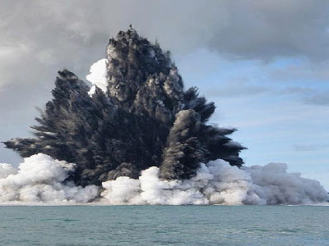
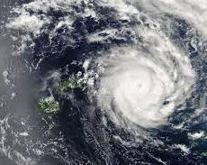

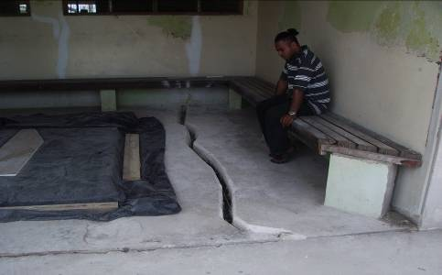
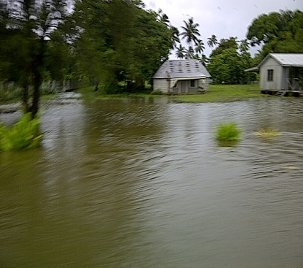
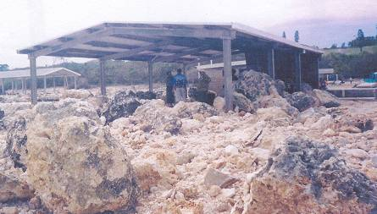
3. The Hazards in Tonga
NEMO’s brief covers coordination of responses to:
Tropical Cyclone
Earthquake
Volcanic Eruption
Tsunami
Drought
Storm Surge
Tornado & Severe Storm
Flood
Man-made hazards: hazmat leakages & spillages, maritime & aviation emergencies.

Slide 7
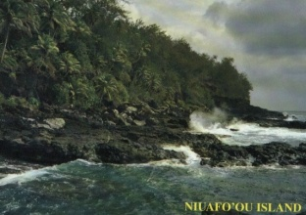
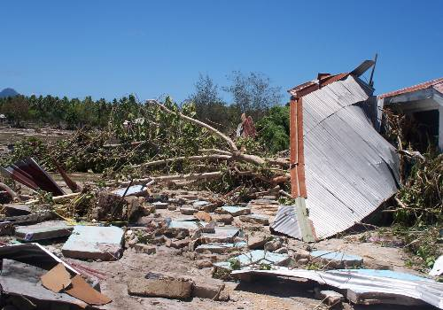
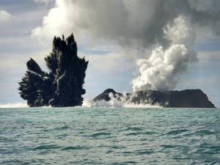
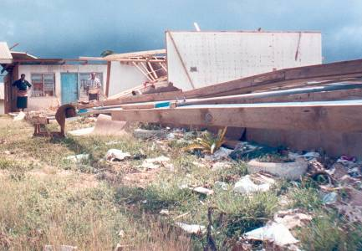
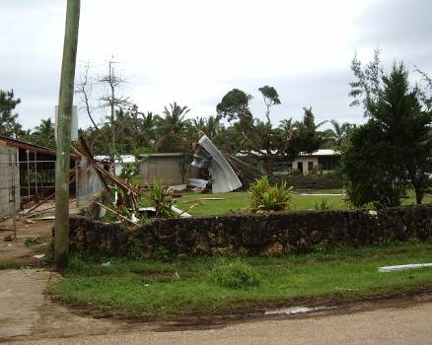
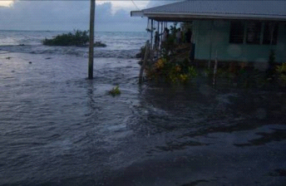
Sleeping giant-
last eruption was 1946
NTT Tsunami 30 th Sept 2009. Three waves were reported with the last one reaching six meters
Most recent event(15 Mar 09) – Hunga Tonga about 60 km to the NNW of Nuku’alofa (Tongatapu) erupted.
Average of 1cyclone/yr
Cyclone Waka 2001($104m)
Tornadoes-The latest event was happened in September 2004
4 May, 2006 (7.8 magnitude)
Storm surge – $1.4 million
Coastal flooding
9th Jan2009

Slide 8
4. The STRUCTURE: National Co-ordination in Tonga
National Disaster Council (CABINET)
Chair: Hon. Minister of MEIDECC
NATIONAL
Policy and Preparedness
Delivery of
Emergency Response
Coordination of Relief and Recovery
National Emergency Management Committee
Members CEO:
PMO, MoI, MIA, MEIDECC, Education, Health, MAFFF, Lands, Foreign Affairs, MPE, Revenue & Customs, Finance, MIA, Police, HMAF
National Emergency
Operations Committee
Members CEO:
PMO, MoI, MIA, MEIDECC, Foreign Affairs, Finance, MIA, Police, HMAF
National Emergency
Recovery Committee
Members CEO:
PMO, MoI, MIA, MEIDECC, Finance and Planning, Foreign Affairs, HMAF, NGO representative
NEMP
Secretary: NEMO NEMO Secretary: NEMO
Chair: Governor/
Gov’t Rep
District Emergency Management Committee
DISTRICT
‘Eua
Ha’apai
Vava’u
Niuafo’ou
Niuatoputapu
DEMP
Chair: Town Officer
VILLAGE
Village Emergency Management Committee
VEMP

Slide 9
5. MECHANISMS TONGA HAVE IN PLACE TO DEAL
WITH OUR SITUATION
1. EMERGENCY PLANS:
2007 EMERGENCY MANAGEMENT ACT
NATIONAL EMERGENCY MANAGEMENT PLAN 2008-09 (NEMP)
TONGA NATIONAL TSUNAMI PLAN 2012
DISTRICT EMERGENCY MANAGEMENT PLANS (DEMP)
VILLAGE EMERGENCY MANAGEMENT PLANS (VEMP)
POLICE – DISMAC
HMAF EMERGENCY PLAN
OTHER AGENCIES EMERGENCY/BUSINESS CONTINUITY PLANS
2. STANDARD OPERATING PROCEDURES (SOPs):
METEOROLOGICAL SERVICES NEW WARNING CRITERIA AND PRODUCTS, 2014
NATIONAL EMERGENCY OPERATION CENTRE (SOP)

Slide 10
6. The Cluster System
HM Cabinet Decision (No.141) of the 25th February 2015 granted approval to improve co-ordination of disaster by strengthening the “Cluster Leads”. Coordination through NEMO and the Cluster System is to be headed up by Line Ministries. The Clusters are strongly supported by the International Community.
1. Coordination & Logistics
2. Emergency Shelter & Non-food Items (NFI) MEIDECC
3. Health, Nutrition, Water, Sanitation & Hygiene (WASH)
4. Food Security & Livelihoods
5. Education
6. Safety & Protection
7. Emergency Telecommunications
8. Essential Services (Power, Water)
9. Reconstruction
10. Economic & Social Recovery

Slide 11
7. EMERGENCY TELECOMMUNICATION CLUSTER (ETC) IN TONGA
Emergency Telecommunication Cluster (ETC) Committee was established on the 10th November 2016
ETC is established with the Ministry of MEIDECC under the Communication Department which is mandated under the following Act & Legislation:
- Communications Act 2015
- Telegraph Act
- Tonga Broadcasting Commission Act
- Tonga Communications Corporation Act 2000
- Radiocommunications Act
FN – Under the Act and Legislation Term of reference (TOR) has being established and in place for the ETC 2018
- The ETC Committee is actively working in-accordance with TOR

Slide 12
8. COMMUNICATION CLUSTER COMMITTEE
The ETC committee is chaired by the Director for Communication Department of MEIDECC.
Members of the committee consist of:
National Emergency Management Office (NEMO)
Tonga Meteorological Service (TMS)
Ministry of Police
Tonga Fire & Emergency Service
His Majesty’s Royal Arm Force (HMRAF)
Tonga Broadcasting Commission (TBC – Tonga National Broadcaster)
Letio Tonga Broadcom FM 89.5
Tonga Communication Corporation (TCC)
Digicel Tonga Ltd
Tonga Red Cross

Slide 13
9. COMMUNICATION CLUSTER COMMITTEE RESPONSIBILITIES
Work under the cluster framework as defined by the Tonga National Emergency Management Office (NEMO)
Coordinate overall emergency telecommunications activities, including coordination of international agencies providing emergency telecommunications assistance to Tonga
Guide planning and strategy development as it relates to emergency telecommunications
Recommend solutions that meet the communication needs of responders (eg. NEMO) and communities
Oversee the deployment of emergency telecommunication systems in disaster response
Identify training needs related to emergency telecommunications and work with partners to build capacity through such trainings and simulation

Slide 14
9. COMMUNICATION CLUSTER COMMITTEE RESPONSIBILITIES
To conduct technical needs assessment and analysis of emergency telecommunications equipment and procedures
To develop a register of all emergency telecommunication systems in country such as VSAT, HF/VHF radio communication systems etc.
To ensure adequate preparedness for new emergencies. This may include the development of minimum preparedness actions for the Telecommunications Cluster to ensure it is ready to respond to disasters when they emerge
To provide input to NEMO for inclusion in situation reports (sitrep) and other updates

Slide 15
10. Communication Systems Available
Common Channel Marine & Land - VHF Radio Analogue Network System
Common Channel Marine & Land - VHF Radio Digital / Analogue Network System (B/Station and Held Held)
Early Warning System (EWS) IP Network System (Siren & Loud Speakers)
Satellite Phones (Iridium) NDMO, US Peace Corps, Tonga Red Cross, TCC, Digicel, LDS - Chatty Beetle EMWIN System-Receive only (MET Services)
Network Operators (landlines & mobile phone) (TCC & Digicel-SMS Bulk service)
Cell Broadcasting by operators (TCC & Digicel Tonga)

Slide 16
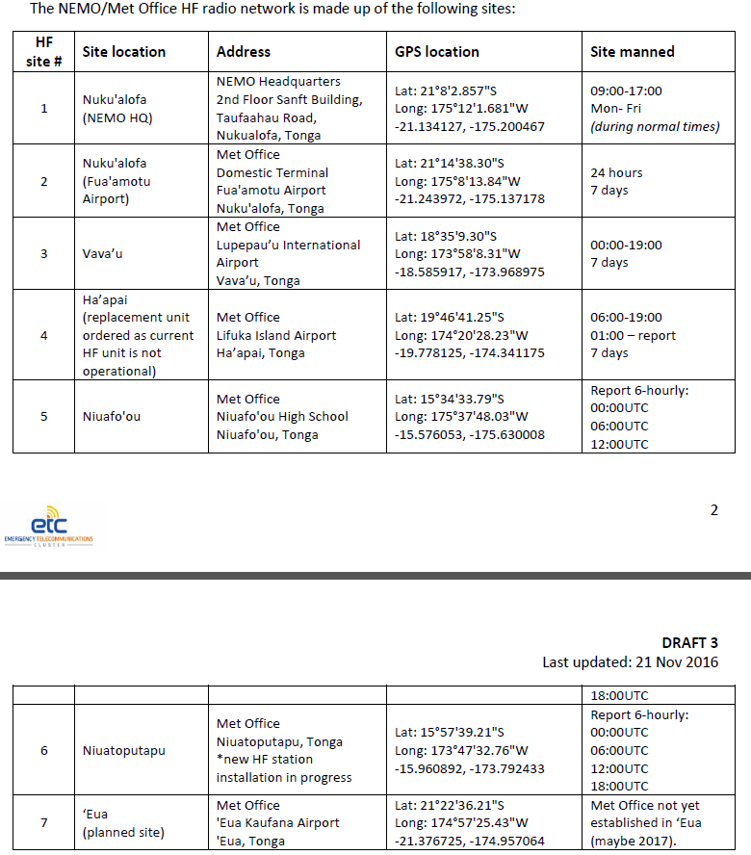
11. HF RADIO NETWORK SYSTEM NEMO/MET (COMMUNICATION FOR ALL REMOTE ISLANDS (NORTHEN ISLANDS )

Slide 17
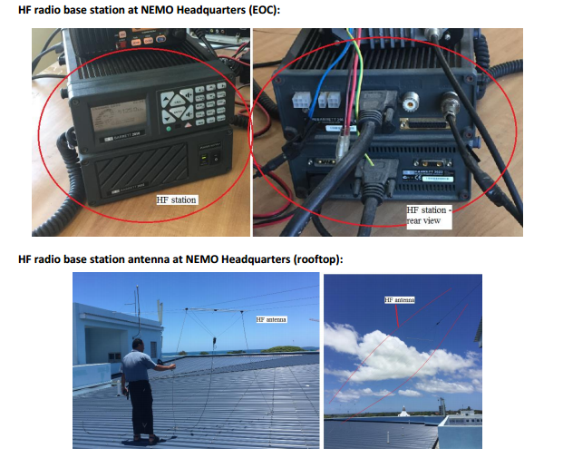
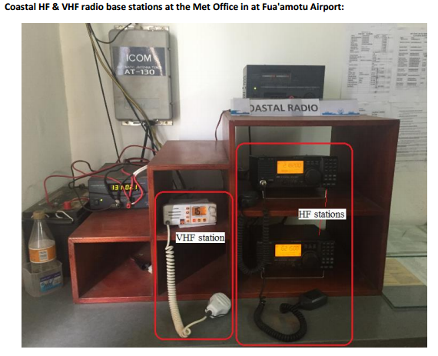
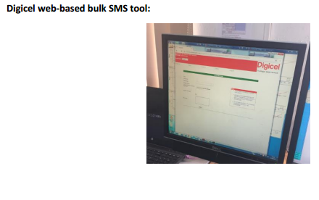

Slide 18
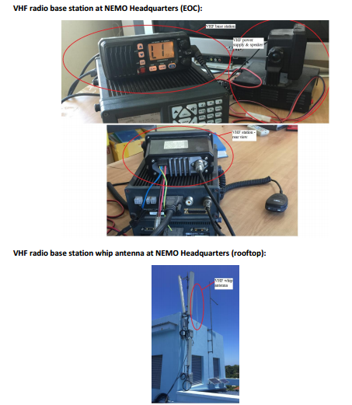
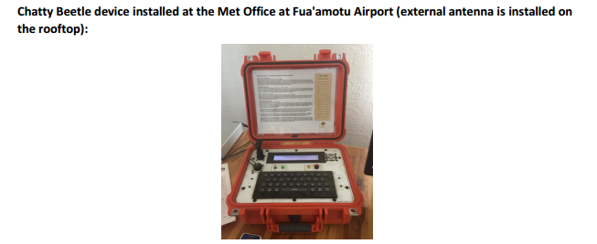
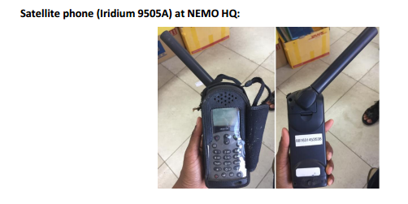
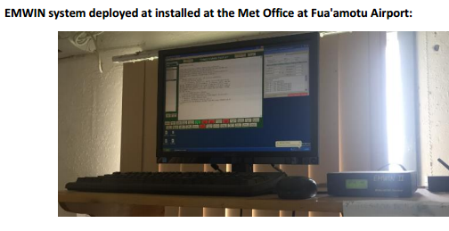

Slide 19
12. Communication Projects
ITU V-SAT - Regional Pacific Connectivity Project
Nationwide Early Warning System Project (NEWS)
E-Gov. Project (WB)
Technical Advisory and Capacity Enhancement with World Food Program
Coastal Radio Network Station (PREP Project (2017)
VHF Small Vessel Marine Radio Station – (8m below) PREP Project Search & Rescue (100 Radio - 76 Install) (SOLAS – Safety of Life at Sea)

Slide 20
13. Activities
Developing Telecommunications Cluster Plans and Standard Operation Procedures (SOP)
Testing efficiency of plans and Standard Operation Procedures (SOP) through training, seminars and mock drills
Ongoing testing and programing of existing analogue radio system to new digital system; maintenance of system and equipment
Capacity building
Resources availability (funding/human)
Assistance from International Partnership

Slide 21
Reminding you all that God has done great things for you, me and for us all – Those who sow in tears shall reap in joy
Vinaka

