Slide 1
S A M O A
Pacific Radio Communication Workshop, Sigatoka, Fiji
12 April 2019

Slide 2
Presentation Content
Introduction
Background
Office of the Regulator
RF Management
Type Approval
NETP and NETOP
DTTV Project

Slide 3
Introduction
Assistant CEO Spectrum Management and Technical Division
Samoa as a case study on some of the practices and projects conducted
Regulator
Assistant CEO Legal
Assistant CEO Regulatory
Assistant CEO Spectrum Management and Technical
Assistant CEO Electricity
Assistant CEO Corporate

Slide 4
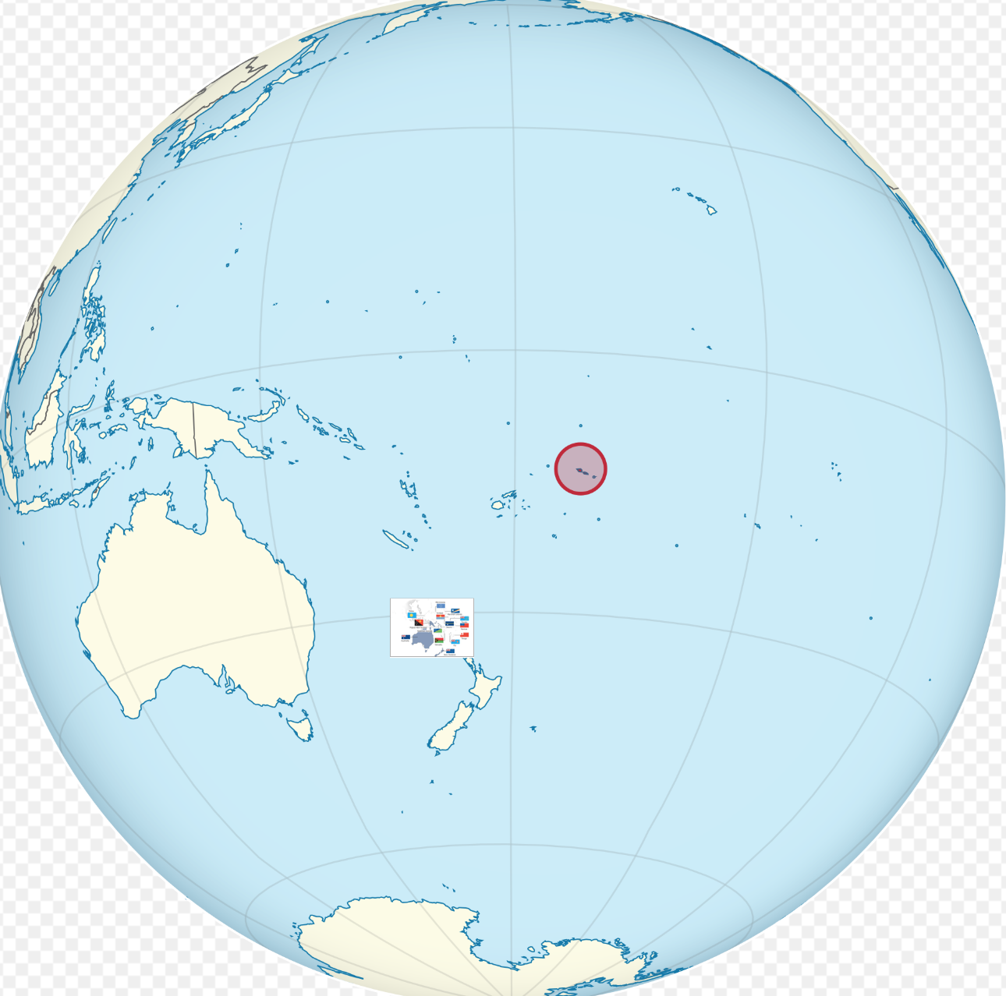
Background
Samoa’s location
Pacific Ocean
Center of the World
S A M O A
Sacred Center

Slide 5
Office of the Regulator
Mandate of the OOTR
Telecommunication Act 2005
Broadcasting Act 2010
Electricity Act 2010
Postal Act
Functions
Promote the best interest of consumers using ICT, broadcasting, postal and electricity services
Projects
Connectivity Project
Digital TV Project
NETP & NETOP

Slide 6
RF Management
Regulatory Assessment
Legal Assessment
Spectrum and Technical Assessment
RF Application
Invoice
Certificate
Financial Evaluation
Legal Evaluation
RF Evaluation

Slide 7
Type Approval
Application
Check & Test
Certificate
Monitoring
TA Process [10 applications per month, Free]
Challenges [Time consuming, late Samples, Ad hoc monitoring]
Way Forward [Strengthen community awareness, AI, fee]

Slide 8
NETP / NETOP
Review of the NETP
October 2018 – Completed
Consultation 2019 new documents – Completed
Final Comments - Completed
Approval Final Documents – End May 2019
NETP 2019 Draft
NETOP 2019 Draft
Preparation
Warning
During
Post - Recovery

Slide 9
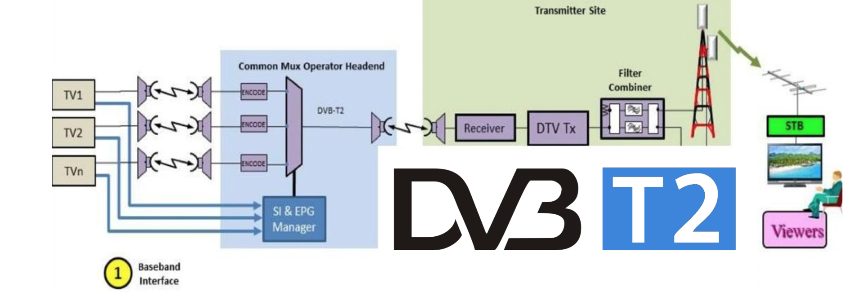
DTTV Project
Project Objectives
Improve coverage
Improve services
Affordable
Project Sponsor
Project Update – Implementation Phase One
Awareness

Slide 10
DTTV Project - Current

Slide 11
DTTV Project - After

Slide 12
Public Awareness
https://www.regulator.gov.ws/

