Slide 1
ITU Radiocommunications workshop 11-12 April 2019
NAURU GENERAL OVERVIEW OF
RF MANAGEMENT.

Slide 2
WHERE ARE WE?
NEARLY 2000 MILE FROM AUSTRALIA.
32 KM SOUTH OF THE EQUATOR.

Slide 3
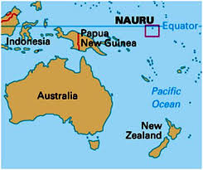

Slide 4
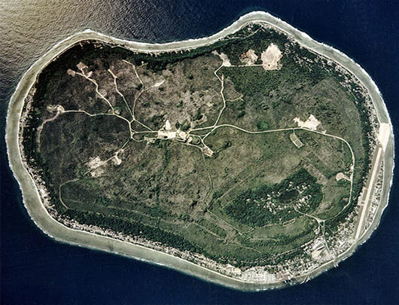
CONSIST OF ONE ISLAND 22SQ KM IN AREA.
Notes:
CONSISTS OF ONE ISLAND WITH A TOTAL AREA OF 21 SQUARE KM.
POPULATION APPROX. 11,000.00 PEOPLE.

Slide 5
HOW MANY OF US?
AFTER WWII POPULATION DROPPED TO JUST OVER 600 PEOPLE .
DANGER OF BECOMING EXTINCT.

Slide 6
HOW MANY OF US NOW?
CURRENT POPULATION OVER 11,000.00.

Slide 7
COMMUNICATIONS INFRASTRUCTURE
DIGICEL COMMENCED IN 2009.
SECOND OPERATOR IN ACCLINKS COMMENCED IN 2019.

Slide 8
INFRASTRUCTURE CONTD.
Total subsribers 15,000
Total wireless network
Total 6 base stations
80% smart phone penetration.

Slide 9
SPECTRUM MANAGEMENT.
SPECTRUM MANAGED VIA SIMPLE EXCEL SPREAD SHEET.
HOPE TO GAIN ACCESS TO SPECTRUM MANAGEMENT SOFTWARE.
TOTAL SATELLITE DOWNLOAD 900MHZ
TOTAL SATELLITE UPLOAD 300MHZ.
GSM 900MHZ FULLY UTILIZED FOR 2/3G
HALF OF 1800MHZ BAND FOR 4G/LTE

Slide 10
SPECTRUM MANAGEMENT. UNUSED SPECTRUM
2100MHZ (BAND 1)
HALF OF 1800MHZ (BAND3)
45MHZ (BAND28)
2.5-2.8GHZ (BAND41)

Slide 11
FUTURE
SUBMARINE CABLE .
ESTIMATE TO BE IN PLACE 2021.

Slide 12
Wrc 19
Watching closely on the happenings at WRC wrt 26GHZ band.
Utilisation of 26GHZ band will eventually touch us all.
Saying that when developed countries sneeze, us little folks get the flu.

Slide 13
…That’s all folks
ALL QUESTIONS TO BE REFERRED TO WWW.NAURUGOV.NR.

