Slide 1
RF Management in the FSM
PRW-19
Coral Coast, Fiji
11 April, 2019
FSM Department of Transportation, Communications & Infrastructure

Slide 2
The Federated States of Micronesia – Basic Info
4 States
  Kosrae
  Pohnpei - Capitol
  Chuuk
  Yap
Over 600 islands
Currency: USD
Mode of Transportation
  Air transport between states – each state has 1 international airport
  Sea transport to outer islands
    Air transport (15 passenger aircraft) to only a few outer islands
Population: A little over 105,000
Telecommunications Operator: 1

Slide 3
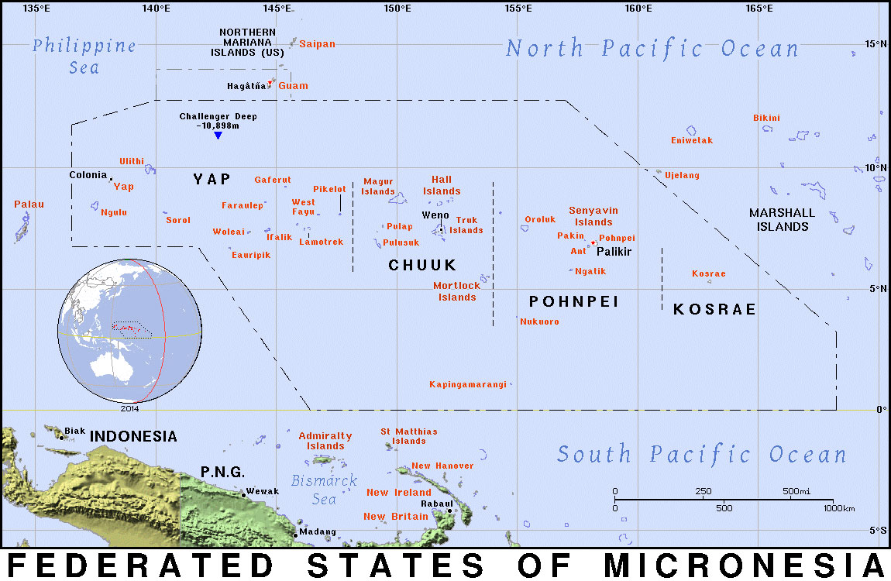
The Federated States of Micronesia

Slide 4
FSM Department of Transportation, Communications & Infrastructure
Currently undertaking the role of managing RF for the FSM
  1 main person
  1 back-up person – me
In 2018, FSM Congress passed Public Law 18-52
  Establishes the new Office of the Telecommunication Regulation Authority (FSM TRA)
    Currently has 4 people
      CEO
      1 Board Member
      Secretary
      Legal and Regulatory Officer
  Law reassigns RF management to the FSM TRA

Slide 5
RF Management
Spectrum XXI – Very basic application for collecting RF and operator data.
  Provided by US
Since 2017, we have adopted the SMS4DC application to manage RF and operator data.
  Provided by ITU
Since 2018, we have also been using AFIS
  Provided by APT
Currently not charging operators for RF usage, although we are still requiring registration and renewal of expired licenses.
Application is available on department website for download.

Slide 6
Type Approval
Legislation is in place which requires the FSM TRA to ensure type approval is enforced, although their rules and regulations are in the drafting stage. We encourage importers to import FCC approved equipment.

Slide 7
Thank You

