Slide 1

5G in Korea
ITU BDT TND
JONGHO KIM
2019. 4.12

Slide 2

CONTENTS
Relationship between the Fourth industrial Revolution and 5G
Status of 5G commercialization
Key Implementation tasks for 5G
Characteristic in 5G Services

Slide 3
Relationship between the Fourth industrial Revolution and 5G

Slide 4
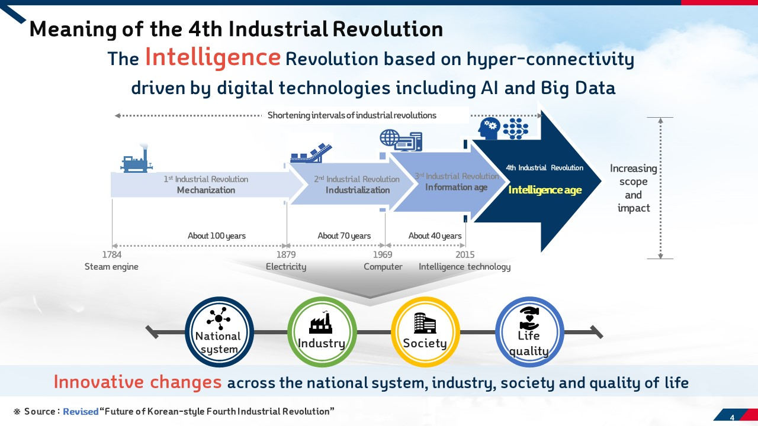

Slide 5
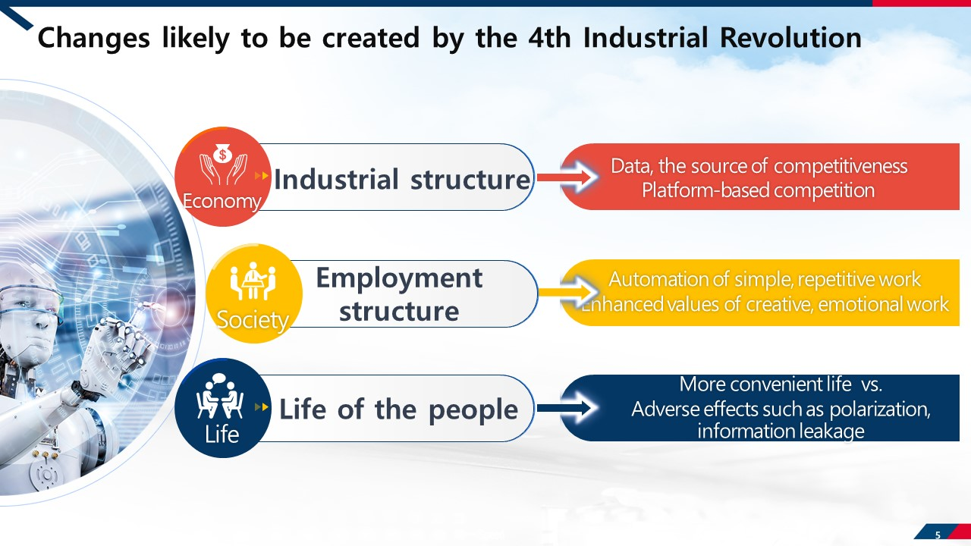

Slide 6
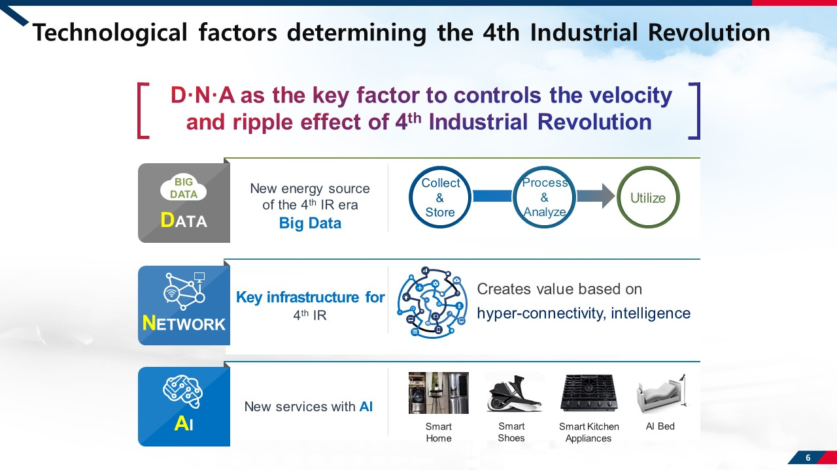

Slide 7
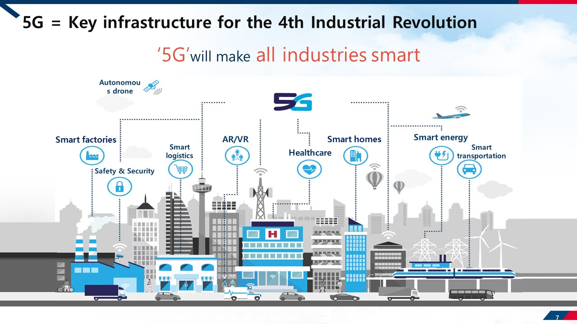

Slide 8
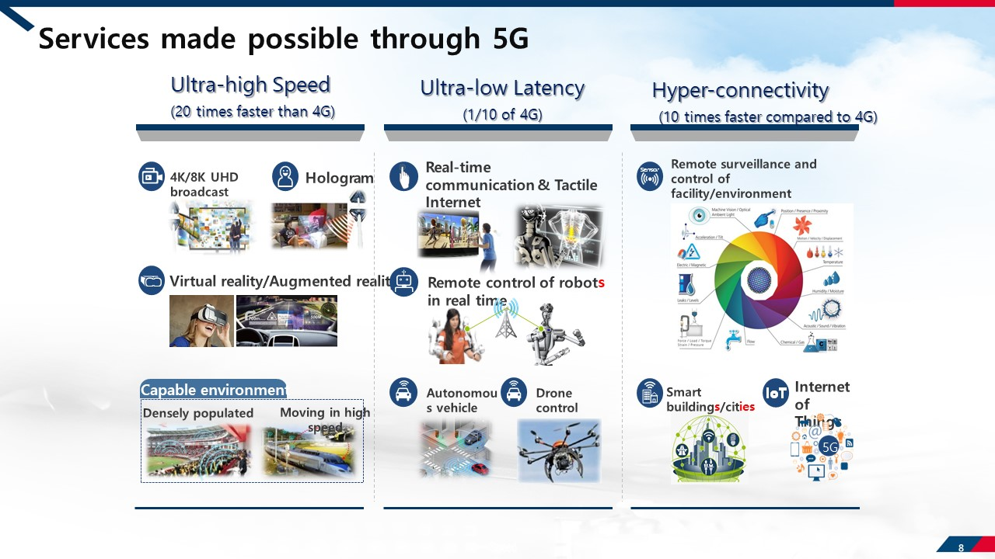

Slide 9
Status of 5G commercialization

Slide 10
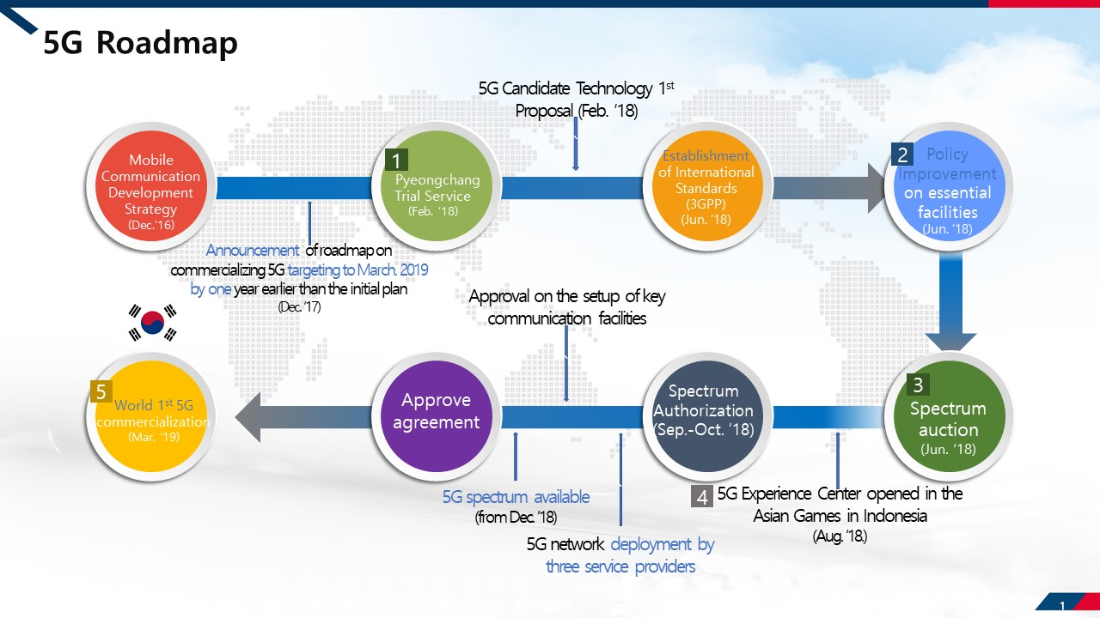

Slide 11
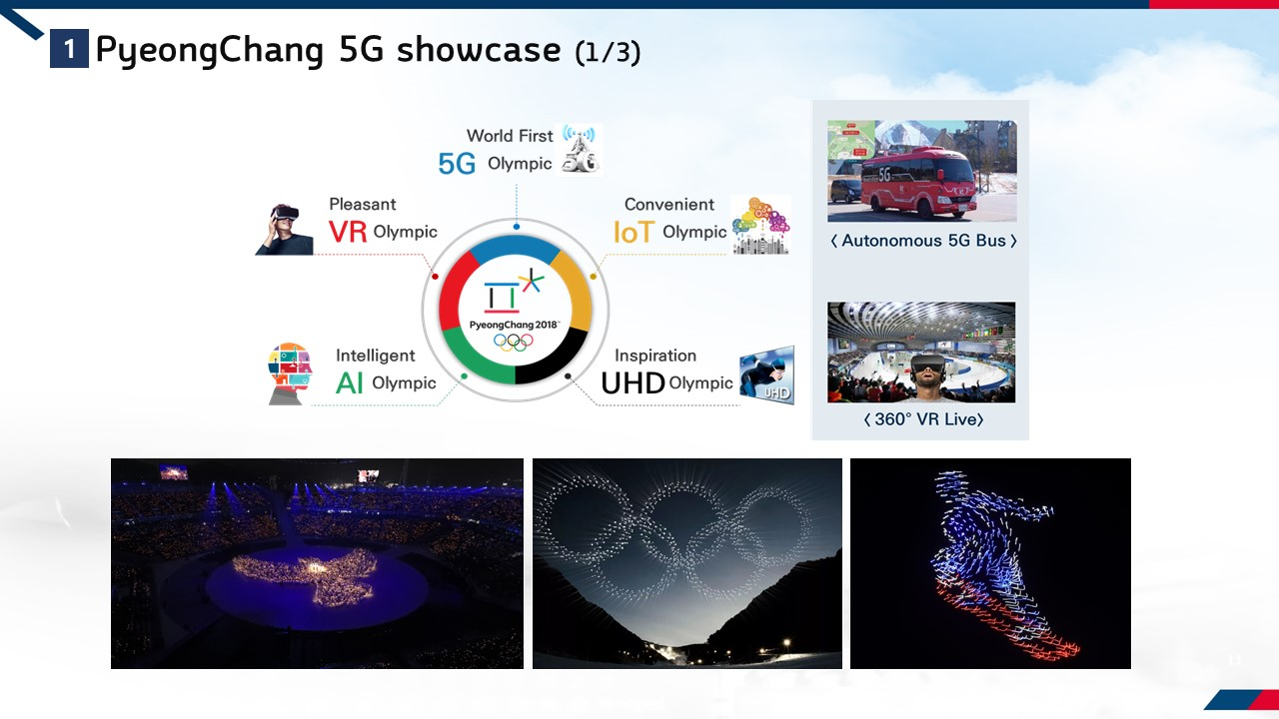

Slide 12
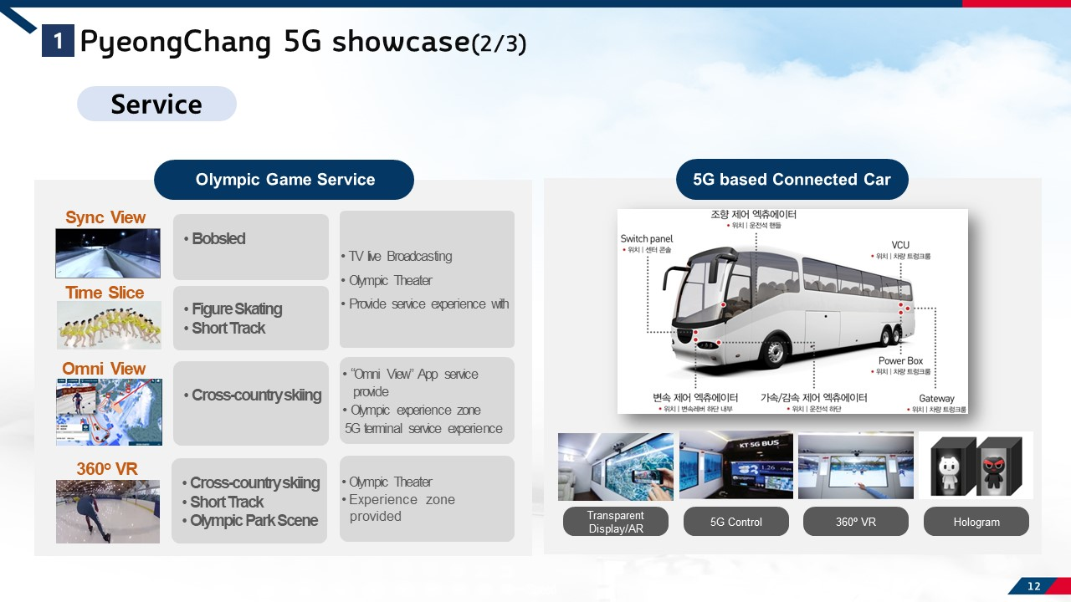

Slide 13
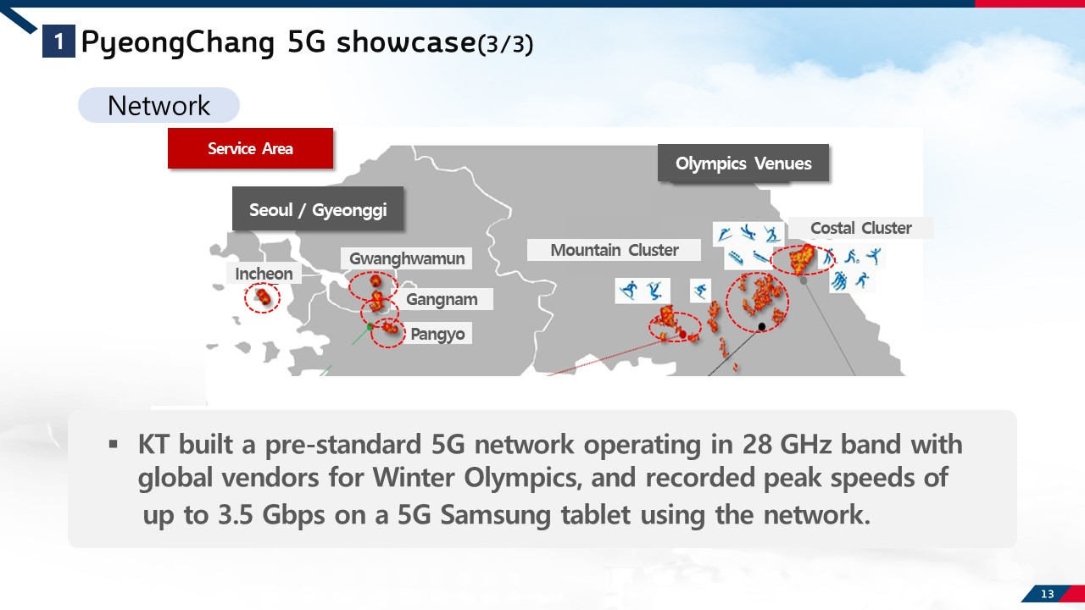

Slide 14
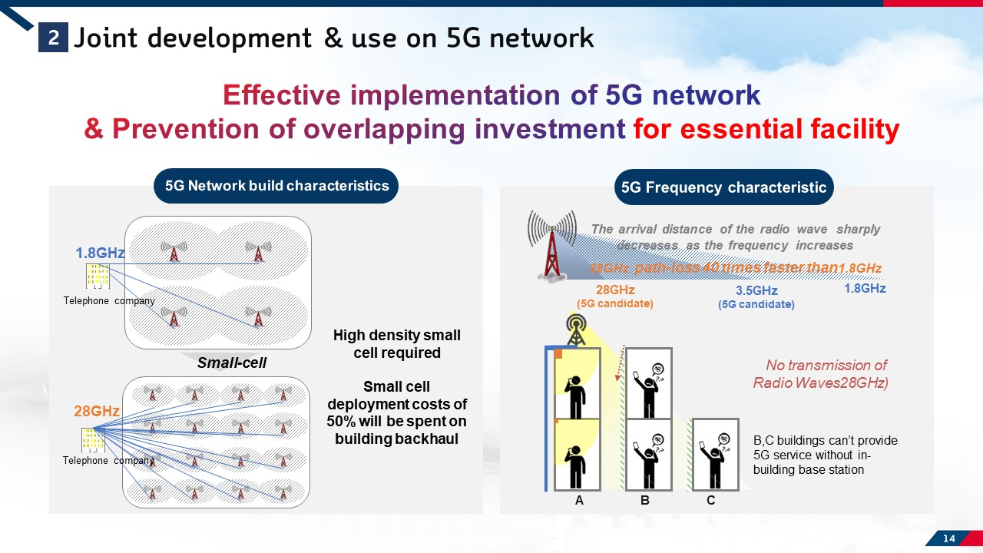

Slide 15
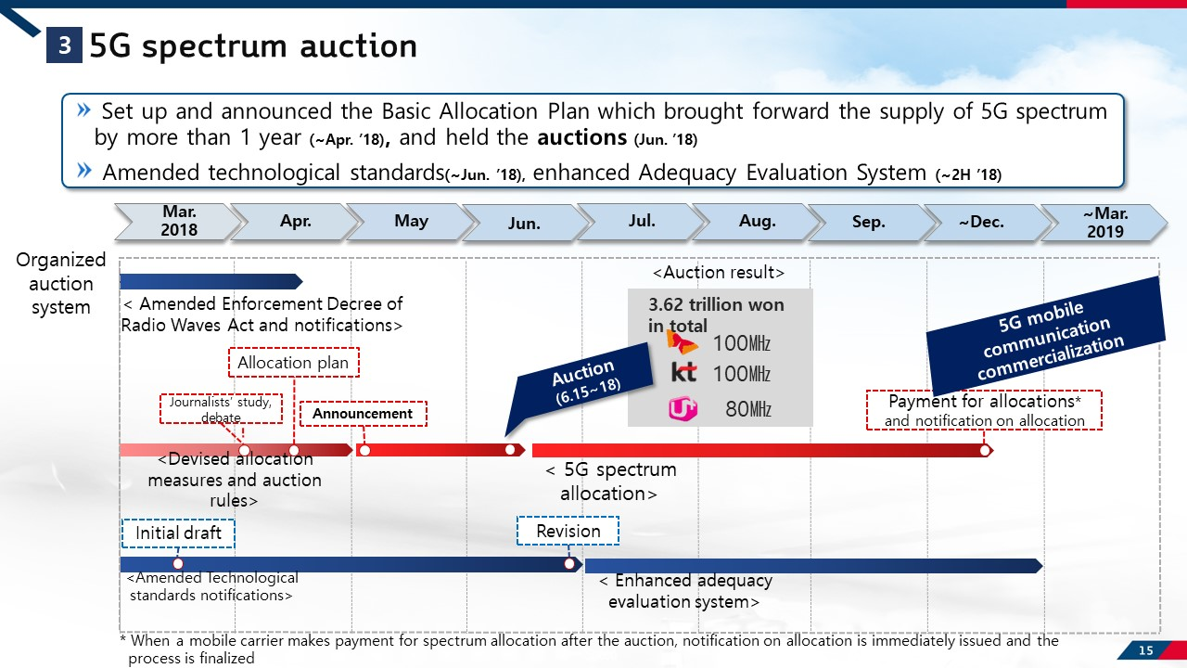

Slide 16
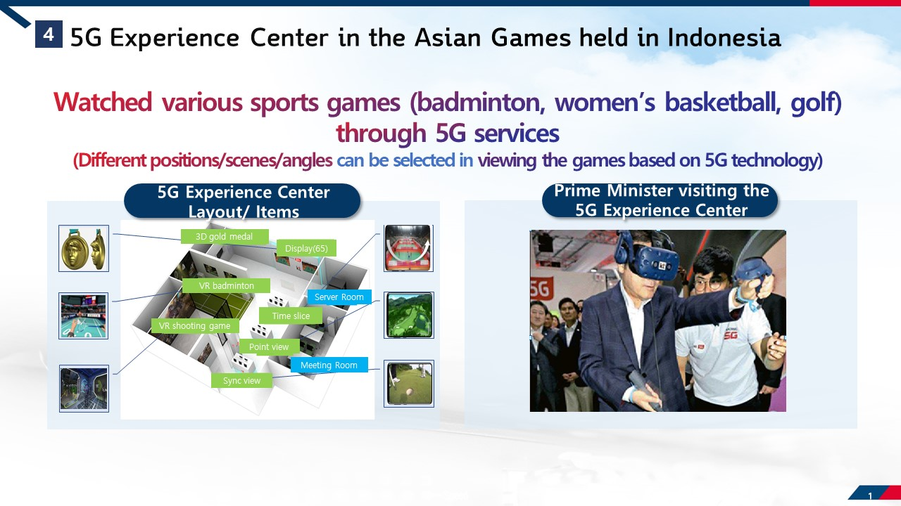

Slide 17
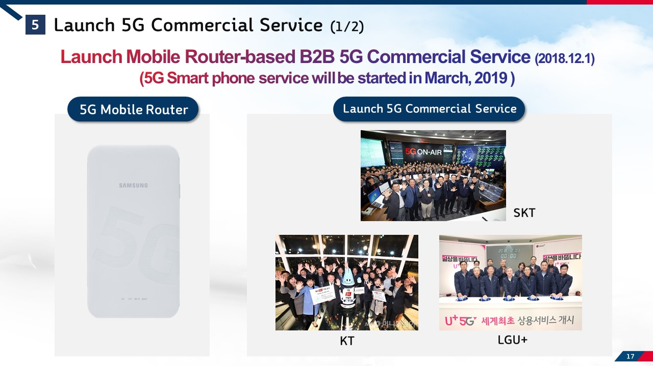

Slide 18
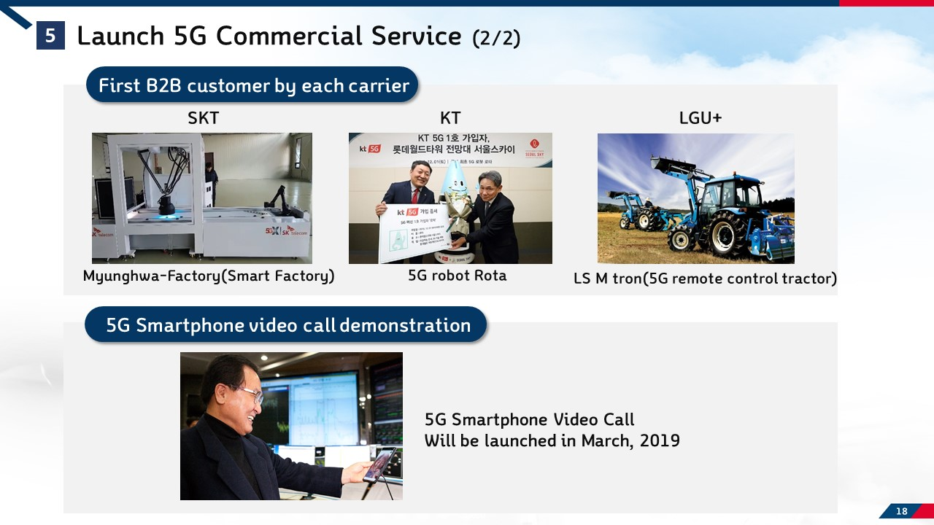

Slide 19
Key Implementation tasks for 5G

Slide 20
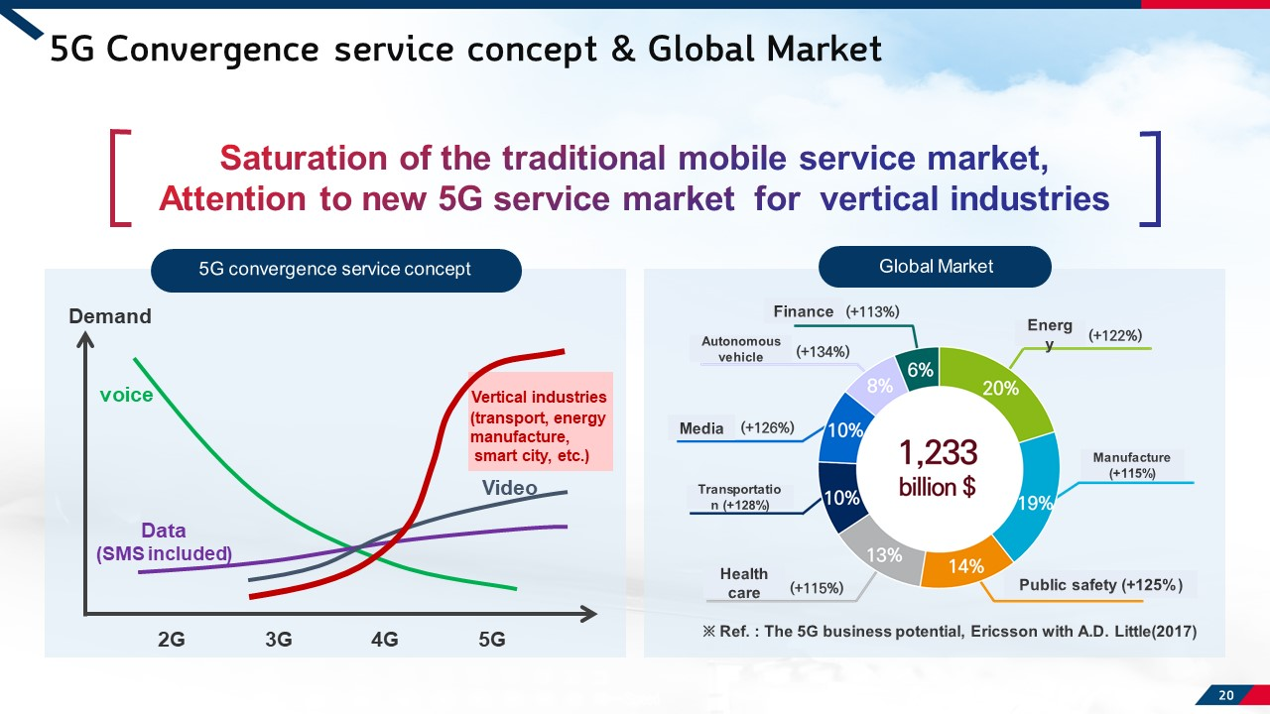

Slide 21
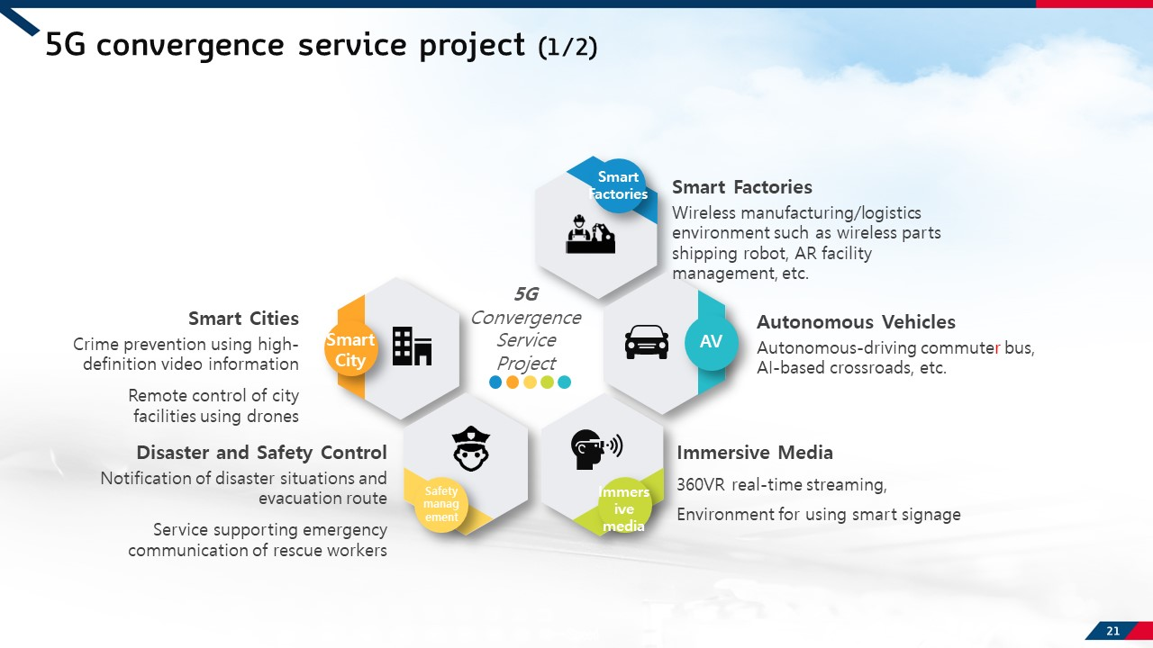

Slide 22
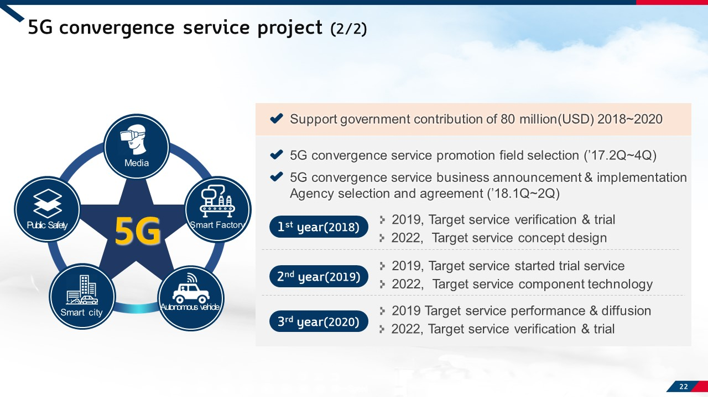

Slide 23
CHARACTERISTICS in 5G SERVICES
One Connectivity; Telco based services
B2B>B2C
CONTENTS and SERVICES; GAP BETWEEN TECHNOLOGIES AND CONTENTS
COLLABORATION with OTHER SECTORS’ INDUSTRIES
ODD and EVEN GENERATION OF MOBILE SERVICES; introducing destructive innovation and improving and spreading out innovation. 1G-mobile service, 3G-smart phone, 5G-IoT, AI

Slide 24
Thank you

