Slide 1
5G (IMT-2020) Enabling Digital Services
Pacific Radio Communication Workshop 2019 (PRW-19)
Coral Coast, Fiji
11th –12th April 2019
International Telecommunication Union

Slide 2


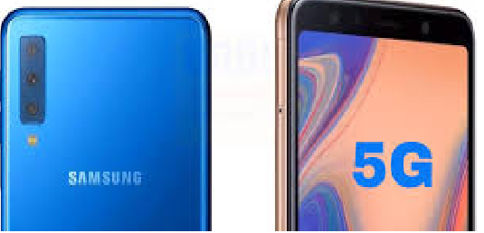
Where are we – hype vs reality?
Verizon (USA) and SK, KT and LG (Korea)
Ahead of 2020
Ongoing 5G deployments
Race to be the first to market
Target consumer for early launch
Building business solutions for future growth
Consumer vs Business
Smartphones and mobile hotspots are flowing into the market
Growth is in 2020
Mobile devices

Slide 3



Other 5G Market Development
Belgium, Canada, Germany, Italy eyeing new entrants
Japan, India and Singapore
Or consolidation for cost effectiveness
Introducing a new entrant with 5G Spectrum Auction
5G is ideal for gaming
Faster throughput, lower latency
AR/VR gaming opportunities
Mobile Cloud Gaming
Delivering broadband services where there is lack of fibre
For business: faster deployment and backup
Fixed Wireless Access

Slide 4
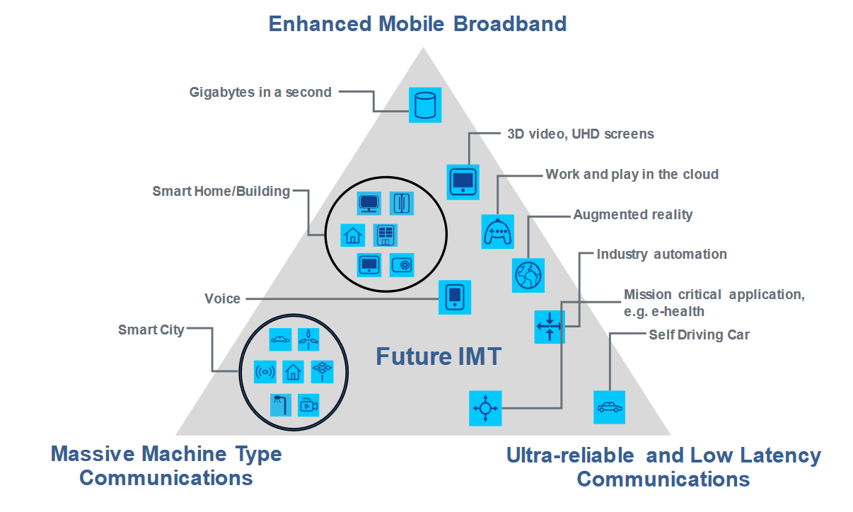
Why Invest in 5G?
1 | Competitiveness – costly to lose customers to rivals
2 | Cost per bit argument
3 | FWA as an additional source of revenue
4 | Gradual deployment – LTE provides full coverage
5 | Leap of faith – build the network and the apps will come
Think of 5G when rolling out LTE – upgrading path

Slide 5
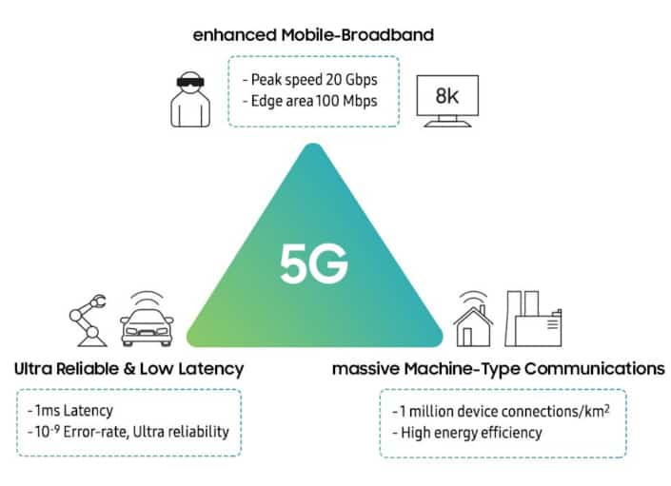
What about Business Solutions?
1 | Grow awareness – too much hype and lack of 5G awareness
2 | Ecosystem – from devices to applications
3 | Co-creation with customers
4 | From technology to business outcomes
5 | Private network vs WiFi 6?
Not all telcos/markets are ready to develop these solutions

Slide 6




Is our country ready for 5G?
Staying ahead in 5G adoption is key for some policy makers – economic benefits ($billions more to GDP, smart cities, productivity, jobs, innovation)
Assess readiness based by benchmarking against market leaders – market readiness and regulatory readiness
Gap Analysis – assess current situation, identify gaps and provide recommendations

Slide 7
Market Readiness
Infrastructure Readiness | Is the current infrastructure ready to support 5G? Backhaul infrastructure Higher speed LTE Small cell deployment
Industry Readiness | Is the industry ready to deploy 5G? R&D and manufacturing activities Operator 5G preparation – trials, and vendor engagement (devices, network supplier selection)
User Readiness | Will the people buy into 5G? Current mobile and Internet usage Level of IoT activities within the business segment Availability of government services via mobile/Internet

Slide 8
Regulatory Readiness
Spectrum Allocation | 1,886 MHz – how much is available Availability for <1GHz, 1-6GHz and mmWave Timeframe: Spectrum allocation roadmap
Licence Fees | Does the existing spectrum pricing formula work? (think GHz bandwidth) Base station licensing (think small cell) Subscriber licence (think IoT)
Site Acquisition & Sharing | Site access – framework for building towers and access to buildings Street furniture – lamppost, bus stops, etc.
Backhaul Options | Access to incumbent fibre National fibre infrastructure Wireless backhaul – likely to be hybrid
QoS | Coverage requirements tied to spectrum licence
Others considerations | Cybersecurity, numbering, smart city initiative

Slide 9
“Committed to
connecting the WORLD”
I Thank U

