Slide 1
IMT- Identified Spectrum
Industry Roundtable: Partnership for Digital Economy Growth
7 August 2018
Dhaka, Bangladesh
Sameer Sharma
Senior Advisor , ITU

Slide 2
ITU – Organization
Membership Inputs
WRC
Treaty
RPR
RPM
WTDC
WTSA
RA
Organiz.
RR
TDAG
Action
Plan
Advisory
TSAG
Action
Plan
RAG
Action
Plan
Study Groups
Study Groups
Study Groups
and CPMs
Technical
BDT
TSB
BR
Secretariat

Slide 3
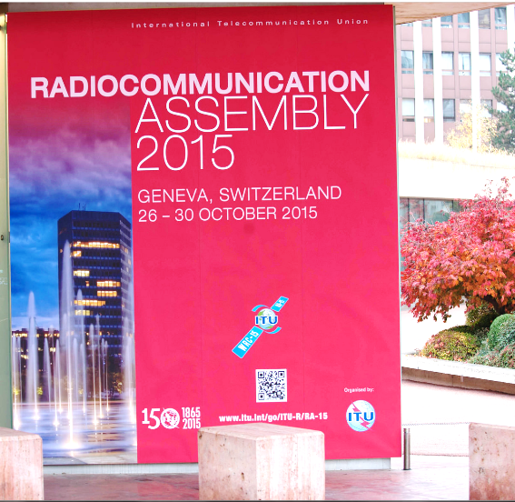
Definition
    Res. ITU-R 56-1: Naming for International Mobile Telecommunications
  Since ITU is the internationally recognized entity that has sole responsibility to define and to recommend the standards and frequency arrangements for IMT systems, with the collaboration of other organizations such as standard development organizations, universities, industry organizations and with partnership projects, forums, consortia and research collaborations, therefore the RA-15 debated especially on naming of IMT systems.
  the existing term IMT-2000 continues to be relevant and should continue to be utilized;
  the existing term IMT-Advanced continues to be relevant and should continue to be utilized;
  However for systems, system components, and related aspects that include new radio interface(s) which support the new capabilities of systems beyond IMT-2000 and IMT-Advanced, the term “IMT-2020” be applied
  In addition it was resolved that the term “IMT” would be considered the root name that encompasses all of IMT-2000, IMT-Advanced and IMT-2020 collectively.

Slide 4
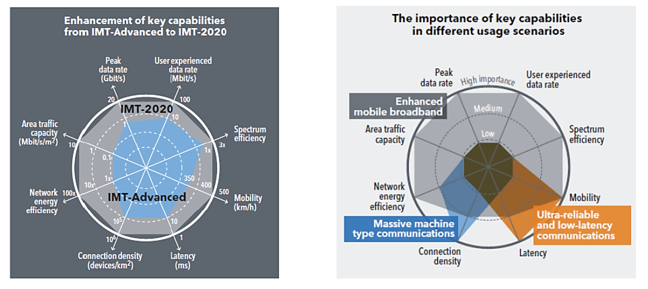
IMT
The values in the figures above are targets for research and investigation for IMT-2020 and may be revised in the light of future studies. Further information is available in the IMT-2020 Vision (Recommendation ITU-R M.2083)

Slide 5
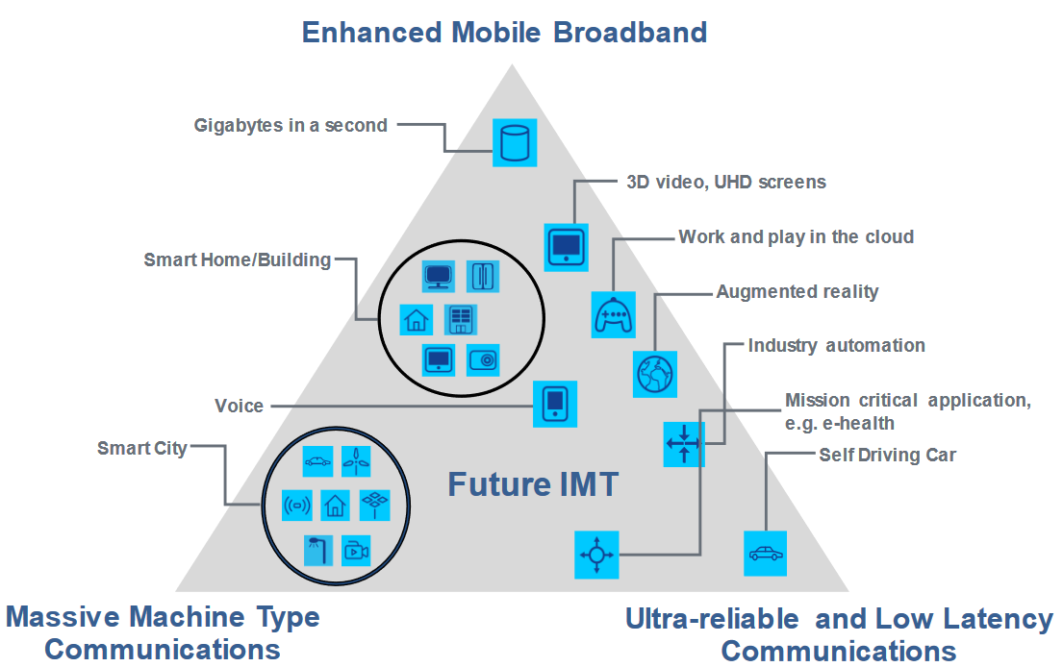
IMT Supports IoT

Slide 6
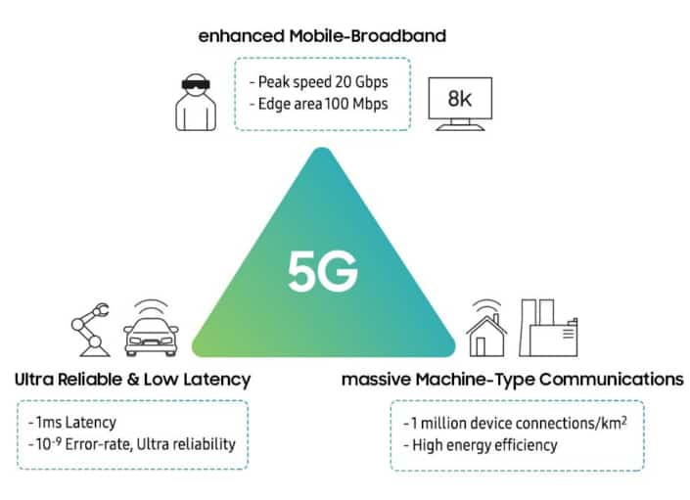
Understanding IMT applications
Consumer – Fixed wireless
IMT
Business

Slide 7
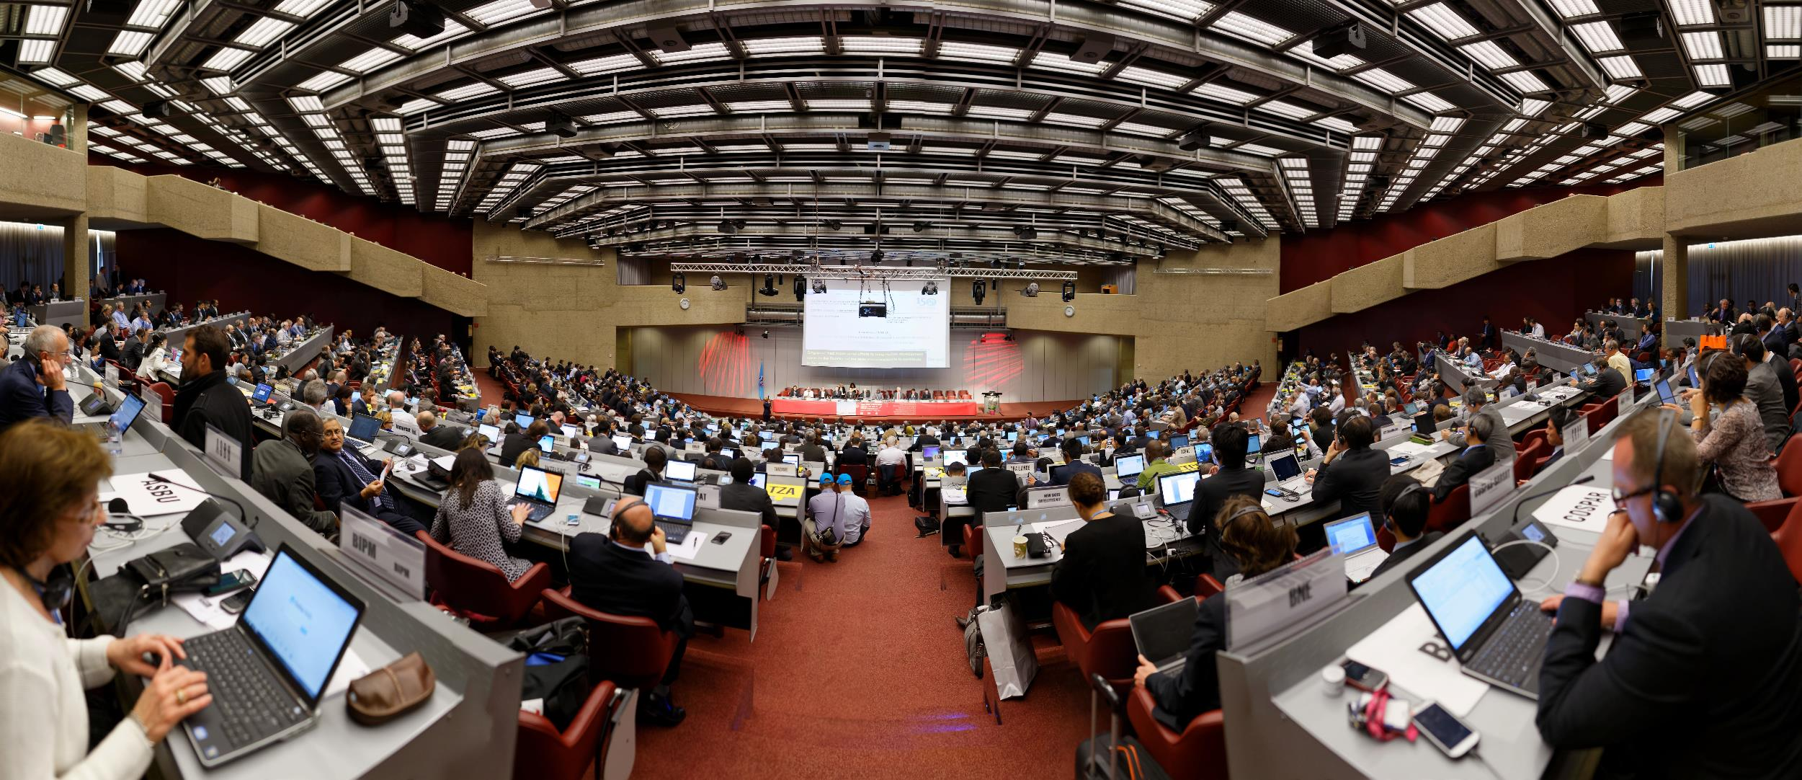
Recalling WRC-15 outcomes

Slide 8
WRC-15 (General Information)
2-27 November 2015 in Geneva
  3275 participants attended WRC-15, including:
  2780 participants from 162 Member States, and
  495 participants representing 130 other entities, including industry, which also attended as observers
678 Documents including 2888 Member states proposals
  Two thirds (66%) of those were common proposals (either regional or multi-country).
WRC-15 addressed over 40 topics related to frequency allocation and frequency sharing for the efficient use of spectrum and orbital resources.

Slide 9

Outcomes of WRC-15
Mobile Broadband (MBB)
(agenda Item 1.1 and 1.2)

Slide 10
IMT Spectrum after WRC-07
    1177 MHz
    1177 MHz
    1085 MHz
    951 MHz

Slide 11
Outcomes of WRC-15
    Need for More spectrum
User density | Total requirement by 2020 (MHz) | Region 1 |  | Region 2 |  | Region 3
 |  | Already identified (MHz) | Additional demand (MHz) | Already identified (MHz) | Additional demand (MHz) | Already identified (MHz) | Additional demand (MHz)
Low | 1 340 | 981-1 181 | 159 – 359 | 951 | 389 | 885 - 1 177 | 163 – 455
High | 1 960 |  | 779 - 979 |  | 1 009 |  | 783 - 1 075
  Estimated additional spectrum requirements by 2020 ranged from 159 to 1075 MHz depending on Region and user density)
Source: CPM-15 report (Additional Spectrum Requirements)

Slide 12
Outcomes of WRC-15
    New spectrum Identified
WRC - 15
Band (MHz) | Bandwitdh (MHz) | R1 | R2 | R3
470 – 608 | 138 |  | some
608 – 698 | 84 |  | some
1427 – 1452 | 25 | any | any | any
1452 – 1492 | 40 | some | any | any
1492 – 1518 | 26 | any | any | any
3300 – 3400 | 100 | some | some | some
3600 – 3700 | 100 |  | some
4800 – 4990 | 190 |  | some | some
 | New BW 709

Slide 13
Outcomes of WRC-15
    Spectrum for IMT
Band (MHz) | Footnotes identifying the band for IMT |  |  | Bandwidth
 | Region 1 or parts thereof | Region 2 or parts thereof | Region 3 or parts thereof
450-470 | 5.286AA |  |  | 20
470-698 | - | 5.295, 5.308A | 5.296A | 228
694/698-960 | 5.317A | 5.317A | 5.313A, 5.317A | 262
1 427-1 518 | 5.341A, 5.346 | 5.341B | 5.341C, 5.346A | 91
1 710-2 025 | 5.384A, 5.388 |  |  | 315
2 110-2 200 | 5.388 |  |  | 90
2 300-2 400 | 5.384A |  |  | 100
2 500-2 690 | 5.384A |  |  | 190
3 300-3 400 | 5.429B | 5.429D | 5.429F | 100
3 400-3 600 | 5.430A | 5.431B | 5.432A, 5.432B, 5.433A | 200
3 600-3 700 | - | 5.434 | - | 100
4 800-4 990 | - | 5.441A | 5.441B | 190
Total Bandwidth | 1,886 (Regional allocations vary and therefore totals can be different for a specific region)

Slide 14
IMT Bands after WRC-15

Slide 15
IMT Bands after WRC-15
    +60%
    1886 MHz
    +85%
    1764 MHz
    +52%
    1786 MHz
    +26%
    1372 MHz

Slide 16
Outcomes of WRC-15 (Significance for MBB)
Satisfy growing IMT broadband spectrum requirements:
  60% increase in IMT bands after WRC-15
  Total IMT spectrum of 1886 MHz
Harmonization of IMT bands:
  39% increase in globally harmonized spectrum after WRC-15
  318 MHz of harmonized bands in more than 80% of countries:
Secures future of other services through:
  coordination procedures,
  technical restrictions,
  In some cases operation on a non-interference basis

Slide 17
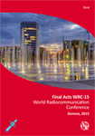
WRC-15 (Follow up)
  WRC-15 Final ACTs available at:
    www.itu.int/pub/R-ACT-WRC.12-2015 (ITU CL-16/22 of 17 May 2016)
  Radio Regulation 2016 edition available at:
  http://www.itu.int/pub/R-REG-RR/en

Slide 18
Going Forward

Slide 19
Main Steps towards WRC-19
WRC-15: WRC-19 Agenda - Resolution 809 (WRC-15)
1st Session of Conference Preparatory Meeting: CPM19-1
30 Nov – 1 Dec. 2015; Results @CA/226 of 23/12/2015
C-16: WRC-19 agenda & dates in Res. 1380 with MOD venue @ C-17
Agenda & dates approved, new venue for consultation of MS
2nd Session of Conference Preparatory Meeting: CPM19-2
Planned dates at CICG in Geneva from 18 to 28 February 2019
Final meetings of regional groups
Member States’ proposals to WRC-19
RA-19: 21 to 25 Oct. 2019 ; WRC-19: 28 Oct. to 22 Nov. 2019

Slide 20
CPM19-1
Following the WRC-15 the CPM19 had its first meeting from 30 November – 1 December 2015.
  269 participants from 63 Member States, 1 Observer from the State of Palestine and 25 Sector Members
The main task of the CPM was to decide on the structure of the CPM Report (for the WRC-19 conference) and the chapter rapporteurs and allocate the work to the relevant study groups.
Resolution COM 6/16 of WRC-15 contains the proposed agenda items for the WRC-19 and also references to the relevant Resolutions which are calling for the appropriate studies.

Slide 21
CPM19-1
CHAPTER 1: Land mobile and fixed services
  Agenda items: 1.11, 1.12, 1.14, 1.15
Rapporteur: Ms Keer ZHU (China (People's Republic of))
CHAPTER 2: Broadband applications in the mobile service
  Agenda items: 1.13, 1.16, 9.1 (issues 9.1.1, 9.1.5, 9.1.8)
Rapporteur: Mr José ARIAS (Mexico)
CHAPTER 3: Satellite services
  Agenda items: 1.4, 1.5, 1.6, 7, 9.1 (issues 9.1.2, 9.1.3, 9.1.9)
Rapporteur: Mr Nicolay VARLAMOV (Russian Federation)
CHAPTER 4: Science services
  Agenda items: 1.2, 1.3, 1.7
Rapporteur: Mr Vicent MEENS (France)

Slide 22
CPM19-1
CHAPTER 5: Maritime, aeronautical and amateur services
  Agenda items: 1.1, 1.8, 1.9, 1.10, 9.1 (issue 9.1.4)
Rapporteur: Mr Wael EL SAYED (Egypt (Arab Republic of))
CHAPTER 6: General issues
  Agenda items: 2, 4, 9.1 (issues 9.1.6, 9.1.7), 10
Rapporteur: Mr Peter N. NGIGE (Kenya (Republic of))

Slide 23
Summary of AI
Agenda Item | Issues Covered | Chapter Number
1.1, 1.2, 1.3, 1.4 | Mobile and Amateur | 1
1.11, 1.12, 1.13, 1.14 | Science | 2
1.5,1.15, 1.16, 1.17, 1.18 | Aeronautical, Maritime and Radiolocation Issues | 3
1.6, 1.7, 1.8 , 1.9 (1.9.1 and 1.9.2), 1.10 | Satellite Services, FSS | 4
7, 9 (9.1, 9.2, 9.3) | Satellite Regulatory Issues | 5
2 (2.1 and 2.2), 4, 9, 10 | General Issues | 6
Res. 809 (WRC-15): 17 specific and 6 standing Items

Slide 24
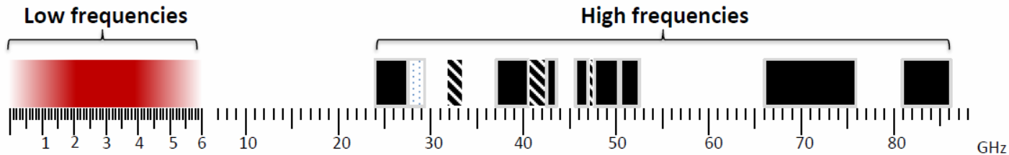
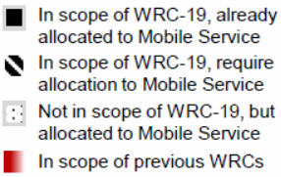
IMT spectrum requirements and WRC-19

Slide 25
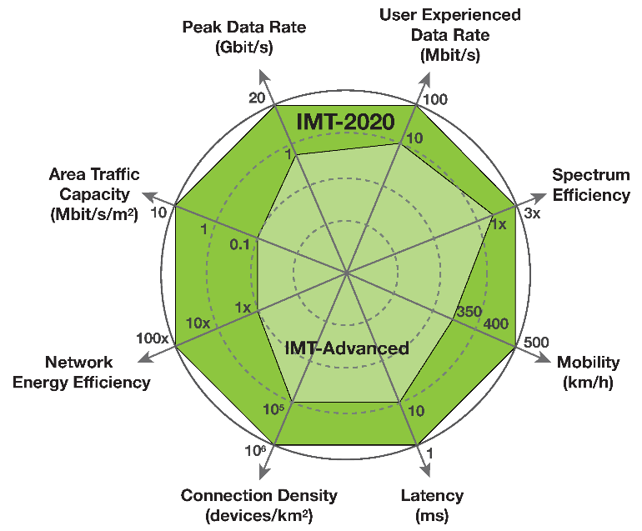
BB applications in MS
(WRC-19 Agenda item 1.13 and 1.16)
The following bands, which are already allocated to mobile, will be studied with a view to an IMT-2020 identification:
  24.25 – 27.5 GHz
  37 – 40.5 GHz
  42.5 – 43.5 GHz
  45.5 – 47 GHz
  47.2 – 50.2 GHz
  50.4 – 52.6 GHz
  66 – 76 GHz
  81 – 86 GHz
The following bands will also be studied, although they do not currently have global mobile allocations: Res. 238 (WRC-15)
  31.8 – 33.4 GHz
  40.5 – 42.5 GHz
  47 - 47.2 GHz

Slide 26
Overlapping Bands in WRC-19 Agenda Items
1.6 – NGSO FSS Res. 159 (WRC-15) | 1.13 – IMT Res. 238 (WRC-15) | 1.14 – HAPS Res. 160 (WRC-15) | 9.1 (9.1.9) – FSS Res. 162 (WRC-15)
 | 24.25 - 27.5 | 24.25 - 27.5 (Reg. 2)
37.5 - 39.5 (s-E*) | 37 - 40.5 | 38 ‑ 39.5 (globally)
39.5 - 42.5 (s-E*) | 40.5 - 42.5
47.2 - 50.2 (E-s*) | 47.2 - 50.2
50.4 - 51.4 (E-s*) | 50.4 - 52.6 |  | 51.4 - 52.4 (E-s*)
E-s: Earth-to-space; s-E: space-to-Earth. All bands in GHz
Studies to address mutual compatibility & sharing feasibility among the services/applications for which allocation/identification is envisaged
under the corresponding Res. relating to the AI in the overlapping bands

Slide 27
Future Spectrum need estimation for IMT (24.25 GHz - 86 GHz)
 | Examples | Associated conditions for different examples (For details, please see the corresponding sections in the Annex A) | Spectrum needs in total (GHz) | Spectrum needs (GHz) per range
Application-based approach ITU-R M.1651 | 1 | Overcrowded, Dense urban and Urban areas | 18.7 | 3.3 (24.25-33.4 GHz range) 6.1 (37-52.6 GHz range) 9.3 (66-86 GHz range)
 |  | Dense urban and Urban areas | 11.4 | 2.0 (24.25-33.4 GHz range) 3.7 (37-52.6 GHz range) 5.7 (66-86 GHz range)
 | 2 | Highly crowded area | 3.7 | 0.67 (24.25-33.4 GHz range) 1.2 (37-52.6 GHz range) 1.9 (66-86 GHz range)
 |  | Crowded area | 1.8 | 0.33 (24.25-33.4 GHz range) 0.61 (37-52.6 GHz range) 0.93 (66-86 GHz range)
Source: Chairman’s report TG 5/1 Annex 2: Working document towards Draft CPM text for WRC-19 AGenda Item 1.13

Slide 28
Future Spectrum need estimation for IMT (24.25 GHz - 86 GHz)
 | Examples | Associated conditions for different examples (For details, please see the corresponding sections in the Annex A) | Spectrum needs in total (GHz) | Spectrum needs (GHz) per range
Technical performance-based approach (Type 1) Calculated on single technical performance requirement, i.e. user experienced data rate. | 1 | User experienced data rate of 1 Gbit/s with N simultaneously served users/devices at the cell‑edge, e.g., Indoor | 3.33 (N=1), 6.67 (N=2), 13.33 (N=4) | Not available
 |  | User experienced data rate of 100 Mbits/s with N simultaneously served users/devices at the cell-edge, for wide area coverage | 0.67 (N=1), 1.32 (N=2), 2.64 (N=4) | Not available
 | 2 | eMBB Dense Urban | 0.83-4.17 | Not available
 |  | eMBB Indoor Hotspot | 3-15 | Not available
 | 3 | With a file transfer of 10 Mbits by a single user at cell-edge in 1 msec | 33.33 GHz (one direction) | Not available
 |  | With a file transfer of 1 Mbit by a single user at cell-edge in 1 msec | 3.33 GHz (one direction)
 |  | With a file transfer of 0.1 Mbits by a single user at cell-edge in 1 msec | 333 MHz (one direction)
Source: Chairman’s report TG 5/1 Annex 2: Working document towards Draft CPM text for WRC-19 Agenda Item 1.13

Slide 29
Future Spectrum need estimation for IMT (24.25 GHz - 86 GHz)
 | Examples | Associated conditions for different examples (For details, please see the corresponding sections in the Annex A) | Spectrum needs in total (GHz) | Spectrum needs (GHz) per range
Technical performance-based approach (Type 2) Calculated taking into account different technical performance requirements, i.e. user experienced data rate, peak data rate and area traffic capacity | – | Dense urban micro | 14.8-19.7 | 5.8-7.7 (24.25-43.5 GHz range)
 |  | Indoor hotspot |  | 9-12 (24.25-43.5GHz and 45.5‑86 GHz range)
Information from some countries based on their national considerations | – | – | 7-16 | 2-6 (24.25-43.5 GHz range) 5-10 (43.5-86 GHz range)
Source: Chairman’s report TG 5/1 Annex 2: Working document towards Draft CPM text for WRC-19 Agenda Item 1.13
Note: The spectrum needs estimates of the different approaches and examples should be considered separately.

Slide 30
Future Spectrum need estimation for IMT (24.25 GHz - 86 GHz)
Deployment scenarios | Indoor hotspot | Dense urban |  | Urban macro
 |  | Micro | Macro
Frequency range | 24.25-86 GHz | 24.25-43.5 GHz | <6 GHz | <6 GHz
Deployment scenario | Micro | Indoor hotspot
Total spectrum needs for 24.25-86 GHz | 14.8-19.7 GHz*
Spectrum needs for 24.25-43.5 GHz | 5.8-7.7 GHz | 9-12 GHz
Spectrum needs for 45.5-86 GHz | –**
* Considering the coexistence between multiple network operators (e.g. the guard band(s) may be required in the case of multiple network operators scenarios), the total spectrum needs are expected to be increased. ** The division in this table regarding frequency ranges and deployment scenarios is just an indicative example on how spectrum needs could be distributed for different spectrum sub-ranges within 24.25-86 GHz and different deployment scenarios. This table should not be understood nor used to exclude any possible IMT-2020 deployment options in the range 45.5-86 GHz.
Source: WP 5D Liaison statement to Task Group 5/1

Slide 31

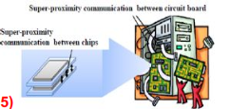
LMS and FS systems and applications
(WRC-19 Agenda item 1.14 and 1.15)
Res. 160 (WRC-15) Studies for considering appropriate regulatory actions for HAPS, within existing FS allocation i.e
  at 47.2-47.5, 47.9-48.2 & 31.0-31.3**/27.9-28.2GHz (outside Reg. 2, +5 ADMs @6.5/6.5MHz)
  or study new bands: 38-39.5 GHz & 21.4-22 &24.25-27.5 GHz
Res. 767 (WRC-15) Studies towards an identification for use by Administrations for LMS and FS applications operating in the frequency range 275-450 GHz

Slide 32

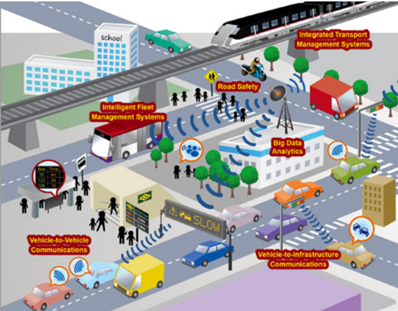
New transport Systems in MS
(WRC-19 Agenda item 1.11 and 1.12)
Res. 236 (WRC-15) Studies to facilitate global or regional harmonized bands to support railways RF systems between train & trackside within existing MS allocations
Res. 237 (WRC-15) Global or regionally harmonized bands, to the maximum extent possible, for implementation of evolving ITS within existing MS allocations

Slide 33
Agenda for WRC-19 (Agenda item 10 of WRC-15)
Res. 958 (WRC-15): URGENT STUDIES to be reported under WRC-19 agenda item 9.1 :
  (9.1.6) Wireless Power Transmission (WPT) for electric vehicles
    Study suitable harmonized bands to minimize impact on RF services
  (9.1.7) Managing unauthorized operations of Earth Station terminals
    study need for possible additional measures and possible methods that will assist administrations
  (9.1.8) Narrowband & BB machine-type communication infrastructures
    study related technical and operational aspects of radio networks and systems (incl. spectrum needs & possible harmonized use of spectrum)

Slide 34
Other studies in WRC-15 Res. to be reported in WRC-19
OTHER STUDIES to be reported under WRC-19 agenda item 9.1 :
  (9.1.1) Res. 212 – Terrestrial and Satellite components (Rev.WRC-15) of IMT, co- existence & compatibility @ 1 885-2025 & 2110-2200 MHz
  (9.1.2) Res. 761 – IMT and BSS sound @ 1452-1492 MHz (WRC-15) in R1&3
  (9.1.3) Res. 157 – N-GSO Sat. in “C-Band” allocated to (WRC-15) the FSS
  (9.1.4) Res. 763 – Stations on board sub-orbital vehicles (WRC-15)
  (9.1.5) Res. 764 – Incorporation by reference of (WRC-15) Rec. ITU-R M.1638-1 & ITU-R M.1849-1
  (9.1.9) Res. 162 – FSS needs @ 51.4-52.4 GHz(WRC-15)

Slide 35
WRC-19 agenda items & Resp. Groups
1.1
Amateur @ 50-54 MHz
Responsible
ITU-R Groups
Railway in MS
1.11
1.2
WP 5A
ITS in MS
1.12
MSS/MetSat/EESS ES @ 400MHz
1.3
MetSat/EESS @ 460-470MHz
WP 7B
1.13
1.4
BSS Plans/Lists & FSS
App. 30 Annex 7 limitations
WP 4A
24.25 GHz < IMT < 86 GHz
1.14
HAPS
1.5
FSS ESIM
WP 5B
1.15
TT&C for NGSO of Short duration
N-GSO QV-FSS
1.6
TG 5/1**
1.16
WAS/
RLAN
** see 2nd next slide
MS/FS Apps Id. @ 275-450 GHz
Sat. RR
procedures
1.7
GMDSS, incl. Sat.
WP 5C
7*
Maritime radio devises
1.8
***
WP 1A
9.1.5
VDES Sat. comp.
WP 4C***
1.9.1
*** WP 4C is also in charge of developing studies and draft CPM text on resolves to invite ITU-R 2 of Res. 359 (Rev.WRC-15) (AI 1.8) and sending that to WP 5B
9.1.1*
1.9.2
9.1.2*
GADSS
WP 5D
9.1 Issues
BR Dir.’s Report (9)
9.1.3
9.1.9
1.10
WP 1B
9.1.4
2, 4, 10
CPM19-2
9.1.8
* Relevant
part
8
Art. 5 (country)
footnotes
WRC-19
3, 5, 6, 9
9.1.6
9.1.7

