Slide 1
The Authority of Radio Frequency Management
COUNTRY REPORT
OF VIETNAM

Slide 2
CONTENTS
Vietnam at a glance
Radio licences
National RF management
Monitoring infrastructure
Bilateral agreements

Slide 3
VIETNAM AT A GLANCE
Socialist public of VietNam
Location: Center of southeast Asia
With a S shape
Capital: HaNoi City
Area: 331.698 Km²
Population: 92 million
Neighbours: China, Laos, Cambodia

Slide 4
RADIO FREQUENCY LICENSES AND TELECOMMINUCATION STATISTICS
29560 licenses (2017)
Telecommunications:
02 geosynchronous satellite, 01 Earth observation satellite
05 mobile phone service providers, 130 million mobile phone subscribers
Radio and television broadcasting: 67 main TV broadcasters
Analog TV broadcasting → digital TV broadcasting (2020)
Navigation: radiocommunication devices in 1880 seagoing ships and 10873 fishing boats (2000 lisences)
Aviation : 22 airports with instrument landing systems, 200 radio navigation systems

Slide 5
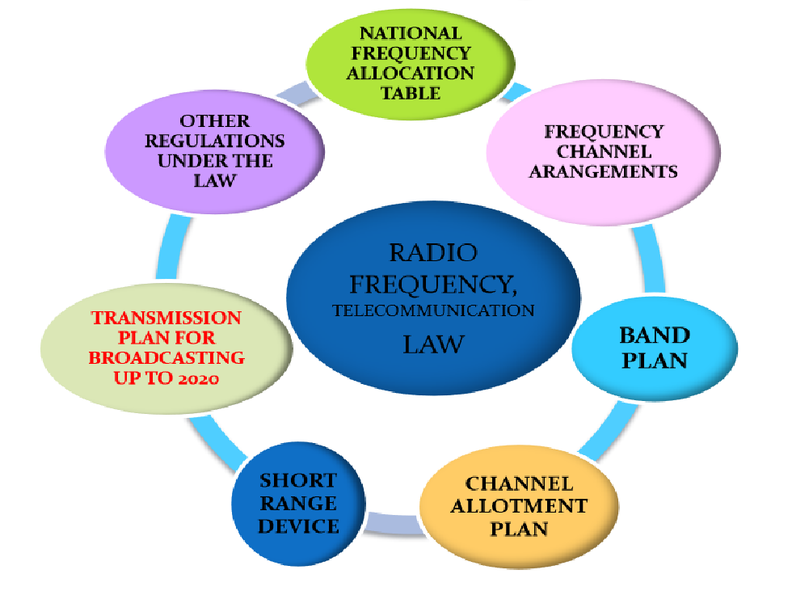
RADIO FREQUENCY LAW

Slide 6
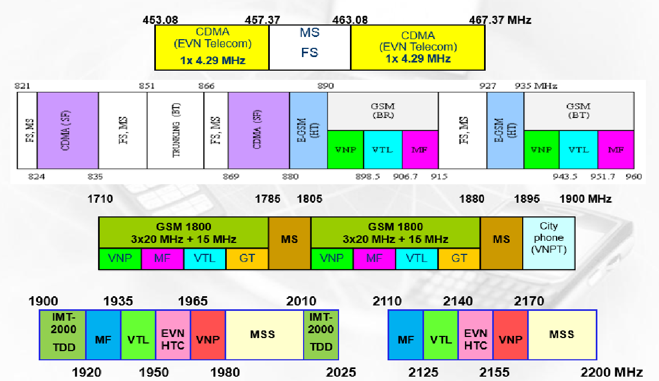
SPECTRUM PLANNING AND ASSIGNMENTS
SPECTRUM PLANNING AND ASSIGNMENTS

Slide 7
SPECTRUM PLANNING AND ASSIGNMENTS
Private Mobile Radio: 136-174 MHz; 400-470MHz
Analog TV Broadcasting: 174-230 MHz; 470-806MHz
Digital TV Broadcasting (finished in 2020):
Radio Broadcasting: 87-108MHz
Navigation:
Aviation: 108-136MHz
Satellite: C and Ku band.

Slide 8
Re-assignment for mobile broadband
Planned 2.3GHz – 2.6 GHz for Mobile Broadband
After 2020 (TV digitalization) will plan 698MHz- 806MHz for IMT.
Rearrangement GSM band.

Slide 9
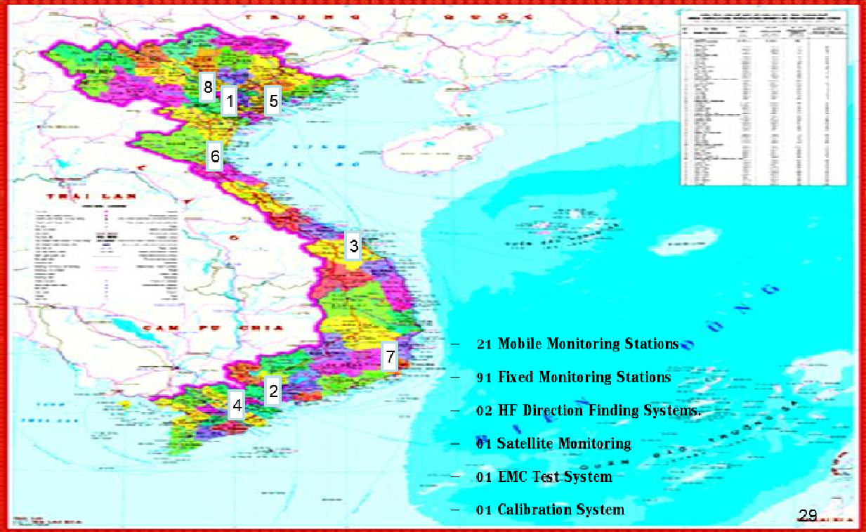
MONITORING INFRASTRUCTURE

Slide 10
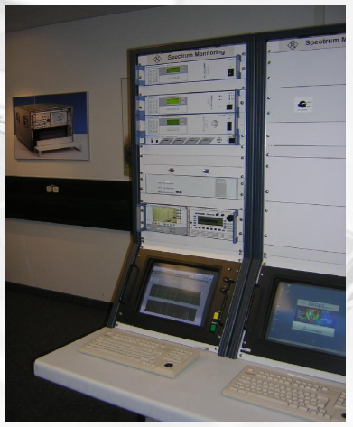
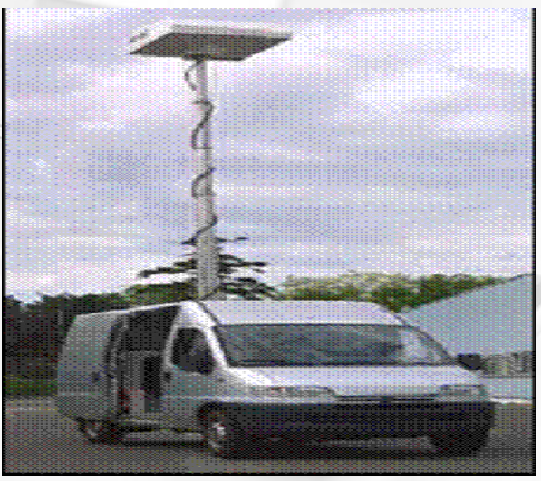
MONITORING STATIONS
91 Fixed monitoring stations
21 Mobile monitoring stations
Manufactures: R&S, TCI, Greentek, Thales
Frequency range: 9Khz – 3GHz.

Slide 11
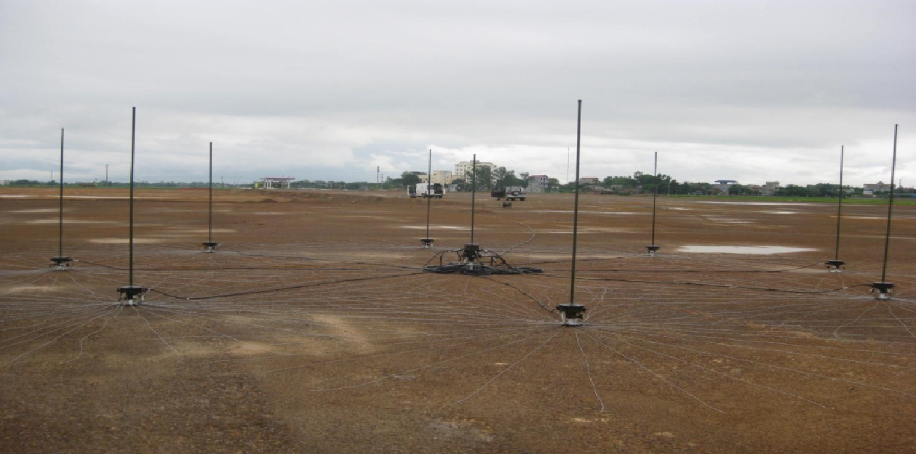
HF MONITORING AND DF STATIONS
02 Semi-fixed HF Direction-finding
Frequency range: 1MHz – 30MHz

Slide 12
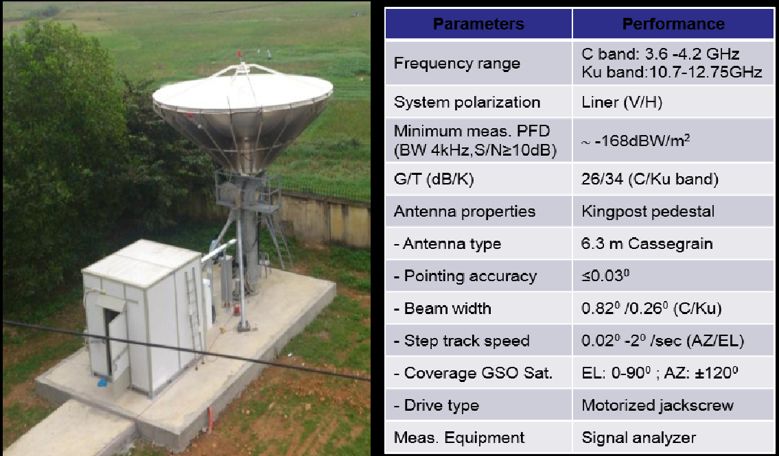
SPACE MONITORING STATION

Slide 13
BILATERAL AGREEMENTS
Cross border interference mitigation agreements with China in Mobile radio frequency band: GSM900, GSM1800, 3G
The electric field strength of GSM channel in 0km, 5km, 10km from border for:
- Common channel
- Private channel

Slide 14
THANK YOU

