Slide 1
ITU ASP COE TRAINING
MONITORINING RF SPECTRUM IN MODERN WIRELESS ARE
16th – 20th APRIL 2018
KUN MING, P.R. CHINA
RF Spectrum Management
in Cambodia
Touch Kimhuy
Mobile: +855-12-400040
E-mail: kimhuy.t@gmail.com
Ministry of Post and Telecommunications (MPTC)

Slide 2
Contents
1. RF Spectrum Management
2. RF Spectrum Assignment
3. RF Spectrum Monitoring

Slide 3
1. RF Spectrum Management
Law on
Telecommunications
Responsibilities of
MPTC
Functions and
Duties of TRC
Royal Kram NS/RKM/1215/017
Signed on 17 Dec 2015
Article 5
Article 47 and 48
Sub degree No.45 R.N.Kr - B.K
signed on 16 Mar 2016.
- Article 12 of law on telecommunications
TRC has autonomy to perform its administrative, regulatory and financials duties and functions
Is independently from telecommunications operators and persons involved with the telecommunication sector.
TRC has self-budget by considering as annex of MPTC budget.

Slide 4
Function and Duty of MPTC and TRC
Ministry of Posts and
Telecommunications (MPTC)
Telecommunication Regulator of Cambodia
(TRC)
Determining the National Telecom and
ICT Policy
Telecommunication Regulation
International Cooperation on
Telecommunication & ICT, as State Member
Monitoring the Market and Dispute
Resolution
Telecom Numbering and IP Address
Frequency Assignment & Radio Monitoring
Authorization (Licensing & Approval)
Domain Name System Registration and Internet Café Registration

Slide 5
2. RF Spectrum Assignment
Frequency Harmonization and Re-farming bands in Cambodia
450
460
460
470
450 MHz
IMT
825
835
870
880
850 MHz
LTE
880
915
925
960
900 MHz
GSM
60%
UMTS
40%
2G
3G
4G
1710
1785
1805
1880
1800 MHz
GSM
27%
LTE
73%
1800 MHz
1920
1980
2110
2170
2100 MHz
UMTS
58%
LTE
42%
2500
2570
2620
2690
2600 MHz
LTE
100%
TDD
40 MHz

Slide 6
2. RF Spectrum Assignment Cambodia Band Plan on 700MHz
APT 700MHz No. APT/AWF-09/REP-14, September 2010 Almost 10
Years from WRC identification
703
803
Long term DTV plan
700 MHz
470
694
According to Council Minister No. 1165 SCD.PH dated 09 October 2015, we are planning to re-farm
700MHz from TV Broadcasting to Mobile Broadband Service.
Since 2016, It would be no new license for broadcasting stations in range 694 – 806 MHz
Update the information on re-farming the range 694 – 806 MHz
Cambodia will fully switch off analogue broadcasting by 2020 – 2023.

Slide 7
2. RF Spectrum Assignment Number of RF Licenses in 2017
1 | Broadcasting | 373
2 | Fixed Station | 53
3 | Microwave link | 2115
4 | Private network | 1208
 | TOTAL | 3749

Slide 8
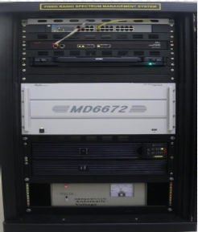
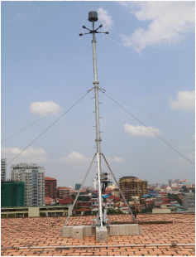
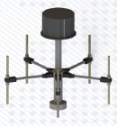
3. RF Spectrum Monitoring Equipment for Monitoring RF Spectrum
First Fixed Radio Monitoring Station
Low- Band: 20MHz ~ 700MHz
Middle-Band: 700MHz ~ 3GHz
High-Band: 3GHz ~ 6GHz
Model: MDFS-6A
RF Receiver: MD6672
Freq. Range: 20MHz-6GHz
Tuning Resolution: 1Hz
Freq. Scan: Up to 1500Ch./sec
DF Antenna: ADDF-6G3B (Low, Middle, High Band)
Antenna Height: 6.85m
From Ground Level: 34.85m

Slide 9
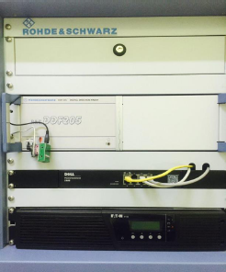
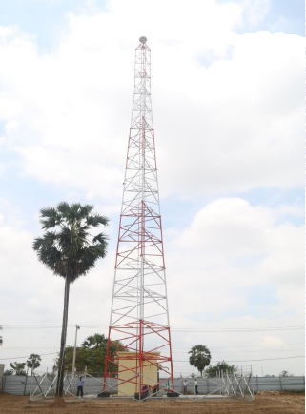
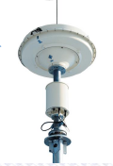
3. RF Spectrum Monitoring Equipment for Monitoring RF Spectrum
Second Fixed Radio Monitoring Station
Manufacturer : Rohde & Schwarz
Receiver Model : R&S DDF205
Frequency Range : 20MHz – 3GHz
Country of Product1 : Germany
Antenna Height: 45cm
Function: Monitoring and Direction Finding

Slide 10
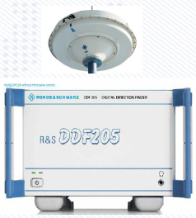
3. RF Spectrum Monitoring Equipment for Monitoring RF Spectrum
Mobile Radio Monitoring Stations
Manufacturer : Rohde & Schwarz
Receiver Model : R&S DDF205
Frequency Range : 20MHz – 3GHz
Country of Product : Germany
GPS on the top of the car
Function: Monitoring and Direction Finding

Slide 11
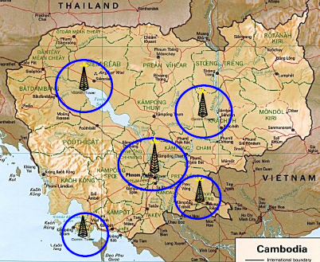
3. RF Spectrum Monitoring RF Spectrum Monitoring System (Planning)
A- Central Monitoring Center
Phnom Penh
B- Regional Monitoring Center
Kampong Som
Kratie
Svay Rieng
Siem Reap
C- Mobile Direction Finder : (2 Vehicles)
Specification
-VHF/UHF frequency Range: 20MHz-6GHz
-System Hardware/software

Slide 12
Thanks
Q & A

