Slide 1
Laos country report Cross Border Interference Management By Somphone SYHALATH Director of Radio Spectrum Management Division 2/5/2017 Bangkok, Thailand.
1

Slide 2
Contents
Country Profile
Regulator polices
Bilateral
Conclusion
2

Slide 3
Country profile
Capital Vientiane
Area 236 800 sq km
Population 6.5 million
Urban population 30 %
3

Slide 4




Regulator polices
Lao Telecom Co. Ltd (LTC):
2. Enterprise of Telecommunications Lao (ETL)
3. Star Telecom
4. Millicom Lao Co.Ltd (MLL)
4

Slide 5
Regulator polices
Telecommunication Law,
Frequency decree,
Decision on National Frequency Allocation Table (NFAT)
Minister’s IMT band decisions : 450 MHz, 700 MHz, 900 MHz,
1800 MHz, 2100 MHz, 2300 MHz, 2600 MHz
5

Slide 6
Cross Border Frequencies
Frequency interference (Wide band and Narrow band),
Mistake Broadcast channel for 2G
Mistake Primary scramming code (PSC) for 3G
Signal Strength Threshold
6

Slide 7
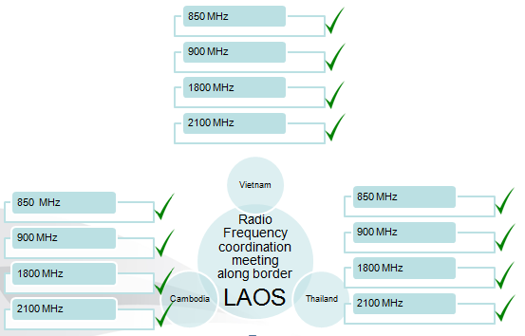
Bilateral
7

Slide 8
Bilateral
Laos - Vietnam
Bilateral
2. Laos - Cambodia
Bilateral
Laos - Thailand
Bilateral
Joint Technical committee (JTC)
Ad-hoc committee
8

Slide 9
Conclusion
Difference technologies,
Very closed border line,
Bilateral agreed minutes not implement
9

Slide 10

10

