Slide 1
Cross Border Interference Management Current Issues of Cross Border Interference in Cambodia
1

Slide 2
Content
Overview of Cambodia
Turning Point 2015/12/17
Frequency Coordination/Monitoring/Management
Bands/Services Needing for Coordination
Conclusion
2

Slide 3
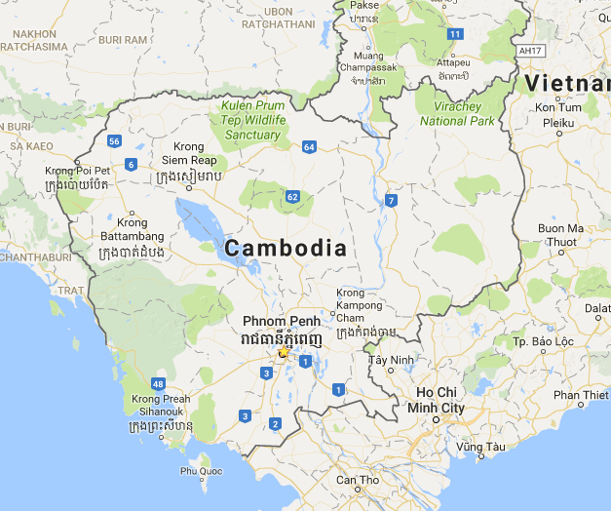
1. Overview of Cambodia
Location: Southeast Asia
Capital: Phnom Penh
Currency: Cambodian riel (៛)
Official script: Khmer
Official language: Khmer (96.3%)
Nationality: Cambodian
Population: 15,957,223 (January 2017)
Religions: Buddhist (96.9%), Muslim (1.9%), Christian (0.4%)
Ethnic groups: Khmer (97.6%), Cham (1.2%), Chinese (0.1%), Vietnamese (0.1%)
3

Slide 4
1. Overview of Cambodia
Geographic Coordinates: 13 00 N, 105 00 E
Climate: Tropical (Rainy and Dry season)
Terrain: Mostly low, flat plains, mountains in southwest and north
Elevation: Mean 126m, Highest 1,810m
Area: 181,035 km² (Land 97.5%, Water 2.5%)
Borders: Gulf of Thailand, Thailand, Laos, Vietnam
Coastline: 443 km
Land boundaries: 2,572 km (Thailand 803 km, Laos 541 km, Vietnam 1,228 km)
4

Slide 5
1. Overview of Cambodia
GDP per capita: 1128 USD
Fixed phones (PSN+WLL): 256,378*
Mobile phones: 20,850,543*
Fixed Internet Subscriptions: 83,504*
Mobile Internet Subscriptions: 6,712,404*
ISP Licenses: 31**
Fixed & WLL Licenses: 8**
Mobile Licenses: 6
* TRC 2015, ** TRC 2016
5

Slide 6
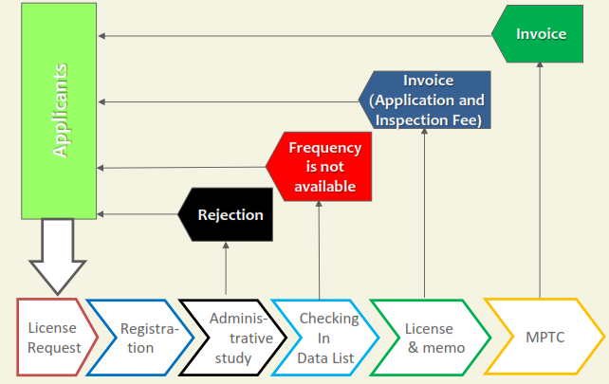
2. Turning Point 2015/12/17
Before:
National Radio Frequency Management is under Telecom Regulator of Cambodia (TRC).
Operational issues of planning and licensing of national Radio resource is undertaken by TRC.
National Spectrum Licensing is by First-come, First-served (FCFS).
After:
National Radio Frequency Management is under Ministry of Posts and Telecommunications (MPTC).
TRC can issue relevant spectrum regulations for dispute resolution but it has to remain within the policy determined by MPTC.
National Spectrum Licensing is by Auction.
National Spectrum Licensing workflow (FCFS)
6

Slide 7
3. Frequency Coordination/Monitoring/Management
Responsibility after Telecom Law:
TRC: Technical Assistance to MPTC
MPTC: Spectrum Managing Agency
Coordination:
Cambodia does not have any formal coordination agreement and/or framework with our neighboring countries.
But we have 3 annual and separate Joint Technical Committees (JTCs) with our 3 neighbor.
Discussion are conducted under different sub-working groups and is usually done on cases of interference in broadcasting and land mobile service.
Agenda of JTCs is decided between countries and there is no limit of scope of bands involved.
Current JTCs of Cambodia with our neighbors for Cross border RF interference Mitigation
7

Slide 8
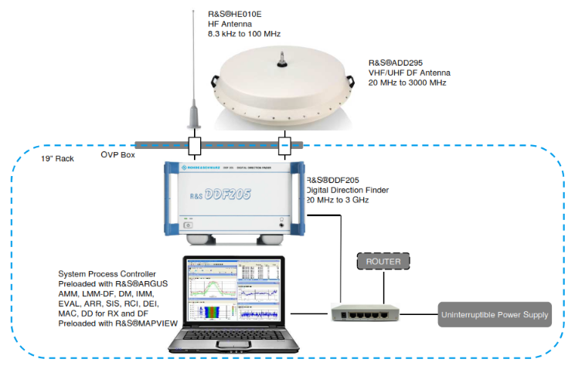
3. Frequency Coordination/Monitoring/Management
Data Exchange: Case to Case basis
No specific data format
Exchange in the form of CD, DVD, Email…
Monitoring: very limited
Fixed station (20MHz-3GHz): 1 in Phnom Penh
Mobile station (20MHz-3GHz) with directional finder: 2
Portable (9kHz-7.5GHz): 2
Spectrum Analyzer (9kHz-20GHz): 1
Management: SMS4DC from ITU.
Licensing: Local made for local language
Technical Planning: use Terrain maps and ITU recommendation P.1546 as propagation model.
8

Slide 9
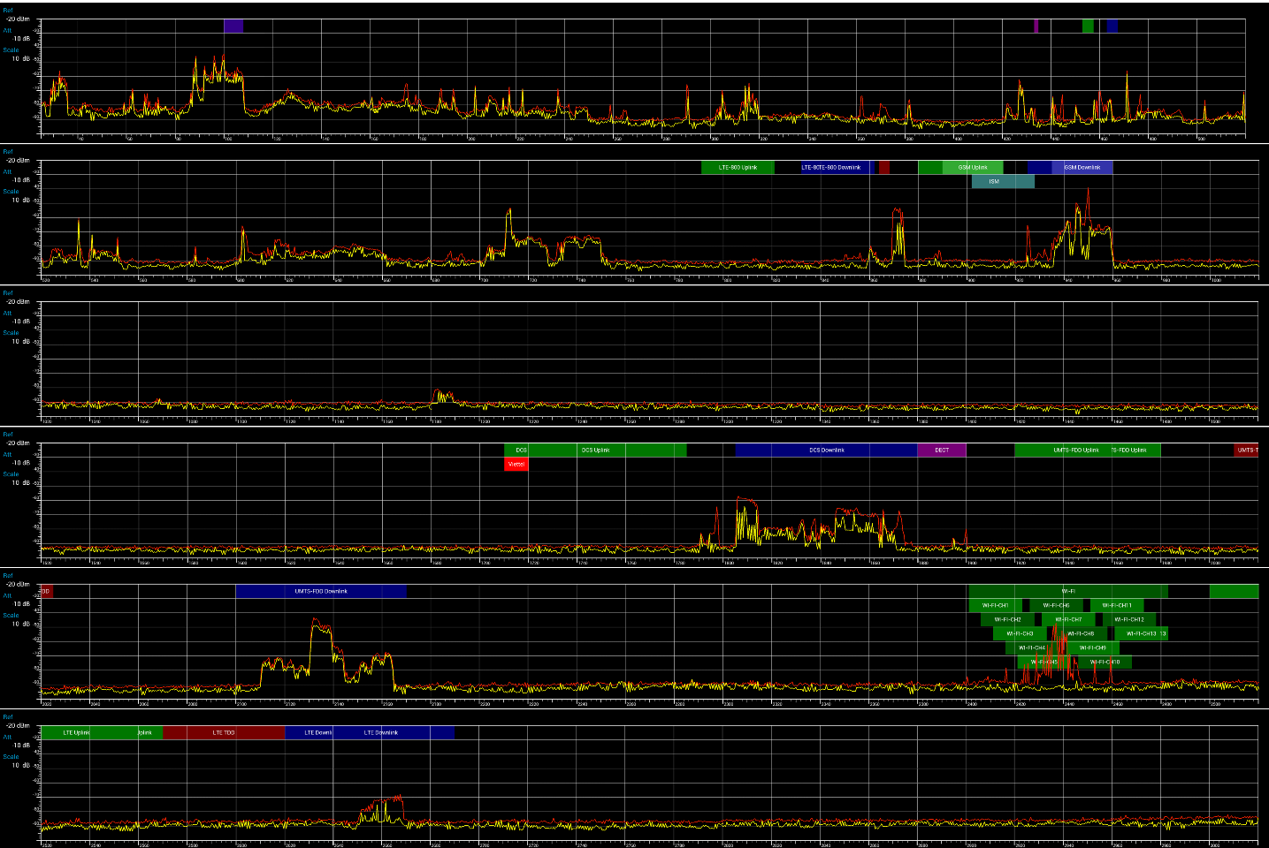
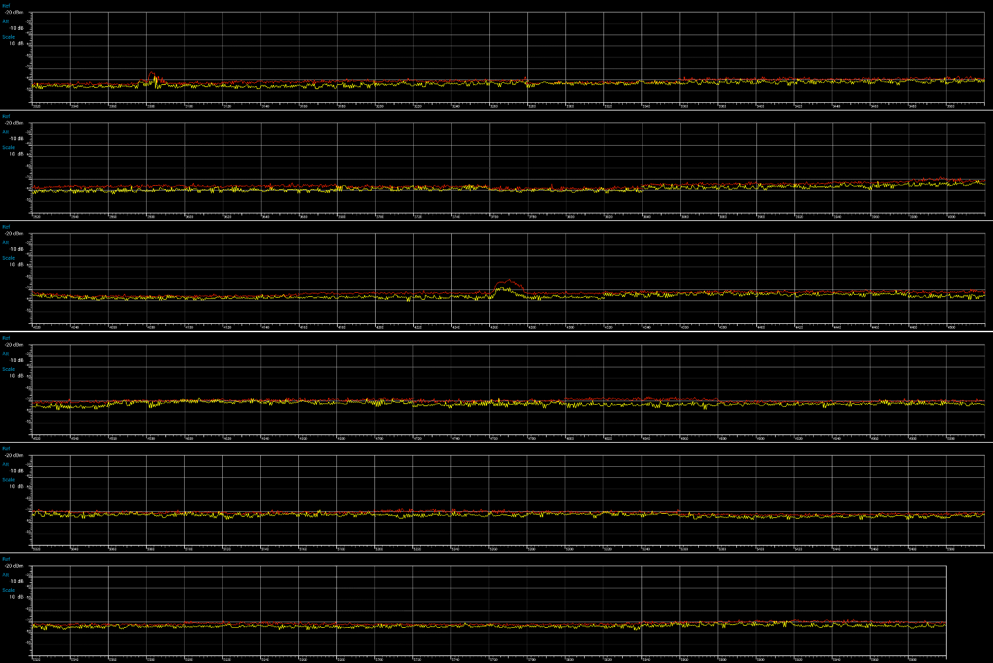
3. Frequency Coordination/Monitoring/Management
Spectrum Frequency from 25MHz to 3020MHz
Spectrum Frequency from 3.02GHz to 6GHz
9

Slide 10
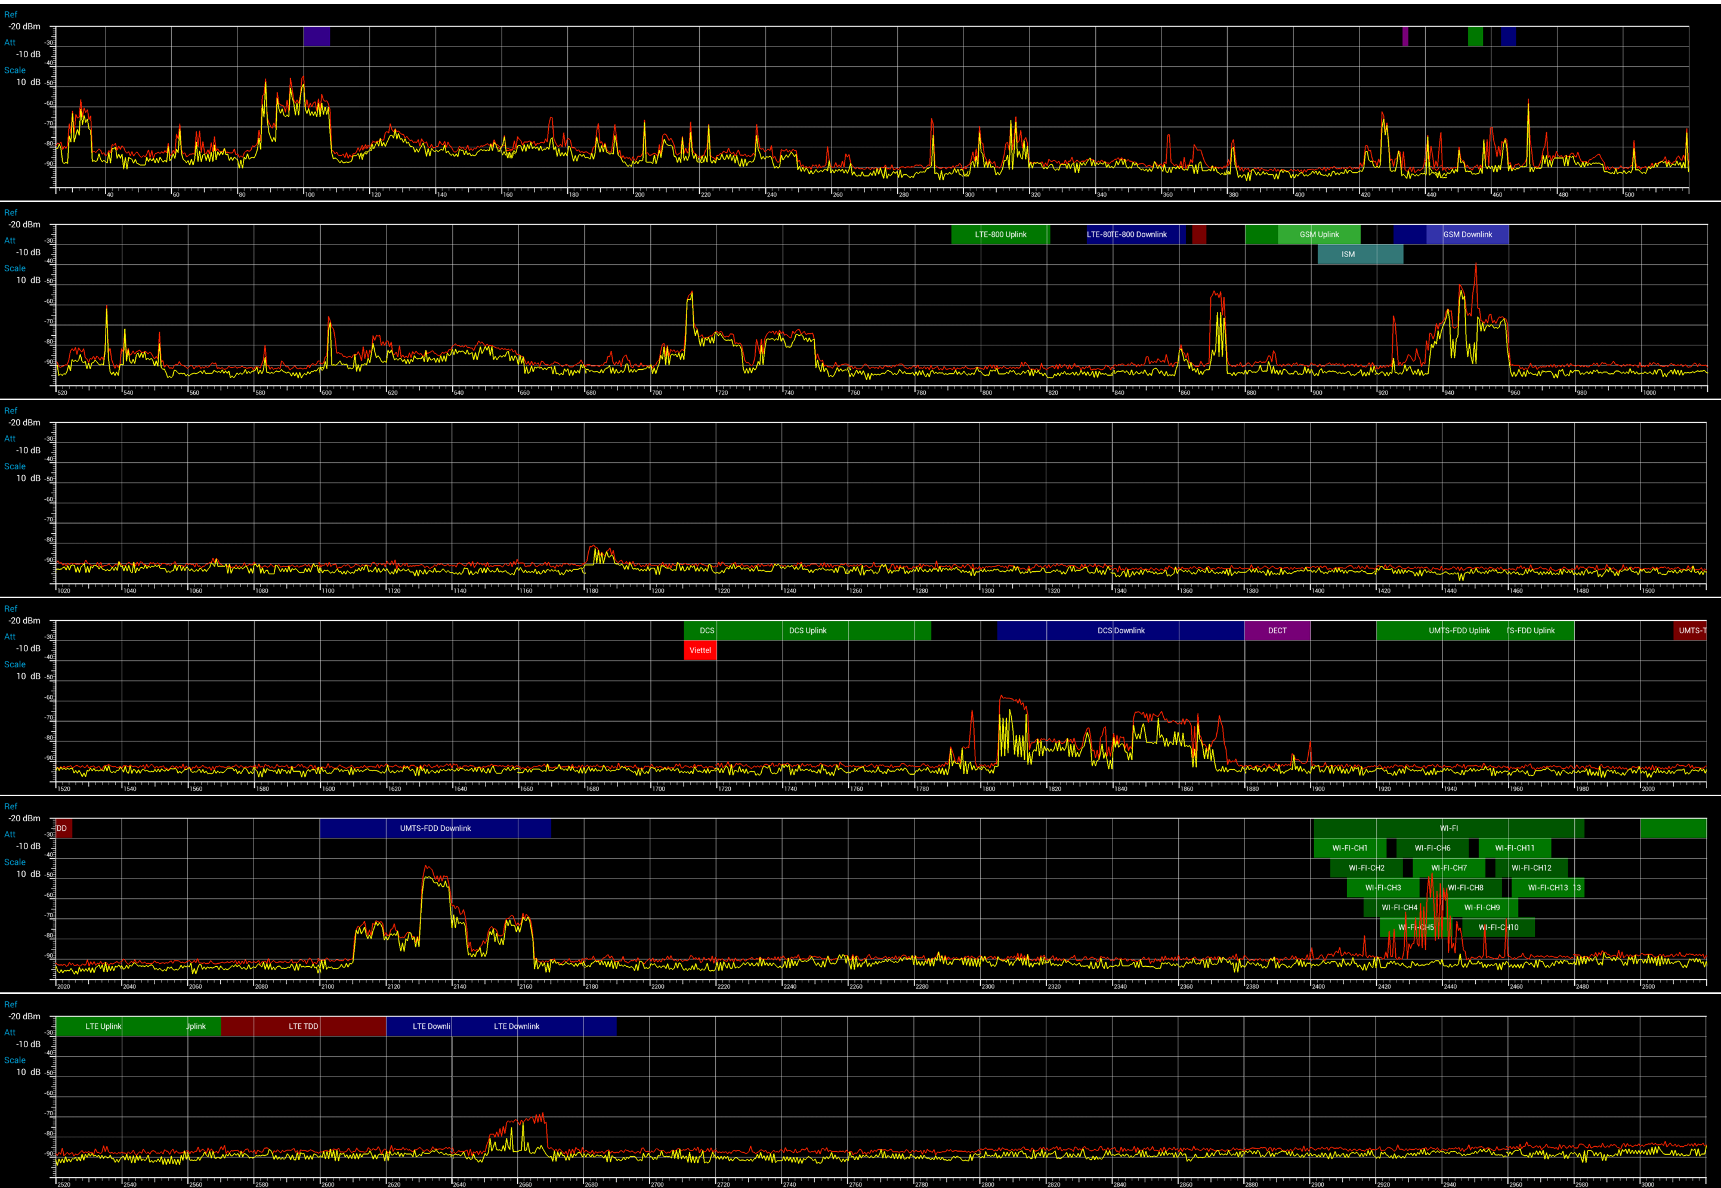
3. Frequency Coordination/Monitoring/Management
VHF TV
FM
VHF TV
UHF TV
UHF TV
U 850
D 850
U 900
D 900
Spectrum Frequency from 25MHz to 1520MHz
10

Slide 11
3. Frequency Coordination/Monitoring/Management
U 1800
D 1800
U 2100
D 2100
U 2600
U 2600
D 2600
Spectrum Frequency from 1520MHz to 3020MHz
11

Slide 12
4. Bands/Services Needing for Coordination
Thailand and Vietnam:
VHF BS Sound Band
UHF TV Band
MS [703-748] MHz, MS [758-803] MHz
MS [790-960] MHz (Band 850, 900E)
MS [1710-1785] MHz (Band 1800)
MS [1885-2025] MHz (Band 2100)
MS [2300-2400] MHz
MS [401-470] MHz (Band 450)
Laos
MS [790-960] MHz (Band 900E)
MS [1710-1785] MHz (Band 1800)
Color Code of Interference Level:
High Low
12

Slide 13
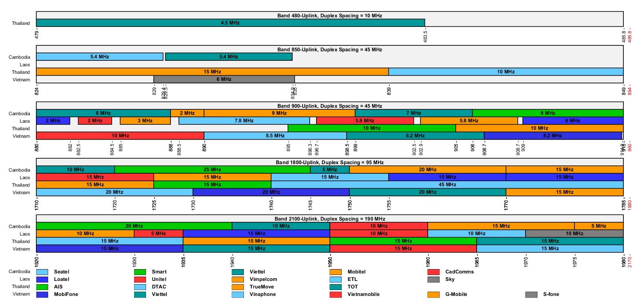
13

Slide 14
5. Conclusion
To mitigate the cross border RF interference
Adopt the same Technology for the same Standard Band of the Region (Easy to share Arfcn, PSC, PCI)
Respect ITU Power Limit along the border for each frequency band (Reduce Interference)
Share information (Prevent interference and Speed up solution) by:
Organize regular JTC meeting with our neighbor
Create a clear procedure/format for frequency coordination
Inform each others about the Frequency Registration submitted by concerning Administrations…
14

Slide 15
Thank You
15

