Slide 1
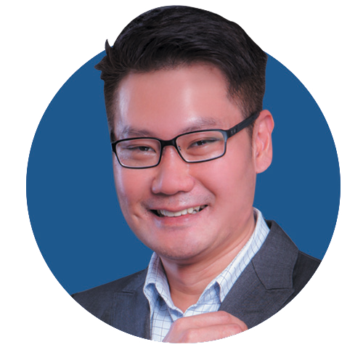
Speaker
Lim Chee Siong
Chief Marketing Officer Strategy & Marketing Dept Huawei Southern Pacific Region
With more than 18 years’ experience in the Telecom industry, he possesses broad experience in the Next Generation Telecommunications technology, business strategy, solutions development, Sales and Marketing; and he is dedicated in supporting the regional customers to identify and develop the right future telecom & ICT transformation solutions, to build a Better Connected World.
Chee Siong Lim

