Slide 1
Lessons of leadership through ICT Development Index in ASP
Dr. Bohyun SEO
Managing Director
Korea Information Society Development Institute (KISDI)

Slide 2
Table of Contents
ITU IDI
Recent Development in the Information Society
2015 IDI at Global Level
2015 IDI for Asia-Pacific Region (ASP)
Top performer and dynamic country in ASP
Findings & Implication

Slide 3
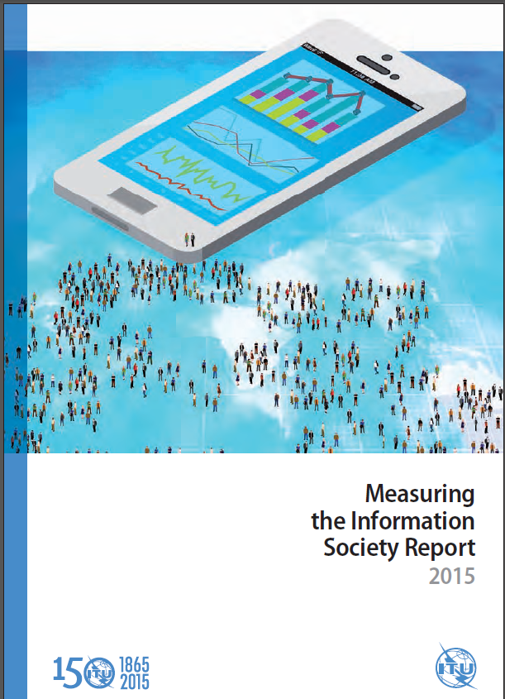
1. ITU IDI
The ICT Development Index (IDI) is a composite index that combines 11 indicators into one benchmark measure that can be used to monitor and compare developments in ICT between countries and over time
The IDI was developed by ITU in 2008 in response to requests from ITU Member States to develop an overall ICT index
It was first presented in the 2009 edition of the Measuring the Information Society Report (ITU, 2009), and has been published annually

Slide 4
2. Recent Development in the Information Society
<Global changes in major ICTs, 2000-2015*>
The growth in mobile-cellular (voice and SMS) and mobile-broadband subscriptions has been particularly rapid, with the deployment of mobile networks in developing countries and adoption by users of mobile devices in preference to those requiring fixed networks
The proportion of the global population covered by mobile-cellular networks is now over 95 per cent (ITU, 2015a), while the number of mobile-cellular subscriptions has quintupled since WSIS
The growth in fixed-broadband subscriptions has been more sluggish than that of mobile broadband, with the number of fixed-telephone subscriptions worldwide having fallen over the past decade owing partly to fixed-mobile substitution

Slide 5
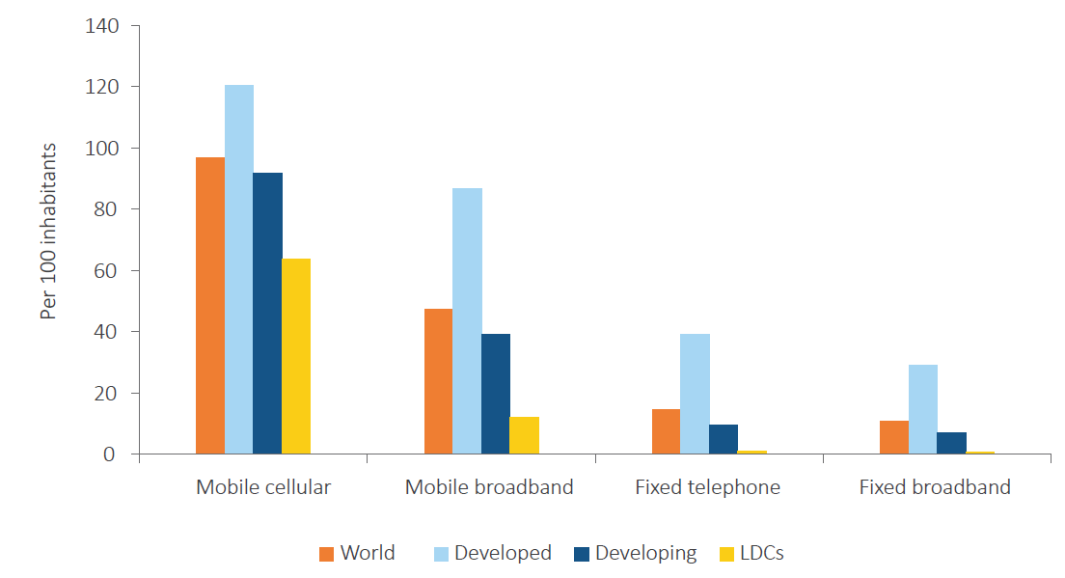
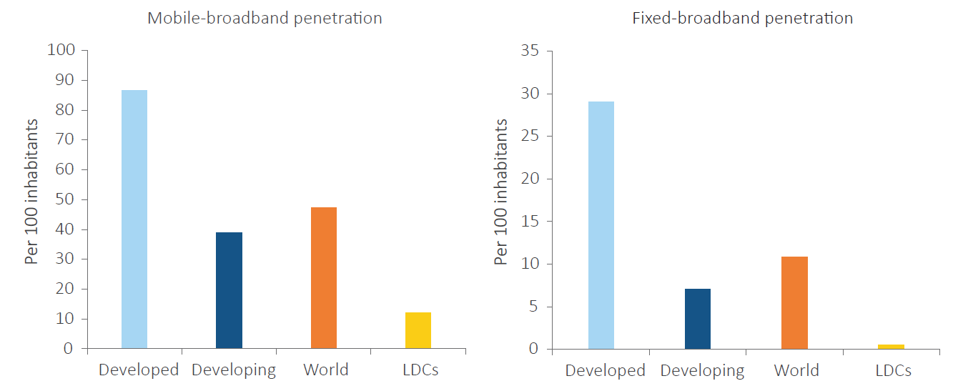
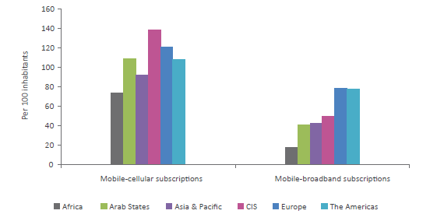
2. Recent Development in the Information Society
But, there are still substantial digital divides between different development categories, and different regions
<ICT access by development status, 2015>
<Mobile-broadband and fixed-broadband penetration, 2015>
<ICT access by regions, 2015>

Slide 6
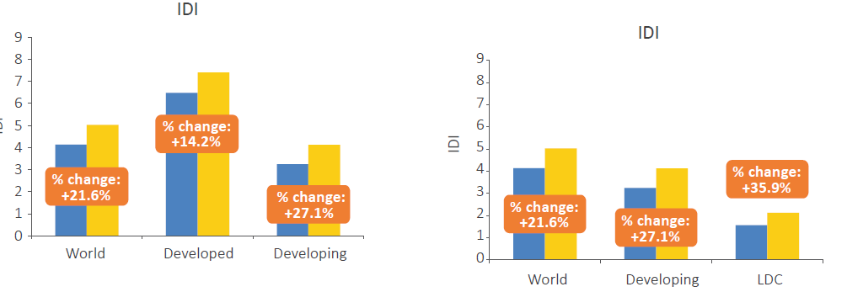
3. 2015 IDI at Global level
<IDI ratings for LDCs compared with global ratings and
with all developing countries, 2010 & 2015 >
<IDI ratings by development status, 2010 & 2015>

Slide 7
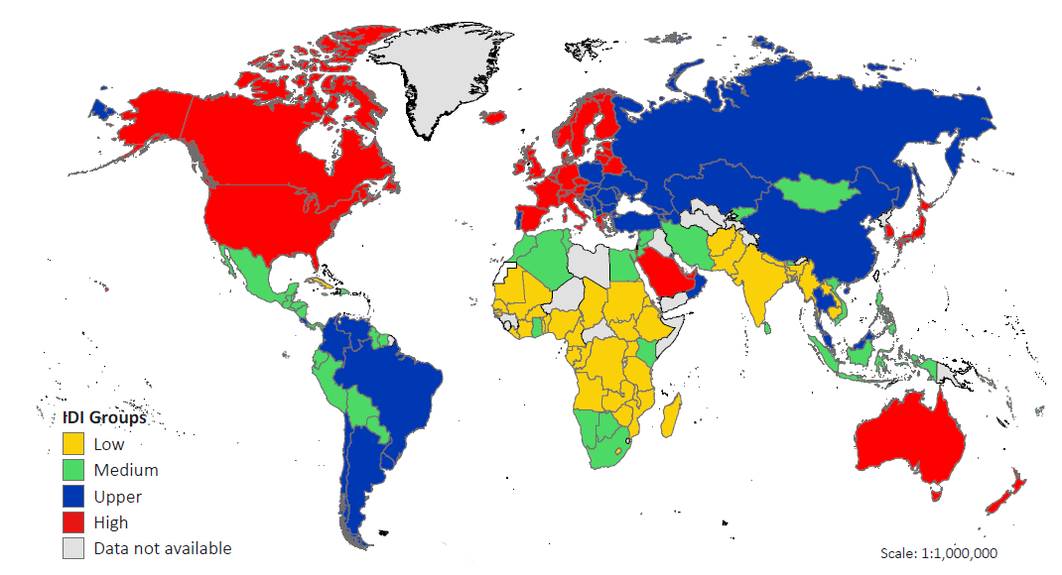
3. 2015 IDI at Global level
<Quartiles by IDI value, 2015>
Average IDI for 2015: 5.03 (total 167 countries)
The high quartile is heavily concentrated in Europe, N America and high-income countries in the Pacific rim
The majority of LCCs, by contrast, are in Africa
ASP is the most diverse region in terms of ICT development, reflecting stark differences in levels of economic development

Slide 8
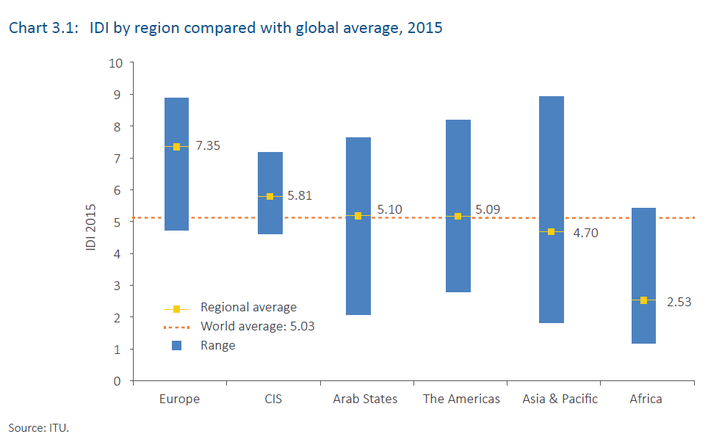
3. 2015 IDI for ASP
2015 IDI for ASP ranks 5th out of 6 regions of ITU
2015 Regional Average IDI for ASP is 4.70 (world average, 5.03)
<IDI by Region, 2015 and 2010>
<IDI by Region compared with global average, 2015>

Slide 9
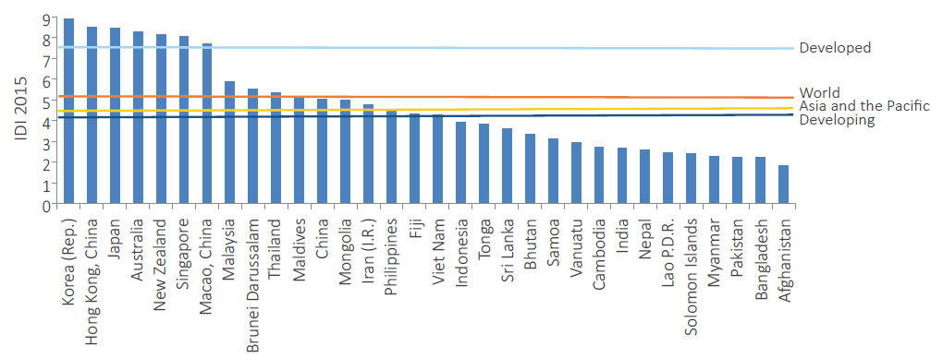
4. 2015 IDI for ASP
<IDI values, ASP 2015>

Slide 10
4. 2015 IDI for ASP
ASP is the most diverse region in terms of ICT development, reflecting stark differences in levels of economic development
The average growth in value for ASP was 0.85 points, just below the global average 0.89
7 economies in ASP have IDI rankings in the top 25 worldwide. The average nominal growth in IDI rates is 0.70 points far less
The most dynamic improvements in IDI rankings were achieved by Thailand, Mongolia, Bhutan & Philippines, which rose by 18, 13, 9 & 7 places, respectively
Middle-income 8 countries in ASP, have shown considerable improvements in their IDI values (1.25) between 2010 and 2015

Slide 11
5. The most dynamic & Top performer in ASP (TH)
Thailand, the most dynamic country in ASP
Thailand’s IDI ranking improved by 18 places, rising from 92nd to 74th position, while its IDI value rose from 3.62 to 5.36
The country has made good progress in both use and access sub-indices, but stands out in particular for its achievements in mobile broadband
At the end of 2014, Thailand’s Government formally announced its adoption of a digital economy policy framework. This includes the proposed establishment of a national broadband committee and specific targets for connecting businesses and homes, including a broadband network to every village and home over the next two to three years. It highlights the importance of expanding the country’s infrastructure network, based on the roll-out of both mobile and fixed broadband, and on public-private partnerships

Slide 12
5. The most dynamic & Top performer in ASP (TH)
Thailand
It was relatively late in awarding 3G mobile-broadband licences, doing so in December 2012 to three competing carriers. High demand for services put pressure on wireless-broadband providers to offer competitive prices, especially after the introduction of mobile-number portability in 2011 … (Market competition)
At the end of 2014, Thailand’s Government formally announced its adoption of a digital economy policy framework. This includes the proposed establishment of a national broadband committee and specific targets for connecting businesses and homes, including a broadband network to every village and home over the next two to three years. It highlights the importance of expanding the country’s infrastructure network, based on the roll-out of both mobile and fixed broadband, and on public-private partnerships. (Policy & regulatory)

Slide 13
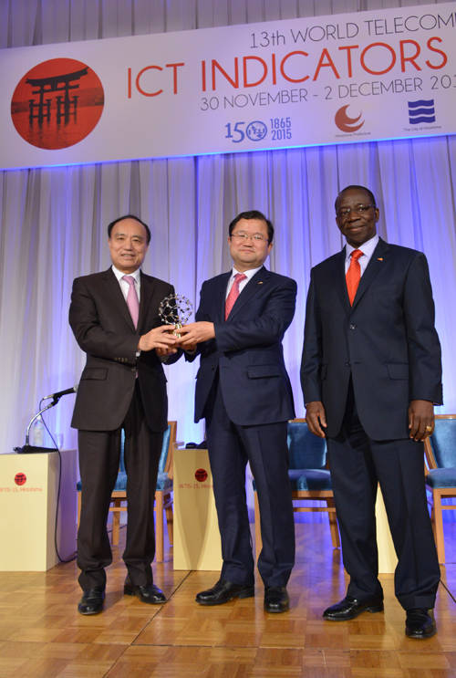
5. The most dynamic & Top performer in ASP (KR)
Korea (Rep of)
Korea has consistently held top positions in the IDI rankings, owing to its early adoption of advanced ICTs. And it has the highest percentage worldwide of households with Internet access(98.49%)
It has long had a strong government leadership and innovative ICT industry which has contributed to building an enduring ICT ecosystem
Other factors include high levels of education, government’s support for ICT projects, and the “ICT culture”, meaning that citizens display a high degree of ICT awareness and an eagerness to adopt new technologies
Korea launched LTE in 2010 and in 2014, 77 % of the country’s total mobile-telecommunication traffic went through LTE and LTE Advanced networks

Slide 14
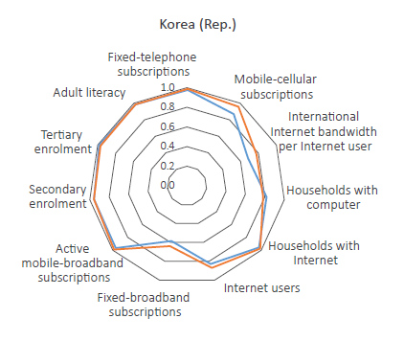
5. Top performers and dynamic countries in Asia-Pacific Region (KR)
Index | Rank
ICT Access | 9
1. Fixed telephone subscription per 100 inhabitants | 4
2. Mobile-cellular telephone subscription per 100 inhabitants | 71
3. International Internet bandwith per internet user | 71
4. Percentage of households with a computer | 37
5. Percentage of households with internet access | 1
ICT Use | 4
6. Percentage of individuals using the internet | 15
7. Fixed-broadband subscriptions per 100 inhabitants | 6
8. Active mobile-broadband subscriptions per 100 inhabitants | 13
ICT Skills | 2
9. Adult literacy rate | 54
10. Secondary gross enrolment ratio | 2
11. Tertiary gross enrolment ratio | 22
Total | 1

Slide 15
6. Findings & Lessons (IDI Report)
Each individual economy faces different challenges, related to its geography, infrastructure requirements and social and economic structure, and to the financial resources and capabilities available to its people.
While issues of national context are crucial to policy development, it is also possible for governments and ICT businesses to draw on the experience of other countries when developing their plans for the deployment and take-up of telecommunications, broadband and Internet.
The experience of countries which have achieved higher rates of progress against the IDI is valuable within this context. Assessments illustrate the importance, in facilitating access to and use of ICTs, of building strategic approaches to ICT deployment and implementation, integrating the implementation of infrastructure, ensuring that communications devices and services are affordable, and building the skills base that is required to maximize the effective use of ICTs.
Understanding how and why individual countries have achieved more dynamic rates of growth within the IDI can help others as they seek to design and adopt their own strategies in pursuit of dynamic growth in ICTs
Useful findings from the most dynamic and top performer in the region (TH & KR)

