Slide 1
Regional Initiatives Beyond 2017, World Telecommunication Development Conference and the linkage to the Sustainable Development Goals (SDGs)
Dr. Bohyun SEO
Vice Chair of TDAG
Managing Director, KISDI

Slide 2
Table of Contents
MDGs and SDGs
SDGs and ICT
WSIS ALs for SDGs
RIs for SDGs

Slide 3
1. MDGs & SDGs/MDGs
- The Millennium Development Goals (MDGs) were the eight international development goals for the year 2015 that had been established following the Millennium Summit of the United Nations in 2000, following the adoption of the United Nations Millennium Declaration. All 189 United Nations member states at the time (there are 193 currently), and at least 23 international organizations, committed to help achieve the following Millennium Development Goals by 2015:
1) To eradicate extreme poverty and hunger
2) To achieve universal primary education
3) To promote gender equality and empower women
4) To reduce child mortality
5) To improve maternal health
6) To combat HIV/AIDS, malaria, and other diseases
7) To ensure environmental sustainability
8) To develop a global partnership for development

Slide 4
1. MDGs & SDGs/SDGs
- At the United Nations Sustainable Development Summit on 25/09/15, world leaders adopted the 2030 Agenda for Sustainable Development, which includes a set of 17 Sustainable Development Goals (SDGs) to end poverty, fight inequality and injustice, and tackle climate change by 2030.
Sustainable Development Goals(SDGs)
Goal 1 | End poverty in all its forms everywhere | Goal 10 | Reduce inequality within and among countries
Goal 2 | End hunger, achieve food security and improved nutrition and promote sustainable agriculture | Goal 11 | Make cities and human settlements inclusive, safe, resilient and sustainable
Goal 3 | Ensure healthy lives and promote well-being for all at all ages | Goal 12 | Ensure sustainable consumption and production patterns
Goal 4 | Ensure inclusive and equitable quality education and promote lifelong learning opportunities for all | Goal 13 | Take urgent action to combat climate change and its impacts
Goal 5 | Achieve gender equality and empower all women and girls | Goal 14 | Conserve and sustainably use the oceans, seas and marine resources for sustainable development
Goal 6 | Ensure availability and sustainable management of water and sanitation for all (6.a, 6.b) | Goal 15 | Protect, restore and promote sustainable use of terrestrial ecosystems, sustainably manage forests, combat desertification, and halt and reverse land degradation and halt biodiversity loss
Goal 7 | Ensure access to affordable, reliable, sustainable and modern energy for all | Goal 16 | Promote peaceful and inclusive societies for sustainable development, provide access to justice for all and build effective, accountable and inclusive institutions at all levels
Goal 8 | Promote sustained, inclusive and sustainable economic growth, full and productive employment and decent work for all | Goal 17 | Strengthen the means of implementation and revitalize the global partnership for sustainable development
Goal 9 | Build resilient infrastructure, promote inclusive and sustainable industrialization and foster innovation

Slide 5
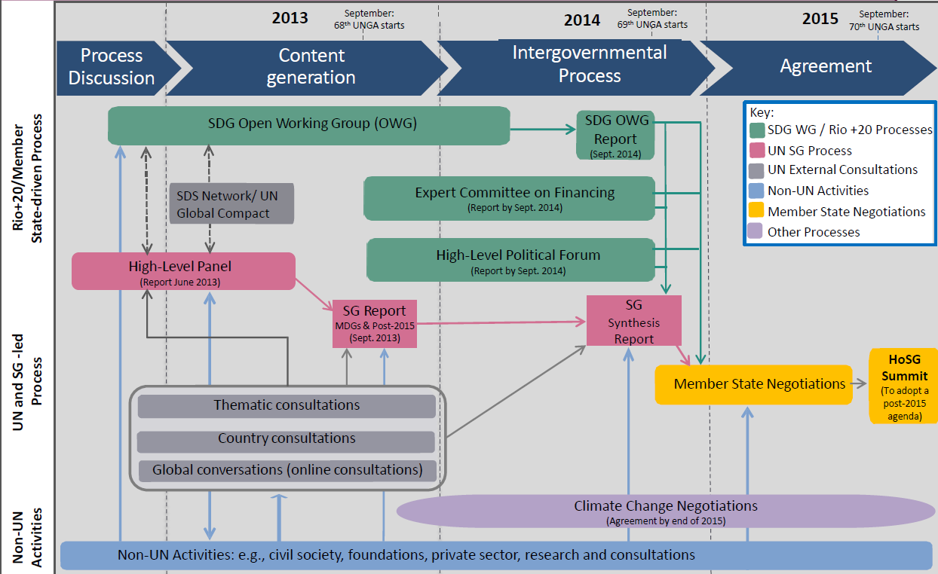
1. MDGs & SDGs/SDGs Consensus process

Slide 6
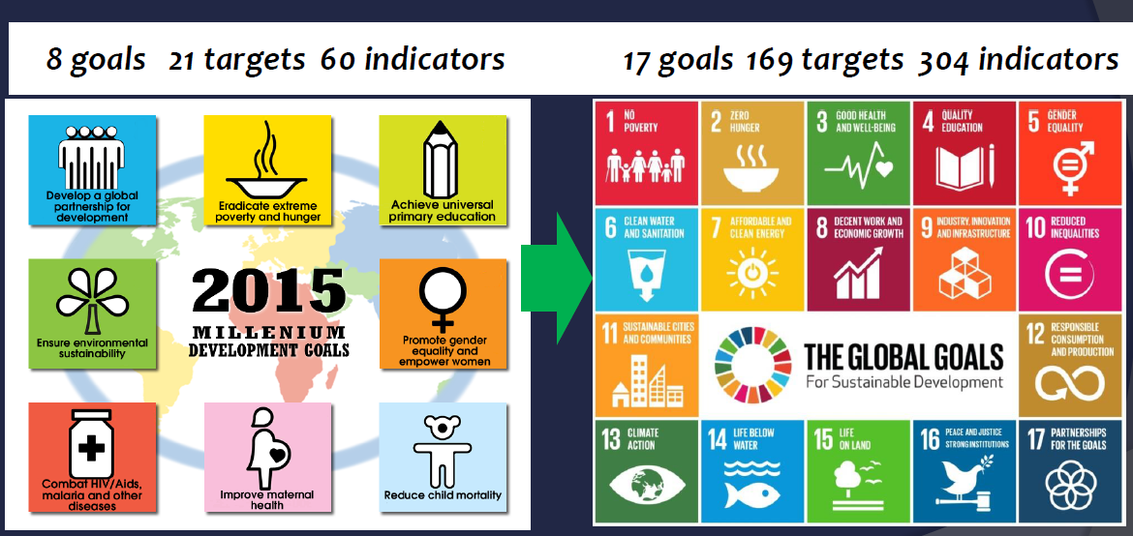
1. MDGs & SDGs/Comparison

Slide 7
1. MDGs & SDGs/Comparison
MDG | SDG
Traditional assistance | Traditional assistance + Universal goals
Limited goals | More comprehensive
Top-down process | Inclusive goal setting
Traditional statistics | Traditional + Data revolution
Hunger and poverty together | Distinction
Quantity Education | Quality Education
Funding: Focus on ODA | Broader set of financial sources

Slide 8
2. SDGs and ICT/ SDGs targets related to ICTs
While none of the SDGs is specifically about ICTs, several targets make references to ICTs and technology
1.4) By 2030, ensure that all men and women, in particular the poor and the vulnerable, have equal rights to economic resources, as well as access to basic services, ownership and control over land and other forms of property, inheritance, natural resources, appropriate new technology and financial services, including microfinance
4.3) By 2030, ensure equal access for all women and men to affordable and quality technical, vocational and tertiary education, including university
4.4) By 2030, substantially increase the number of youth and adults who have relevant skills, including technical and vocational skills, for employment, decent jobs and entrepreneurship
4.b) By 2020, substantially expand globally the number of scholarships available to developing countries, in particular least developed countries, small island developing States and African countries, for enrolment in higher education, including vocational training and information and communications technology, technical, engineering and scientific programmes, in developed countries and other developing countries
5.b) Enhance the use of enabling technology, in particular information and communications technology, to promote the empowerment of women
9.1) Develop quality, reliable, sustainable and resilient infrastructure, including regional and transborder infrastructure, to support economic development and human well-being, with a focus on affordable and equitable access for all

Slide 9
2. SDGs and ICT/ SDGs targets related to ICTs
9.5) Enhance scientific research, upgrade the technological capabilities of industrial sectors in all countries, in particular developing countries, including, by 2030, encouraging innovation and substantially increasing the number of research and development workers per 1 million people and public and private research and development spending
9.c) Significantly increase access to information and communications technology and strive to provide universal and affordable access to the Internet in least developed countries by 2020
16.10) Ensure public access to information and protect fundamental freedoms, in accordance with national legislation and international agreements
17.6) Enhance North-South, South-South and triangular regional and international cooperation on and access to science, technology and innovation and enhance knowledge sharing on mutually agreed terms, including through improved coordination among existing mechanisms, in particular at the United Nations level, and through a global technology facilitation mechanism
17.7) Promote the development, transfer, dissemination and diffusion of environmentally sound technologies to developing countries on favourable terms, including on concessional and preferential terms, as mutually agreed
17.8) Fully operationalize the technology bank and science, technology and innovation capacity-building mechanism for least developed countries by 2017 and enhance the use of enabling technology, in particular information and communications technology
17.16) Enhance the global partnership for sustainable development, complemented by multi-stakeholder partnerships that mobilize and share knowledge, expertise, technology and financial resources, to support the achievement of the sustainable development goals in all countries, in particular developing countries
17.17) Encourage and promote effective public, public-private and civil society partnerships, building on the experience and resourcing strategies of partnerships

Slide 10
2. SDGs and ICT/ SDG indicators related to ICTs
ITU has made a concerted effort to highlight the role that ICTs will play in achieving the SDGs. It is actively participating in the discussions on the indicators that will be used to track the SDGs
The February 2016 version of the IAEG-SDGs(Inter-agency and Expert Group on SDGs) report includes the following 7 ICT indicators covering 6 targets under Goals 4, 5, 9, and 17. (The organization indicated in brackets tracks the indicator at the international level).
<Proposed SDG indicators related to ICTs>
Target 4a: Proportion of schools with access to the Internet for pedagogical purposes (UIS)
Target 4a: Proportion of schools with access to computers for pedagogical purposes (UIS)
Target 4.4: Proportion of youth/adults with ICT skills, by type of skills (ITU)
Target 5b: Proportion of individuals who own a mobile telephone, by sex (ITU)
Target 9c: Percentage of the population covered by a mobile network, broken down by technology (ITU)
Target 17.6: Fixed Internet broadband subscriptions, broken down by speed (ITU)
Target 17.8: Proportion of individuals using the Internet (ITU)

Slide 11
3. WSIS ALs for SDGs
WSIS Action Lines | Facilitator
С1. The role of public governance authorities and all stakeholders in the promotion of ICTs for development | ECOSOC/UN Regional Commissions/ITU
С2. Information and communication infrastructure | ITU
C3. Access to information and knowledge | ITU/UNESCO
C4. Capacity building | UNDP/UNESCO/ITU/UNCTAD
C5. Building confidence and security in the use of ICTs | ITU
C6. Enabling environment | ITU/UNDP/UN Regional Commissions/ UNCTAD
C7. ICT Applications E-government E-business E-learning E-health E-employment E-environment E-agriculture E-science | UNDP/ITU WTO/UNCTAD/ITU/UPU UNESCO/ITU/UNIDO WHO/ITU ILO/ITU WHO/WMO/UNEP/UN-Habitat ITU/ICAO FAO/ITU UNESCO/ITU/UNCTAD
C8. Cultural diversity and identity, linguistic diversity and local content | UNESCO
C9. Media | UNESCO
C10. Ethical dimensions of the Information Society | UNESCO/ECOSOC
C11. International and regional cooperation | UN Regional Commissions/UNDP/ITU/UNESCO/ECOSOC

Slide 12
3. WSIS ALs for SDGs: Matrix
 | C1 | C2 | C3 | C4 | C5 | C6 | e-gov | e-bus | e-lea | e-hea | e-emp | e-env | e-agr | e-sci | C8 | C9 | C10 | C11
SDG 1
SDG 2
SDG 3
SDG 4
SDG 5
SDG 6
SDG 7
SDG 8
SDG 9
SDG 10
SDG 11
SDG 12
SDG 13
SDG 14
SDG 15
SDG 16
SDG 17
Notes:
WSIS-SDG Matrix developed by UN WSIS Action line Facilitators is playing a key role to serve as the mechanism to map, analyze and coordinate the use of ICTs as enablers and catalysts for the implementation of the SDGs

Slide 13
4. RIs for SDGs
Regional Initiatives
- Intended to address specific telecommunication/ICT priority areas, through partnership and resource mobilization
Africa /Americas/ Arab States / Asia-Pacific / CIS /Europe
< Asia-Pacific Regional Initiatives>
2010-2014 | 2015-2018
1. Unique ICT needs of least developed countries(LDCs), small island developing States(SIDS) and landlocked developing countries(LLDCs) 2. Emergency telecommunications 3. Digital broadcasting 4. Broadband access and uptake in urban and rural areas 5. Telecommunication/ICT policy and regulation in ASP region | 1. Special consideration for least developed countries, small island developing states, including Pacific island countries, and landlocked developing countries 2. Emergency telecommunications 3. Harnessing the benefits of new technologies 4. Development of broadband access and adoption of broadband 5. Policy and regulation | ?

Slide 14
4. RIs for SDGs
2015-2018 ASP-RI | SDG (Goal) | SDG (Target)
1. Special Consideration for LDCs, SIIDS, LLDCs | Goal 3, Goal 4, Goal 7, Goal 9, Goal10, Goal 13, Goal17 | 3.c, 4.b, 4.c, 7.b, 9.a, 10.b, 13.b, 17.5, 17.18
2. Emergency telecommunications | Goal 11, Goal 13 | 11.5, 11b, 13.1, 13.3
3. Harnessing the benefits of new technologies | Goal 1, Goal 5, Goal 9 | 1.4, 5.b. 9.5
4. Development of Broadband access and adoption of broadband | Goal 9 | 9.1, 9.c
5. Policy and regulation | Goal 1, Goal 16, Goal 17 | 1.b, 16.b, 17.6, 17.3, 17.14. 17.15, 17.16, 17.17
 | SDG1 | SDG2 | SDG3 | SDG4 | SDG5 | SDG6 | SDG7 | SDG8 | SDG9 | SDG10 | SDG11 | SDG12 | SDG13 | SDG14 | SDG15 | SDG16 | SDG17
RI 1
RI 2
RI 3
RI 4
RI 5

Slide 15
RIs-ASP beyond 2017
4. RIs for SDGs

