Slide 1


Slide 2

ICTs FOR SMART SUSTAINABLE
ASIA PACIFIC
ITU Asia & the Pacific
Regional Development Forum
Sofitel Philippine Plaza
Manila, Philippines.
06-07 June 2016
Ioane Koroivuki
Regional Director
ITU Regional Office for Asia & the Pacific
Bangkok, Thailand

Slide 3
ICTs FOR SMART SUSTAINABLE
ASIA PACIFIC
Session 2: Innovative Approaches on Partnerships and Resource Mobilization to Meet the Objectives of the Asia-Pacific Regional Initiatives
Recalling the Objectives of the
Asia-Pacific Regional Initiatives
Ioane Koroivuki
Regional Director
ITU Regional Office for Asia & the Pacific
Bangkok, Thailand
ITU ASP RDF 2016
Sofitel Philippine Plaza
Manila, Philippines
06-07 June 2016

Slide 4
Agenda
The ITU 2020 Agenda
Situational Analysis
Mid Term Review
Recalling the Objectives
Action Plan Transitions
New Initiatives
Partnering for a Sustainable Future
Conclusions
Measuring Up

Slide 5
ITU CONNECT 2020 VISION
GROWTH
Enable and foster access to and increased use of telecommunications/ICTs
55% households access to the Internet
60% individuals using the Internet
40% Telecoms/ICTs be 40% more affordable
(i) 50% of households access to the Internet in the developing world; 15% in LDCs (ii) 50% of individuals using the Internet in developing world; 20% in LDCs (iii) 40% affordability gap be reduced by 40% between developed and developing countries (iv)
SUSTAINABILITY
Manage challenges resulting from the telecommunication/ ICT development
40% improvement in cybersecurity readiness
50% reduction in volume of redundant e-waste
30% decrease GHG emissions per device generated by the telecom/ICT sector
INNOVATION & PARTNERSHIP
Lead, improve and adapt to the changing telecommunication/ICT environment
Telecommunication/ICT environment conducive to innovation
Effective partnerships of stakeholders in telecommunication/ICT environment
Resolution on Connect 2020 Agenda
Approved by the ITU Plenipotentiary Conference (PP-14):
Includes measurable targets – ICT indicators
Notes:
At the end of 2014, ITU membership adopted the Connect 2020 Agenda, which sets a number of ambitious goals and targets. These include: increasing the number of households with Internet access; increasing the affordability of ICTs (and reducing the affordability gap between developed and developing countries); increasing the percentage of people in rural areas covered by broadband services; and improving cybersecurity readiness.
In adopting the Connect 2020 agenda, governments highlighted the role of ICTs in social, economic and environmentally sustainable development, and recognized the need for collaborative efforts for the achievement of these goals.
The Connect 2020 Agenda’s seventeen targets have been designed to assist the international community in monitoring and measuring progress towards ICT access for all, covering the areas of ICT growth, inclusiveness, sustainability and innovation and partnership (Table 1.1). They provide the basis for enabling ICTs to contribute fully towards the 2030 Agenda for Sustainable Development.
Public-private partnerships are key for our success – and ITU, through its diverse membership, including 193 Member States and more than 700 Members from the private sector and academia, can support you in building these partnerships.

Slide 6
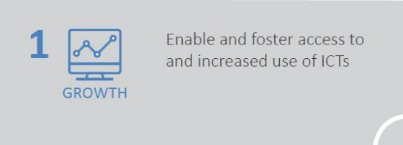
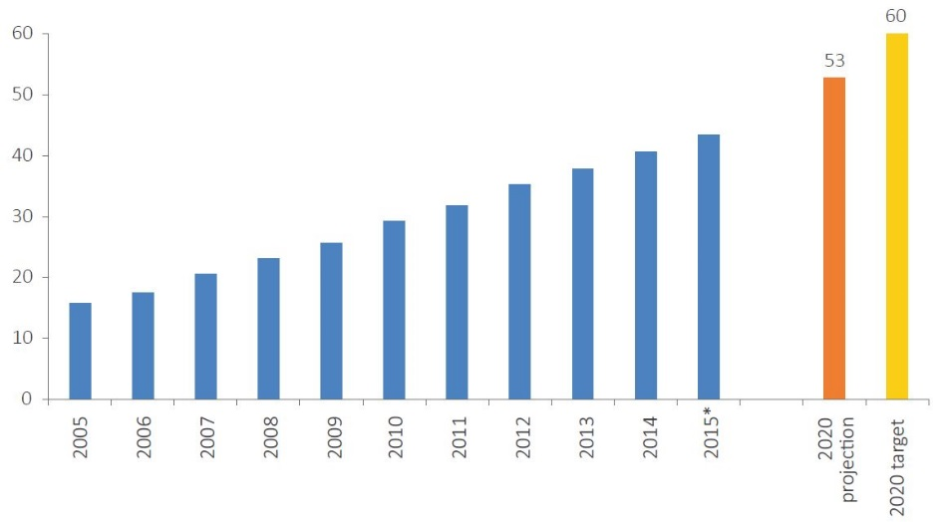
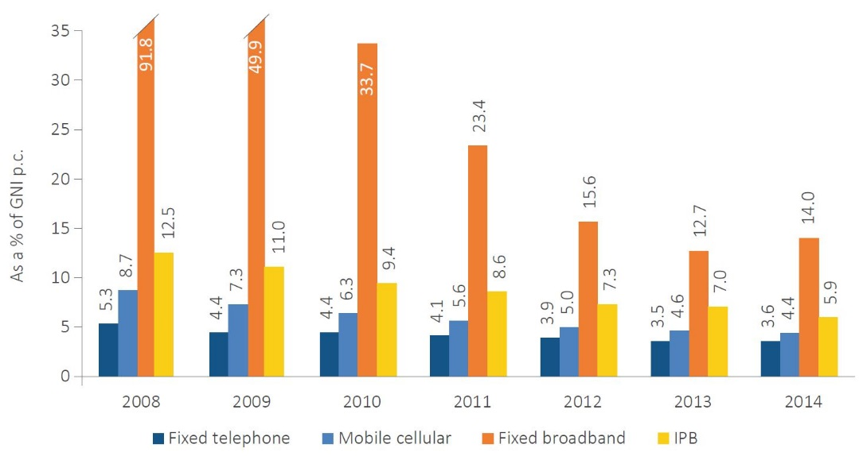
1.2 Worldwide, 60% of individuals should be using the Internet by 2020
% individuals using the Internet worldwide
% Internet users worldwide expected to fall short of the Target
1.3 Worldwide, ICTs should be 40% more affordable in 2020 than in 2012
The IPB and sub-baskets, global averages
Affordability
improving significantly
Note: *Estimate. Source: ITU.
Notes:
The Connect 2020 Agenda seeks to ensure that at least 60 per cent of individuals worldwide use the Internet by 2020. In 2015 43.4 per cent of individuals worldwide are online, a rise of 2.8 per cent on 2014. ITU predicts that 53 per cent of individuals worldwide will be using the Internet by 2020, and that further policy initiatives will be required to foster greater take-up in order to achieve the target.
In addition, the Connect 2020 Agenda calls for telecommunications/ICTs to be 40 per cent more affordable worldwide in 2020 than in 2012. Prices for ICT services have become more affordable in recent years. In particular, 29 per cent of the reduction in mobile-cellular prices needed to meet the global target was achieved between the baseline date of 2012 and 2014, a period which also saw sharp reductions in mobile-broadband prices.
These findings indicate that significant progress has been achieved in improving affordability, but that sustained regulatory and policy attention will be required to ensure continued price reductions in order to achieve affordability targets, particularly in developing countries.

Slide 7
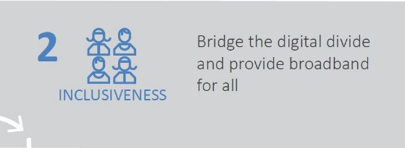
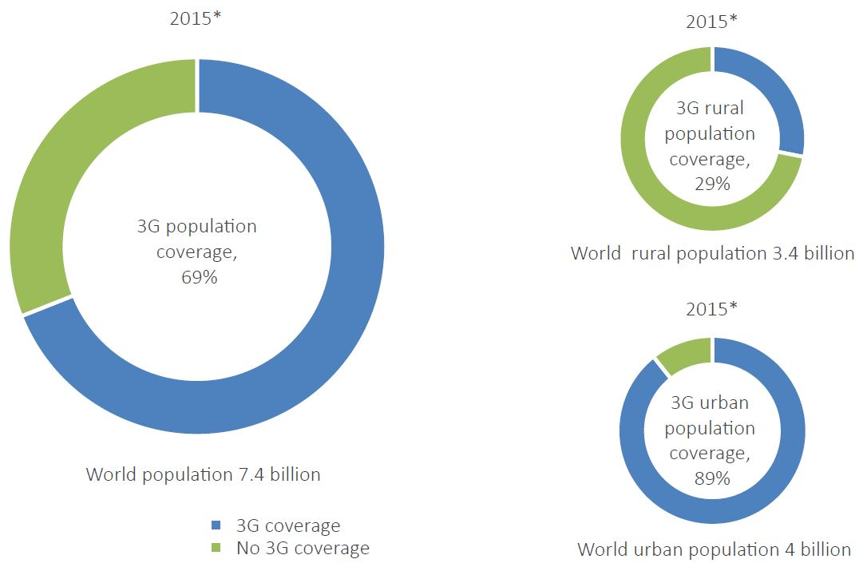
2.4 Worldwide, 90% rural population should be covered by broadband in 2020
3G absent in many rural areas
Note: *Estimate. Source: ITU.
Notes:
The Connect 2020 Agenda seeks to ensure that 90 per cent of the rural population worldwide is covered by broadband services by 2020.
In most countries, connectivity has tended to favour urban areas, which have higher aggregated demand and secure earlier returns on investment.
It is estimated that 95 per cent of the world’s population is now covered by a mobile-cellular signal.
However, while 3G network coverage grew from 45 to 69 per cent of world population between 2011 and 2015, 3G networks remain absent from many rural areas in low-income countries, only 29 per cent of the world’s rural population was covered by a 3G network in 2015.

Slide 8
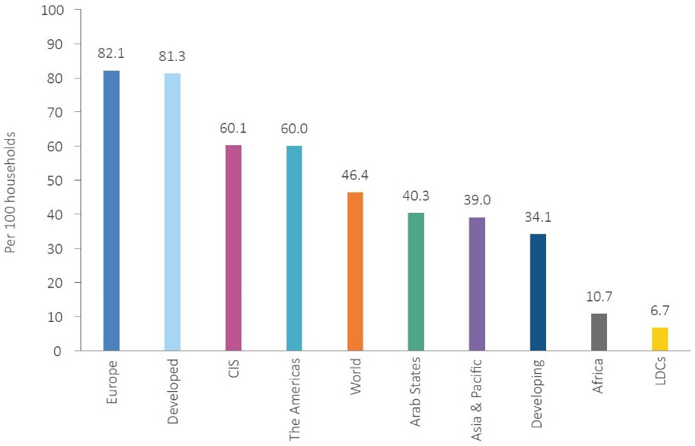
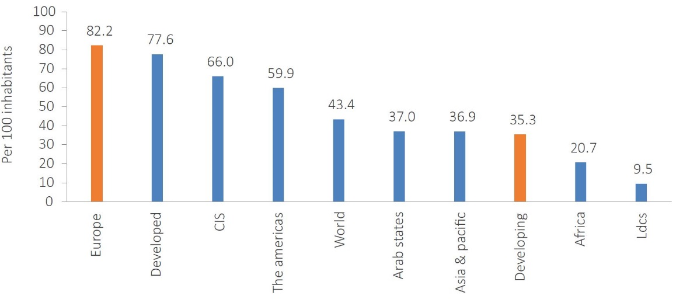
2.1 50% of households should have Internet by 2020 in developing countries, 15% in LDCs
Households with Internet, 2015*
Households with Internet
 | target | projection
Developing | 50% | 45%
LDCs | 15% | 11%
2.2 50% of individuals should be using the Internet by 2020 in developing countries, 20% in LDCs
Individuals using the Internet, 2015*
Internet Users
 | target | projection
Developing | 50% | 46%
LDCs | 20% | 16%
Note: *Estimate. Source: ITU.
Notes:
It is a priority for the international community to address the digital divides between developed and developing countries. At present, access to the Internet is much more prevalent in developed than in developing countries. In particular, the world’s LDCs are lagging behind.
The Connect 2020 Agenda aims to ensure that at least 50 per cent of households in developing countries and at least 15 per cent of households in LDCs have access to the Internet by 2020. ITU estimates that 45 per cent of households in developing countries and 11 per cent of households in LDCs will have Internet access by that date.
The Agenda also aims to ensure that at least 50 per cent of individuals in developing countries and at least 20 per cent of individuals in LDCs will use the Internet by 2020. Based on current trends, ITU estimates that only 46 per cent of those in developing countries and 16 per cent of those in LDCs will use the Internet by then.
These indicators show that further action is needed to ensure that developing countries, and particularly LDCs, are fully included in the information society. Regulatory changes and further investments, including public-private partnerships, will be required to achieve these targets, together with further improvements in technology and affordability.

Slide 9
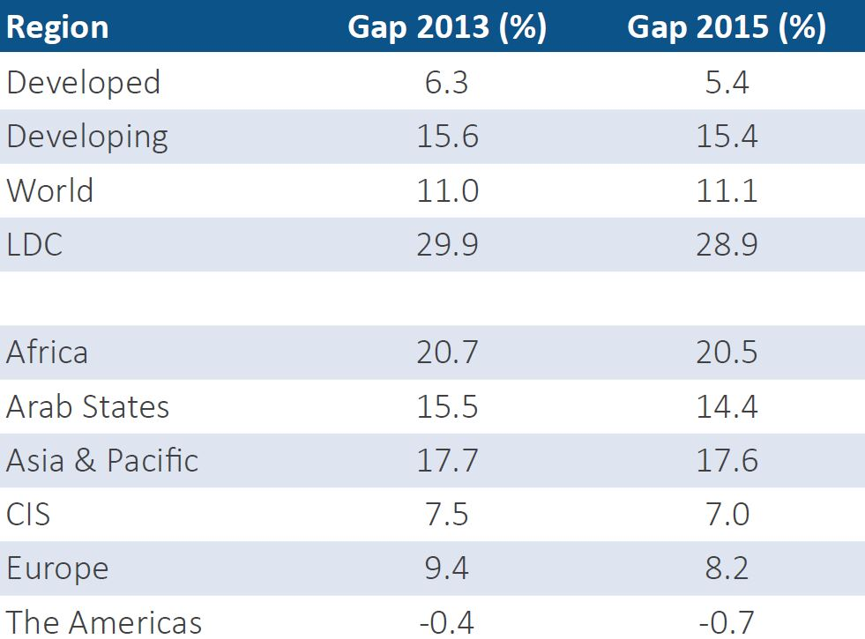
Gender Equality
  There is a significant divide in ICT access and use between men and women
  The gender gap is higher in developing countries and LDCs
Note: The gap represents the difference between the Internet user penetration rates for males and females relative to the Internet user penetration rate for males, expressed as a percentage.
Source: ITU.
Notes:
ICT access is important for gender equality because it enables women to achieve greater independence, improves access to economic and social opportunities, and facilitates empowerment. However, there are significant differences in levels of Internet access between men and women, which reflect inequalities in income, education and other structural inequalities between men and women in many economies and societies. The Connect 2020 Agenda aims to secure gender equality among Internet users by 2020.

Slide 10
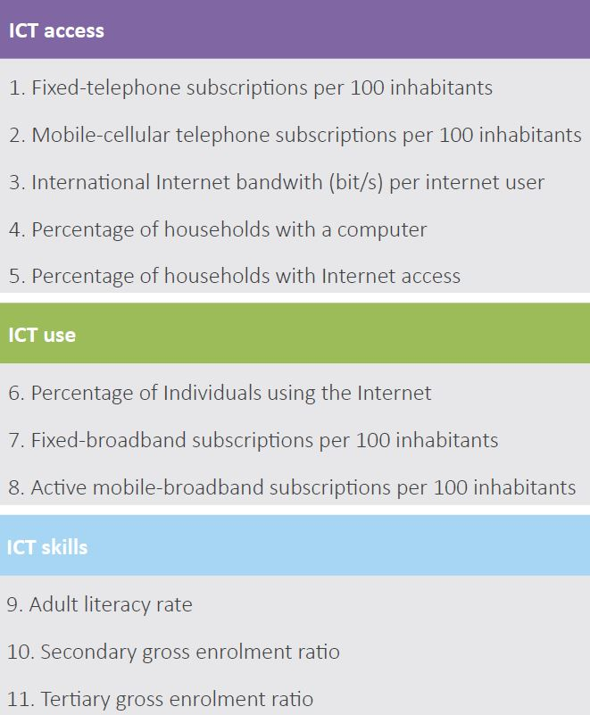
The ICT Development Index (IDI)
11 indicators, covering 3 areas
167 economies
Comparison of data from 2015 and 2010
Regional analysis
Source: ITU.
Notes:
The ICT Development Index (IDI) is a composite index combining eleven indicators into one benchmark measure that can be used to monitor and compare developments in information and communication technology (ICT) between countries and over time
The main objectives of the IDI are to measure:
• the level and evolution over time of ICT developments in countries and the experience of those countries relative to other countries;
• progress in ICT development in both developed and developing countries;
• the digital divide, i.e. differences between countries in terms of their levels of ICT development; and
• the development potential of ICTs and the extent to which countries can make use of them to enhance growth and development.

Slide 11
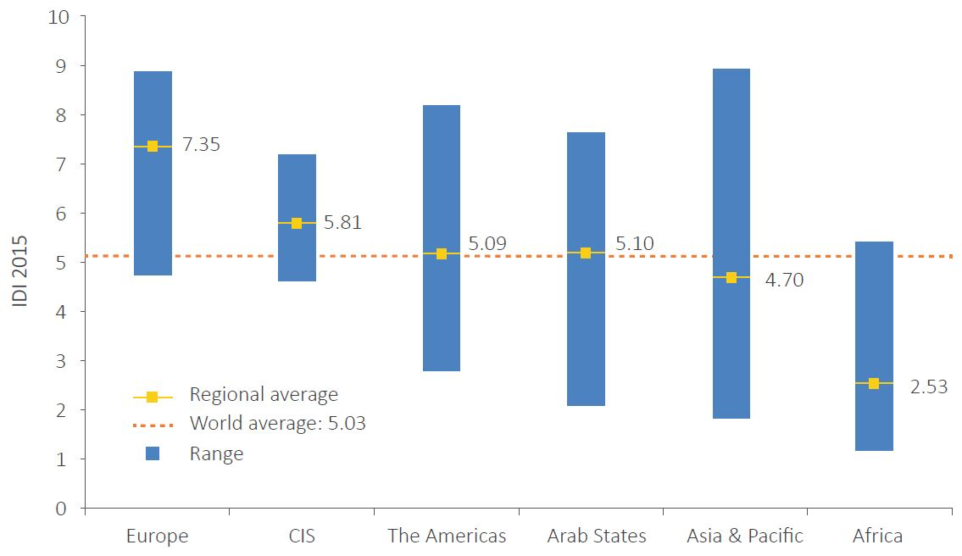
Regional IDI
IDI by region and compared to world average, 2015
Source: ITU.
Notes:
The results of the IDI for 2010 and 2015 provide insights into trends and disparities between the six ITU Telecommunication Development Bureau (BDT) regions – Africa, the Americas, the Arab States, Asia and the Pacific, the Commonwealth of Independent States (CIS) and Europe1 – in the development of ICTs, including changes over time, and point to challenges which these different regions are facing in achieving progress towards inclusive information societies.
Average IDI values vary considerably between regions. Europe has by far the highest average IDI value, at 7.35. The average regional values for the CIS region, the Americas and the Arab States all now exceed the global average of 5.03. Africa has by far the lowest average IDI value, at 2.53, less than half of that in every other region except Asia and the Pacific.

Slide 12
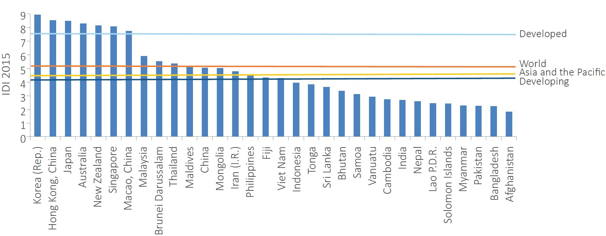
IDI values in Asia & Pacific
Source: ITU.
Notes:
Asia and the Pacific is the most diverse region in terms of ICT development, reflecting the stark differences in levels of economic development between OECD member countries and other high-income economies, on the one hand, and LDCs on the other. IDI ratings for the Asia-Pacific region are set out in the chart.
There is a substantial gap in IDI values and rankings between these high-performing economies and the next-highest-ranking countries in the Asia-Pacific region.
7 countries = developed nations
6 countries = average
Rest = with varying decreasing values….

Slide 13
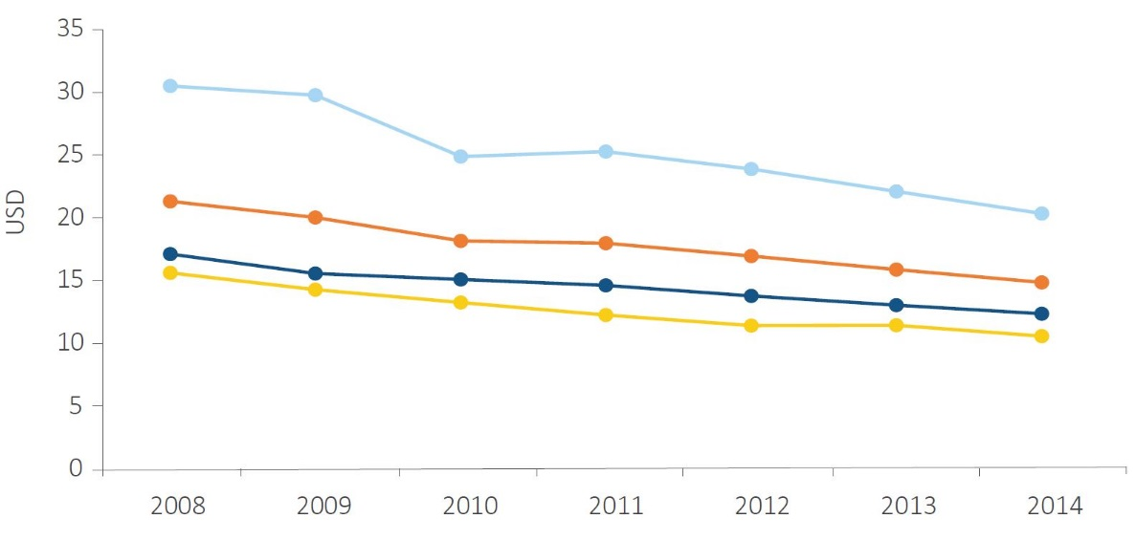
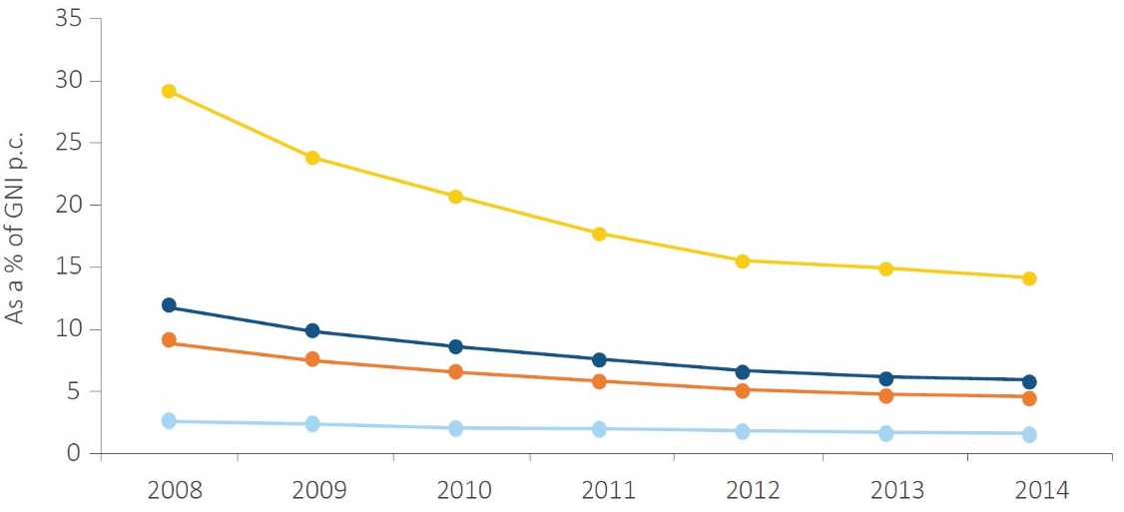
Mobile-cellular prices continue to fall
Mobile-cellular sub-basket, USD
and the service is becoming more affordable
Mobile-cellular sub-basket, % GNI pc
Source: ITU.
Notes:
The MIS Report looks also at the cost and affordability of ICT services, which remain a determining factor for ICT uptake.
As the number of mobile-cellular subscriptions approaches 7.1 billion and mobile population coverage reaches close to 95 per cent globally, prices continue to fall.
.

Slide 14
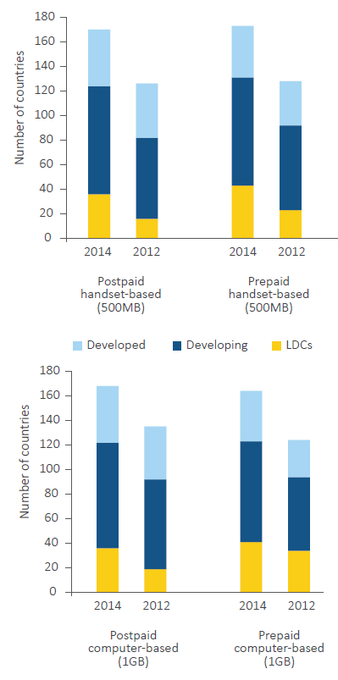
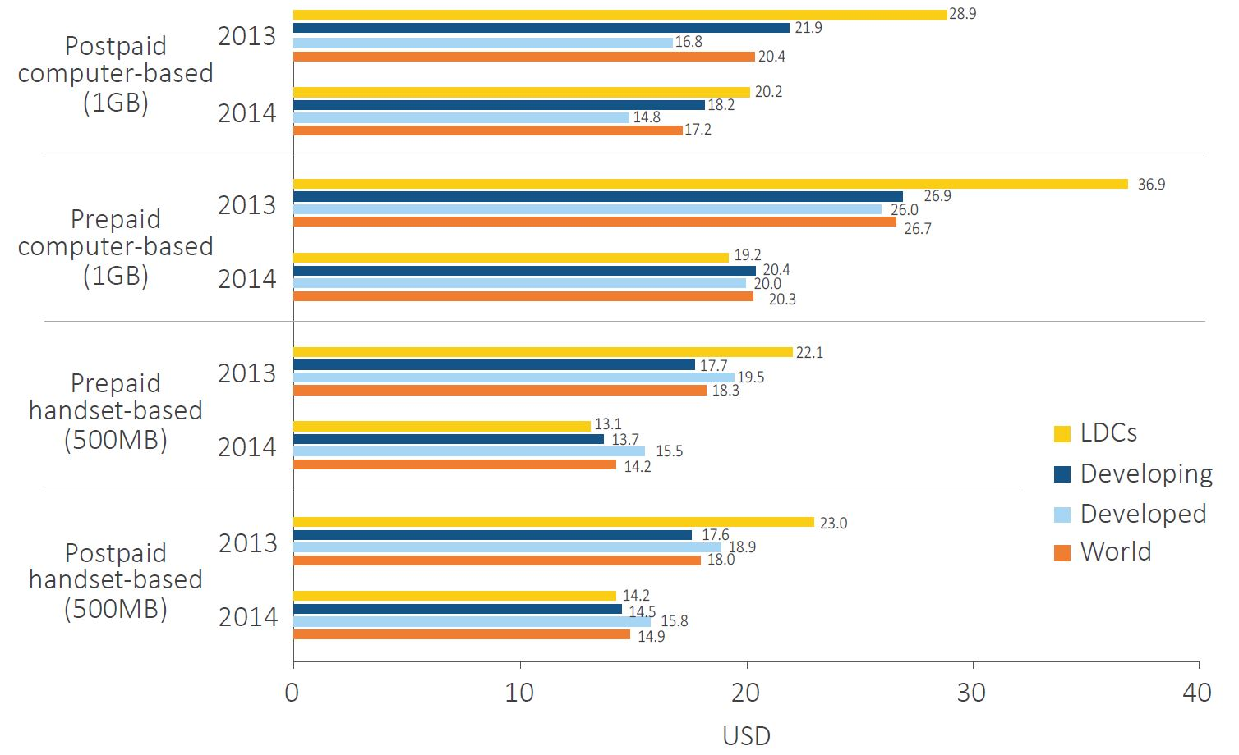
Mobile-broadband: more offers, lower prices
Availability by type of service
Mobile-broadband prices
Note: Simple averages. Based on 119 economies for which 2013 and 2014 data on mobile-broadband prices were available for the four types of data plan.
Source: ITU.
Notes:
Mobile broadband has become the most dynamic telecommunication market segment, enjoying sustained double-digit growth rates in subscription figures over the past eight years. For most of the population in developing countries it is de facto the only option for accessing broadband Internet services, given the limited capacity and reach of fixed infrastructure in the developing world.

Slide 15
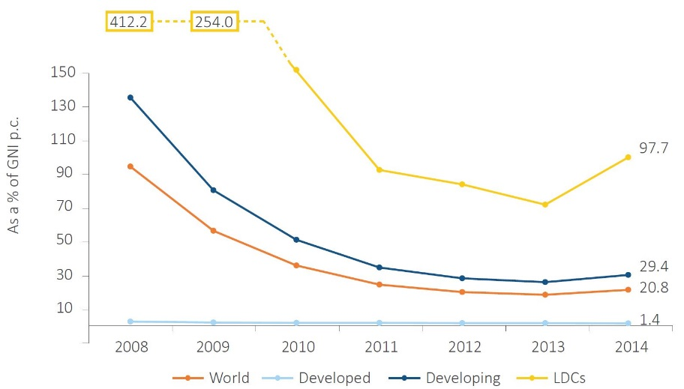
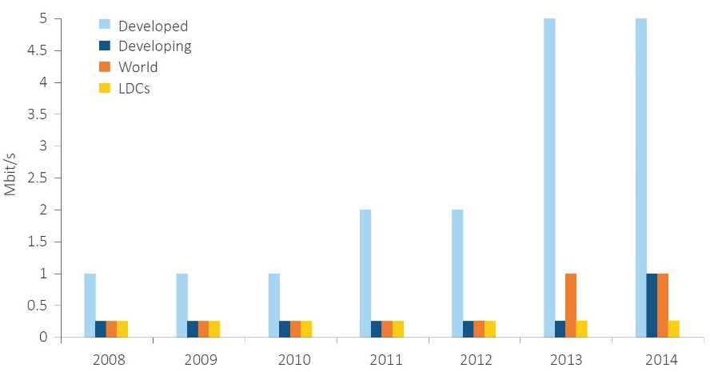
While fixed-broadband prices fell throughout the world until 2013, they increased in 2014
Fixed-broadband prices as a % of GNI p.c.
In more than half the countries prices stagnated or increased between 2013 and 2014…
…but entry-level fixed broadband plans in some countries include better quality, i.e. higher speeds or more data for money
In the LDCs, fixed-broadband services remain unaffordable
  Major constraint: International Internet bandwidth
Most common entry-level fixed-broadband speed
Source: ITU.
Notes:
While fixed-broadband prices fell throughout the world until 2013, the trend has since changed. Overall, fixed-broadband prices are stagnating and the service is even becoming more expensive in a number of developing countries and higher fixed-broadband prices will remain a major barrier to service growth.
In 2014, the price of the fixed-broadband basket in developing countries represented an average of 29 per cent of GNI p.c.,
In the LDCs, fixed-broadband services remain unaffordable: and will not improve the already very low uptake of fixed-broadband in the world’s poorest countries.
In these countries, international Internet bandwidth – a key element of Internet access- remains limited and expensive, whichis keeping prices up.

Slide 16
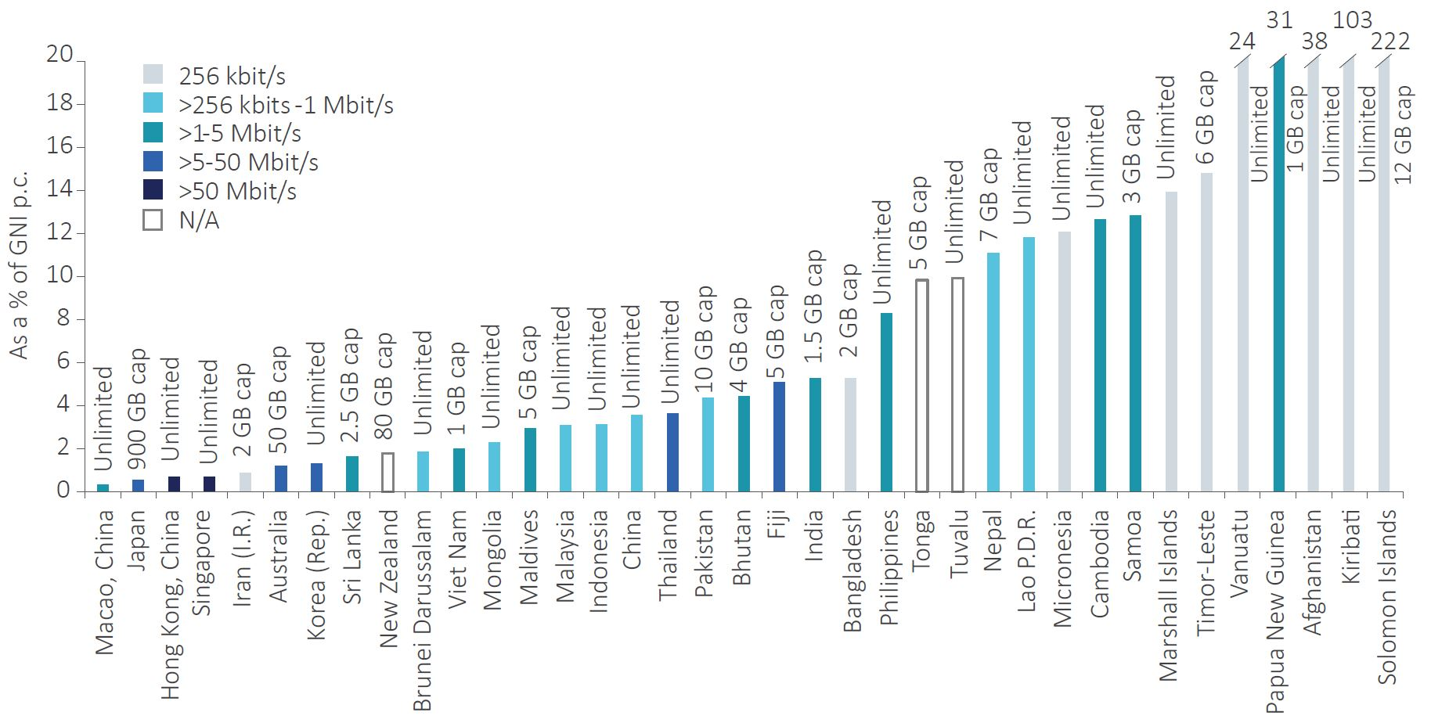
Fixed-broadband prices in Asia & Pacific
Source: ITU.
Notes:
Asia and the Pacific is one of the most diverse regions in the world by many criteria, and this diversity is also reflected in the absolute and relative prices paid by citizens for fixed-broadband services.
It is home to economies with the most affordable fixed‑broadband services, including Macao (China), Japan, Hong Kong (China) and Singapore, where the price of the fixed‑broadband basket represents less than 1 per cent of GNI p.c.
Prices have become relatively affordable and lie below 5 per cent of GNI p.c. in about half the countries in the region, including Indonesia, China, Thailand and Pakistan. India and Bangladesh.
Countries with the least affordable basket include the region’s LDCs, Lao People’s Democratic Republic and Cambodia, and many SIDS, where the high cost of international Internet bandwidth often keeps retail prices very high. In the Solomon Islands and Kiribati, the price of a fixed-broadband connection represents more than twice the average GNI p.c. In Afghanistan, Papua New Guinea, and Vanuatu, prices also remain very high in terms of GNI p.c., and services remain largely unaffordable.

Slide 17
Initiative #1
Recalling the Objectives of the Regional Initiatives
Special consideration for least developed countries, small island dev states, incl Pacific island countries, and landlocked dev countries
Objective : To provide special assistance to least developed countries (LDCs), small island developing States (SIDS), including Pacific island countries, and landlocked developing countries (LLDCs) in order to meet their priority ICT requirements
Initiative #2
Emergency Telecommunications
Objective : To provide assistance to Member States at all phases of disaster management, i.e. disaster preparedness including early warning, disaster response/relief and rehabilitation of telecommunication networks.
Initiative #3
Harnessing the benefits of new technology
Objective To assist ITU Member States in utilizing new technologies and address human and technical capacity challenges related to issues such as those identified in the expected results, among others.
Initiative #4
Development of Broadband Access and Adoption of Broadband
Objective : To assist Member States in the development of broadband access in urban and rural areas and to support system construction to resolve social issues leveraging the benefits of
telecommunication/ICT applications.
Initiative #5
Policy & Regulation
Objective : To assist Member States in developing appropriate policy and regulatory frameworks, enhancing skills, increasing information sharing and strengthening regulatory cooperation.

Slide 18
Transitioning between Action Plans
Hydrabad Action Plan (HAP)
Dubai Action Plan (DuAP)
[Proposed]
Buenos Aires Action Plan (BuAP)
2018-2021
2015-2017
2010-2014
Notes:
Recalling the Objectives of the Regional Initiatives
This would be a good poijnt to review the progress of the implementation of the Operational Plan in the Region
In recalling the Objectives, we are actually taking a review (a performance appraisal if we may call it) on how the region has transitioned from one Operational Plan into the current and how it is strategizing to the next .
We are at midpoint taking a look at where we have come from, to where we are , and where we want to go.
It was the HAP, We are currently in the DuAP and now preparing for the BuAP or BAP

Slide 19


















Goals for a Sustainable Future : The SDGs
Notes:
The SDGThe 17 goals and 169 targets, known collectively as the SDGs, which came into effect on 1 January 2016, do not only replace the MDGs, but build on them, making them more “integrated and indivisible”.
While the MDGs represented a more limited set of goals towards poverty eradication, education, and good health, the SDGs cover economic, social, and environmental pillars of sustainable development, universally applicable in all countries.
The SDGs are intended to be aspirational and action-oriented. Equally important is the need to assess progress towards the achievement of the goals, accompanied by targets and indicators.
Although the target date for the SDGs is the year 2030, certain targets are expected to be met along the way with some as early as 2017 or 2020

Slide 20
Enhancing the Objectives
ICTs are a key cross-cutting enabler for promoting and achieving each and every SDG.
Has great potential to accelerate human progress
Bridge the digital divide and to develop knowledge societies.
Notes:
“(ICTs) in the SDGs, they are a key cross-cutting enabler for promoting and achieving each and every SDG.
The Agenda recognizes in the Declaration that “the spread of information and communication technology and global interconnectedness has great potential to accelerate human progress,
to bridge the digital divide and to develop knowledge societies, as does scientific and technological innovation across areas as diverse as medicine and energy”.

Slide 21

Mainstreaming the 2030 Agenda
The new universal agenda requires that ITU :
-support governments, the UN system and sector partnership efforts effectively at the national, regional, and global levels to meet the sustainable development goals.
-Better inter-sectoral coordination at ITU to strengthen its related work and enhance the important role of ICTs as crosscutting enablers for the SDGs.
- Ensure coherent support towards the implementation of the 2030 Agenda when reviewing ITU strategic and operational plans and implementation and progress reports;
Notes:
It is recognized that telecommunications/ICTs are a key enabler to accelerate social, economic and environmentally sustainable growth and development, and therefore in the achievement of the Sustainable Development Goals and Targets, and are recognized as holding great potential for human progress;
And that information and communication technologies are specifically referenced in four targets within the Sustainable Development Goals and Targets: Goal 4 on inclusive and equitable quality education (Target 4.b), Goal 5 on gender equality and empowerment of women and girls (Target 5.b), Goal 9 on infrastructure, industry and innovation (Target 9.c), and Goal 17 on means of implementation and global partnerships (Target 17.8);
In particular, Target 9.c specifically aims to “Significantly increase access to information and communication technology and strive to provide universal and affordable access to the Internet in least developed countries by 2020”;
It is noted that the 2030 Agenda for Sustainable Development serves as a guiding framework for all stakeholders from all nations, encompassing both developing and developed countries,

Slide 22






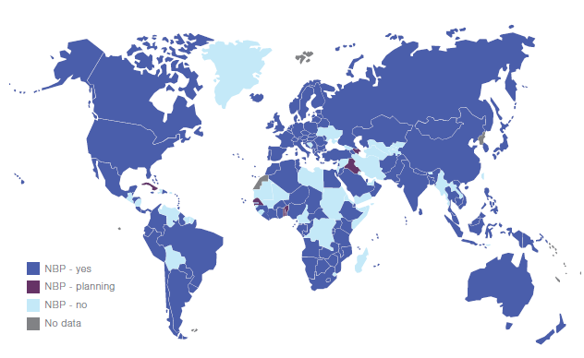


















E-application & Services
..
Emergency
Education
Health
Agriculture
Investment
Governance
Applications
Policy & Regulation
Capacity Building
Transport
Sensor Networks
Universal Broadband
Green ICT & E-Waste
Measurements
Electricity
Privacy & Security
Infrastructure Security
SMART
SOCIETY
Water
Digital Inclusion
Spectrum Management
Standards, Conformity & Interoperability
Teleworking
C&I

Slide 23





















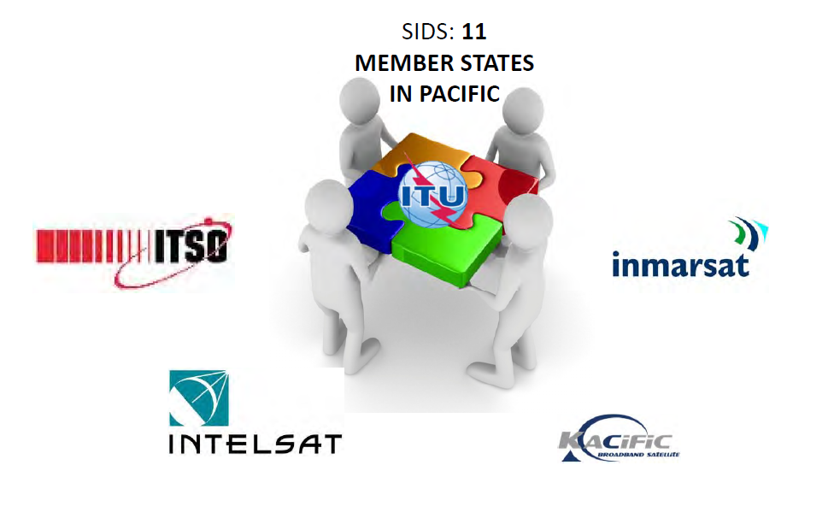








ITU: Partnering in Asia-Pacific (2015-2016)
Examples…..
Governments
Regulatory Authorities
INFRASTRUCTURE..
POLICY & REGULATION..
UN & Development Agencies
APPLICATIONS..
HUMAN CAPACITY BUILDING..
Regional Organizations
PROJECTS..
Industry
Academia

Slide 24
Towards WTDC-2017
Envisioning the new Regional Initiatives
Refocusing Objectives
SDG Considerations
Identifying Projects & Initiatives
Engaging Partnerships
A Smart Sustainable Asia Pacific

Slide 25
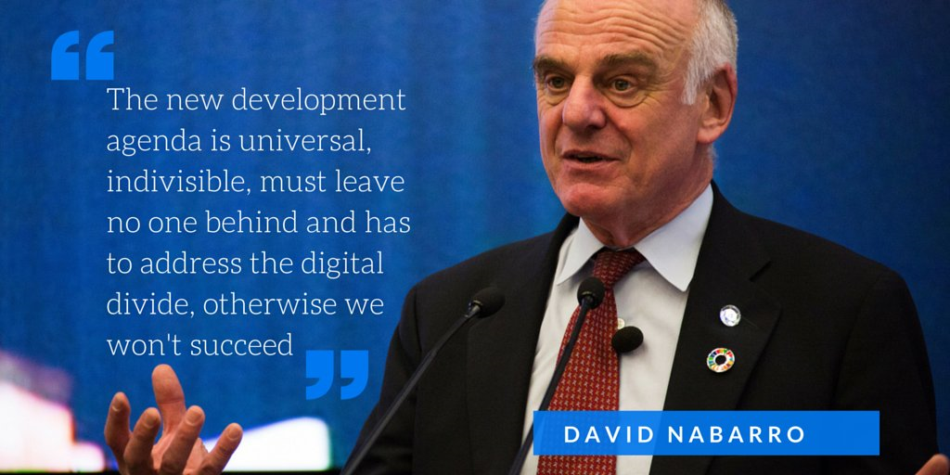
Source : ITU

Slide 26
Thank You
Ioane Koroivuki
Regional Director
ITU Regional Office for Asia & the Pacific
111/3 ChaengWattana Road, Laksi,
Bangkok 10210, THAILAND
P : +66-2-575 0055 F : +66-2-575 3705

