Slide 1

Expanding the human possibilities
of the connected world
Guillaume Mascot
Head of Government Relations APJ & India
Nokia
1
© Nokia 2016

Slide 2
While the past has been about connecting people, the future is about connecting things – improving personal life, optimizing business processes
The programmable world improves people's lives through automation, enhanced connectivity and intelligence. It also helps industries to become more efficient, agile and real-time.
  Programmable things
3
  Connected things
2
  Many things
1
Fixed internet with 1 bn places connected by 2005
Mobile internet with 5 bn people connected by 2020
Programmable World with 50 bn things connected by 2025
Notes:
Let’s have a look into how the internet has been evolving…in the beginning we say fixed internet connecting places and by and by 2005 we will reach 1bn connections
When mobile internet started it took some time, but then with the introduction of mobile broadband the number of connections started to grow much faster and will soon exceed the number of fixed internet connection with a projection to have 5bn people connected to the mobile internet by 2020
The Internet of Things will have even much faster growth as we are expecting by 2025 to have 50bn things connected, and it is not just about connecting things! It is also about improving the capabilities with analytics and automation and build a programmable world. This programmable world will improve our personal lives through automation, enhanced connectivity and intelligence. It will help to optimise business processes to become more efficient, more agile and have interactions in real-time.
So the Internet of Things is not just a technology evolution, but it represents a paradigm shift in all areas of life. Where today we are connected with our devices to the internet in future the things will be connected to the internet, to each other and to central cloud and analytics applications plaforms.

Slide 3
Explosion of possibilities: new performance levels of people and things
AUGMENTED
REDEDICATED
AUTONOMOUS
Computing spreads to everyday objects
Services expand from the virtual to the physical
Human and things connectivity blending
Networks become user centric & service aware
Super connected infra-
structure
All objects that can benefit from connectivity will be connected
Self driving
Augmented
gaming
Work & game
while traveling
Automotive
Augmented
shopping
Time shift
Assisted driving
INTERCONNECTED
Augmented
dashboard
Maintenance optimization
Factory
automation
Logistics
Real-time
remote control
Personal
robot
Real time
work in cloud
Smart
clothes
Real world
mobility
4th industrial
revolution
3D printing
Industry 4.0
Mobile living
Smart
watch
Tracking / inventory
systems
8k Video beamer
4k Video
People & Things
REVOLUTIONIZED
Communication
VR gaming
Virtual
mobility
High performance
infrastructure
Travel &
commute
Toll collection
Traffic Mgmt.
Traffic steering &
management
Real time
cloud access
Connected
home
Virtual 3D
presence
Health
Advanced
monitoring
Smart grids
Safety & Security
Waste mgmt.
Utility & Energy
Remote
Diagnosis
Reliable emergency
communications
Touch & steer
HD Cams NW
VIRTUAL
Real-time
remote control
TACTILE
SUPEREFFICIENT
Notes:
The future of mobile communications is likely to be very different to that which we are used to today. While demand for mobile broadband will continue to increase, largely driven by ultra high definition video and better screens, we are already seeing the growing impact of the human possibilities of technology as the things around us become ever more connected.
Objects ranging from cars and factory machines, appliances to watches and apparel, will learn and organize themselves to fulfill our needs by automatically adapting to our behavior, environment or business processes. New uses will arise, many not yet conceived, creating novel requirements that communications networks must be able to meet flexibly and cost effectively in order to support operator profitability and the wider ecosystem. The way
- how we travel and experience our environment (real world mobility)
- how we can control remote environments (virtual mobility)
- how the infrastructure around supports us (high performance infrastructure)
- how we produce goods (4th industrial revolution)
will completely change. We already have indicators about these long-term trends and disruptions and they are not only driven by the Internet and telecommunication industry but also from the other industries such as automotive, healthcare, manufacturing and logistics, the public sector etc. who need to reinvent themselves. As a result this creates a highly dynamic and innovative environment.
Every industry will be affected by 5G. Network speeds as high as 10Gbps and with extremely low latency are a driving force for new applications that use massive broadband capabilities. 5G will be the platform enabling growth in many industries, ranging from the IT industry to the car, entertainment, agriculture and manufacturing industries. 5G will connect the factory of the future and help creating a fully automated and flexible production system. It will also be the enabler of a superefficient infrastructure that saves resources. Immersive augmented & virtual reality are changing business processes already today.
We can expect that safety and business-critical applications will increasingly run on the wireless network, which necessitates absolutely stringent, reliable and predictable service levels in terms of capacity, throughput and latency. These levels will far exceed those used today

Slide 4
Large worldwide population with unserved broadband needs
Developed households without internet,
19%
Developing households without internet,
66%
4 billion people overall from developing countries remaining offline
Percentage of households without Internet access
ITU Information and Communication Technologies Report 26 May 2015
Notes:
The United Nations has stated that broadband access is a basic human right. Yet 20% of households in developed countries and as much as 66% of households in developing countries do not have internet access. Currently, more than 4 billion people overall from developing countries remaining offline. *
Operators have looked at providing broadband via cable, DSL, or fiber but find it cost prohibitive to delivering internet access in rural locations. Today’s mobile rural LTE networks are not designed for triple play (telephone + TV + broadband) as received indoor signal is insufficient to allow for triple play. A typical household located more than 2 km away from a LTE radio station transmitting at 2.6 MHz would have insufficient signal for next generation broadband access. Even if signal was sufficient, mobile LTE network throughput capacity may not guarantee a minimal bit rate required for triple play.

Slide 5
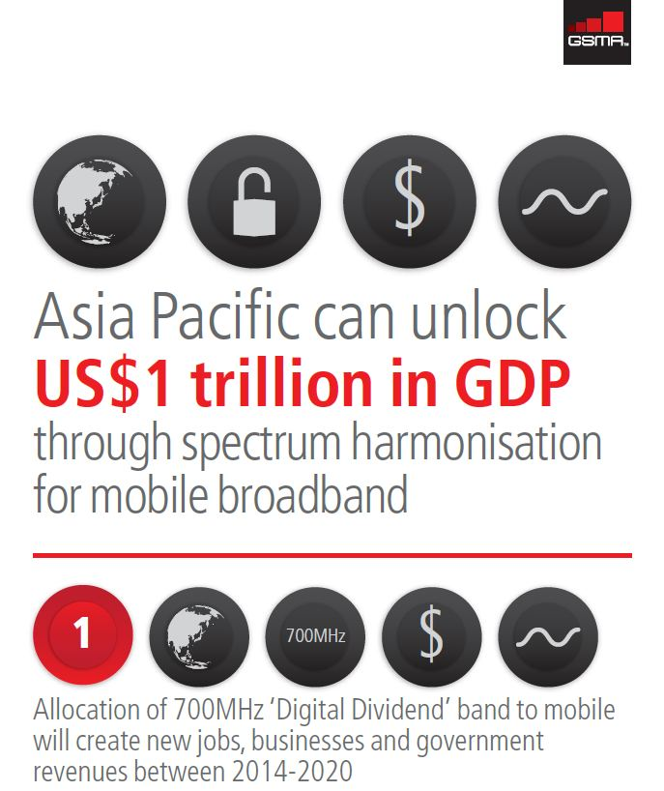
Asia Pacific: The mobile broadband opportunity when including all
Economic growth and new opportunities to monetize mobile broadband
Digital inclusion and productivity gains
Efficient broadband connectivity for large areas and good indoor coverage
LTE on Digital Dividend bands
Source: http://www.gsma.com , 2012
Notes:
In May 2012, the Boston Consulting Group (BCG) published a report entitled The Economic Benefits of Early Harmonisation of the Digital Dividend Spectrum & the Cost of Fragmentation in Asia-Pacific, which clearly outlines the economic benefits of the 700MHz band. The study identifies the following economic benefits:
By 2020, allocation of 700MHz band to mobile services throughout the region could increase GDP by more than USD 1 trillion, as well as result in tax revenue growth of USD 215 billion.
An additional 1.4 million new businesses (including new departments or business units within existing firms) and 2.7 million new jobs may be created by 2020 through timely regional allocation of the 700MHz band to mobile services.
All of this enhanced economic activity would drive greater tax revenues for governments throughout the region—use of the 700MHz band for mobile broadband is expected to generate a further USD 52.3 billion in revenues between 2014 and 2020 while use of the band for broadcasting would add considerably less, at approximately USD 7.8 billion over the same period.
Failure to harmonize and allocate the 700MHz band by 2014 may result in substantial loss of incremental GDP growth. By delaying allocation for just one year—until 2015—countries in the region could suffer a loss in incremental GDP growth of USD 40 billion and an indirect loss of USD 70 billion over the following three years.
Rural Development – mobile broadband can help close the digital divide by opening up regional and global markets to local entrepreneurs.
The Boston Consulting Group and GSMA, “The Economic Benefits of Early Harmonisation of the Digital Dividend Spectrum & the Cost of Fragmentation in Asia-Pacific,” May 9, 2010, http://www.gsma.com/spectrum/bcg-spectrum-fragmentation-ap/.

Slide 6
SETTING THE SCENE
THE PROGRAMMABLE WORLD IS STARTING TODAY
Broadband is evolving from basic connectivity to a critical ubiquitous connectivity and associated services with Quality of Experience at all times. This requires a profound transformation of telecom network architectures and continuous innovation. 5G and new network architecture (NFV and SDN) will be a major step in the programmable world.
A fourth industrial revolution is ongoing and is radically modifying the economy, the functioning of manufacturing and industry-related services. It is improving products, processes, business models, value networks, information management, and is affecting workplaces, employment relationships and business strategies.
Digital technologies are delivering cross-sectoral efficiencies to business, including SMEs. The Internet of Things (IoT) is a reality. The market for IoT components and systems has grown 160 % in 2013 and 2014, and is still expected to grow more than 30% in the next ten years.
DEVELOPING A MODERN AND INVESTMENT FRIENDLY REGULATORY APPROACH
Promoting and facilitating networks investment (access to all kind of passive infrastructure, simplification of rights of way granting, mandatory fibre pre-cabling for new buildings, spectrum allocation and sharing)
Adapting regulatory framework a horizontal layer approach: ensuring healthy and sustainable competition at each layer and avoiding gridlocks between any layers that become inter-dependant
Operators should be allowed to monetize the data flow through service differentiation which is key to foster innovation, new services and meet demand for different levels of quality. (e.g: providing End to End QoS service delivery, in becoming Cloud and CDN providers)
Spectrum allocation should be strongly harmonized at regional level to favor timely allocation of frequencies for LTE and prevent market fragmentation.

Slide 7

Notes:
As we shape the future of technology for an increasingly connected world, Nokia remains
committed to designing and delivering technology to help people thrive.
Nokia has always been a company that focuses on serving human needs, and today, more than
ever before, it’s our integrity, our values, and focus on the human possibilities of technology
that set us apart.
No other company can be better trusted to steer and shape the technology that is seamlessly
interwoven into our daily lives, to create and deploy technology in the service of people:
effortless, intuitive technology, designed to help people thrive.

Slide 8
LTE on Digital Dividend bands
For most efficient mobile broadband coverage
Band
(typical European scenario + APT700)
Coverage
per radio cell
Capacity
Total bandwidth of band
2.6GHz
1x
High bands
➔
Capacity
60MHz
for LTE
1800MHz
2x
75MHz for GSM and LTE
900MHz
Low bands
➔
Coverage
4x
35MHz for GSM/3G/LTE
800MHz Digital Dividend EU800
30MHz for LTE
700MHz Digital Dividend APT700
Up to 45MHz for LTE
GSM 900 = coverage benchmark
Users’ expectation based on voice
Efficient LTE coverage on EU800/APT700 with GSM900 site reuse
More bandwidth with EU800/APT700 than with 900MHz re-farming

