Slide 1


Asia Pacific Information superhighway (AP-IS)
Enhancing e-resilience
Atsuko Okuda
ICT and Disaster Risk Reduction Division
ESCAP

Slide 2


ASIA PACIFIC DISASTER REPORT 2015
Disasters Without Borders
The scale of modern day disasters, combined with instant international communications,
means that many disasters, national or regional instantly, become global phenomena.
And thus it is key to translate SFDRR into action
to establish disaster risk reduction at the heart of sustainable development

Slide 3





Asia Pacific the decade of 2005-2014
1,625
500,000
most
economic
damage
earthquake
flood
1.4 Bn
suffer less
with
greater impacts
earthquake
typhoons
523 Bn
SIDs, LDCs , and LLDCs
remain to be most vulnerable

Slide 4
High exposure, low capacity
Source: ESCAP based on data from Alliance Development Works and UNU-EHS, 2014
Notes:
Note: One graph indicates degree of exposure (number of people and scale of assets/infrastructure exposed to an event). The other indicates the coping capacity of the government and medical services, along with the extent of insurance in a country.

Slide 5
Takeaways
Asia Pacific is the epicenter of disasters: with presence of natural hazards, exacerbated by economic growth, rising populations, and burgeoning cities, and is worsened by effects of climate change
2015 is pivotal year: strategic window of opportunity from the transition from HFA to SFDRR, global climate agreement, and 2030 Agenda for Sustainable Development
Investing in disaster risk reduction is proven effective, but critical areas remain neglected – drought, early warning systems, and information management systems
Regional cooperation is critical to address the growing threat of disasters to promote sustainable development

Slide 6
Sendai Framework for Disaster Risk Reduction 2015-2030
Priority 1: Understanding disaster risk
Priority 2: Strengthening disaster risk governance to manage disaster risk
Priority 3: Investing in disaster risk reduction for resilience
Priority 4: Enhancing disaster preparedness for effective response and to “Build Back Better” in recovery, rehabilitation and reconstruction

Slide 7
Asia-Pacific Information Superhighway
Connectivity
Physical network design, development, management at regional level
Traffic/ Network Mgmt
Ensuring efficient and effective Internet traffic and network management at regional, sub-regional and national levels
Broadband for all
Bridging digital divides
E-Resilience
Resilient ICT Networks
Inter-governmental negotiation
Support to disaster management systems
Ensuring last mile disaster communication
Promoting affordable access to underserviced areas
Improving regulations based on open access
Policy and technical support to governments

Slide 8
E-resilience: guiding principles
1) understanding risk;
2) having data and information sharing policies;
3) generating actionable information;
4) customizing information and reaching out to people at risk; and
5) using real-time information
Right people – making effective decisions
Understanding risk
Having data and information sharing policies
Generating actionable information
Using real-time information
Customizing information and reaching out to people at risk
Right information (cumulative knowledge)
Post-disaster
During
Pre-disaster
Right time (optimal time)

Slide 9
Understanding risks to ICT infrastructure
Source: ESCAP (2015) APDR 2015
Source: ESCAP (2015) APDR 2015

Slide 10
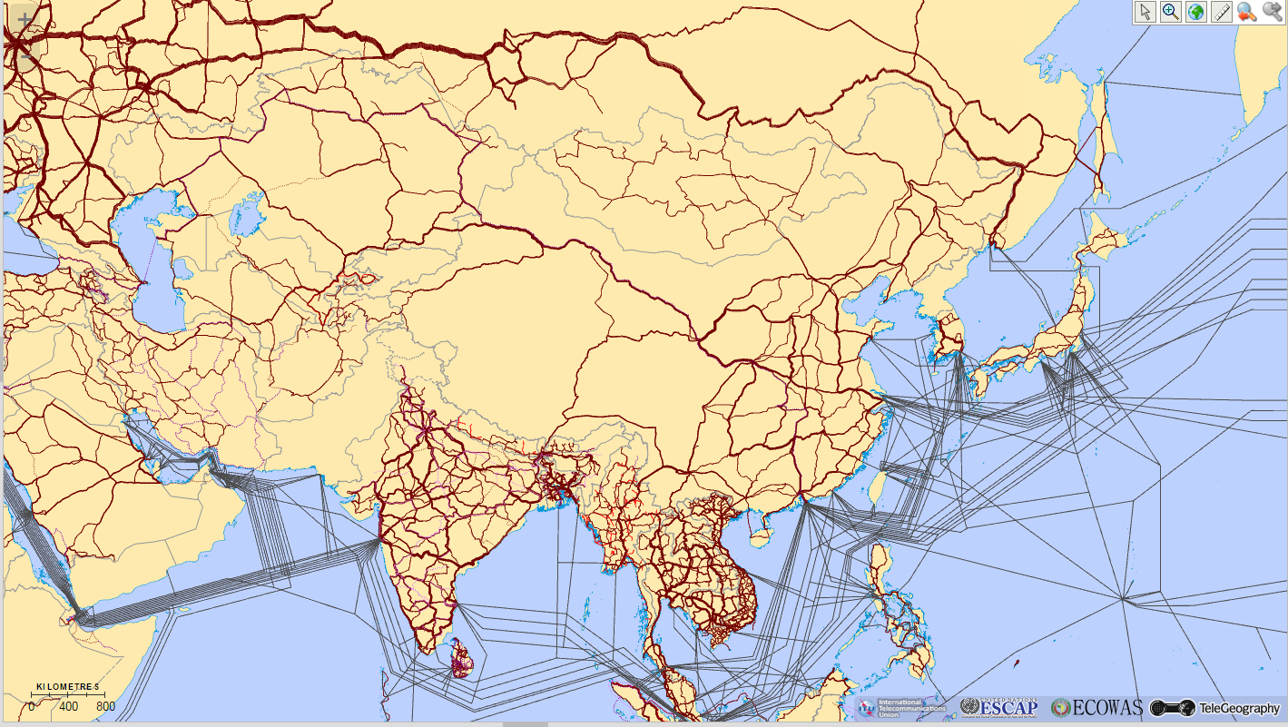
ICT infrastructure risk map:
Designing for resilience
Source: ITU-ESCAP, AP-IS map (2013). Available at http://www.unescap.org/our-work/ict-disaster-risk-reduction/asia-pacific-information-superhighway

Slide 11
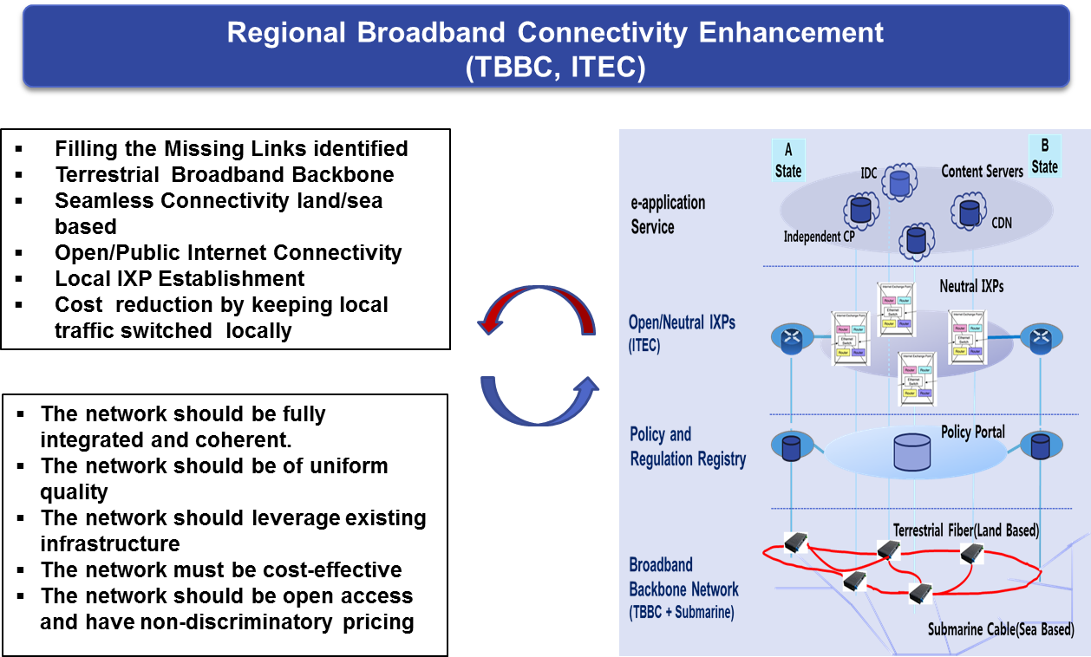
Ensuring the E-resilience from the design to implementation
Source: A pre-feasibility study on the AP-IS in the ASEAN sub-region, ESCAP, 2015

Slide 12
Shortening the time needed for restoration
restoration of critical telecommunication services is of paramount importance
minimization of the time needed to restore critical communications infrastructure—should form the basis of any e-resilience plan

Slide 13
Thank you
Atsuko Okuda
okuda@un.org

