Slide 1
USOF for Broadband
India Experience

Slide 2
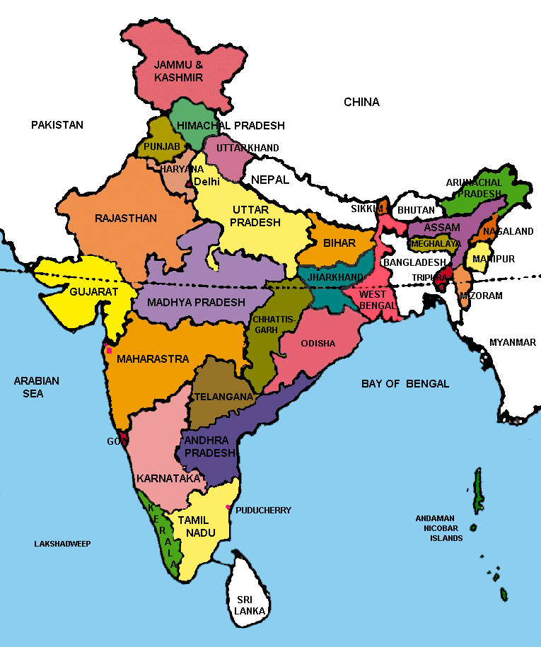
India – Administrative Setup
Population | 1.28 Billion 72% Rural
Area | 32,87,263 Sq. Km
States + UTs | 29 + 7
Districts | 651
Blocks | 6612
Village Panchayats | 2,65,000
Villages | 6,40,930

Slide 3
PRESENT TELECOM SCENARIO (SOURCE: TRAI)
 | 31-03-2014 | 01-07-2015
Total Telephone subscribers | 933 Million | 1002 Million
Tele-density | 75.23 % | 79.67 %
Urban Tele-density | 145.78 % | 148.90 %
Rural Tele-density | 43.96 % | 48.60 %
Broadband subscribers | 60.87 Million | 104.96 Million

Slide 4
India – Demographics
Population | 1.28 Billion (17.31% of world’s population)
Below 25 years | 50%
Below 35 years | 65%
Rural Areas | 72.2% (6,40,000 Villages)
Urban Areas | 27.8% (5,500 Towns & Urban Agglomerations)
Active Internet Users | 18% (232 Million)
Active Rural Internet Users | 5.4% (69 Million)
Digital Buyers | 53 Million
Digital Buyers (Rural Areas) | 13 Million
Smartphone Users (Age 31-40) | 10% in 2013 to 30% in 2015
Projected Population (2030) | 1.53 Billion

Slide 5
India – Smartphone Data Usage
Percentage of Users
5

Slide 6
Why Broadband?
Recognized as a key driver of economic growth and national competitiveness
    Every 10 percentage point increase in broadband penetration in low and middle income countries accelerates economic growth by 1.38 percentage points
    Leads to creation of jobs and new businesses
  Deep and widespread social impact
    Delivery of public services – health care, education, electronic voting, land registration etc
    Leads to inclusive growth
Source: World Bank Report on Broadband 2010

Slide 7
So what is Broadband?
Is it just a network delivering high speed connectivity?
    A communication network by itself cannot bring the required benefits
  Broadband is better defined as an ecosystem comprising of
    Network
    Services and
    Users
  Losing focus of any one of the components of the ecosystem leads to incomplete policies and therefore unmet objectives
Network
Services
Users
These components interact with each other to create a cycle of “positive feedback” resulting in wide spread economic benefits

Slide 8
Network – a necessary first step
Offer network as a shared service
Network forms the first layer of broadband ecosystem
Network itself can be viewed as comprising of multiple layers owned by different entities
  Multiple Technology Options
    Fiber Network (Underground / Overhead)
    Microwave
    Satellite
  Network Design Considerations
    Network Scope, Optimum capacity, Reliability, Cost, Centralized Management, O&M, SLAs
Active Infrastructure
Passive Infrastructure

Slide 9
Services – The product & Business Models
Network enables delivery of digital services
    Government Services (G2C, G2B, G2G)
    Telecommunications, Internet services, Cable TV, Telemedicine, e-Education, Banking and many more
  Services that can be offered are constrained by the capacity, reach and reliability of the network
  Proliferation of services by offering the infrastructure as a service through multiple business models
    Fiber leasing
    Bandwidth wholesale
    Auctioning

Slide 10
Users – the consumers
Users refers to –
    End user devices that are used to consume and render services – laptops, mobiles, tablets etc.
    Users themselves who need to be made aware about the availability of services and trained on how to use them
  Provides the “Pull” for services
  Provides the “positive feedback” necessary for proliferation of broadband and related economic and social gains
    More users, more services and therefore better utilization of network

Slide 11
Broadband Evolution & Growth Framework
Phase 1
Phase 2
Phase 3
50%-60%
Household Broadband Penetration
Level of Policy and Regulatory Intervention
10%-20%
Year 1
Year 3
Year 5
Year 7
Year 9

Slide 12
USOF Genesis in India
One of the objectives of the NTP ‘94 was Universal service : provision of access to all people especially villages.
New Telecom Policy (NTP) envisaged development of telecom facilities in remote, hilly & tribal areas and provision of universal services to all uncovered villages.
TRAI recommendations in 2002 for establishment of USOF & USL @5% of AGR of the TSPs except pure VAS providers
Universal Service Support Policy (USSP) came into effect w.e.f. 1.4.2002.
USOF is a non-lapsable fund, has been established to provide the people access to telecommunication services at reasonable and affordable prices in the rural and remote areas of the country.

Slide 13
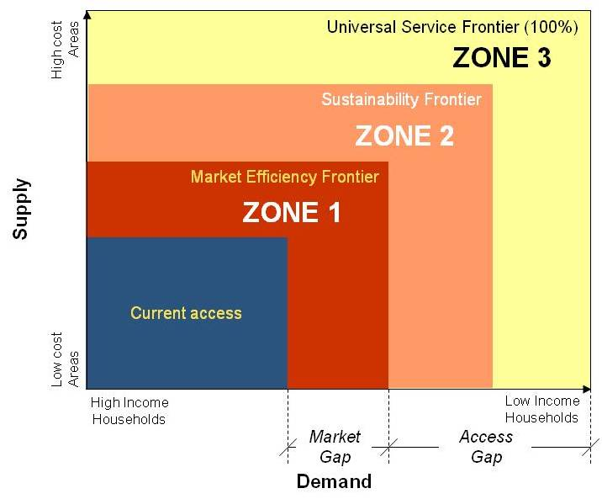
Need for USOF Subsidy

Slide 14
India – USOF Objectives
Economic: Network extension & stimulate uptake of the ICT services
Social: Mainstreaming the underserved & un-served areas/groups by bridging the 'Access Gap'
Political: to enable citizens exercise their political rights in an informed way
Constitutional: Equitable distribution of the fruits of the telecom/digital revolution and fair allocation of national resource (pooled USO levy) via targeted subsidies

Slide 15
USOF Disbursements
  Fund to be utilised exclusively for meeting Universal Service Obligation i.e. obligation to provide access to telegraph services to people in the rural and remote areas at affordable and reasonable prices.
  Central Government has the power to administer the Fund in such manner as may be prescribed by rules made under this Act.
  The Central Government shall be responsible for the coordination and ensuring timely utilisation and release of sums in accordance with the criteria as may be prescribed by rules made under this Act.
  Financial Support from the Fund shall be provided to meet the Net Cost of providing the specified Universal Service Obligation as per the procedure specified by the Administrator from time to time, and the period for which such support shall be provided and the services covered shall be governed by an Agreement entered into with the Universal Service Provider. "Net Cost" means Operating Expenses plus Capital Recovery minus Revenue.
Administrator, USOF has powers, inter alia, to settle the (subsidy) claims of the Universal Service Provider after due verification, and make disbursements accordingly from the Fund and to monitor the performance of the Universal Service Provider

Slide 16
USOF – Stream of Activities
Provision of Public Access Service:
Provision of Household Telephones in Rural and Remote Areas as may be Determined by the Central Government from Time to Time
Creation of Infrastructure for provision of Mobile Services in Rural and Remote Areas
Provision of Broadband Connectivity to rural & remote areas in a phased manner
Induction of new technological developments in the telecom sector in Rural and Remote Areas
Creation of General Infrastructure in Rural and Remote Areas for Development of Telecommunication facilities

Slide 17
Need for a National Broadband Network NOFN
e-governance
e-healthcare
Land Records
Birth/Death Certificates
UID based services
NREGA
Online medical consultations
Medical records
Pan India exchange of patient information
e-education
Public Internet Access
Quality education delivery
Digital literacy programmes
Availability of Internet services to villages
Delivery of Internet by Common Service Centres
Employment Generation
e-commerce
Rural banking through online transactions and ATMs
Online purchases and transactions for bill payments, tickets etc.
Large scale employment generation through operation and maintenance activities, BPO services, rural entrepreneurship etc.

Slide 18
NOFN aims to reach the bottom of the pyramid
1.2 Million KM existing fiber
28% population (largely urban)
Reaches
0.7 Million KM new fiber under NOFN
Will Reach
72% population (largely rural)
18

Slide 19
Project Features
Intended Beneficiaries
Scale of
Infrastructure
People in remote rural areas of India
> 100 million immediate beneficiaries
> 1.2 million KMs of fiber network (50% to be laid fresh)
>250K end points
Key Considerations
Multiple Stakeholders
Citizen
Service Providers
Funding and Regulatory Agencies
Implementation Partners (Govt & Private)
Affordability
Non Discriminatory
Long Term Operability and Sustainability

Slide 20
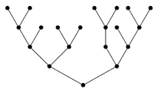

NOFN Program Structure
(Key guiding principles)
Guiding Principles for Project Implementation, Operations, Utilization & Maintenance
No Monopoly
Non discriminatory access
Consistent operation nationally
Centralized NMS & NoC
Implementation by CPSUs
Incremental Cable to be laid (Av 2.4 Kms / GP).
Existing Fibers of CPSUs to be used
(Av 3 Kms per GP).
Key Guiding Principles
Linear Network
GPON technology, Optical tree structure
Centre – State joint effort
No RoW charges by State Govts
Except Tamil Nadu
Service Providers participation
(TSPs, ISPs etc)
- Provide Block to District connectivity
- Provide Services at Gram panchayats.
~$4 Billion Funding by USOF
Govt Of India
Competitive Price Discovery
ensuring network is rolled out at optimal cost

Slide 21
Key challenges faced in NOFN implementation
Key Challenges
Availability of execution agencies
RoW permissions
Location of Existing Fiber
Availability of Stores
Availability of GPON Equipment
Power supply & space at GPs
Speed of Execution
Trained manpower

Slide 22
Sustainable Finance Model Foundation Stone for NOFN Funding
USOF Funding
Private Investment
Last mile (partial)
Content & Services
Project Opex (limited duration)
Last Mile
Sustainable Finance Model
Middle Mile Capex
End user Devices
Sustainable Growth Ecosystem
End User Service Demand
Telecom Services
Economic Growth
Telecom Investment
Innovative Services

Slide 23
Thank You

