Slide 1


ROLLING OUT BROADBAND NETWORKS AND SERVICES IN THE RURAL AREAS
“PAPUA NEW GUINEA EXPERIENCE”
FOR
ITU Asia-Pacific Regional Forum on Reshaping Policy and Regulatory Landscape for Accelerating Broadband Access
08-10 September 2015, Jakarta Indonesia
Warren Suti
NICTA (UAS)

Slide 2
Outline of Presentation
1. PNG KEY STATISTICS
2. PNG MAJOR OPERATORS
3. UNIVERSAL ACCESS & SERVICE STRUCTURE
4. PILOT PROECTS ON UNIVERSIAL ACCESS & SERVICE
5. PROJECT 1: VOICE TELEPHONY
6. PROECT 2 : BROADBAND SCHOOL & COMMUNITY ACCESS
7. UAS FUNDING
8. STEPS TAKEN & WAYFORD

Slide 3
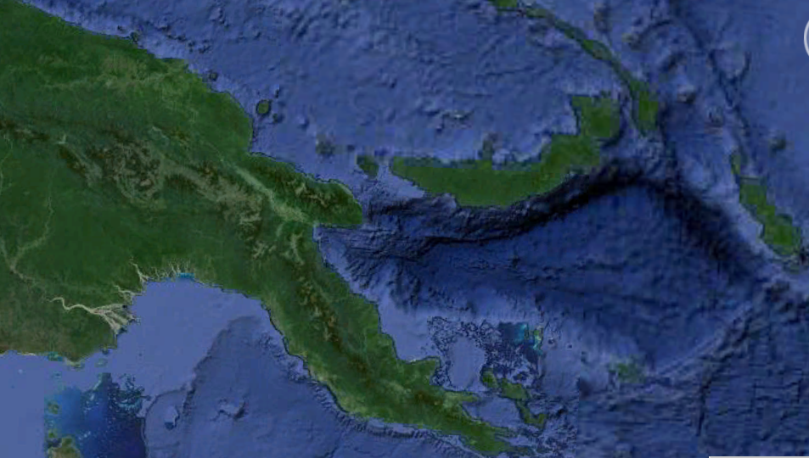
PNG : KEY STATISTIC
Landmass : 462,840 km²
Population: About 8 million
3 MNO (GSM, CDMA,UMTS & LTE
Mobile Penetration: About 40-50%
PSTN Penetration: 1.2%
1 Fixed Cable Network Operator
2 International fiber cable links

Slide 4
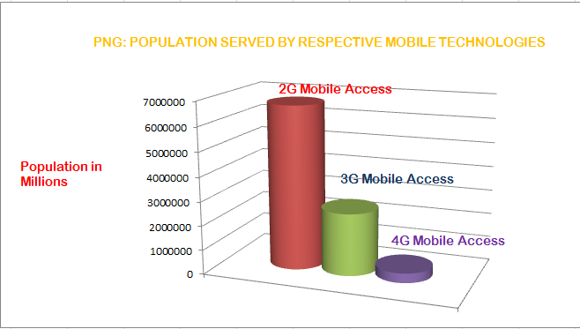
PNG STATUS

Slide 5
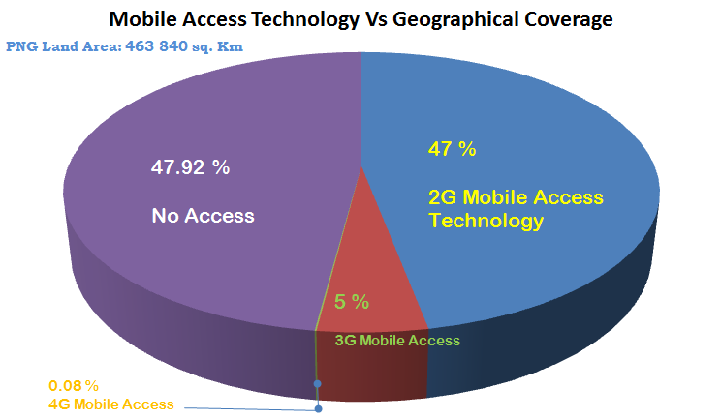
PNG STATUS

Slide 6



PNG: Major Operators
TELIKOM PNG : (FIXED and MOBILE)
FIXED - ADSL, Fiber, WiMAX, Satellite
MOBILE – CDMA +EVDO (3G), UMTS
BEMOBILE : (MOBILE)
MOBILE - GSM EDGE (2.5G) UMTS (3G)
DIGICEL : (MOBILE & FIXED WIRELESS)
FIXED - Satellite , WiFi
MOBILE - GSM +EDGE (2.5 G) UMTS+HSDPA (3G)
LTE (4G)

Slide 7
UNIVERSAL ACCESS & SERVICE STRUCTURE
NICTA Board
Under NICTA (Regulator)
UAS Board
UAS board reports to NICTA board
UAS Director
NICTA board has the final say
UAS Secretariat

Slide 8
PILOT PROJECTS ON UNIVERSIAL ACCESS & SERVICE
Three Demonstration Projects
1. Voice Telephony - Completed
2. Broadband School & Community Access – Evaluation Process
3. 3G Internet Access – Evaluation Process

Slide 9
PROJECT 1: VOICE TELEPHONY
1. Least Cost Subsidy Approach (with highest population)
2. Only Voice Telephony – 2G service
3. Awarded to Digicel PNG Limited
4. Total of 59 towers (30m high)
5. Completed ( May 2014-May2015)
6. Independent Verification Agent (IVA) Verified milestone

Slide 10
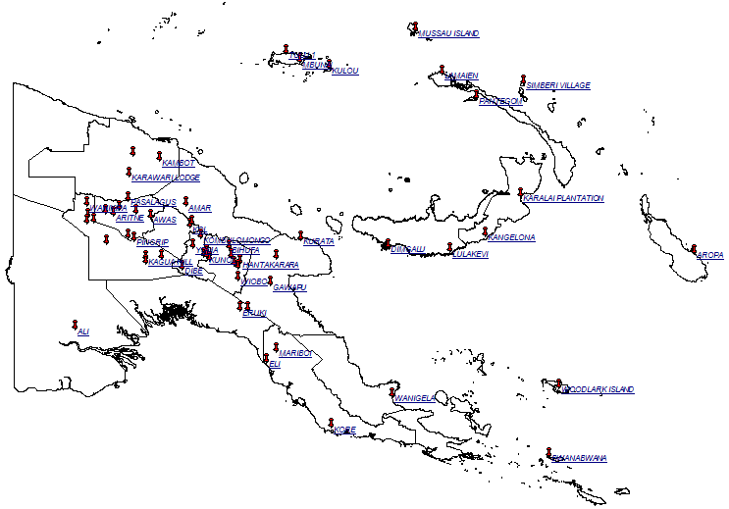
59 TOWERS IN REMOTE LOCATIONS IN PNG

Slide 11
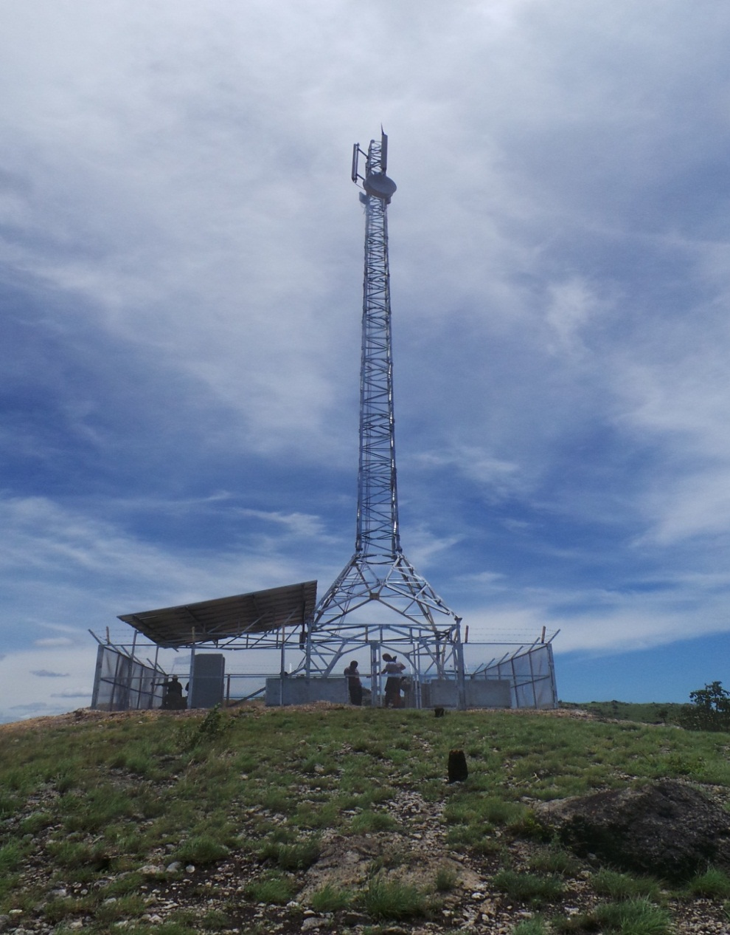
SITE SPECIFICATIONS
30 Meter tower
2G service (3G ready)
All 59 towers in remote area, only accessible by chopper
Powered by Solar energy
Community mobile chargers - Solar energy
Six sites vandalized, three recovered by Digicel, 56 on Air

Slide 12
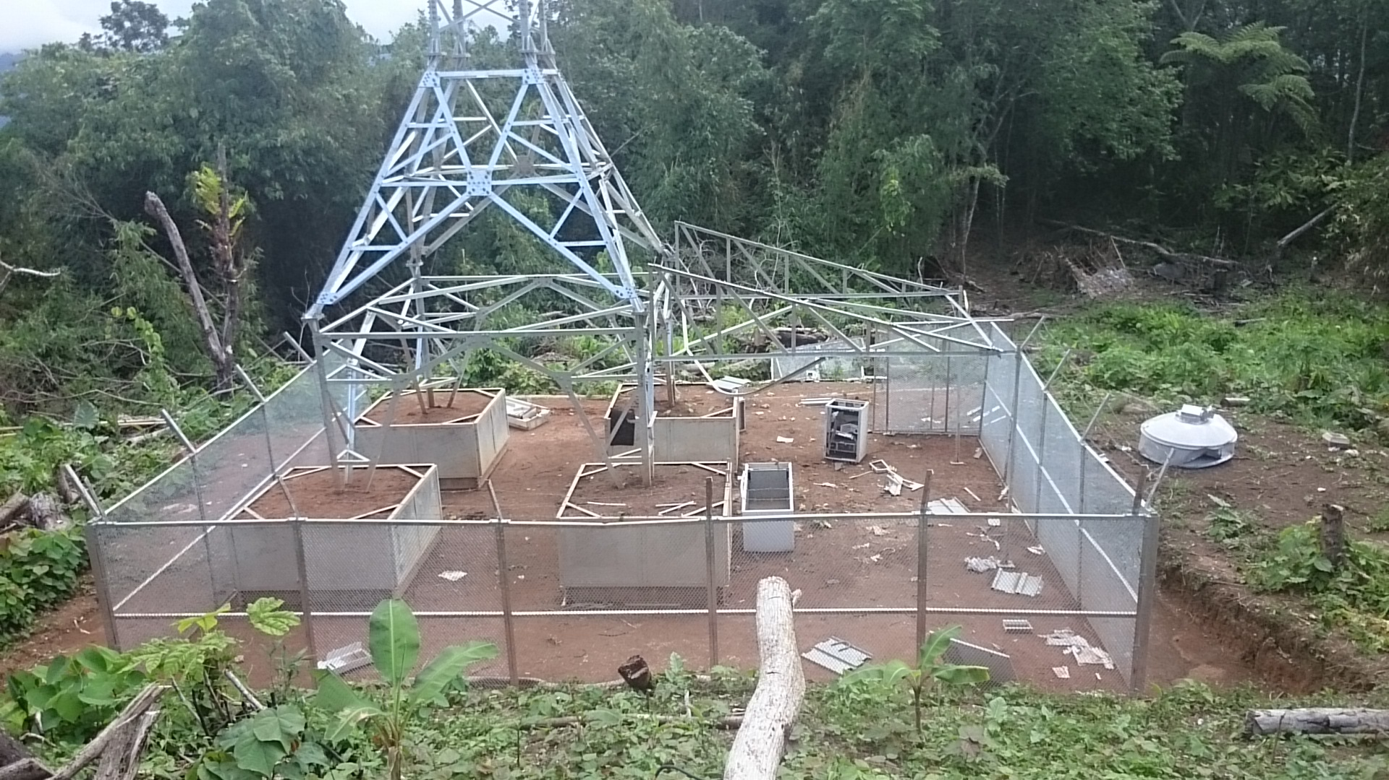
OUR CHALLENGES
Vandalism & Theft

Slide 13
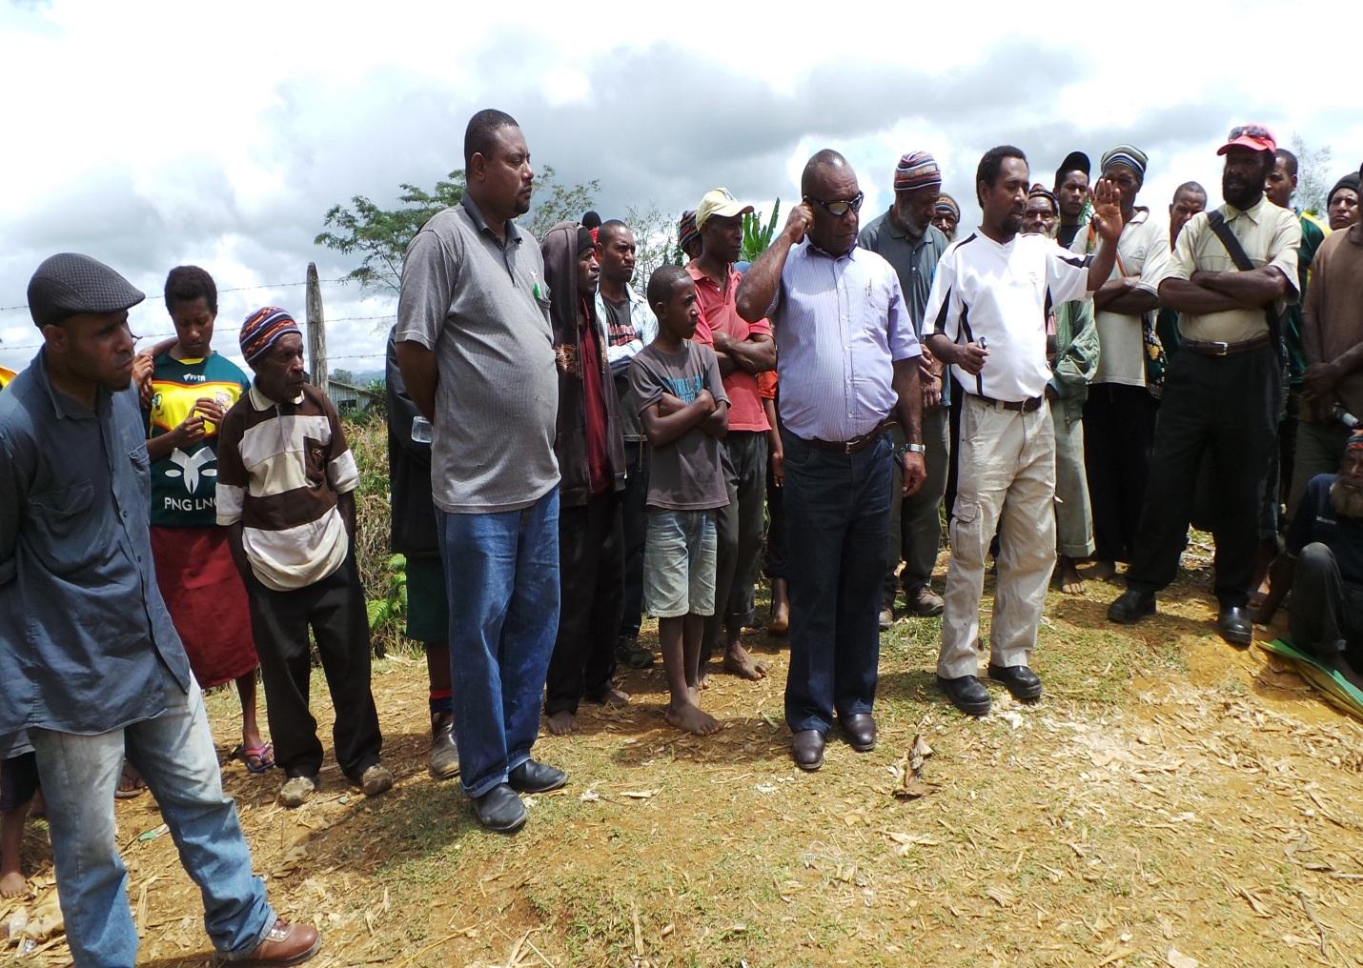
OUR CHALLENGES
Landowner issues

Slide 14
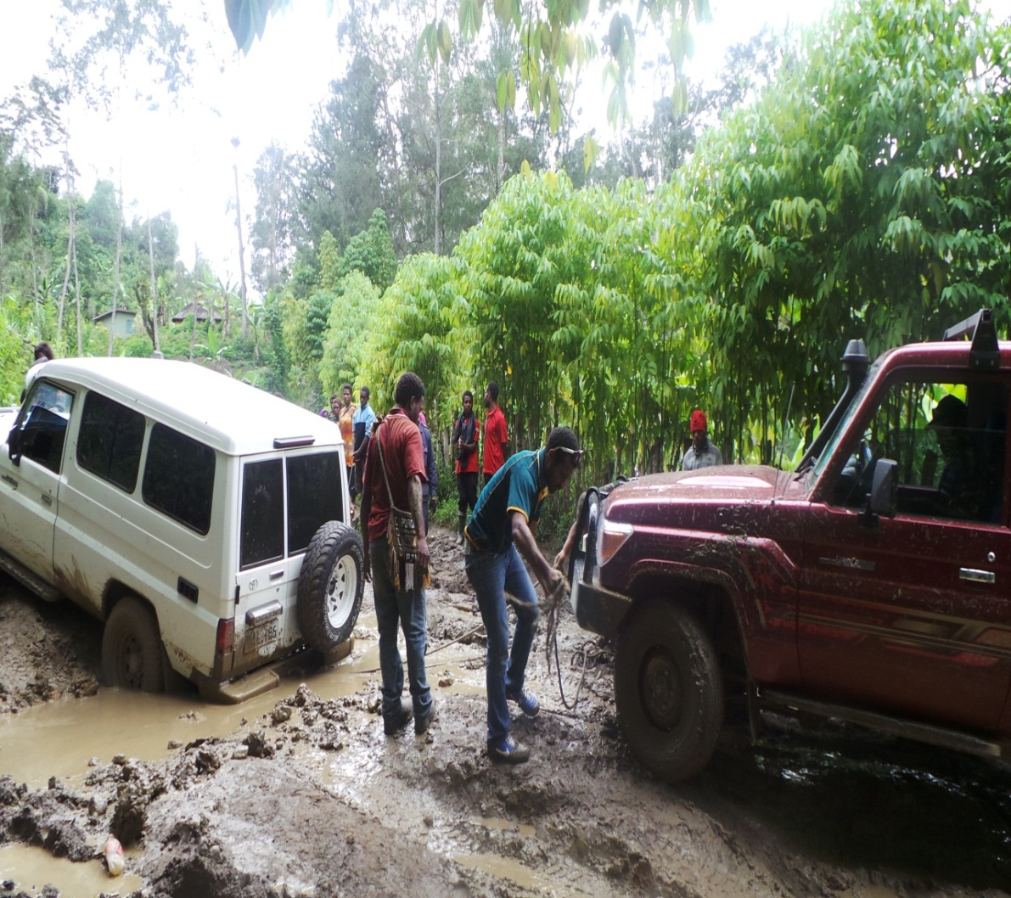
OUR CHALLENGES
Logistics, Road & Weather conditions

Slide 15
PROJECT 2 : BROADBAND SCHOOL & COMMUNITY ACCESS
1. Objective: Provide Broadband Access Service to the Student body and the Surrounding Community
2. Eight High School for the Project
3. Successful Bidder will manage the project in consultation with the School administration
4. Bid evaluation in progress

Slide 16
PROJECT 3 : 3G INTERNET SERVICE
1. Objective:
To provide voice and data/Internet telecommunications network and service in selected geographic locations that currently do not have 3G internet services
2. Either upgrade from 2G or new greenfield
3. Bid evaluation in progress

Slide 17
UAS FUNDING
Pilot Projects funded by the GoPNG, others to be funded by the UAS LEVY
First collection of UAS levy is in progress
Other source of funding will be from NICTA and GoPNG

Slide 18
STEPS TAKEN & WAY FORWARD
Land Mediation process for Land Ownership issues, land rentals in a trust account awaiting land mediation
More awareness in the rural areas
Continue from the three Pilot Projects (Voice & Internet)
Other projects in line with our National Broadband Policy
Continue dialogue with other stakeholders in dealing with underlying concerns like, infrastructure and rural and remote access.

Slide 19
Thank you..

