Slide 1
Defending Against Modern Cyber Advisories
Rajitha Udayanga , CISSP | rajitha.udayanga@gmail.com

Slide 2
The Flow……
Introductions
Cyber attacks and their consequences
Adversary capabilities
Types of attacks / pathways
Cyber security myths
Steps for implementing an effective cyber security program
Cyber security controls Resilience in the face of a cyber attack

Slide 3
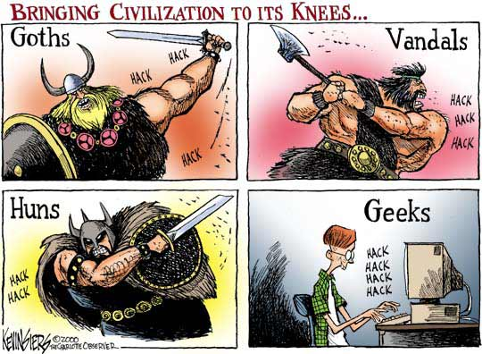
Who is the bad guy and where is he ???
Person who hate for western
Person who has some disorder
Person who want to show their colors
Living in Russian federation
BUT
It has changed

Slide 4
Then who ????
“Insiders” (yes..yes.. Your employees.....)
Evolving technologies and organizational policies
Negligence
Industrial Competitors
Organized Crime
Extremists / Terrorists
Nation States
Source : http://www.cisco.com/web/offer/gist_ty2_asset/Cisco_2014_ASR.pdf

Slide 5
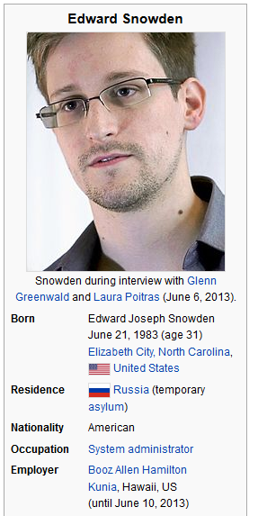
Insiders
Disaffected employees
Former employees
Current or prospective employees
Contractors / out sourced employees
Support service employees
Unintentional action / negligence
Insecure coding / software development
Design / implementation errors

Slide 6
Evolving technologies and organizational policies
“Where does our critical data reside?” and “How can we create a secure environment to protect that data, especially when new business models like cloud computing and mobility leave us with little control over it?”
- cisco security expert
BYOD (Now it’s BYOT)- Bring your own device / thing
IOT - Internet of things
Big data
Cloud services

Slide 7
Organized crimes
Threat: Organized crime is using cyber attacks to make billions of dollars per year through:
Theft
Extortion
Commodity market manipulation
Selling exploits to others
Real World Example: In 2008, cyber attacks
disrupted electrical power in South America.
Impact: Disrupted power in multiple cities.
Cause: European organized crime syndicate
(see http://news.cnet.com/CIA-Cyberattack-caused-multiple-city-blackout/2100-7349_3-6227090.htmll

Slide 8
Extremist/Terrorist Threat
Threat: Disruption or destruction of critical infrastructure, (including emergency response services), denial of service of attacks, theft of information, etc.
Real World Examples:
al Qaeda called for "cyber jihad”
“They will enter the cyber world because it‘s comparatively remote, comparatively safer than strapping on a bomb” said Cofer Black, former head of the CIA Counter Terrorism Center.
In 2011, Anonymous conducted denial of service attacks and broke into “secure” computer systems
operated by governments and private industry.

Slide 9
National State Threats
Threat: Over 100 countries are actively involved in acquiring cyber warfare capabilities.
Low cost / high impact
Real-World Example: Stuxnet
Stuxnet worm targets nuclear industry software and equipment in Iran. Stuxnet impacts only clandestinely obtained Siemens control systems.
Damages plant infrastructure causing extended shutdowns at Iranian nuclear facilities.
Speculation is that a worm of such complexity could only be developed by a nation-state.

Slide 10
How they comes in to my office??
Malware coming from the internet
Malware coming from a trusted source
Wireless break-ins
Social engineering
“Inappropriate” connections
Compromise data storage

Slide 11
Myth | “We have security by obscurity”
“My systems are too old and obscure to be interest to attackers.”
“No one can understand what my system is doing – they can break in but they could not figure out how to abuse the system”
System, language, and control information is readily available on the Internet.
Exercises have shown that given enough time and interest, a hacker can crack and take over most systems.

Slide 12
Myth| “We have firewall and anti virus guard. So we protected”
Provide protection from what?
Known viruses/worms
Some attack pathways
A firewall is only as good as its configuration
Purpose: Deter, delay, detect, & deny
Are firewall logs being monitored to detect an ongoing attack?
Anti-virus tools only protect you from known viruses. Zero-day viruses cannot be stopped.
There may be multiple pathways around (or through) firewalls and anti-virus products.

Slide 13
Myth | “We have no insider threat!”
Even the most secure organizations cannot discount the threat posed by insiders (current or former staff members)
Co-workers tend to protect colleagues
Managers tend to protect their team members. “Michel is having a tough time right now, but they will pull through this.”
It is psychologically easier to mount a cyber attack than a physical attack.
Non-malicious activities or the failure to follow security policies can turn out to be the insider threat that poses the greatest risk.

Slide 14
To be secure….
Examine organization- or corporate-wide cyber security practices
Identify important computer/digital assets
Conduct table top reviews
Conduct walk-through inspections and validation testing
Assess potential threats, attack vectors, and vulnerabilities
Determine the consequences of compromise
Perform simple risk assessments
Evaluate “new” security controls and make risk based decisions on security enhancements
Maintain an ongoing cyber security program

Slide 15
Top four mitigating steps
1. Rigorously conduct system patching
Do not let known vulnerabilities persist for extend periods of time
2. Restrict administrative privileges
Accounts with these privileges are prime targets for attackers
Limit and tightly control accounts with these privileges
3. Perform and enforce application white listing
Only allows authorized applications to run
4. Implement defence in depth
Do not rely on one single technology or defensive measure; have multiple security controls in case one approach fails.

Slide 16
Any questions ????

