Slide 1

NBTC/ITU Workshop
on Cross-Border Frequency Coordination
June 29 - 30, 2015
Bangkok, Thailand

Slide 2

Examples: European HCM-Agreement
The web-site of the European Frequency Co-ordination Agreement,
The HCM-Agreement (Harmonized Calculation Method)
can be accessed via the following link:
Federal Network Agency | Managing Administration of the "HCM Agreement" | Map of Europe
http://www.hcm-agreement.eu/http/englisch/verwaltung/index_europakarte.htm

Slide 3
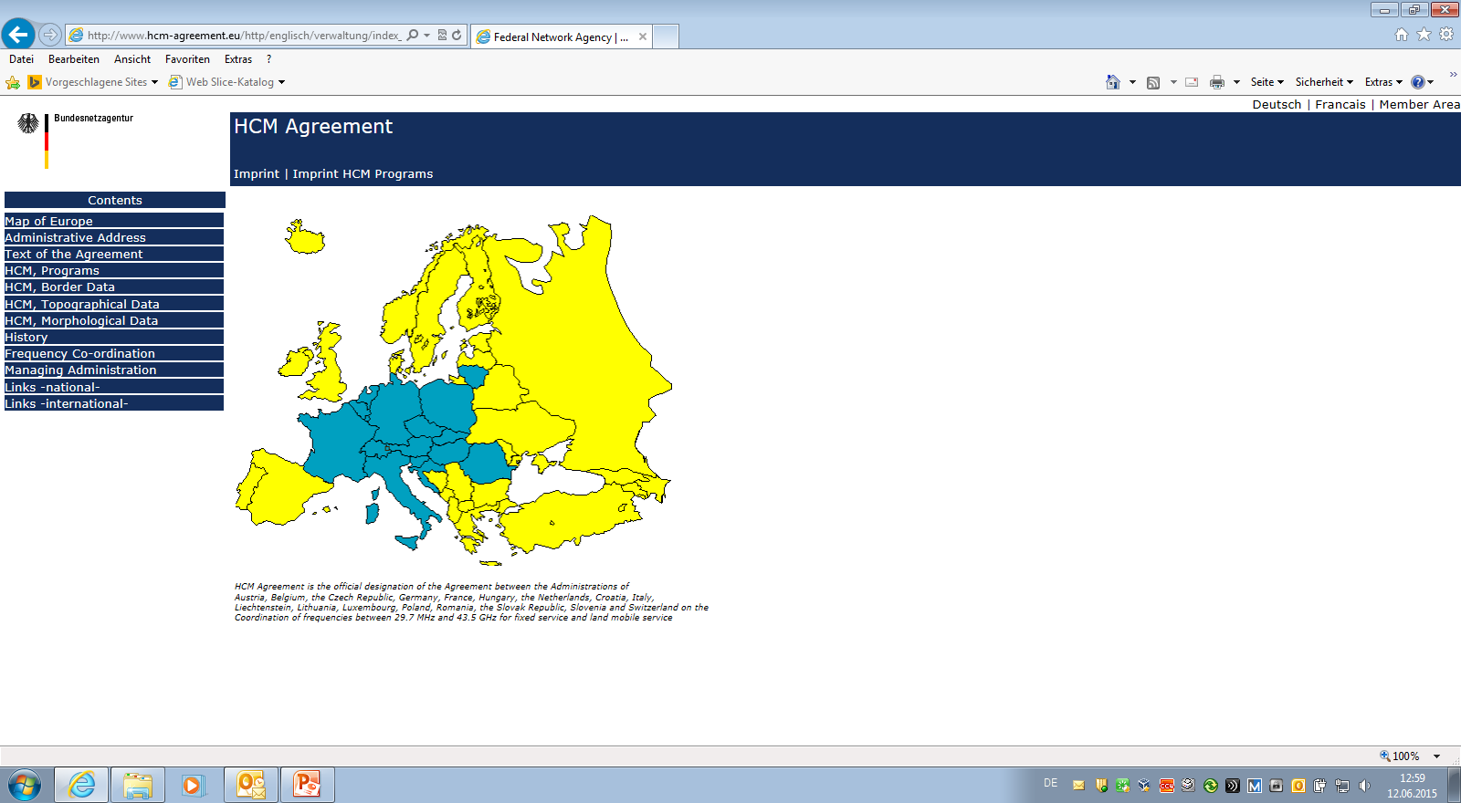
Examples: European HCM-Agreement

Slide 4
Examples: European HCM-Agreement

Slide 5
Examples: European HCM-Agreement
Information on the HCM web-site:
HCM programs
Legacy, test and official versions for fixed and mobile service
.EXE executable test program
.DLL calculation kernel accessible from surrounding programs
Source code, Documentation, User Guide and further tools
HCM Border data
Border data of various regions, border program, manuals
HCM Topo data
Height data of various regions, topo-viewer, manuals
HCM Morpho data
Morpho data of various regions, morpho-viewer, manuals

Slide 6
Examples: European HCM-Agreement
Structure and main features of the HCM-Agreement:
Main Text and fixed/mobile service specific Annexes
Main Text
17 Member Administrations (Signatories)
Frequency Range 29.7 MHz – 43.5 GHz
Fixed Service and Land Mobile Service
Definition of Frequency Ranges for fixed and mobile service
Definition of Frequency Categories
Establishment of Frequency Register and Exchange of Lists
Description of Technical Provisions
Description of Co-ordination Procedure
Status of co-ordinations prior to Agreement

Slide 7
Examples: European HCM-Agreement
Annexes:
Annex 1
Maximum permissible interference field strengths and maximum cross-border ranges of harmful interference for frequencies requiring co-ordination in the Land Mobile Service
Annex 2A
Data exchange in the Land Mobile Service
Annex 2B
Data exchange in the Fixed Service

Slide 8
Examples: European HCM-Agreement
Annex 3A
Determination of the correction factor for the permissible interference field strength at different nominal frequencies in the Land Mobile Service
Annex 3B
Determination of the Masks Discrimination and the Net Filter Discrimination in the Fixed Service
Annex 4
Propagation curves in the Land Mobile Service
Annex 5
Determination of the interference field strength in the Land Mobile Service

Slide 9
Examples: European HCM-Agreement
Annex 6
Coding instructions for antenna diagrams in the Land Mobile Service
Annex 7
Provisions on measurement procedures in the Fixed Service and the Land Mobile Service
Annex 8A
Method for combining the horizontal and vertical antenna patterns
in the land mobile service
Annex 8B
Method for combining the horizontal and vertical antenna patterns in the Fixed Service

Slide 10
Examples: European HCM-Agreement
Annex 9
Threshold Degradation in the Fixed Service
Annex 10
Determination of the basic transmission loss in the Fixed Service
Annex 11
Trigger for co-ordination in the Fixed Service

Slide 11
Examples: European HCM-Agreement
Experience with the HCM-Agreement:
Application of harmonized calculation method leads to reproducible results on both sides of the border
In case of inconsistencies the HCM-Agreement provides guidance on resolution
HCM-Agreement solid basis for a multitude of bi- or multilateral Agreements among Administrations
Very low interference cases experienced in recent years
Investigation showed that most cases were caused by deviating data between co-ordination database and real transmit parameters
Permissible levels are rather conservative, therefore some tolerance in co-ordination triggers and status assignment based on calculations
All Signatories contribute to the further development of the HCM-Agreement

Slide 12

Thank you !

