Slide 1
NBTC/ITU Workshop on Cross-Border Frequency Coordination
June 29 - 30, 2015
Bangkok, Thailand

Slide 2
Calculation of interference
Based on previous introduction of IT-supported frequency co-ordina-tion following examples shall illustrate evaluation of co-ordination obligation and interference calculations in fixed and mobile service:
Fixed Service (CalcFiSH):
Co-ordination Distance (determination of affected country)
Threshold Degradation (stations: point-to-point)
Mobile Service (HCM-MS and GREKO/FLAP):
Co-ordination Trigger (determination of PM on border-line)
Cross Border Range (determination of PM on CBR-line)
Preferential Condition ( determination of PM on x-km-line)
Stations: point-to-point (determination of PM at counter-stations)
Point-to-Area prediction (propagation from a station to an area)

Slide 3
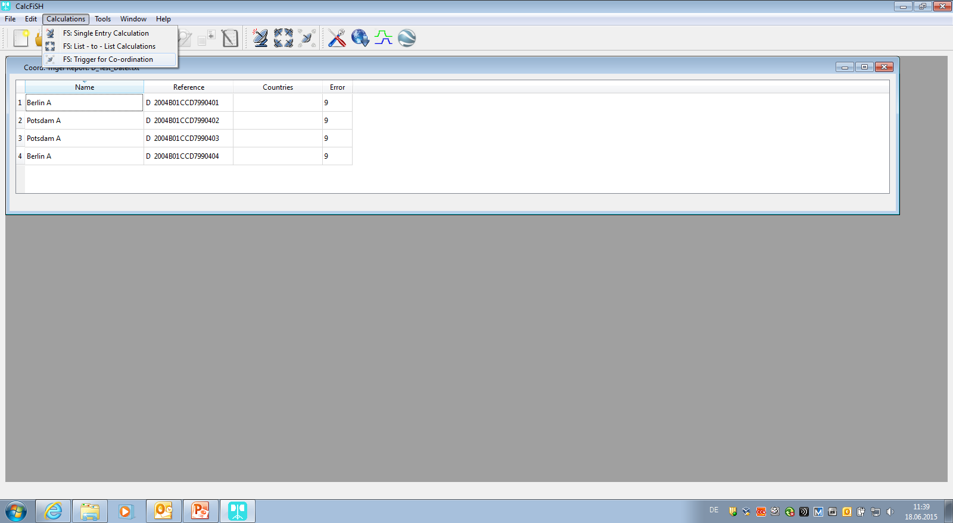
Calculation of interference
No obligation to co-ordinate as no country is affected.

Slide 4
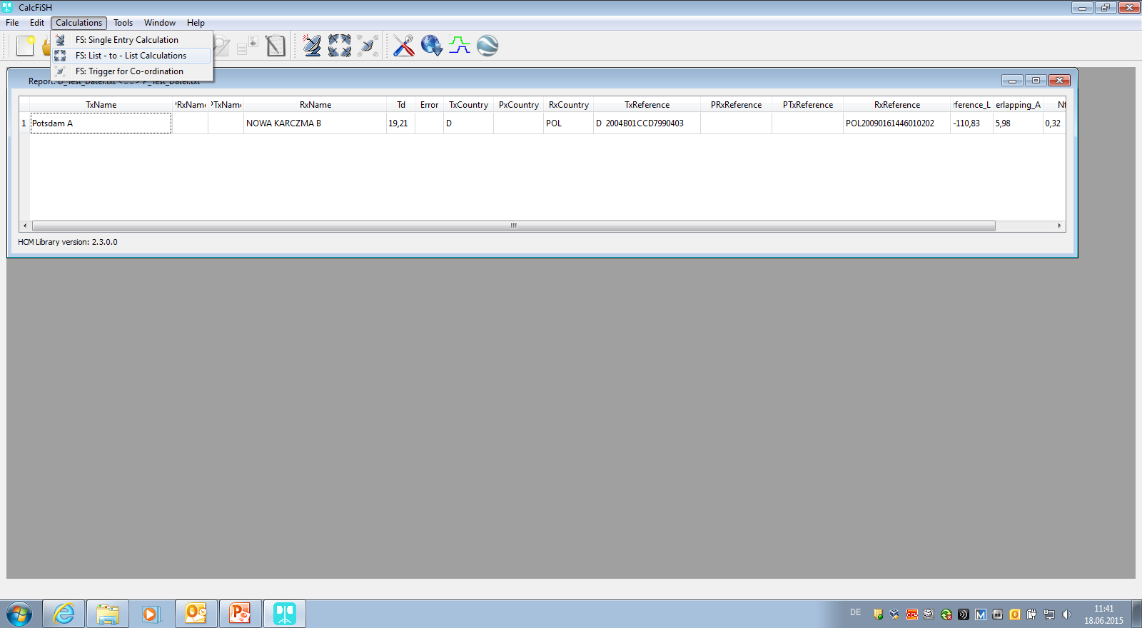
Calculation of interference
Station Potsdam A to be refused as TD > 1 at station of affected country.

Slide 5
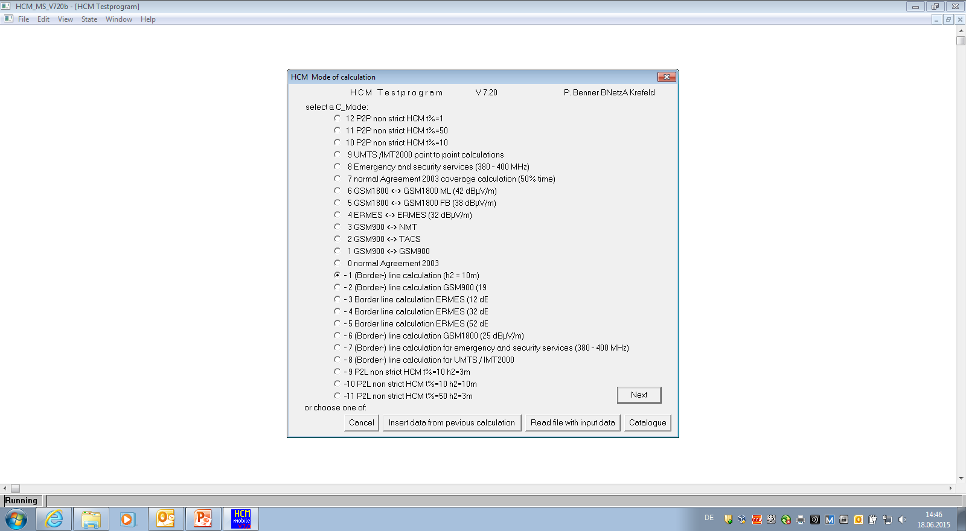
Calculation of interference
Selection of
Cmode -1:
Point-to-Line:
Border-line
Cross Border Range
x-km-line

Slide 6
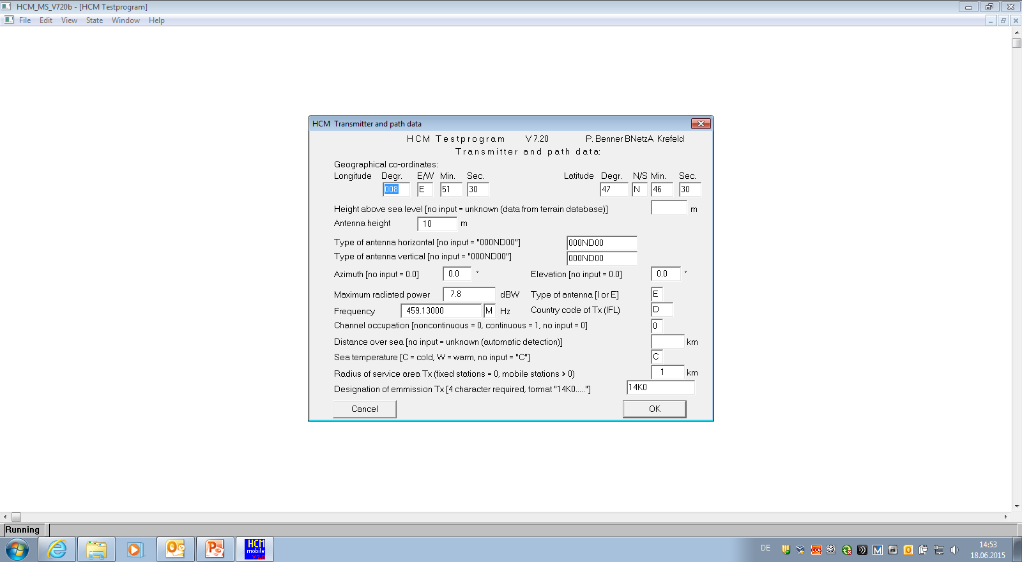
Calculation of interference
Input of
Data of transmitting station

Slide 7
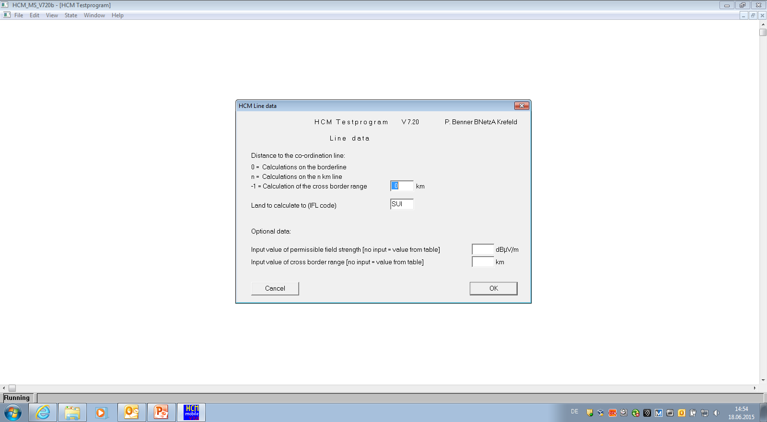
Calculation of interference
Selection of Borderline
and Country

Slide 8
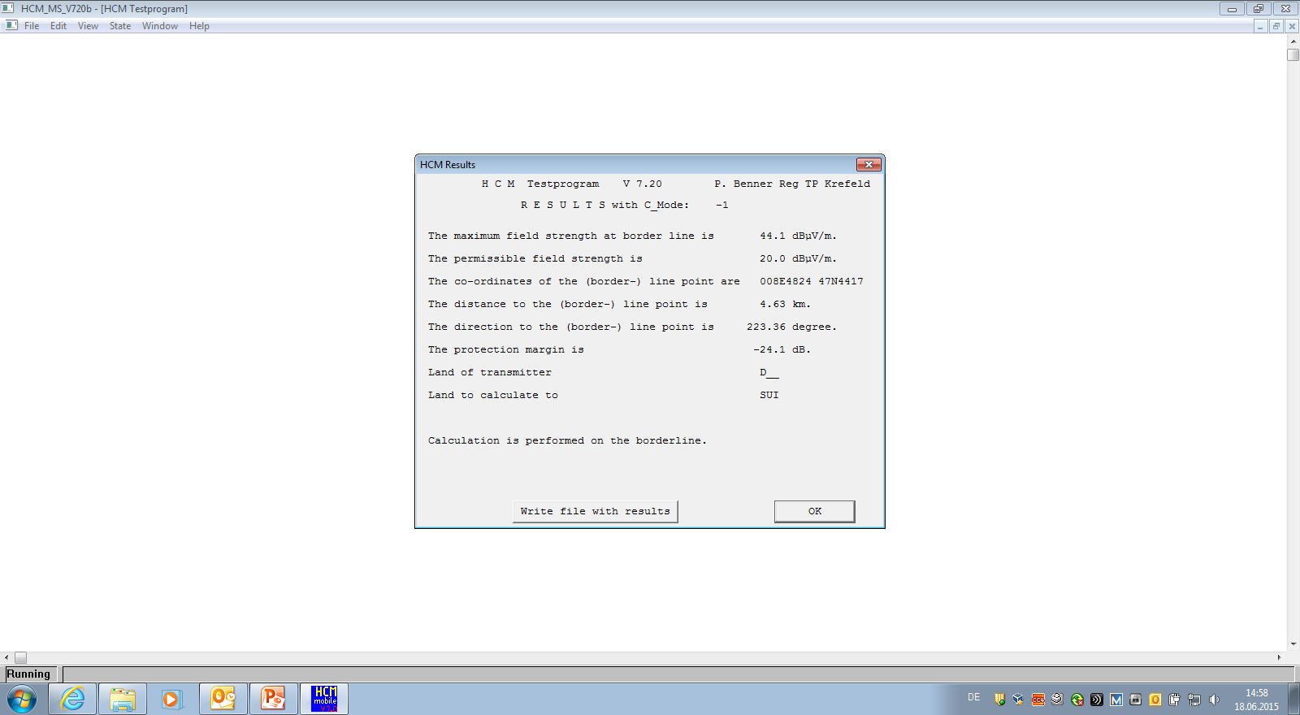
Calculation of interference
Co-ordination obligatory due to negative Protection Margin on border

Slide 9
Calculation of interference
Selection of the Cross Border Range Line and Country

Slide 10
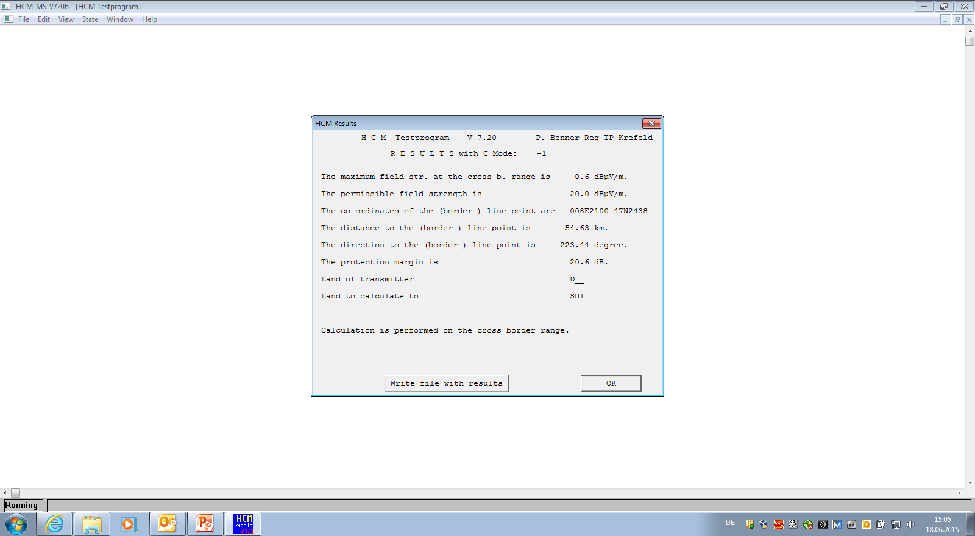
Calculation of interference
No refusal permitted due to positive Protection Margin on CBR-Line

Slide 11
Calculation of interference
Selection of the
x-km-line 50 km and Country

Slide 12
Calculation of interference
In case of preferential frequency no refusal permitted due to positive Protection Margin on x-km-line

Slide 13
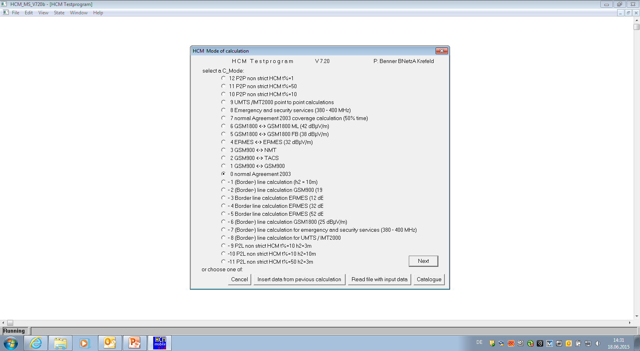
Calculation of interference
Selection of Cmode 0: Interference of Stations:
Point-to-Point

Slide 14
Calculation of interference
Input of data of transmitting station

Slide 15
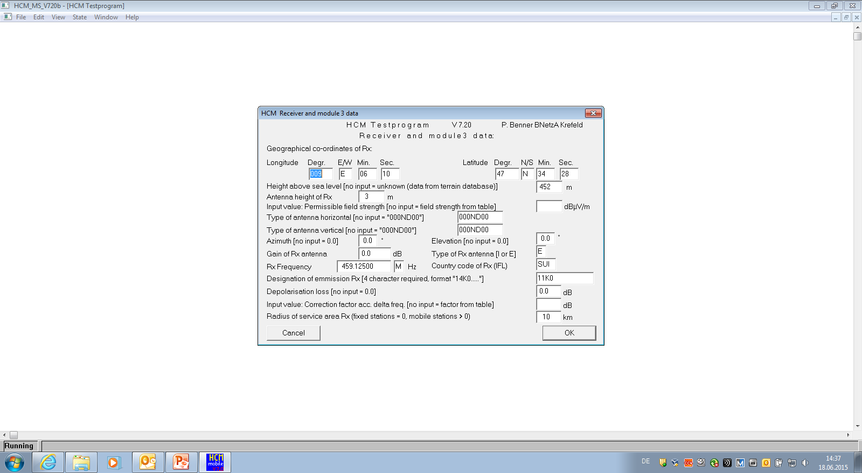
Calculation of interference
Input of data of receiving station

Slide 16
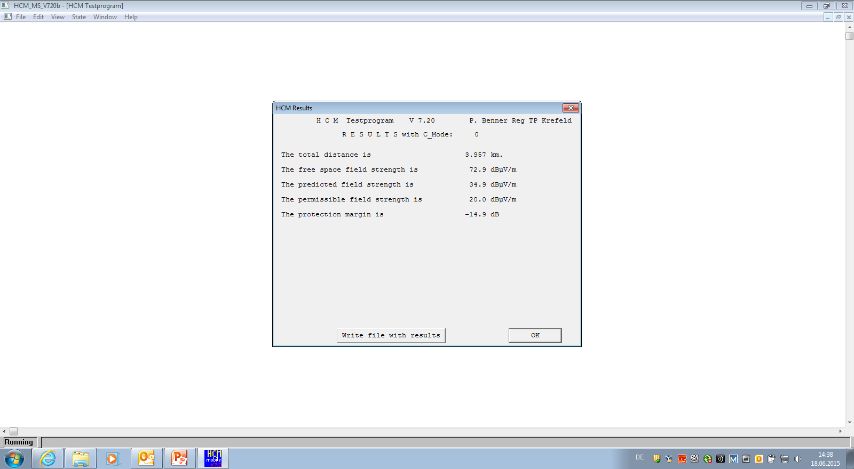
Calculation of interference
Negative Protection Margin at receiving station leads to refusal of request

Slide 17
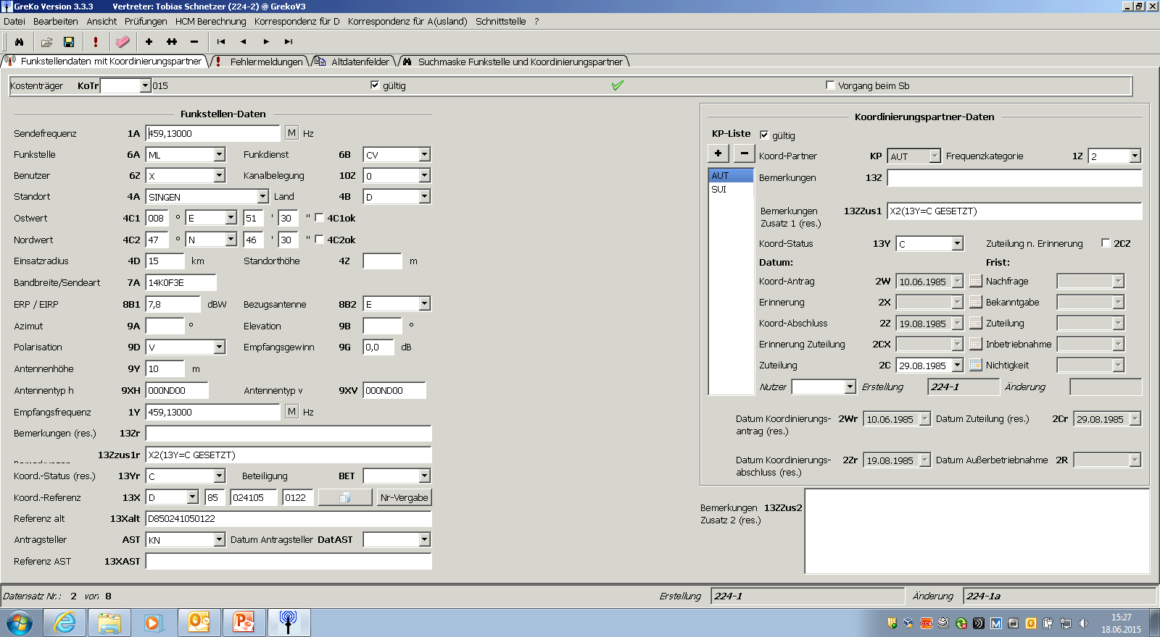
Calculation of interference
Station retrieved from database

Slide 18
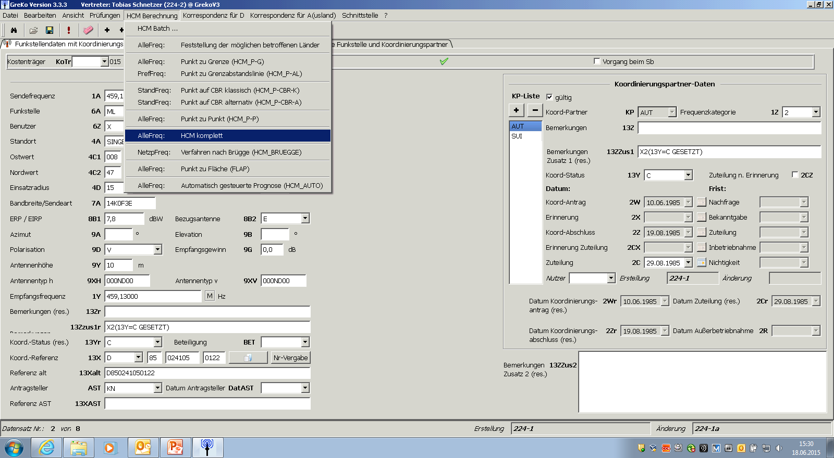
Calculation of interference
Select complete HCM-calculations from menue, i. e.
P2L
P2P

Slide 19
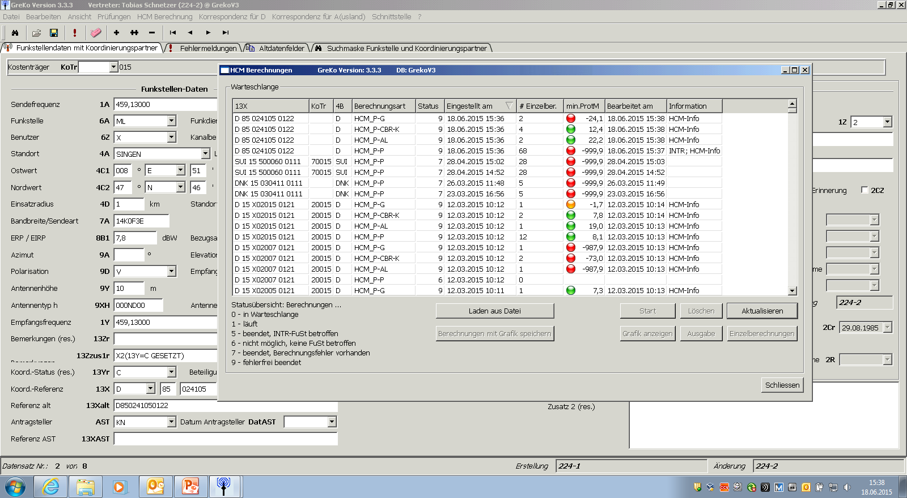
Calculation of interference
Complete results pre-view

Slide 20
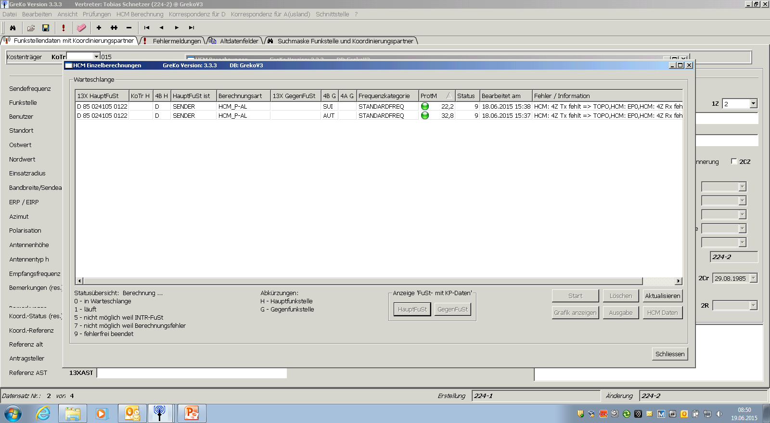
Calculation of interference
Single result view: Point to x-km-line

Slide 21
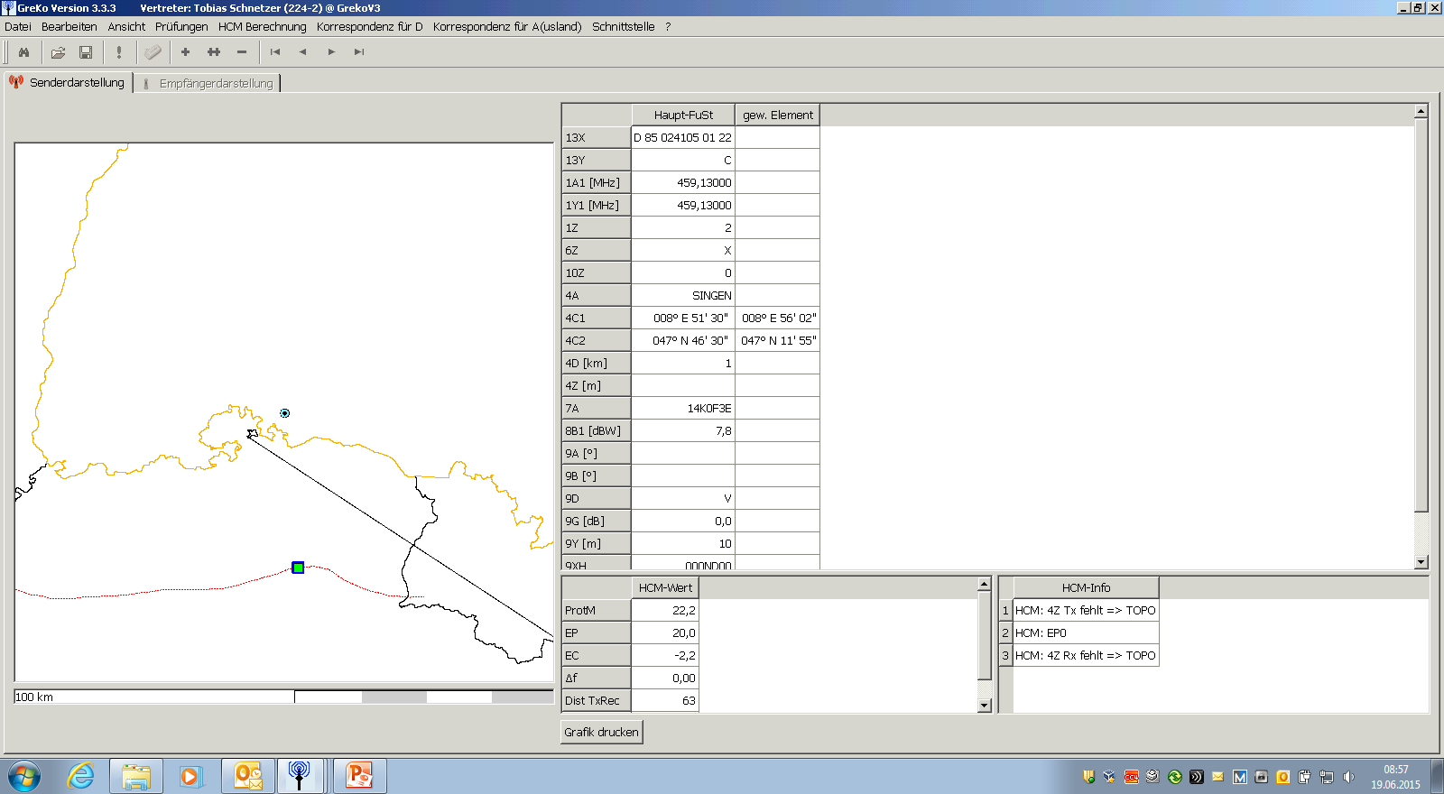
Calculation of interference
Single result graphical view:
Point to x-km-line
Single result graphic view:
Point to x-km-line

Slide 22
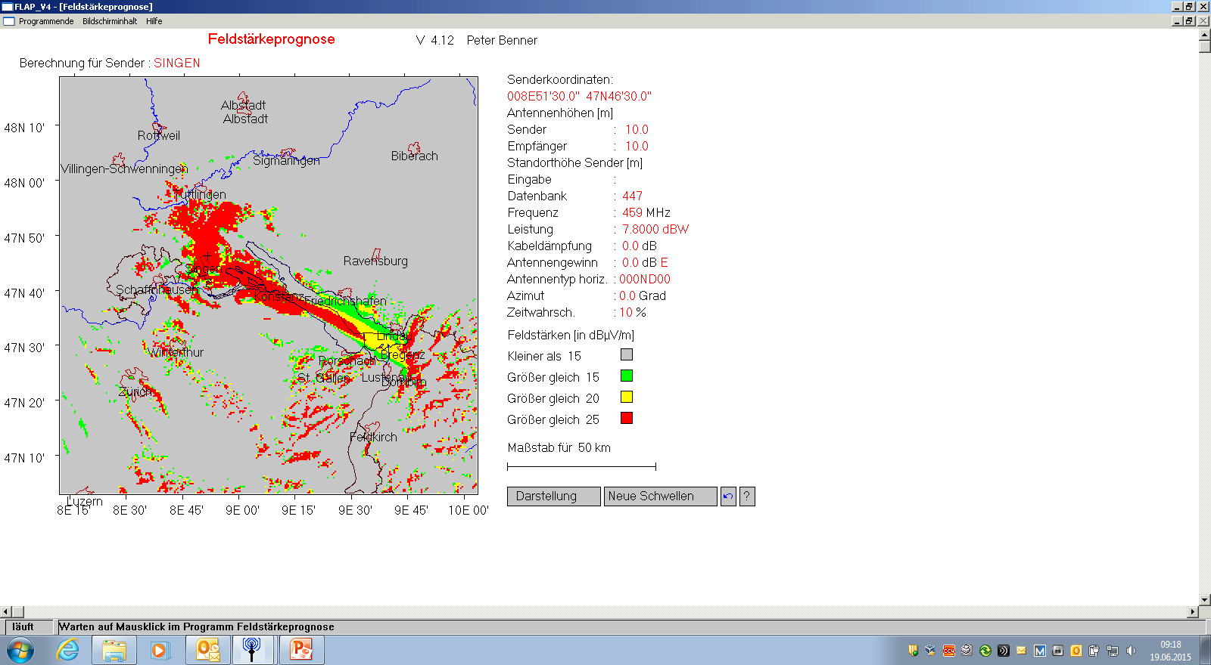
Calculation of interference
Point to Area prediction
Colors/Levels chosen to detect exceeded coverage in affected country

Slide 23
Thank you !

