Slide 1
NBTC/ITU Workshop on Cross-Border Frequency Coordination
June 29 - 30, 2015
Bangkok, Thailand

Slide 2
Software Tools and Common Data
Steps towards IT-supported cross-border co-ordination:
Trigger levels
Frequency categories
Data, data exchange
Propagation model, curves
Calculation modes
IT-support:
Software tools
Co-ordination programs
Spectrum Management systems
Common geographical data

Slide 3
Software Tools and Common Data
Software tools:
Provide a calculation kernel
Single calculations possible
Input manually or by simple file format
Developed often by regional harm./stand. groups
Examples:
HCM-MS-tool DLL and executable test-program
HCM-FS-tool DLL and shell CalcFiSH (Calculation Fixed Service HCM)

Slide 4
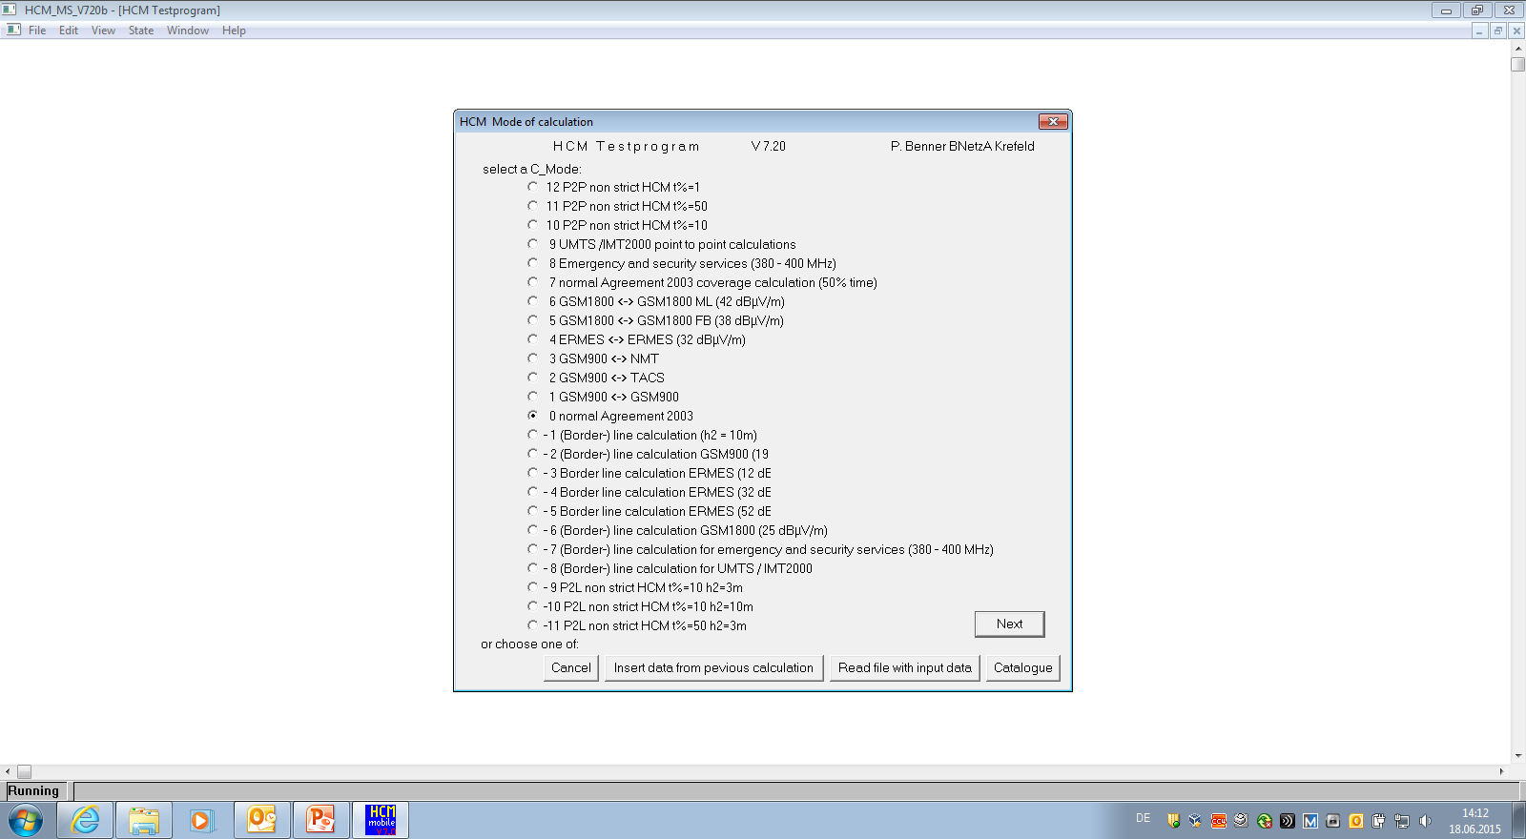
Software Tools and Common Data
HCM-MS-tool

Slide 5
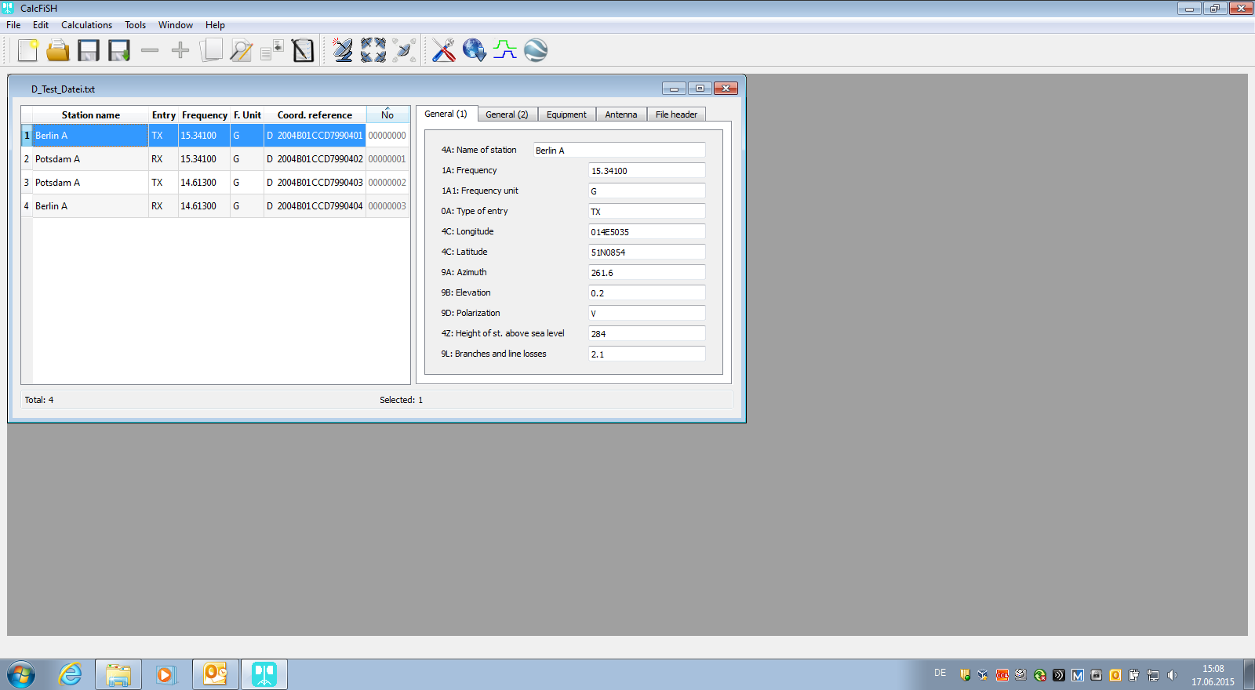
Software Tools and Common Data
HCM-FS-tool
CalcFiSH

Slide 6
Software Tools and Common Data
Co-ordination programs:
Surrounding program
Calculation kernel (.dll)
Mass calculations possible
Attached database
Standard Interfaces
Proprietary products
Example:
GREKO by company OPTIMUM-Solutions

Slide 7
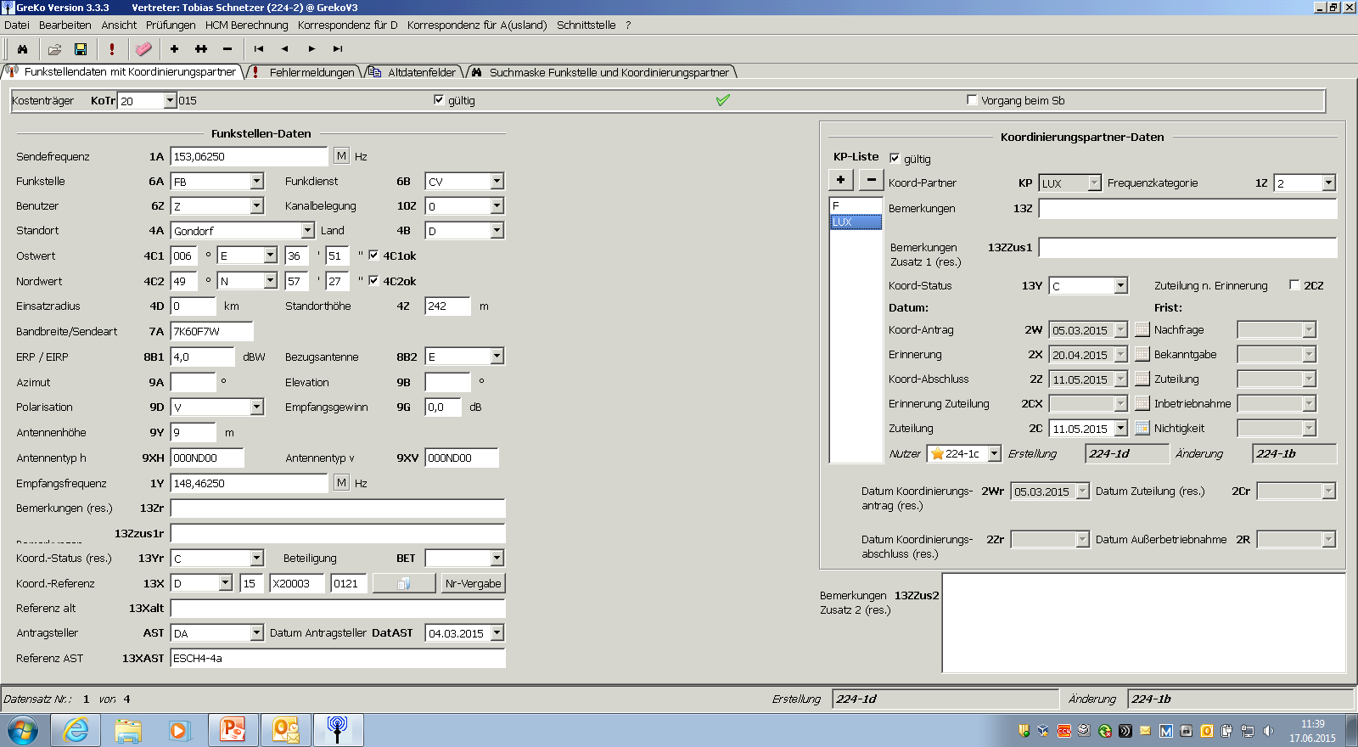
Software Tools and Common Data
Border co-ordination program
GREKO

Slide 8
Software Tools and Common Data
Spectrum Management systems:
Mass calculations for assignment and border co-ordination
High-performance database(s)
Interfaces to import/export files and correspondence required for assignment (licensing) and border co-ordination
Often modular structure
Adaptation to individual requirements/environment necessary
Commercial products
Examples:
ATDI ICS manager
LS-telcom spectra

Slide 9
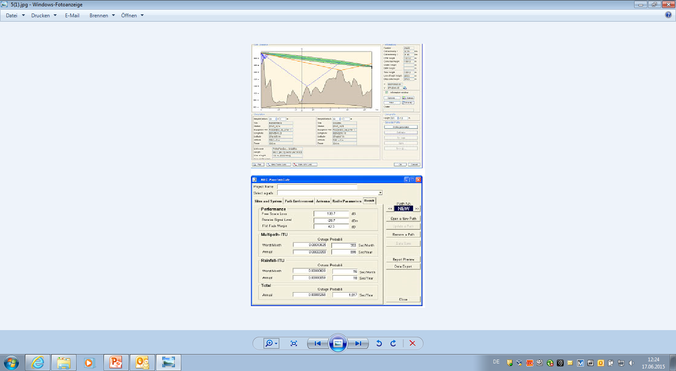
Software Tools and Common Data
ATDI ICS Manager

Slide 10
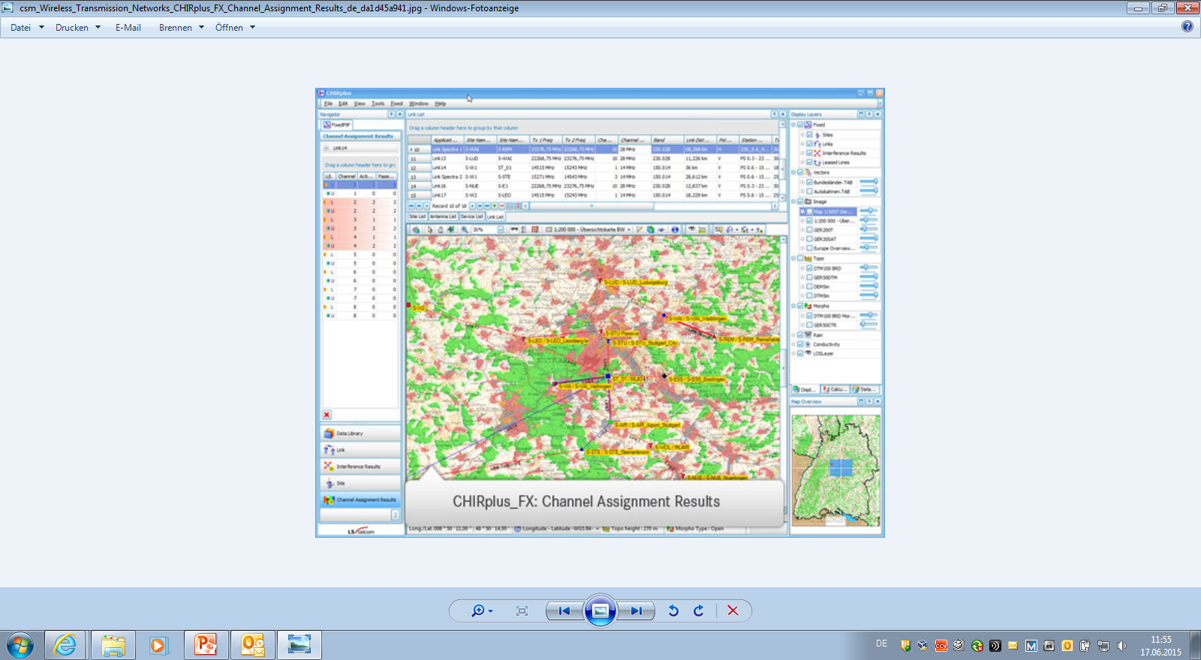
Software Tools and Common Data
LS telcom
CHIR plus

Slide 11
Software Tools and Common Data
Common to all these software is their dependency on geographical data.
In order to achieve similar calculation results on both sides of the border geo-data has to be agreed among administrations applying a co-ordination procedure.
Data has to cover the own country and an additional area in the border zone(s) of neighboring countries, e. g. land mobile service 100 km, fixed service 200-400 km.
Geographical information comprises:
Borderline data
Topographical data
Morphological data

Slide 12
Software Tools and Common Data
(Border-)line data:
Not necessarily the political borders → co-ordination lines
Comprises land-borders, sea-borders, border-distance-lines (x-km)
Line points are defined by their geographical co-ordinates
Necessary granularity dependent on course of border, e. g. 50 m, 200 m
It is recommended that line points in decimal form be stored in files consisting of fixed length records.

Slide 13
Software Tools and Common Data
Topographical data:
The geographical height information may be retrieved from different sources, e. g.
Military (Digital Terrain Elevation Data (DTED) level 1 coverage
National Geographic Institutes
GTOPO30 U.S. Geological Survey (USGS), resolution 30 seconds
SRTM3 (Shuttle Radar Topography Mission), resolution 3 seconds
It is recommended that all source data be converted to a single format, e. g. WGS84 (World Geodetic System 1984) and a certain resolution,
e. g. 3x3 or 3x6 geographical seconds.
An appropriate store format has to be defined.
1 geographical second appr. 31 meters

Slide 14
Software Tools and Common Data
Morphological data:
Consideration of characteristics of objects on the surface may increase accuracy of calculations.
The predominant height of objects may be stored together with morphology class information, e. g.
Normal land
Sea, ocean
Small lake, river
Coastal area
Villages, towns, buildings
Trees
A subset of mentioned criteria may be sufficient, source GTOPO30.

Slide 15
Thank you !

