Slide 1
Software tools - ITU
István Bozsóki
Head of Division
BDT/IEE/SBD
NBTC/ITU Workshop on Cross-Border Frequency Coordination
June 29 - 30, 2015
Bangkok, Thailand

Slide 2
Computer aided spectrum management
The use of computers in the spectrum management process has become crucial for most administrations that are faced with the ever-increasing use of the radio frequencies.
Several aspects of this process, such as frequency coordination, administrative procedures (registration and issuing of licences) and notifications of assignments to the ITU according to the Radio Regulations, are crucial in the establishment of a computer-automated process.
ITU-R Handbook: Computer-aided Techniques for Spectrum Management (CAT) (2015, New)
http://www.itu.int/pub/R-HDB-01

Slide 3
CAT Handbook
This Handbook should be seen as complementary to Handbooks 'National Spectrum Management' (2015) and 'Spectrum Monitoring' (2011).
The topic of national spectrum management has evolved and become the central hot spot in the activities of all telecommunication administrations.
This is particularly true for developing countries, where the dramatic development of ICT technologies and their wide application have led to a heavy increase in related spectrum usage.
The user/reader will find basic material and numerous models for developing efficient projects that will assist in reaching their objective - implementing automated spectrum management as soon as possible.

Slide 4
Chapter 5 of the CAT Handbook
Examples of automated spectrum management procedures
This Chapter illustrates the practical use of methods described in the Handbook on National Spectrum Management and in the previous Chapters of the CAT Handbook to aid the spectrum management process.
Computer techniques can help in at least two ways: managing and examining large amounts of data; and performing calculations, whether complex, or simple but repetitive.
In many cases, administrations have used electronic data interchange to facilitate the coordination and notification processes. The RDD specifies the data elements for the items required for coordination with neighbouring countries. SMS4DC determine the list of the countries with whom to coordinate using the IDWM routines of the ITU-R.

Slide 5
SMS4DC
(Spectrum Management System for Developing Countries)
The International Telecommunication Union Telecommunication Development Bureau (ITU-BDT) can supply a computer program to assist the administrations of developing countries to perform their spectrum management responsibilities more effectively.
This program is known as the Spectrum Management System for Developing Countries (SMS4DC).
SMS4DC is intended to be a low-cost, entry-level spectrum management system; however, it is a very complex software tool with many technical features and functions.

Slide 6
The main features of the SMS4DC
User-friendly GUI
2. Incorporating the ITU IDWM
3. Installable in networked environments
4. Availability of different user access levels
5. Employment of digital terrain model (DTM) on server or workstations
6. Management of a shared hierarchical administrative database
7. Integration of several propagation models
8. Demonstration of calculation results on DTM
9. Generation of BR electronic notice forms
10. Interference calculation
11. Frequency assignment
12. Consideration of regional/national frequency allocation tables

Slide 7
The main features of the SMS4DC
13. Consideration of regional agreements in technical calculations
14. Frequency-planning capabilities
15. Interface with BR-IFIC databases
16. Generation of informative reports
17. Employment of ITU modules for coordination contour calculation around Earth stations
18. Frequency spectrum billing management
19. Link to budget calculation
20. User log for audit control
21. English and French software interface (soon also Spanish)
22. Links to Argus (R&S) and Esmeralda (Thales) monitoring software
23. Interface to Google™ Earth mapping

Slide 8
Some of the main functions of the SMS4DC
Utilities and Administrative
ability to track coordination requests or responses received to coordination requests,
Technical
implementation of ITU-R propagation models as well as other relevant ITU-R recommendations for various types of implemented radio services,
frequency coordination calculations,
interference analysis for assigning frequencies to stations in given locations,
determination of affected countries for conducting international coordination.
Graphical user interface
User friendly interface, displaying of DTM, capability of importing standard mapping formats including Globe map and displaying of geographical maps,
Online latitude, longitude and altitude presentation, overlaying, Scrolling and Zooming functionality capability of handling vectors

Slide 9
Structure of the SMS4DC
BR IFIC
SRS
External Database
Interface to the externaldatabases
MAPS
InternalDatabase
LIBRARIES
SMS4DC software
Technical& Administrative Modules
Interface to the externalresources
External Resources and Applications
Monitoring Systems
IDWM
RR App.7

Slide 10
Frequency Assignment and Interference Calculation
SMS4DC offers a range of functions that can be used to provide detailed technical and administrative assistance in the assignment of frequencies to the Land Mobile, Fixed and Broadcasting Services.
These include:
Providing a database structure that contains all the necessary technical and administrative information;
Ability to specify which channels are available;
Automatic assessment of all available channels in a given frequency range;
Propagation tools to estimate service/coverage/interference areas;
International frequency coordination tools
SMS4DC automates the technical analysis used in the assignment process but does not decide which frequency should be assigned. The engineer must have a thorough understanding of the principles of frequency assignment in order to interpret the results and, if necessary, carry out more detailed analysis.

Slide 11
SMS4DC Frequency Co-ordination Menu
Broadcasting service (Regional Agreements):
• Analogue Sound Broadcasting (GE84 Agreement)
• Analogue Television (ST61, GE89 and GE06 Agreements)
• Digital Sound Broadcasting (GE06 Agreement)
• Digital Television Broadcasting (GE06 Agreement)
Fixed and Land Mobile services:
Bi-lateral and Multi-lateral Co-ordination Agreements
Enables the technical details of Coordination Agreements to be stored in the database, while (Border) provides functions to assess whether a station meets the technical conditions of the Agreement
Earth station coordination (RR Appendix 7 procedure):
Calculation of the coordination contour and the effected countries.
Also calculate interference caused or received by a selected Earth station on or from other Earth stations or Fixed stations located inside the coordination contour.

Slide 12
Broadcasting services
Co-ordination includes interference analysis and frequency co-ordination tools between Broadcasting Services and between Broadcasting Services and some of the other services (Fixed and Land Mobile only) sharing the frequency bands in the ST61, GE84, GE89, and GE06 Agreements.
Interference analysis methods are in conformity with the relevant requirements of the Agreements

Slide 13
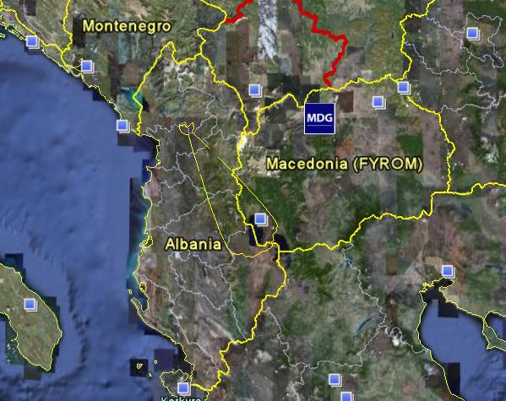
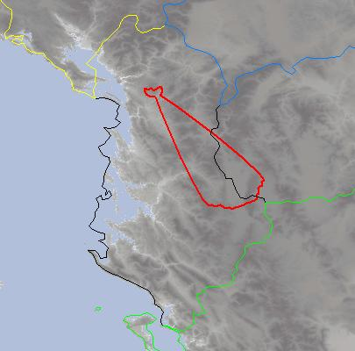
GE-06 (Broadcasting)
GE06 Agreement FXLM2BCBT (Affected Admin)
Identification of Administrations whose broadcasting service is likely (potentially) to be affected by a wanted station in fixed or land mobile service inside another country. Right-hand screenshot shows the coordination contour for the wanted FX station crossing the border of an administration whose broadcasting service is likely to be affected. Left-hand screenshot shows this result exported to Google Earth.

Slide 14
Fixed and Land Mobile Service Coordination Agreements
These are agreed between countries on a bi-lateral or multi-lateral basis and are generally used to assist frequency coordination and avoid interference in border areas.
Without such an agreement, co-ordination could be on a first-come-first-served basis.
Agreements allow frequency bands to be shared equitably between all the countries sharing a border, by dividing the bands into “preferred” and “non-preferred” sub-bands.
In its preferred sub-bands, a country has preferential usage rights. Agreements define the preferred sub-bands allotted to each country and the associated technical conditions for the usage rights, for example by specifying the maximum field strength at the border or at some distance from the border in the territory of the other country.
The SMS4DC Coordination menu (Agreements) enables the technical details of Coordination Agreements to be stored in the database, while (Border) provides functions to assess whether a station meets the technical conditions of the Agreement

Slide 15
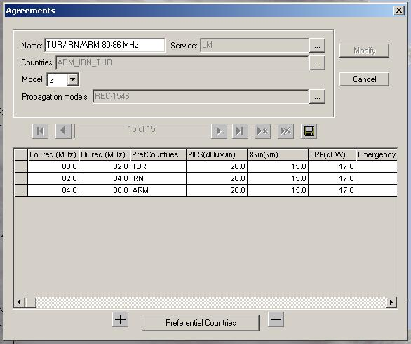
Example for the Land Mobile service
The example shows a cross border coordination agreement for the band 80-86 MHz among three administrations. Three sub-bands are established, one for each country, giving preferential assignment rights. The limits of the preferential rights are 20 dbuV/m measured at 15 km across the border. For coordination of receivers, a reference transmitter with e.r.p. of 17 dBW is used.

Slide 16
Earth station coordination (RR Appendix 7 procedure
SMS4DC has two main menu items that assist with the Appendix 7 procedure. The Options->RR Appendix 7 sub-menu in the IDWM view, enables selection of an Earth station in the database and drawing the various coordination contours (in accordance with BR R1448 software) on the IDWM map.
The Options->RR Appendix 7 (GIBC) sub-menu in the IDWM view uses Appendix 7 software which is integrated into GIBC and produces coordination contours information around earth stations. The input and output to the program will be the same GIBC uses.
By selecting an Earth station from SM44DC database the input data is generated automatically in SNS database format, and sent to BR GIBC Appendix 7 software. After calculation of coordination contours by GIBC software, these contours could be shown on SMS4DC maps.
The DEM Interference menu has sub-menu items to calculate interference caused or received by a selected Earth station on or from other Earth stations or Fixed stations located inside a circular area around the selected Earth station, using ITU-R Recommendation P.452, by consideration of antenna patterns.

Slide 17
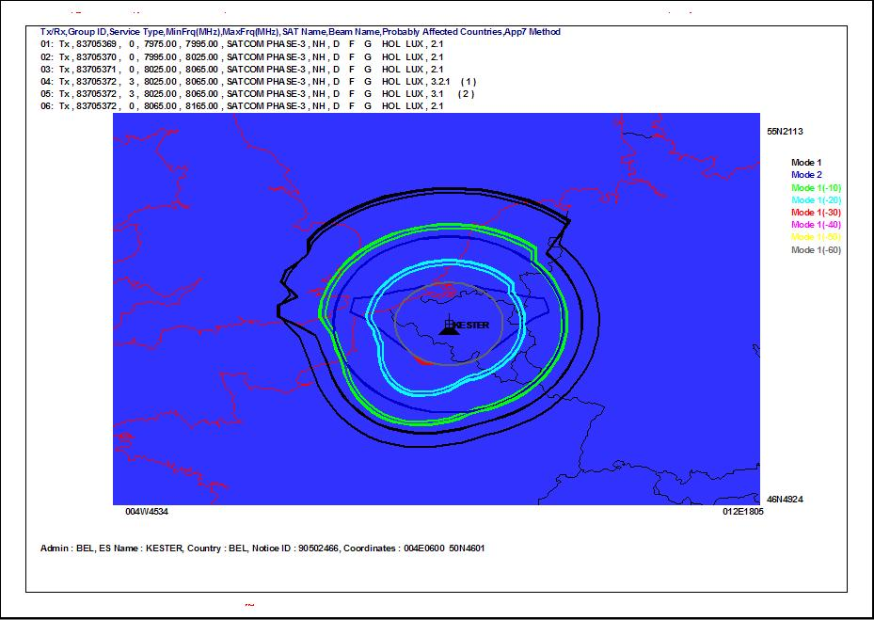
Coordination contours around an Earth station

Slide 18
HCM in SMS4DC
V5 of SMS4DC is under development
HCM calculations will be included
When HCM4A .dll is ready, it will be added

Slide 19
Thank you !
István Bozsóki
Head of Division
BDT/IEE/SBD
Istvan.bozsoki@itu.int

