Slide 1
Administrative Classification of Frequencies
NBTC/ITU Workshop on Cross-Border Frequency Coordination
June 29 - 30, 2015
Bangkok, Thailand

Slide 2
Administrative Classification of Frequencies
Spectrum Efficiency
Service Quality
Interference Avoidance
Operators‘ Business Case
Reliable Radio Links
Sufficient Coverage
Administrations
Focus of International Frequency Co-ordination
Border area may not be appropriate for operators to fulfil coverage obligations imposed by administrations

Slide 3
Administrative Classification of Frequencies
Classification of frequencies
Characteristics:
Aim is to customize / optimize frequency usage
Definition of specific scenarios for which certain frequencies apply
Frequency category is transferred in co-ordination procedure
Enables quick identification of applicable agreements / conditions
Accelerate frequency co-ordination procedure
Accelerate frequency assignment
Increase of spectrum efficiency

Slide 4
Administrative Classification of Frequencies
Overview of defined frequency categories:
1 Frequencies requiring co-ordination (2)
2 Preferential frequencies (1)
3 Frequencies for a planned radio communications network (4)
4 Frequencies used on the basis of geographical network plans (3)
5 Shared frequencies (5)
6 Reserved for bi- or multilateral use (6)
7 Frequencies using preferential codes (7)
Frequencies used on the basis of arrangements between operators (8)
bold Frequency categories covered in presentation
(n) Code of frequency category in data exchange

Slide 5
Administrative Classification of Frequencies
1. Frequencies requiring co-ordination:
Frequencies which Administrations are required to co-ordinate with the other Administrations affected before a station is put into service.
First-come-first-served basis
Resource might become scarce
Regular co-ordination procedure applies

Slide 6
Administrative Classification of Frequencies
2. Preferential Frequencies:
Frequencies which the Administrations concerned may assign, without prior co-ordination, on the basis of bi- or multilateral agreements under the terms laid down therein.
Predefined and equal shares
Notification procedure applies
Often used in harmonized frequency bands, similar techn. conditions

Slide 7
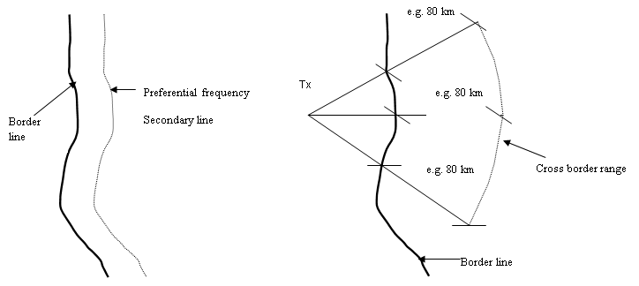
Administrative Classification of Frequencies
Frequencies requiring Co-ordination vs. Preferential Frequencies
Limitation of interference extending into foreign territory caused by own stations.

Slide 8
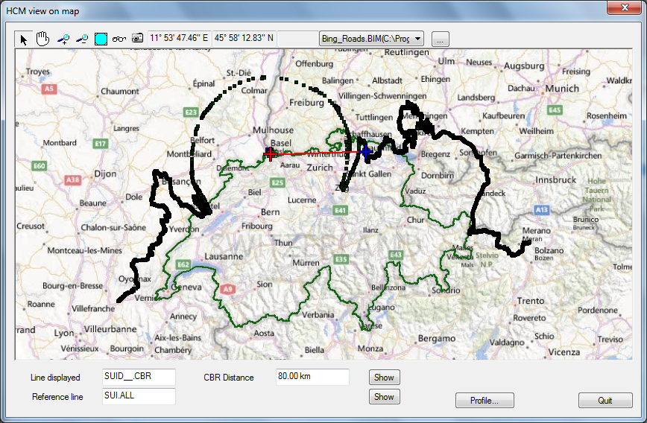
Administrative Classification of Frequencies

Slide 9
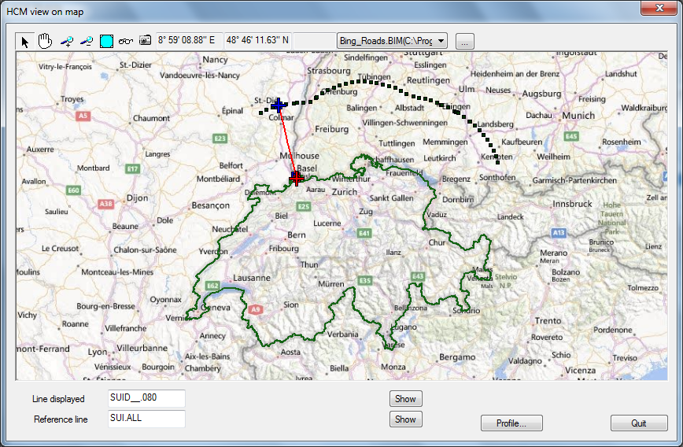
Administrative Classification of Frequencies

Slide 10
Administrative Classification of Frequencies
3. Frequencies for planned radio networks:
Frequencies which the Administrations must co-ordinate with a view to the subsequent introduction of coherent radio communication networks, where the number of locations multiplied by the number of frequencies exceeds 36.
Consultative procedure may take 3 years, planning criteria and station data to be transmitted
Without consultation 180 days, data similar to co-ordination request
Wider timeframe allows deeper analysis and may lead to better co-ordination results

Slide 11
Administrative Classification of Frequencies
4. Frequencies used on the basis of geographical network plans:
Frequencies used for the Land Mobile Service, in the countries concerned on the basis of a geographical network plan prepared and adopted in advance, taking into account the technical characteristics set out in that plan.
Cross-border alignment of national lattice plans
Administrations authorized to put stations into service without prior co-ordination
In the past often used in analogue PMR

Slide 12
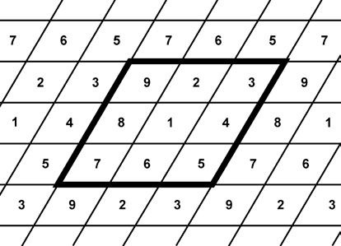
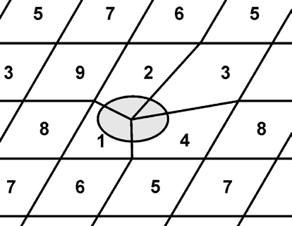
Administrative Classification of Frequencies
national
Country A
Country B
A group of e. g. nine frequencies form a unit which repeats frequently. Therfore frequencies are distributed according a fixed pattern and kept at a certain distance. Standardized transmitter parameters ensure interference free re-use.
Borderline
To ease cross-border co-ordination both national lattice plans have to be aligned . Frequency usage areas close to the border have to be adapted to course border-line.

Slide 13
Administrative Classification of Frequencies
5. Frequencies used on the basis of arrangements between operators:
Frequencies laid down in arrangements between operators may be used without prior co-ordination, on the condition that there is an existing agreement signed by the Administrations concerned authorizing such arrangements. These arrangements between operators may also include the use of the codes.
In WB-PAMR division of frequency bands into preferential frequencies is not feasible because of block-size (1.25 MHz, 5 MHz)
Principle of “Equal Access Probability” applies, but may not ensure sufficient coverage in border areas in all cases
Therefore conditions of operators arrangements may deviate from agreements between administrations
Operators arrangements have to be approved by administrations
example-coord-agreement
example-oper-arrangement

Slide 14
Administrative Classification of Frequencies
Equal Access Probability:
The concept of equal access probability is a new frequency planning principle enabling equitable coverage for two or more networks using the same frequency band with same or different digital technologies in geographically adjacent areas without co-ordination.
Operation of stations in the respective border area exceeding the specified field strength values after performing traditional frequency co-ordination would disturb the balance in the respective border area and is therefore not desireable -> avoidance of co-ordination.
Conditions for operators on both side of the border are not optimal but equal in respect to
grade of service, call drop rate, data rate, BER, capacity loss, time/location probability.
Co-ordination policy for WB-PAMR (FDD and TDD) technologies is defined as
maximum permissible field strength values at a height of 3 m at the borderline and at the border-distance line (x-km-line)
worst-case scenario assumed i. e. centre frequencies aligned, no usage of preferential codes, usynchronized TDD

Slide 15
Administrative Classification of Frequencies
Equal Access Probability:
FS dBµV/m
80
60
40
20
10
8
6
4
2
0
2
4
6
8
10
Distance
FS permitted by system of the other side of the border in 3m heigth
at x-km-line (6) limited to level of thermal noise to avoid interference
at borderline (0) ca. 20 dB higher to compensate fading effects

Slide 16
Administrative Classification of Frequencies
Preferential Frequency Agreements:
Advantages:
All Administrations get same shares (also small countries)
2-country case 50:50
3-country case 33:33:33
4-country case 25:25:25:25
Immediate assignment after notification
Deeper coverage of own border zone (x-km-line)

Slide 17
Administrative Classification of Frequencies
Preferential Frequency Agreements:
Disadvantages:
Limitation of countries‘ shares
Shares of smaller countries may remain unused
Use of other countries pref-frequencies only as non-pref frequencies until co-ordination trigger
Efforts to draft and conclude an agreement
If new agreement is establihed in already used frequency ranges: Exchange of lists to protect existing assignments in foreign pref. ranges
example-pref-agreement

Slide 18
Thank you !

