Slide 1
Frequency Co-ordination - The Procedure
NBTC/ITU Workshop on Cross-Border Frequency Coordination
June 29 - 30, 2015
Bangkok, Thailand

Slide 2
Frequency Co-ordination - The Procedure
Dependent on:
Radio service (mobile, fixed, broadcasting, satellite)
Frequency range (exclusive, shared)
Frequency category (co-ordination, notification)
Basic sequence:
request
Requesting
Administration
Affected
Administration(s)
answer

Slide 3
Frequency Co-ordination - The Procedure
1. Evaluation of obligation to co-ordinate:
Application of co-ordination trigger-criterion (threshold):
Fixed Service: Co-ordination Distance to the borderline(s) Co-ordination necessary if station‘s distance below Co-ordination Distance !
Mobile Service: Protection Margin PM on borderline
Eperm = permissible field strength on borderline Ecalcul = calculated field strength on borderline(s)
Co-ordination necessary if PM < 0 dB !
c) Co-ordination recommended if protection of receiver is required.
PM = Eperm – Ecalcul

Slide 4
Frequency Co-ordination - The Procedure
Trigger for co-ordination in the Fixed Service:
The co-ordination distance depends on the frequency range. The distances in the following table are recommended:
Frequency range [GHz] |  |  | Co-ordination distance [km]
1 | - | 5 | 200*
>5 | - | 10 | 150*
>10 | - | 12 | 100
>12 | - | 20 | 80
>20 | - | 24.5 | 60
>24.5 | - | 30 | 40
>30 | - | 39.5 | 30
>39.5 | - | 43.5 | 20
* The co-ordination distance for frequencies below 10 GHz is limited to 100 km for antenna heights below 300 m above sea level.

Slide 5
Frequency Co-ordination - The Procedure
Trigger for co-ordination in the Mobile Service:
Frequency range (MHz) | Permissible interference field strength (relative to 1 V/m)
29.7 - 47 | 0 dB
68 - 74.8 | +6 dB
75.2 - 87.5 | +6 dB
146 - 149.9 | +12 dB
150.05 - 174 | +12 dB
380 - 385 | +18 dB
390 - 395 ¹ | +18 dB
406.1 - 430 | +20 dB
440 - 470 | +20 dB
790 - 862 | +26 dB ²
870 - 960 ³ | +26 dB
880 - 960 ⁴ | +38 dB
1710 - 1785 ³ | +35 dB
1805 - 1880 ³ | +35 dB
1900 - 1920 ^{4, 5} | +30 dB
1920 - 1980 ⁴ | +46 dB ⁶
2010 - 2025 ^{4, 5} | +30 dB ⁶
2110 - 2170 ⁴ | +46 dB ⁶
2500 - 2690 | +39 dB ²
^{[1]} for emergency and security systems only
^{[2]} Limit is applicable for the aggregate power of all carriers of the respective base station within a bandwidth of 5 MHz
^{[3]} for GSM systems only
^{[4]} for UMTS/IMT-2000 terrestrial systems only
^{[5]} for TDD only
^{[6]} This value is taken from ERC/REC/(01)01
Values on the borderline at 10 m height

Slide 6
Frequency Co-ordination - The Procedure
Trigger Values:
Derivation:
System specifications (input sensitivity, thermal noise)
Measurements (filter curves)
Simulations (SEAMCAT)
Interpolation (based on existing values)
Calculations
Sources:
ITU documents, e. g. ITU-R SM.1049
Regional harmonization bodies, e. g.
CEPT-ECC: Report 97, TR 25-08, cross-border-co-ordination Recs
APT-AWG: …

Slide 7
Frequency Co-ordination - The Procedure
2. Sending of co-ordination request:
Content
Reference Number (unique identifier)
Request Status (B)
Frequency Category (2)
Characteristics of Station
File-format
Word file, Text file (fixed/variable record length with/without separators, CR/LF), HTML
Transmission-media
Email, FTP, https, Fax, Disc
To be agreed among administrations. It is recommended to chose formats which can be imported/exported by interfaces of modern systems.

Slide 8
Frequency Co-ordination - The Procedure
Co-ordination request, example (MS):
 | 1 |  |  |  | 3 |  |  |  | 2
1A | 1Z | 153,18750 M |  |  | 2 | M |  |  |  | 148,58750 M |  |  | 2
6A | FB |  |  |  |  |  |  |  | MO
6 B|Z | CV |  | Z |  |  |  |  |  | CV |  | Z
10Z | 0 |  |  |  |  |  |  |  | 0
4A | Gondorf |  |  |  |  |  |  |  | Gondorf
4 B|C | D | 006E3651 | 049N5727 |  |  |  | | |  |  | D | 006E3651 | 049N5727
4 D|Z | 0 |  | 242 |  |  |  |  |  | 10
7A | 7K60F7W |  |  |  |  |  |  |  | 7K60F7W
8 B1|2 | 4,0 |  | E |  |  |  |  |  | 4,0 |  | E
9 A|B
9D | V |  |  |  |  |  |  |  | V
9G | 0,0 |  |  |  |  |  |  |  | 0,0
9Y | 9 |  |  |  |  |  |  |  | 2
9XH|V | 000ND00 |  | 000ND00 |  |  |  |  |  | 000ND00 |  | 000ND00
1Y | 148,58750 M |  |  |  | M |  |  |  | 153,18750 M
13Y|13Z | B |  |  |  |  |  |  |  | B
2W | 05.03.2015 |  |  |  |  |  |  |  | 05.03.2015
13X | D 15 X20004 0121 |  |  |  |  |  |  |  | D 15 X20004 0122

Slide 9
Frequency Co-ordination - The Procedure
3. Evaluation of co-ordination request:
Fixed Service: Calculation of the Threshold Degradation (TD):
which the requested station causes at Co-ordinated Stations
Mobile Service: Determination of the Protection Margin (PM):
on the Cross Border Range (CBR) line
on the Protection for Receivers (PFR) line
on the Border Distance (x-km) line (preferential only)
at Co-ordinated Stations (P-P)

Slide 10
Frequency Co-ordination - The Procedure
3.1 Evaluation of co-ordination request FS:
Result dependent on TD:
TD > 1: refusal permitted
TD < 1: refusal not perm.
Statuses E, G, H may be assigned dependent on further conditions
TD [dB]
Status
Z
+1
C

Slide 11
Frequency Co-ordination - The Procedure
Threshold Degradation:
The Threshold of a radio receiver is defined as the level of the wanted signal received for a given Bit Error Rate (BER).
In presence of an interfering signal (I), the level of the received wanted signal must be increased to preserve the same BER.
For a given BER, the difference between the increased threshold level value due to interference, and the threshold value without interference, is the Threshold Degradation (TD).
TD is assumed to be equivalent to the noise level increase, due to the interfering signal at the input of the receiver.

Slide 12
Frequency Co-ordination - The Procedure
3.2 Evaluation of co-ordination request MS:
Result dependent on PM:
PM > 0: refusal not perm.
PM < 0: refusal permitted
Status assignment not automated,
therefore human intervention possible, dependent on experience, type of service, etc.
PM [dB]
Status
C
e.g.+5
0
E, G, H
e.g.-5
Z

Slide 13
Frequency Co-ordination - The Procedure
3.3 Evaluation of co-ordination request:
Co-ordination statuses:
A For information, the assignment described is not submitted to a co-ordination
B Request for agreement.
C Agreed without reservation
D Temporary, coordination subject to operational tests or measurements
E Agreement on a non-interference basis (NIB)
F Agreed, subject to a requirement identical or to the requirement of RR 4.4
G Agreed, without any reservation as to interference (NOGAR)
H E+G (NIB/NOGAR)
M Request for agreement following a modified co-ordination after E, G, H or Z
P Assignment according to preferential frequency agreements and others
R Deletion of co-ordinated assignment
W Withdrawal of the co-ordination request
Z Request for agreement refused

Slide 14
Frequency Co-ordination - The Procedure
4. Sending of co-ordination answer:
Content:
Reference Number (as in Request)
Answer Status (C, E, G, H, Z, etc.)
Remark (name and frequency of affected station(s), other (line-) conditions)
Answer file-format and transmission-media as agreed.

Slide 15
Frequency Co-ordination - The Procedure
Co-ordination answer, example (MS) :
Reference | Name | Frequency | Status | Remark
D 15X200040121 D 15X200040122 | Gondorf Gondorf | 153.18750 M 148.58750 | Z C | 153.1900 M Anystation

Slide 16
Frequency Co-ordination - The Procedure
5. Co-ordination Deadlines:
Necessary to control proper application of the co-ordination procedure:
Ask for lacking or supplemental information after initial request: 30 days
Send co-ordination answer after receipt of full information: 45 days
Reminder sent after 45 days shall be responded by co-ordination answer: 20 days
Reminder not responded by co-ordination answer after 20 days : considered status C
Notification that co-ordinated station is put into operation: 180 days
Reminder sent after 180 days shall be responded by notification: 30 days
Reminder not responded by notification after 30 days : Co-ordination null & void
bold: majority of cases
(proposed periods, bi- or multilaterally negotiable)

Slide 17
Frequency Co-ordination - The Procedure
6. Notification on usage of Preferential Frequencies:
Content
Reference Number (unique identifier)
Notification Status (P)
Frequency Category (1)
Characteristics of Station
Condition: Frequencies have been defined by prior bi- or multilateral agreements as preferential frequencies for given Administrations Requesting Administration verifies fs-value on x-km-line
Advantage: No evaluation, answer or deadlines necessary if conditions are met

Slide 18
Frequency Co-ordination - The Procedure
6. Preferential Notification, example (MS):
 | 1 |  |  |  | 3 |  |  |  | 2
1A | 1Z | 153,18750 M |  |  | 1 | M |  |  |  | 148,58750 M |  |  | 1
6A | FB |  |  |  |  |  |  |  | MO
6 B|Z | CV |  | Z |  |  |  |  |  | CV |  | Z
10Z | 0 |  |  |  |  |  |  |  | 0
4A | Gondorf |  |  |  |  |  |  |  | Gondorf
4 B|C | D | 006E3651 | 049N5727 |  |  |  | | |  |  | D | 006E3651 | 049N5727
4 D|Z | 0 |  | 242 |  |  |  |  |  | 10
7A | 7K60F7W |  |  |  |  |  |  |  | 7K60F7W
8 B1|2 | 4,0 |  | E |  |  |  |  |  | 4,0 |  | E
9 A|B
9D | V |  |  |  |  |  |  |  | V
9G | 0,0 |  |  |  |  |  |  |  | 0,0
9Y | 9 |  |  |  |  |  |  |  | 2
9XH|V | 000ND00 |  | 000ND00 |  |  |  |  |  | 000ND00 |  | 000ND00
1Y | 148,58750 M |  |  |  | M |  |  |  | 153,18750 M
13Y|13Z | P |  |  |  |  |  |  |  | P
2C | 05.03.2015 |  |  |  |  |  |  |  | 05.03.2015
13X | D 15 X20004 0121 |  |  |  |  |  |  |  | D 15 X20004 0122

Slide 19
Frequency Co-ordination - The Procedure
7. Exchange of lists of co-ordinated Assignments:
In IT-supported spectrum management the database entries of assigned and co-ordinated stations represent an Administrations Frequency Register.
A List corresponding to each affected Administration contained in the Frequency Register shall be exchanged bilaterally at least once every six months to:
Support network planning
Perform co-ordination pre-check
Evaluate justification of co-ordination answer
Derivate „put into operation“ notifications
Availability of Frequency Register does not exempt from co-ordination obligation !

Slide 20
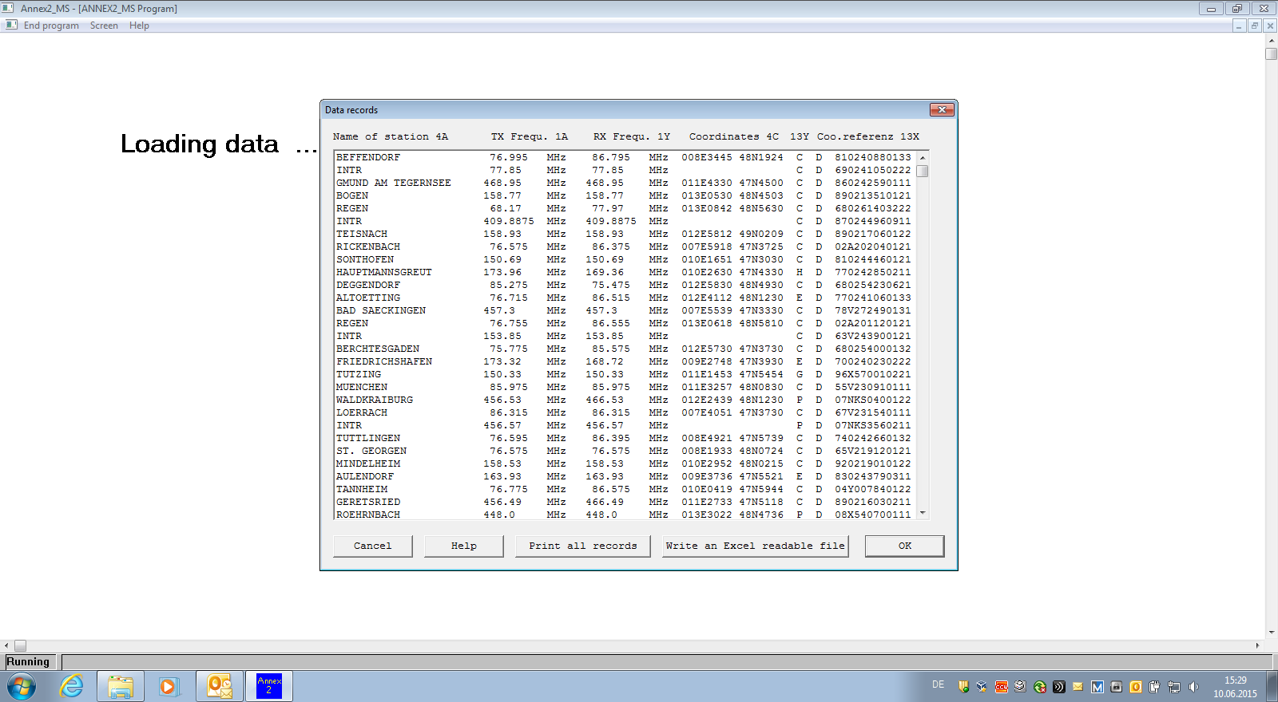
Frequency Co-ordination - The Procedure
Frequency Register, example (MS):

Slide 21
Thank you !

