Slide 1
Nepal’s Experience in Responding to a Disaster: A Telecommunication/ICT sector perspective by
Ananda Raj Khanal,
Director, Nepal Telecommunications Authority
ITU Regional Development Forum: Smartly Digital Asia-Pacific
Thailand, Bangkok
21 August 2015

Slide 2

Short Video presentation

Slide 3
Facts about April 25/May 12,2015 Earthquakes in Nepal

Slide 4
April 25th ,2015, Saturday
A 7.8 Richter scale earthquake
  at 11:56 local time
  lasted for about 56 seconds
  Epicentre:
    Gorkha: approximately 80 km North-west of Kathmandu.
After shocks:
  about 380 aftershocks measuring over 4 on the local Richter scale since then
Initial government reports:
  30 out of 75 districts affected in the Western and Central Regions,
  including Kathmandu Valley districts
  with densely populated cities, rural and mountainous regions.
14 Districts most affected

Slide 5
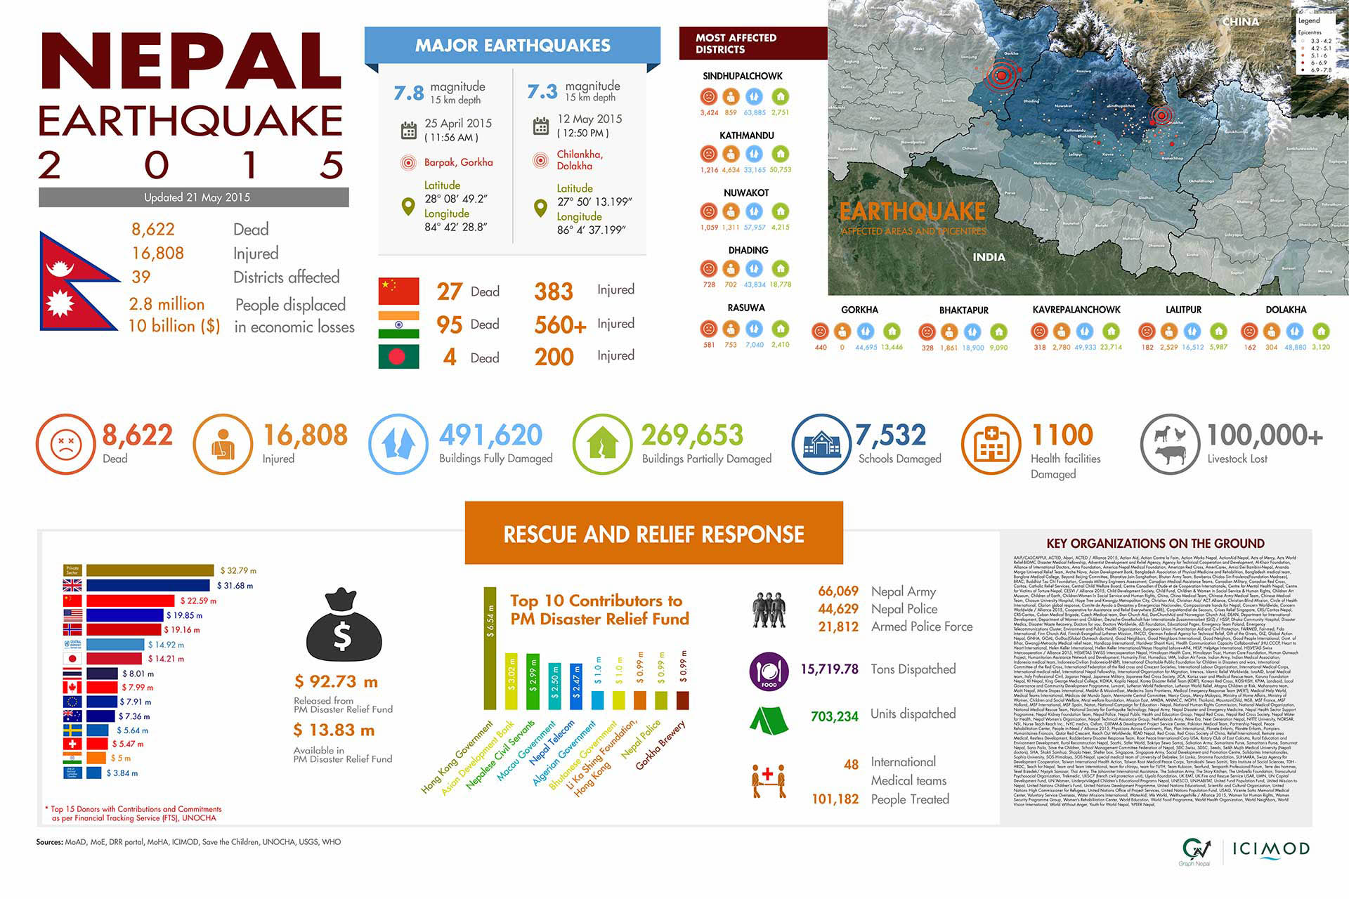

Slide 6
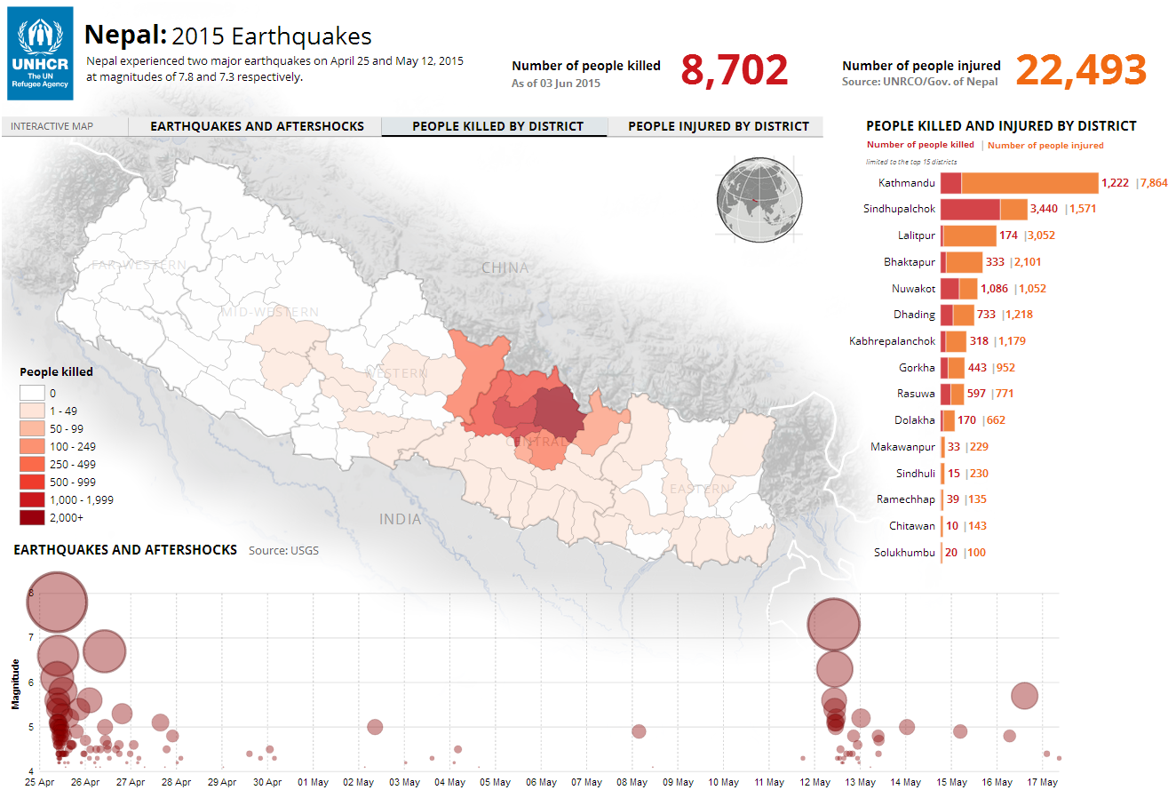
People killed by district

Slide 7
Offices damaged
The Regulator had to work on the ground, temporary shelter and temporary rented places
Some of the operators and ISPs could not run their offices in their premises
These caused delays in the management of human resources and logistic support for the restoration of the networks and services

Slide 8
 | Infrastructure damage- Nepal Telecom-the incumbent operator
S.N. | Asset | Count
1 | BTSs Affected | 525
2 | Transmission Towers Affected | 10
3 | Fiber Backhaul Affected | 2
4 | Microwave Links Affected | 15
5 | Physical Buildings Affected | 197

Slide 9
Damage in Backhaul
Network fiber optic infrastructure and microwave links were damaged in a number of areas.
There were fiber breaks on the hilly parts of the central region.
Teams took action to recover fibers and microwave links, but the transportation was problematic due to closed roads and landslides.

Slide 10
ICT service scenario immediately after earthquake
The earthquakes caused destruction of national infrastructure-including roads and power systems
Mobile telecommunication and ISP services were still operational in capital of Nepal (Kathmandu),
  however mobile network coverage outage and heavy congestion was in common.
  There were mobile communication site losses due to building collapses and transmission disruptions.
  From users’ perspective, mobile communications has been reinforced by the mobile network operators by donating free telecommunication services in Nepal.
  Although using SMS rather than calls was suggested to avoid congestion, initial reports from Rasuwa District were that people preferred making voice calls to using SMS.

Slide 11
ICT service scenario immediately after earthquake
Local and Global Emergency Telecommunications Cluster (ETC) has been activated for Nepal and a response team deployed.
Two biggest mobile network operators in terms of market share, NCELL and Nepal Telecom, provided SIM cards free to the ETC to support the response.
The ETC and response communities tried to determine exact locations for the need of telecommunication connectivity.
ETC installed portable satellite terminals for internet connectivity at the Ministry of Health and Population;
ETC has installed portable satellite terminals at the Reception/Departure Center at the airport.
The challenge was that, some of the hardest-hit areas are also the most remote and strong coordination for the other working groups was needed, as a result telecommunication needs on the ground were not 100% clear in the emergency phase of the operation.
The ETC worked with the Logistics Cluster for movement of equipment from the capital to remote areas.

Slide 12
Post Earthquake Activities in Telecommunications Sector
The service providers provided free sms, calls for about a week
MoIC/NTA provided free additional unused frequency in the 900MHz band for growing traffic management
MOIC/NTA made quick decisions with regards to equipment import for operators
NTA started collecting information about the operational aspects of telecom services and encouraged the operators for early service recovery

Slide 13
Post earthquake activities
Nepal Engineers Association carried out vulnerability assessment of buildings having Roof top Towers in Kathmandu valley on the request of NTA.
Most of the towers for which complains were registered for dismantling for fear were assessed and the house owners pacified to some degree BUT not completely

Slide 14
Post Earthquake activity:
Policy and Strategic front
Preparation of Post Disaster Needs Assessment Report by National Planning Commission: Communication was one of the key sector
ICT Emergency Response workshop organized by ETC Cluster
  Nepal Emergency Telecommunication Continuity Management System (NETCOMS) being prepared with ITU Assistance-draft report already received

Slide 15
PDNA Summary
While network congestion and down time was experienced, service providers were able to restore most of their networks.
Operators faced operational losses due to network downtime and the provision of free services to customers.
The total damage and loss in economic flows are estimated at NPRs 3,610.2 million (US$36.10 million) and NPRs 5084.6 million (US$ 50.85 million), respectively.
The estimated cost of recovery and reconstruction is estimated at NPRs 4,938.8 million (US$49.39 million).

Slide 16
Summary Table with Damage, Loss and Reconstruction Needs
(in NPR and US$)

Slide 17
Recovery needs, priorities, recovery strategy and relevant cross cutting issues
While communication service providers have already invested resources in the recovery phase, the key priorities for recovery are to ensure that
the worst hit districts receive services – both telecommunications and internet on a priority basis;
(ii) displaced communities are provided access to internet services;
towers are constructed at critical sites both within Kathmandu valley and outside so that service interruptions are minimized in the event of another disaster. These towers should be shared among all operators;
Nepal Rastra Bank finalizes its mobile financial services regulations on a fast track basis;
that an emergency public service broadcasting studio infrastructure is built and Radio Nepal and Nepal Television are merged into a single Public Service Broadcasting agency on a fast track basis; and
the disaster recovery integrated data center is constructed immediately.

Slide 18
Short/ Medium/ Long Term needs along with the cost (in NPR and U$)

Slide 19
Emergency Telecommunications Cluster (ETC)
ICT Emergency Response workshop organized
Aimed at initiating an ICT Emergency Response (ICT ER) operational plan during the first three months of a crisis in Nepal.
The pragmatic goal was to define Who does What, How and When, particularly in the GoN, based on the scenario of a magnitude 8 earthquake affecting the Kathmandu valley with massive damage to infrastructure across the country.

Slide 20
ICT Emergency Response workshop
The workshop took place on 18 June 2015 in Kathmandu with 27 stakeholders from leading GoN, humanitarian and commercial organizations attending.
This report provides an overview of the
  Key ICT Emergency Response Capacities and Strengths,
  Gaps,
  Recommendations on a way forward towards to reinforcing the ICT emergency response capacity of the GoN.

Slide 21
ICT Emergency Response workshop
Reviews the roles of all stakeholders during an emergency based on the concepts of Responsibility, Accountability, Consultation and Information (RACI) matrix
  Capacities and Strengths
  Gaps and challenges
Provides an overview of the training needs of the GoN to prepare for the next crisis.

Slide 22
Emergency Telecommunication Continuity Management System
ITU provided technical assistance in formulating Emergency Telecommunication Continuity Management System-draft received recently

Slide 23
Objectives
• Carry out an assessment for the impact of the Nepal earthquake to the telecommunication operators
• Prepare recommendations to strengthen the Nepal’s telecommunication sector response
• Develop NETCOMS which is clear, concise and comprehensive emergency telecommunication management system for Nepal that can guide a more effective and coordinated national response in case of a large scale disaster.
• Prepare NETCOMS business continuity and disaster recovery plans
• Prepare consultation and advices to increase the readiness capacity of stakeholders
• Prepare future preparedness plan for the effectiveness of NETCOMS

Slide 24
The Report
A very comprehensive report
Provides the vision, scope, objectives strategies and phases of action plan
Also identify the process model, roles and responsibility and reporting format and mechanisms
Provides a detailed time bound action plans in the
  Short term ( 3 months)
  Mid term ( 3+3 =6 months)
  Long term( 6+6 =12 months)

Slide 25
The Report
Highlights the importance of:
  assessing the NETCOMS needs with vision, scope, objectives and strategy
  putting into operation the consultations and advices for increasing NETCOMS overall capability to handle telecommunication disruptions caused by nature, human and technology.
  verifying and validating the performance and effectiveness of the NETCOMS
  persistent enhancement based on measurements and recovery time objectives

Slide 26
ITU Assistance
International Telecommunication Unit (ITU) contributed with satellite telecommunications equipment,
  35 satellite phones,
  10 BGAN terminals along with
  10 laptops for the BGANs,
  25 solar chargers for satellite phones and
  solar powered batteries.
The equipment was distributed to the Ministry of Information and Communication through NTA.
Training on the use of the equipment was also provided to different agencies.
ITU financed the deployment of the equipment, three months satellite airtime usage and the returning the equipment back to Geneva.
ITU provided technical assistance in formulating Emergency Telecommunication Continuity Management System-draft received recently

Slide 27
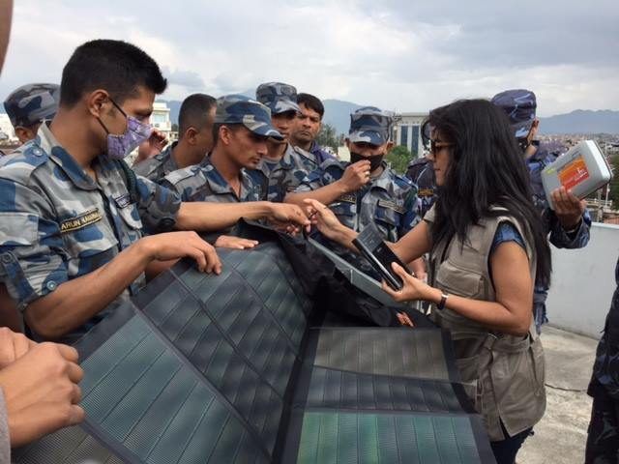
ITU deploys emergency communications equipment (satellite mobile phones + terminals, with laptops and solar power) and train first responders in coordination with NTA

Slide 28
Assistance to connect at remote place:example
After four days trekking across the devastated landscape of Nepal, Inmarsat-sponsored Télécoms Sans Frontières (TSF) has reached communities living in the foothills of the Himalayas, cut off from the outside world nearly 2 weeks.
TSF offered locals, satellite calls so that they could contact family and loved ones for the first time since the disaster struck to let them know they were safe.

Slide 29
Satellite data : important
A commercial company in USA, instructed its satellite, orbiting at 617km above Earth, to start capturing the affected region to support disaster response efforts in Nepal by opening access to satellite data for crowd sourcing analysis which helped initially to identify 3,128 damaged buildings, 1,191 locales of major destruction and 1,129 damaged roads.
The American Red Cross team began building a “shake map” that shows the areas hit hardest by the earthquake using US Geological Survey EarthExplorer data.

Slide 30
Free Communications..
It was a challenge for the citizens outside of Nepal to reach and know their loved ones are safe, being able to connect really matters in this situation.
Microsoft Skype made all Skype calls to landlines and mobiles in and out of Nepal free of charge from 27th April to 15th June.
In Australia;
  Vodafone customers received free calls between Australia and Nepal from 25 April to 1 May (post-paid), from 29th April to 5th May (pre-paid),
  Telstra offered free voice calls and texts made from post paid mobiles and fixed lines to Nepal from 12th May to 19th May,
  Optus mobile and fixed customers received free standard voice calls to Nepal from 14th May to 20th May.
In Germany,
  T-Mobile allowed free calls and texts to Nepal from 25th April to 31th May for both prepaid and postpaid customers with a recommendation to restart their phones right away to receive free data if customers are in Nepal.
  In USA;
  Sprint, Boost Mobile and Virgin Mobile made calling and texting to Nepal free to all postpaid and prepaid customers from 25th April to 16th May.
  AT&T did not charge customers for text messages or International long distance calls from U.S.A, Puerto Rico and U.S. Virgin Islands to Nepal from 25th April to 31th May.
  Viber switched off ‘Viber Out’ billing so Nepal users can call any destination for free

Slide 31
Recovery Challenge: Transportation and blockage
Landslides have been another major challenge to recovery operations.
Unseasonable rain and weather patterns have proven to be one of the greatest challenges to helicopter rescue teams providing aid relief and evacuation assistance in remote areas hit by the earthquake.
Approximately 3,000 landslides have been reported between 12th May and 15th May alone.
Eventually, many roads were damaged or blocked which
  hinders the field operation teams’ access to affected areas.
  Some slopes may have been destabilized by the earthquake and heavy rain, which could lead to other landslides.
Due to transportation problems, mobile communications system in rural areas became more stable later than the urban areas.
Mobile network coverage recovered quickly in the most populated areas at the bottom of the mountains, compared to villages in urban areas.

Slide 32
Recovery Challenge: Energy
Energy needs during the disaster area was a real challenge.
Grid power supply has been interrupted in many affected areas and generators were the only means of electricity.
Even prior to the earthquake, 7 million out of the 28 million population of Nepal (24%) live without any access to electricity, mostly in rural areas using kerosene lamps for lighting.
The remaining 21 million people are grid-connected, but face an electric energy deficit, with about 16 hours of daily blackouts.
Many businesses run diesel generators for backup, but they still suffer from increasing fuel costs, frequent shortages, vibrations, the pollution and noise.
They all need a power source more reliable and affordable than diesel.
Government of Nepal, Ministry of Science, Technology and Environment - Alternative Energy Promotion Centre (AEPC) is working on utilizing alternative energies like bio energy, wind energy, solar energy and mini hydra energy for households.
AEPC has released a procurement request for solar lanterns and solar mobile charging stations.
As the grid power off, the fuel energy is used for power. All fuel and various petroleum products for Nepal is imported, stored and distributed by the state-owned Nepal Oil Corporation (NOC) which is established on 10th Jan 1970.
The business continuity of NOC is vital to Nepal. NOC’s present national storage capacity is just enough for about 20 days national sales based on 2014 sales.
In emergency it may be less than 20 days due to increased demand.
At mobile communication sites, as battery and/or fuel supplies deplete, power became increasingly difficult which started to result in operating mobile communication site disconnects after 8-16 hours from the earthquake.

Slide 33
Recovery Challenge: Energy
From the user perspective, power is needed for the mobile phones to operate.
Local solar companies deployed solar energy panels for mobile-phone charging stations across the country.
They also published a map from social media showing power requests for mobile phone charging.
But the effort was limited compared effected users’ power need.
Reports from Gorkha district are that in villages with no electricity, people are have no access to radio or phone unless they go downtown to charge their phone.
Most people can’t read and are reliant on a community member who has gone to the city sharing information by microphone throughout the village.

Slide 34
Actions undertaken to restore mobile network
The core mobile communication network equipment, major POPs and backbone links were not very much affected in the earthquakes to cause total disruption of services.
38% of 2G and 4% of 3G network sites were down after the earthquake. The field operation teams and outsources went to the down-sites to recover them. There were 3 challenges:
  The building collapsed:
    They could not recover. For some important sites new sites were established.
  The building damaged:
    If it was safe to climb to the top of the building where rooftop tower exist, teams recovered.
  The building was sound and solid but the site equipment damaged:
    The building owner did not allow entrance:
      The owners see the rooftop towers as a risk, they wanted to dismantle them.
    The building owner allowed the entrance:
      Teams recovered the down-sites
Mobile network operators needed network equipment; they started the import procurement process for the equipment that was not available in the country.
After the earthquake the grid power went down.
Depending on the battery reserves, sites remained to work between 8-14 hours.
Then power problems raised in the up and running sites, teams changed the batteries by transferring mobile generators among the sites where there is way to go either by car or on foot.

Slide 35
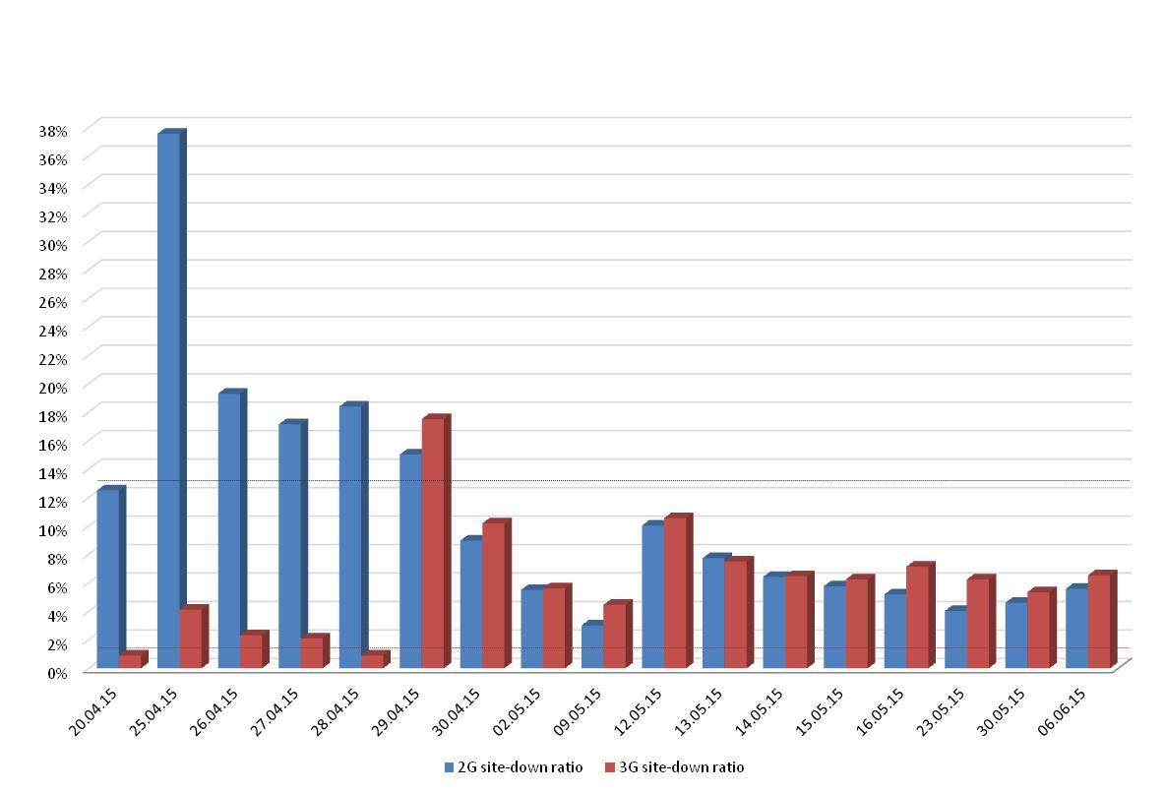
GSM site-down ratio

Slide 36
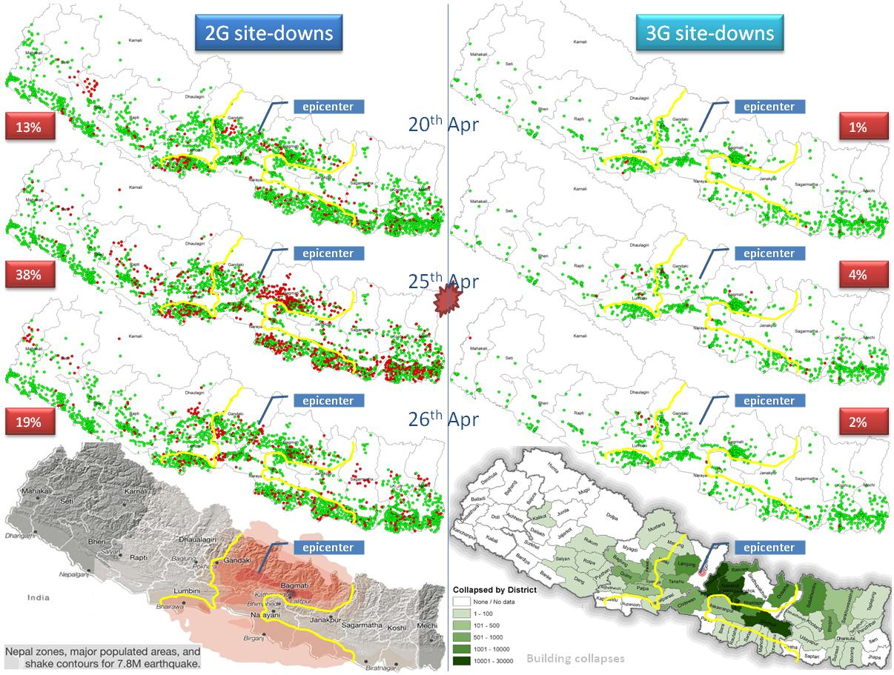
Site status before and after the earthquake

Slide 37
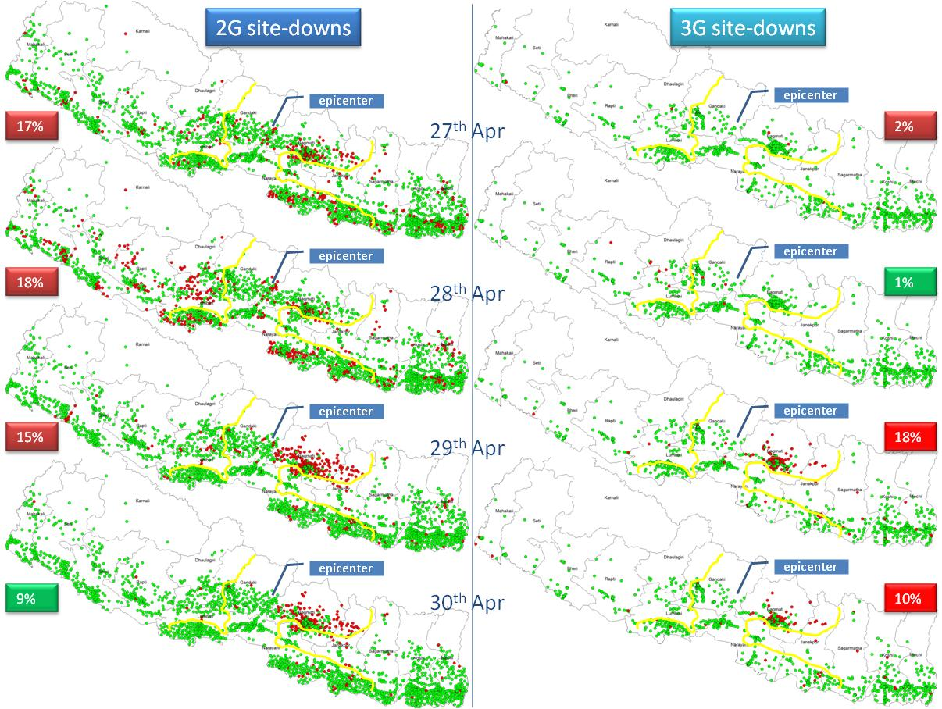
Site status between 27th-30th April, 2015

Slide 38
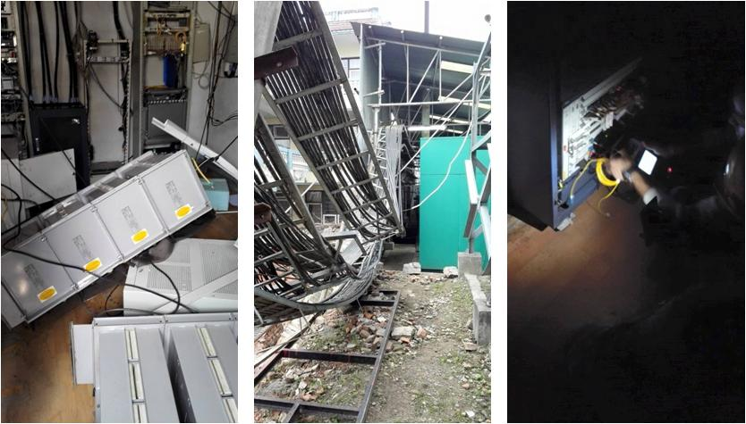
Damaged network equipment

Slide 39
Ad-hoc solutions
Teams devised mobile base stations on a vehicle to increase the coverage and capacity. This solution speed up the recovery process where transportation is possible.

Slide 40
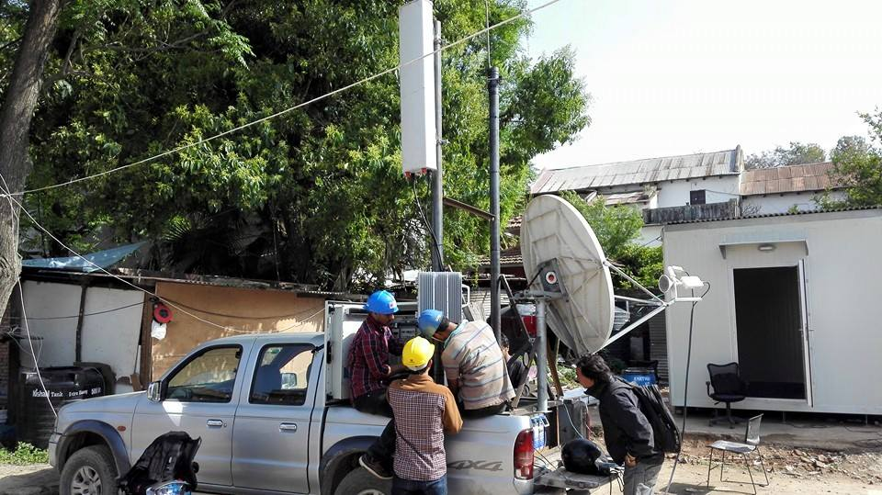
Ad-hoc devised mobile base station

Slide 41
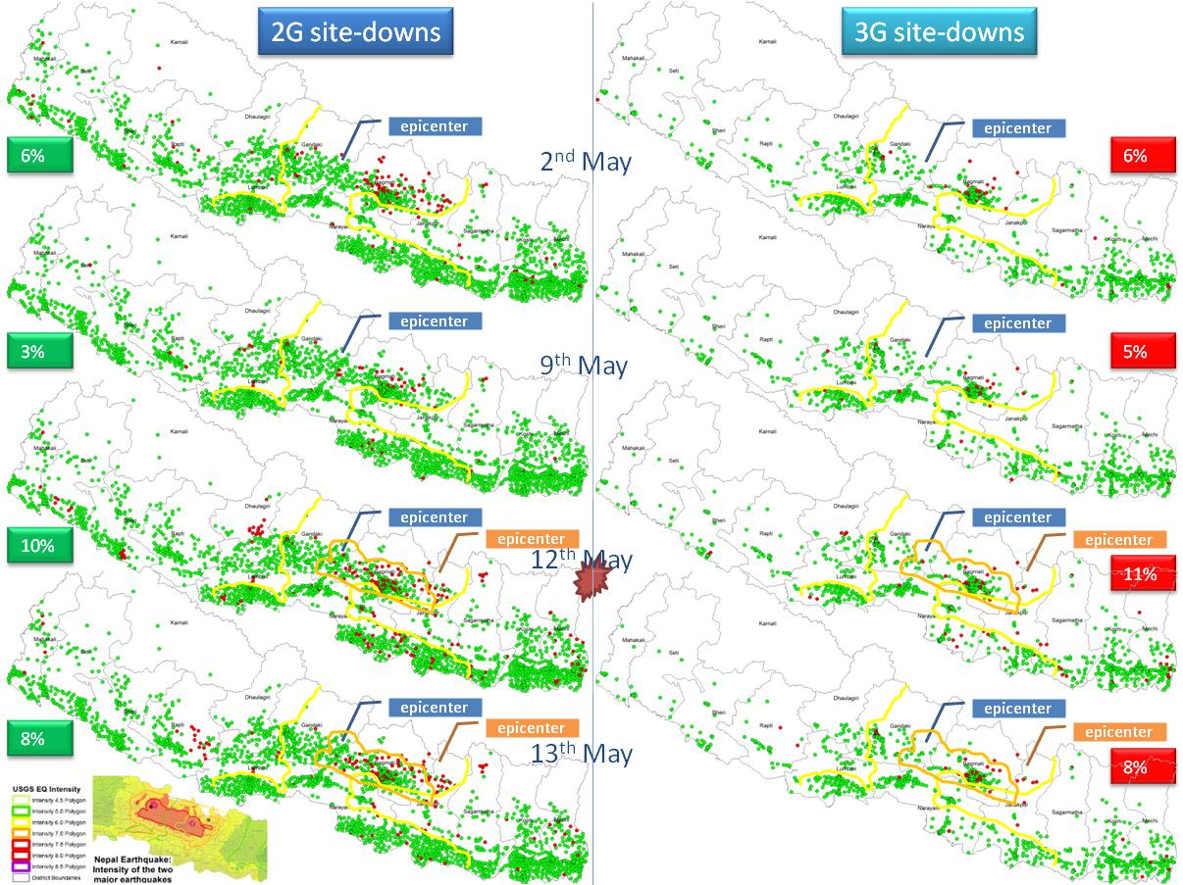
Site status with the second earthquake

Slide 42
Second major earthquake on 12th May
On 12th May, another earthquake hit. It increased the 2G and 3G down sites 7% and 6% respectively.
Although the epicentre was on the east side of the first epicentre, generally the same areas affected again.
The down-sites mainly gathered in Kathmandu Valley and nearby in the Central region.
The reason was that, the building owners of the down-sites do not let the teams to recover the sites and they wanted to dismantle the sites, since they were afraid of risk of the rooftop towers.

Slide 43
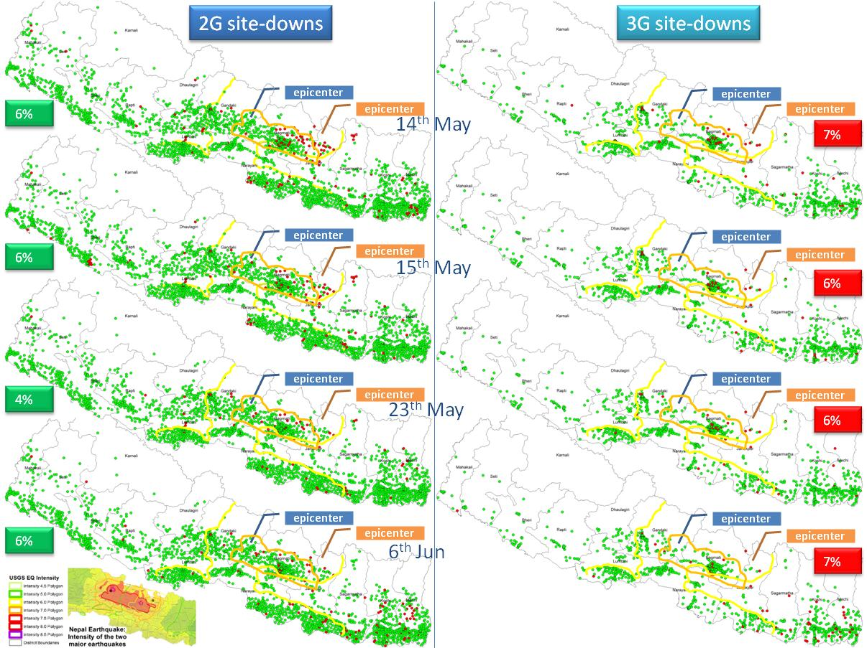
Site status between 14th May to 6th June

Slide 44
Main challenges and how they were solved
Electricity at the switching center locations:
  Core components of the network equipment are in the OMC locations where the main switches and processor equipment exist.
  The grid power went off after the earthquake.
  In order to support OMC operation, 7/24 grid feed line is attached to OMC locations.
Energy at the sites:
  Many sites were down due to no city supply.
  The batteries start to deplete after some time.
  The teams used mobile generators to charge the batteries.
Additional bandwidth to support additional traffic:
  Additional radio bandwidth is requested to support congestion.
  NTA quickly allowed another reserved frequency band to be used by the operators for one month.
Transportation to the down-sites:
  Roads could not be used due to heavy traffic or landslides, teams used helicopters to reach to down-sites.
  But the number of helicopters was less and it was mainly dedicated to relief and rescue teams.
  Whenever an empty seat and place for equipment is available it is utilized by the network teams.

Slide 45
Main challenges and how they were solved
Congestion:
  Especially the voice call congestion was high in the affected area. The SMS and internet usage is promoted by the operators.
Coordination:
  Coordination and information sharing was essential part of emergency management. Nepal Telecommunication Operators (NTO) engaged in Emergency Telecommunication Cluster (ETC) meetings for easy coordination.
Procurement:
  Network operators needed equipments to replace with the damaged ones. They started the procurements process in fast coordination with NTA. From the emergency custom point of view, awareness in the stakeholders shall be increased.
Building owners requests to dismantle base station equipment:
  Convincing huge number of house owners to continue the service in the same infrastructure, if buildings are in good state.
  Dismantled sites are rerouted.
  Use of Cell on Wheel (Mobile Base Station) at dismantled locations.
  Optimization of operational sites to maximize the coverage.
  Started new visits for acquiring sites near dismantled locations.
  Battery bank is shifted to ground floor of some sites to reduce the load at the building. This solution is prone to physical security of the battery.
  Used Light Weight Pole in place of existing roof-top towers

Slide 46
Main challenges and how they were solved
Loss of coverage:
  Assessment of down sites were started immediately
  Installation of Micro BTS on high priority sites like hospitals, governmental locations.
  Most of the physically damaged building sites out of the Kathmandu valley are in operation using tents and sheets temporally
  Construction of prefabricated shelters to shift equipments from physically damaged buildings.
  Construction of sheet shelters with Truss and Foundation is still in progress.
  Transmission link damaged sites restored with satellite link.
  Recovered initially the hub sites, misalignment of Microwave links, fiber damages and satellite links
International voice calls:
  Although international gateways and roaming technologies that enable international communications were not affected, especially citizens needed to call their loved ones in Nepal (or vice versa). But it was costly, operators made quick agreements that were requested from the foreign operators to give free calls.
Upcoming of rainy monsoon season:
  BTS are supported with the tents to protect them from heavy rain

Slide 47
The Way Forward
Extensive use of ICTs in all phases of disaster
Implement the recommendations of the following Reports:
  Post Disaster Needs Assessment
  Emergency Telecommunications Cluster Workshop
  Nepal Emergency Telecommunication Continuity Management System (NETCOMS)
  Approval of National Emergency Telecommunications Plan and Implementation of the same
  High-resolution satellite imagery should be used to identify landslides and landslide-dammed rivers that could lead to severe downstream flooding if the dam is suddenly breached.
  Also learn from what other nations have done to cope in all phases of disasters

Slide 48


