Slide 1

Regulatory Tools to Achieve Universal Broadband
ITU-MCMC International Training Programme
26-28 August 2015
Kuala Lumpur, Malaysia
Sofie Maddens
Head, Regulatory and Market Environment Division
Telecommunication Development Bureau (BDT)

Slide 2

Introduction
The terms universal access (UA) and universal service (US) are used in a wide variety of contexts to describe or demonstrate objectives and policies that governments implement to ensure that all their citizens have access to the benefits of modern economic life
They refer to the ability of everyone, regardless of region or location, socio-economic status, ethnicity, gender, disability, or any other factor, to access services

Slide 3
Why UAS? Why a Strategy?
Where market forces do not fully address the gaps, countries are faced with the need to define a strategy to achieve UAS and to manage and finance it in a marketplace increasingly characterized by competition

Slide 4
Definitions
ITU defines
  universal access : “ a situation where everyone can access the service somewhere at a public place, also called public, community or shared access”
  universal service: “a situation when every individual or household can have service, using it privately, either at home or increasingly carried with the individual through wireless devices” (ITU, 2012)
Key objectives:
  availability
  accessibility
  affordability

Slide 5
Elements of Holistic Approach
UAS policies generally cover the following key areas:
  Defining the vision and scope of UAS policies and actions
  Assigning entities to oversee the implementation of the UAS policies
  Presenting the targets for the services and the population groups in the UAS scope, with a defined timeframe for achievement.
  Presenting the approach and strategies to be employed to achieve UAS targets – USO, licensing, etc.
  Planning funding sources and disbursement methods

Slide 6
Vision and Scope
Examples show that universal access and service measures are generally aimed at providing service to:
  rural areas that are either unserved or underserved,
  low‐population density areas where provision of services is not commercially attractive or even viable
  other areas and population groups, including very poor urban areas in large metropolitan cities or people with specific needs

Slide 7
Vision and Scope
Achieving universal access and service to communications is a challenge for all countries
In order to ensure that universal access and service policy is a central part of the ICT framework and not construed as simply a form of corporate social responsibility, or an act of ‘goodwill’ by investors in the ICT sector, it is important that:
  universal access and service polices are properly formulated
  universal access and service polices are given a proper space in the national policy and legislative frameworks as well as in the institutional framework for telecommunications regulation
  Holistic view and approach – no silos!!

Slide 8
Defining Scope
Some of the main steps to develop the scope of universal access and service (UAS) and related program include:
  ICT sector review
  demand analysis
  financing and subsidy estimation
  prioritization of projects

Slide 9
Scope of UAS
Today, more and more countries include broadband in their universal service or universal access definitions.
  In February 2000, the Estonian Riigikogu (Parliament) enacted the new Telecommunications Act, adding Internet access to its universal service list. It has also been indicated that internet access is a legal right.
  India was one of the first countries to include broadband in the mandate of its universal service fund in 2006.
  The United States which has had a complete re-think of universal service financing; now the universal service fund has helped increase broadband penetration by providing funding for new lines in rural areas.
  In 2001, Greece amended its Constitution to provide that all persons have the right to participate in the Information Society. The State is obliged to facilitate access to electronically transmitted information, as well as to the production, exchange and diffusion of information.
  In Switzerland broadband has been included in the scope of the Universal Service Obligations since 2008 – the universal service provider charged with USO must provide a broadband connection to the whole population, via DSL or satellite or other technologies (at least 600 Kbit/s downloads and 100 Kbit/s uploads, and monthly subscription < CHF 69).
  In Finland broadband access is a legal right and recent national legislation extended USO to cover broadband with the objective of a basic 1Mbit/s broadband connection available to all by 2011.
  Similarly, the Constitutional Court of Costa Rica declared internet access a fundamental legal right in September 2010. The government has thus been urged to adopt the necessary measures to promote its universal service in the country.

Slide 10
Legal Mandate
Is there one solution to creating an “appropriate” institutional framework for universal access and service?
  No!
Universal access and service policy may be implemented by the country’s National Regulatory Authority (NRA), the ministry responsible for telecommunications or ICT, or an independent agency established to manage and administer universal access and service projects as well as the funding.
Importance of clarity, transparency and accountability!

Slide 11
Approach and Strategies to Achieve UAS
There are a number of different approaches used by various jurisdictions to address universal service requirements. These include :
  Market based reforms and regulatory tools
  Mandatory service obligations
  Cross subsidies
  Access deficit charges
  Private public partnerships (PPPs)
  Universal funds

Slide 12
Achieving UAS
In Latin America, of the 19 countries covered by a Regulatel study, nearly all countries implemented various mechanisms that directly or indirectly aim to increase investments and access to telecommunications infrastructure in high‐cost rural and low‐income areas:
    Universal Service Funds (USFs) that provide partial subsidies for programmes largely aimed at stimulating private sector provision of infrastructure in rural or unserved regions (12 countries out of 10 are using funds)
    Other financing methods and project initiatives by national, state and local governments, cooperatives, NGOs and others (13 countries).
    An increasing number of private operators are also putting in place programmes aimed at expanding coverage in high cost rural areas and to increasing demand among lower income consumers;
    State‐mandated and controlled approaches using cross subsidies and other financing mechanisms aimed at state‐owned companies

Slide 13
Financing of UAS
Tools:
Countries should not focus solely on the creation of a Universal Service Fund and see it as the only way in which universality will be achieved - such Funds are s a tool amongst tools
 | CASH (DIRECT) | IN KIND (INDIRECT)
PRIVATE | Infrastructure rollout Device subsidies | Mandatory USAF obligations
PUBLIC | Equity investment PPP Disbursement of USAF subsidies Commitment of Stimulus plan funds | Tax incentives Spectrum licensing Rights of way Risk guarantees
Source: M. Msimang, GSR 2011

Slide 14
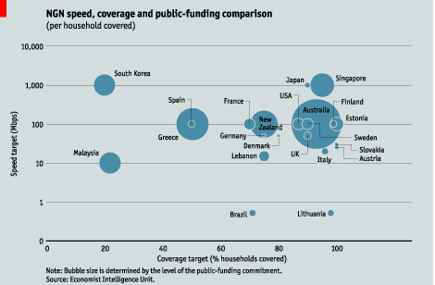
Achieving UAS
Increasing reliance on Public Funding for high cost broadband networks
3 Main Public Funding Models:
Ownership or Equity Participation in broadband projects
Australia, Brazil, New Zealand, Malaysia, Sweden and South Africa;
Public Private Partnerships
broadband infrastructure deployment projects undertaken in France, Thailand, Kenya and Tanzania;
Provision of financial incentives and subsidies
Latin American countries through the use of first-generation Universal Service Funds
China, Japan, the USA and EU through broadband stimulus packages.
Source: M. Msimang, GSR 2011

Slide 15
Financing of UAS
Source: March 2015 WB Group Asia Pacific Forum

Slide 16
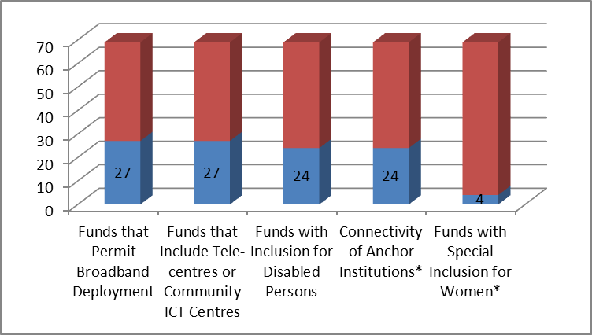
Number of Funds Addressing Specific UAS Objectives
Source: L. Dorward, USF Study

Slide 17
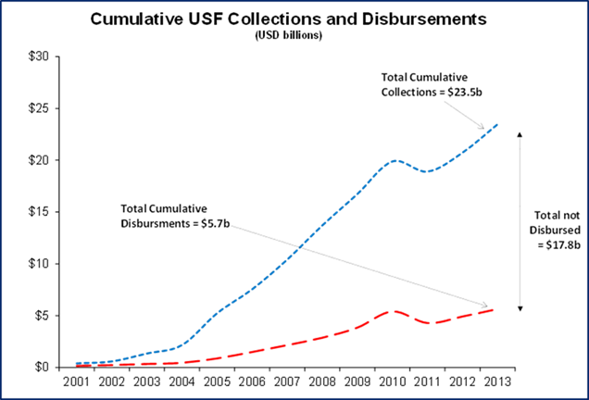
Issues with USF
Across 34 Developing Countries under study, there has been a cumulative USF disbursement gap of US$ 17.8 billion
Root causes of non-disbursement:
  The USF financial framework (e.g. the collection mechanism) is not conducive to disbursement
  USF Fee is transferred to the NTF or withheld from USFA (responsibility over fee)
  The USF legal and regulatory frameworks (legal basis, enabling regulation and scope) are not conducive to disbursement
  The USF institutional arrangements (administration) are not conducive to disbursement
Source: E. Sepulveda, ITU Study on USF, 2015

Slide 18
Operational Blueprint for a Successful USF | Best Practice Examples
Well-articulated policy with respect to how Universal Service (US) will be achieved and organized | Malaysia Uganda
Development of an appropriate and well-defined legal and regulatory framework permitting maximum flexibility | Chile Colombia Peru
Establishment of the USF as separate, independent (autonomous) entity | Nigeria Thailand Pakistan
Clear definition and delineation of fund responsibilities | Chile Uganda Colombia
Development and clear definition of measurable overall Fund objectives which can subsequently be tracked and monitored | Colombia Malaysia Pakistan
High level of transparency, visibility and accountability to all stakeholders | India Peru
Active participation in and input from all concerned stakeholders regarding fund objectives and administration | Canada Morocco
Guidelines and procedures for working with other funding sources | Afghanistan Mongolia
Ensure that full range of sustainability elements and ancillary services are taken into consideration in both policy formulation and project definitions | Bolivia Ghana Indonesia
Fair and unbiased process to allocate subsidy and /or project | Colombia Nigeria
Incentives for project participants | Chile Dominican Republic
The need for digital inclusion as part of the USF | Bulgaria Jamaica
Source: L. Dorward, GSR 2013

Slide 19
Source:March 2015 WB forum

Slide 20
Case studies – Bhutan
Vision “The Royal Government of Bhutan (RGoB) recognises Telecommunications and Broadband as important contributors to the socioeconomic development of the country. They have a vital role to play in enhancing competitiveness, increasing productivity and economic development, and promoting greater social inclusion to mention a few. Telecommunications and Broadband are the foundation on which “An ICT enabled, Knowledge-Based Society as a Foundation for Gross National Happiness” will be built.” - Bhutan Telecommunications and Broadband Policy, 2014
Mandate
  The Ministry of Information and Communications will be responsible for ensuring implementation of the Policy. It will carry out overall implementation, monitoring and review of the Policy and related Plan, working through the Committee as appropriate

Slide 21
Case studies – Bhutan
Scope
  For the purpose of Universal Access, telephony and entry level Broadband are defined as basic services.
  The government will ensure that access to these services is available to village level.

Slide 22
Case studies – Bhutan
Regulatory Tools
  Licensing:
    Government shall adopt a converged and technology neutral licensing framework to encourage innovation, diversity and competition leading to affordability, choice and quality of services.
    When the existing exclusivity expires after 2013, the market may be opened up based on sound proposals and market trends. Priorities shall be given to 100% local bidders through a selective selection process.
  Competition tools:
    Provisions for measures such as access and interconnection, provision for peering, infrastructure sharing, local loop unbundling, rights of way, tariff regulations and oversight, and provision to allow use of dark fiber by licensed telecom operators/ISPs currently in operation

Slide 23
Case studies – Bhutan
Demand creation:
    community access, affordability, school connectivity, creation of Bhutan’s research and education network (DrukREN), Coordinated examination within each Ministry of relevant transaction processes and development of a prioritised e-Government programme for implementation, with initial applications being determined on the basis of their likelihood to encourage broadband service take-up. Etc.
    Government to develop a range of lead applications for delivery of new, enhanced or extended services online using broadband in Health, Education, Tourism, Finance, Foreign Affairs and Agriculture, specifically.

Slide 24
Case studies – Bhutan
Financing:
Implement the sustainability of universal services through USF and PPP mechanism
  USF:
    In areas where service provision is not economically viable, government will take recourse to Universal Service Fund.
    The Universal Service Fund has been used to improve access to basic telephony and mobile services in the country.
    The USF fund is comprised of license fees and a percentage of annual gross revenue collected from operators.

Slide 25
References and Reading Materials:
2011 Best Practice Guidelines on Regulatory Approaches to advance the deployment of broadband, ITU (2011) at https://www.itu.int/ITU-D/treg/Events/Seminars/GSR/GSR11/consultation/GSR11_BPG_E.pdf;
“Universal Service and Access: Toolkit,” ITU (2013) http://www.itu.int/en/ITU-D/Projects/ITU-EC-ACP/HIPSSA/Documents/FINAL%20DOCUMENTS/FINAL%20DOCS%20ENGLISH/us_toolkit.pdf
“Universal Access and Service: Southern African Development Community (SADC) Guidelines,” ITU, (2013) http://www.itu.int/en/ITU-D/Projects/ITU-EC-ACP/HIPSSA/Documents/FINAL%20DOCUMENTS/FINAL%20DOCS%20ENGLISH/us_crasa_guidelines.pdf;
“Universal Access and Service in Southern Africa: Assessment Report” ITU (2013); “Universal Access and Service: Knowledge-based Report,” ITU (2013) http://www.itu.int/en/ITU-D/Projects/ITU-EC-ACP/ICB4PAC/Documents/FINAL%20DOCUMENTS/uas.pdf;
“Universal Access/Service: Assessment Report,” ITU (2013) http://www.itu.int/en/ITU-D/Projects/ITU-EC-ACP/HIPCAR/Documents/FINAL%20DOCUMENTS/ENGLISH%20DOCS/universal_service_and_access_assessment.pdf
2015 APAC WB Forum, available at: http://www.ictd-asp.org/usoforum/wp-content/uploads/2015/03/Session-6b-p2-TenzinDolmaNorbhu-Final-USFs-and-PPP-for-Broadband.pdf

Slide 26
Thank you!
Sofie Maddens
Head, Regulatory and Market Environment Division
Telecommunication Development Bureau (BDT)

