Slide 1

Urban Climate Change Resilience Trust Fund
30 April 2014

Slide 2
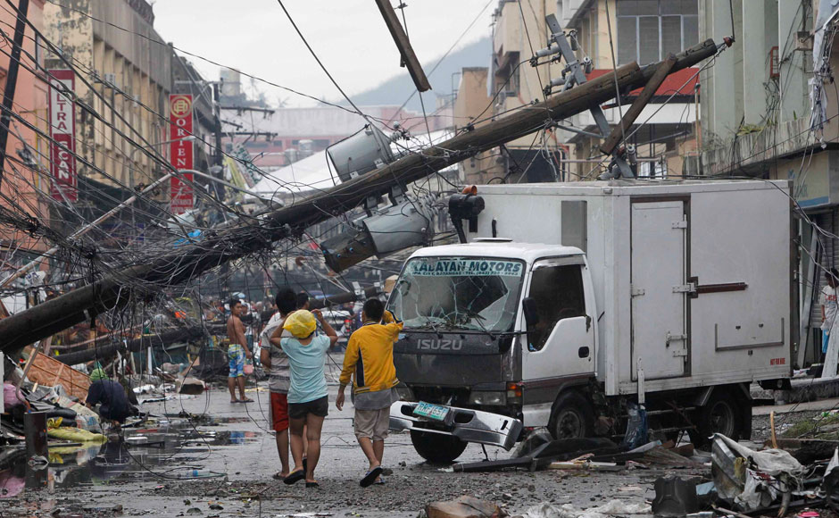
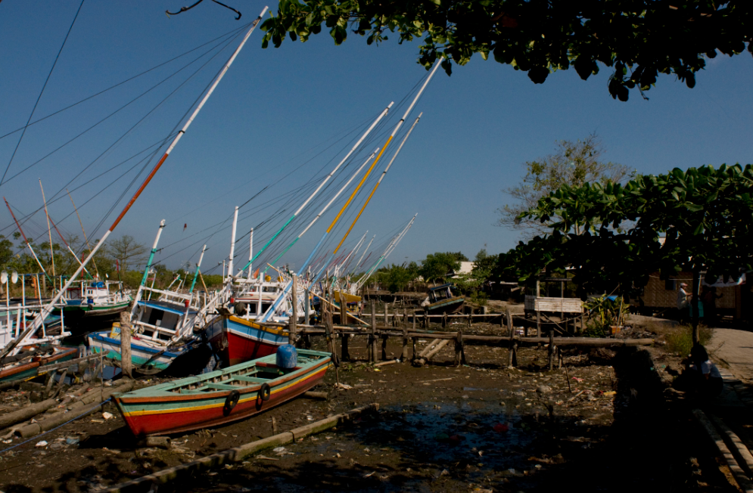
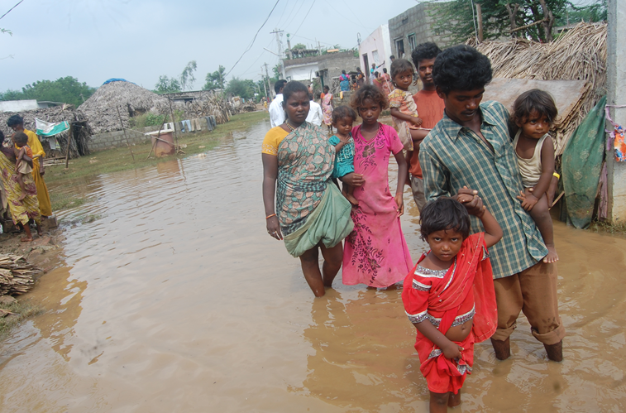
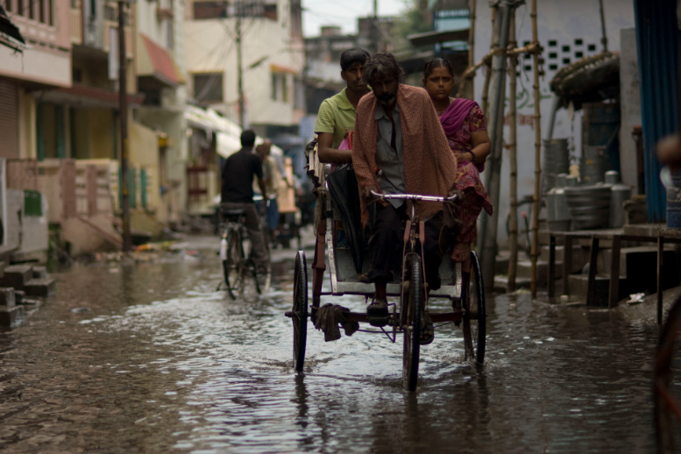
Why Urban Climate Change Resilience?

Slide 3
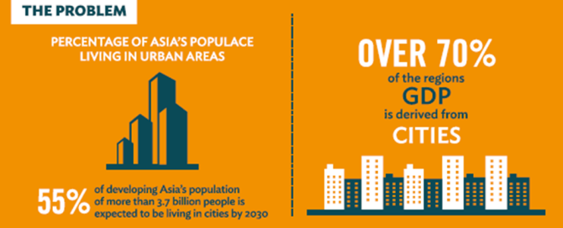
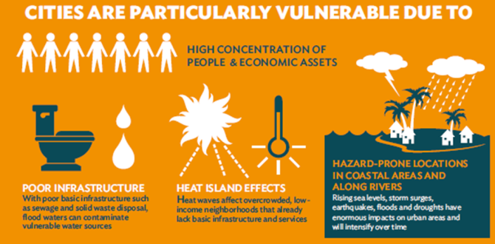
Why Urban Climate Change Resilience?
Urban areas are particular hotspots of risk.
Many are located in hazard prone areas, which climate change may intensify.
Managing risk is tough for medium sized cities due to:
  Limited budgets;
  Limited capacity;
  Limited access to finance.

Slide 4
UCCR requires Context Analysis
URBAN SYSTEMS
Indirect impact
2. What are the direct
and indirect impacts
of climate change ?
1. How does
the city work?
URBAN POVERTY
REDUCTION
URBAN CLIMATE
CHANGE RISK
CLIMATE CHANGE
Direct impact
VULNERABLE
GROUPS
Direct
impact
DISASTER RISK REDUCTION
3. Who is least able to respond
to shocks and stresses?

Slide 5
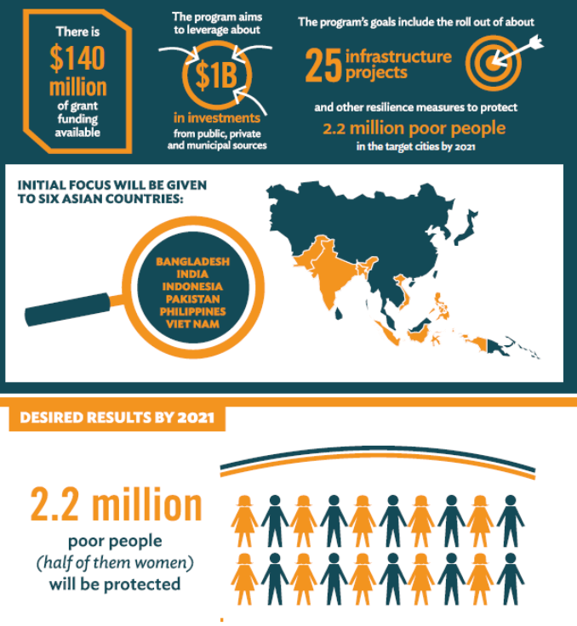
UCCR Partnership and Trust Fund
Launched December 2013
Financing Partners
  DFID
  Rockefeller Foundation
  [USAID]
Facts & Figures
  $140 million grant funding
  for medium sized cities
  6 prioritized countries
  Key components:
  (i) planning,
  (ii) projects/ investments, and (iii) knowledge

Slide 6
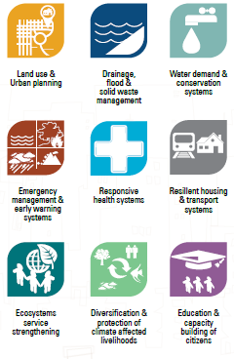

UCCR – Project Categories Examples

Slide 7
Definition
Urban resilience is the capacity of individuals, communities, institutions, businesses and systems in cities to
survive, adapt, and grow in the face of stress and shocks, and even transform when conditions require it.

Slide 8
Alexandra Vogl
Urban Development Specialist avogl@adb.org
Thank you.

