Slide 1
Building Smart Society in Small Island Developing States (SIDs) by Last Mile Broadband
ADB/ITU Initiatives kick-off: ICT for Development
in the Asia-Pacific Region (ICTD-ASP)
29-30 April 2014, Manila
Yasuhiko KAWASUMI
Vice Chairman
ITU-D Study Group 1 dealing with rural communications

Slide 2
Definition of Broadband
Definition of Broadband Commission (Sept. 2013). the Commission has not defined ‘broadband’ in terms of specific minimum transmission speeds, in recognition of the range of market definitions in different countries. Rather, the Commission views broadband as a cluster of concepts: always on, high-capacity connectivity enabling combined provision of multiple services simultaneously.
Report of ITU-D SG2 Rapporteur’s Group Suggest 512/256Kbps for down stream/up stream as minimum requirement for the transmission speed for rural communications
http://www.itu.int/pub/D-STG-SG02.10.3-2014
TRAI of India aims for the 2Mbps by 2015 for rural communications in its regulation according to their comments during the ITU-D SG2 meeting

Slide 3
International Backbones for ASP SIDS
Guam-Kwajalein-Majuro with BU to FSM Submarine Fiber Optic Cable (SFOC) (10Gbps)
Southern Cross Optic Fiber Cable via Suva (Fiji)
Tonga Submarine Optic Fiber Cable (10Gbps, planned to be serviced in 2014, ADB/World Bank and TCL funded)
HAWAIKI Optic Fiber Submarine Cable (Planned)
Geostationary satellites (Global coverage)
Medium Earth Orbit Satellites (O3B: Field Tests on Cock Islands)
Inmarsat BGAN satellites (Global coverage)
Others (Planned)

Slide 4
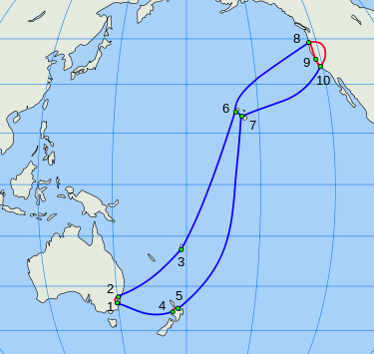
Southern Cross Cable
Landing pt. 3 is Suva, Fiji

Slide 5
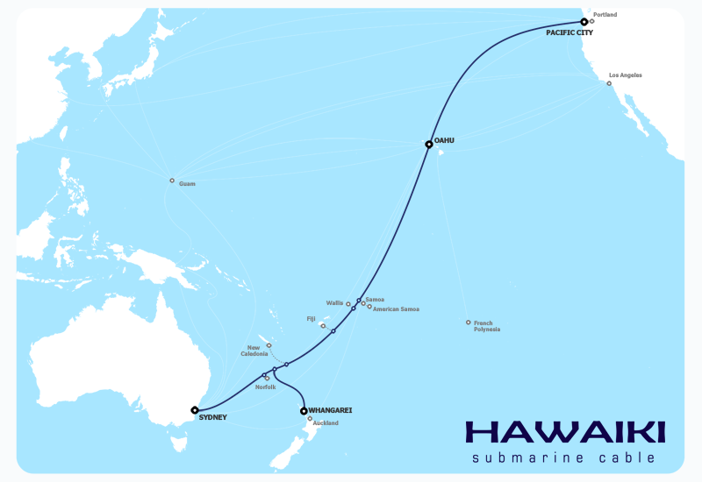
HAWAIKI Submarine Cable

Slide 6
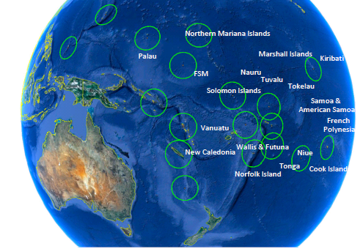
O3B targeted footprints (quoted from O3B website)

Slide 7
Case Study of Republic of Marshall Islands
RMI was interconnected with Guam by submarine fiber optic cable(SFOC) in 2009. The cable is branching out to Federated States of Micronesia. One 10Gbps on one wavelength is activated. The maximum capacity is 80Gbps
However % usage of transmission capacity is less than 1% according to the National Telecom Authority (NTA) as of Nov. 2013.
The bottleneck is the last mile access line (low speed DSL dependent). In response to the request of MOTC, APT offered the grant to provide training workshop for the fiber splicing technique by dispatching Japanese experts with a fusion splicer and necessary parts.

Slide 8
Case Study of RMI (continued-2)
Fiber to the premises (FTTx) is expected to generate the traffic to be put through the SFOC for its efficient use.
It will contribute to the compensation of leasing loan of NTA to Kwajalein Cable System (KCS) which operate/maintain the SFOC
There are 29 atolls and 5 outer islands in RMI. Providing connectivity to atolls and islands by GEO satellite with DAMA is on-going step by step.
Tele-centers are being built on outer islands for providing islanders ICT services. Schools and health posts of outer islands are being connected.
Please visit Case Study Library of ITU-D website http://www.itu.int/en/ITU-D/Study-Groups/2010-2014/Pages/case-study-library.aspx

Slide 9
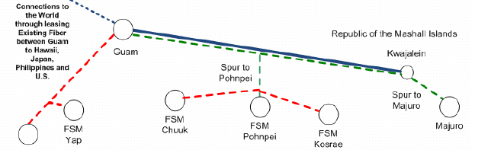

Overview of Guam-FSM-Kwajalein-Majuro Optic Cable
Palau
8 wavelength/fiber to FSM & RMI
10Gbps/1wl
Red dash line is planned

Slide 10
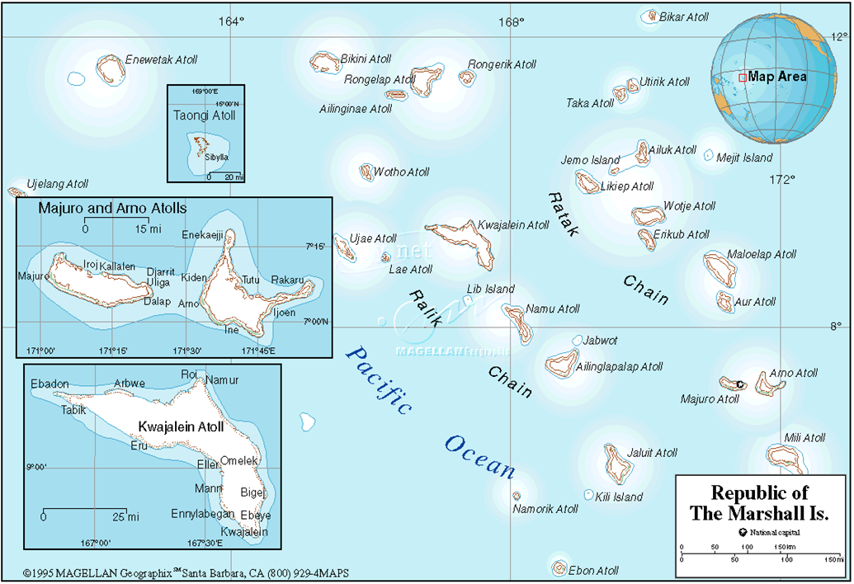

Slide 11
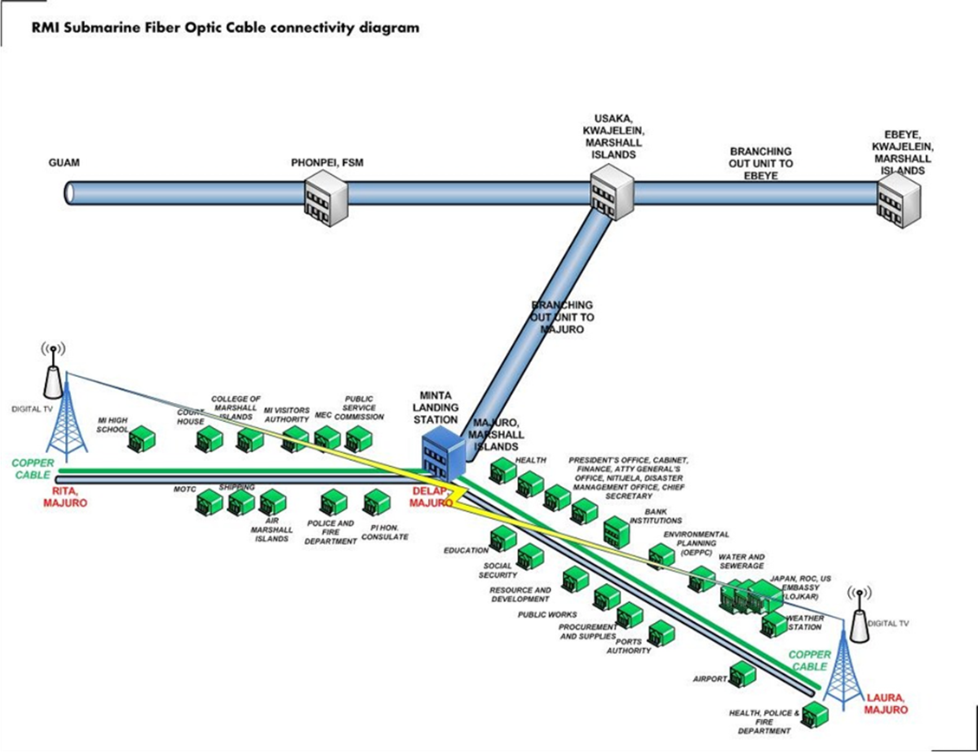
10Gbps expandable
to 80Gbps

Slide 12
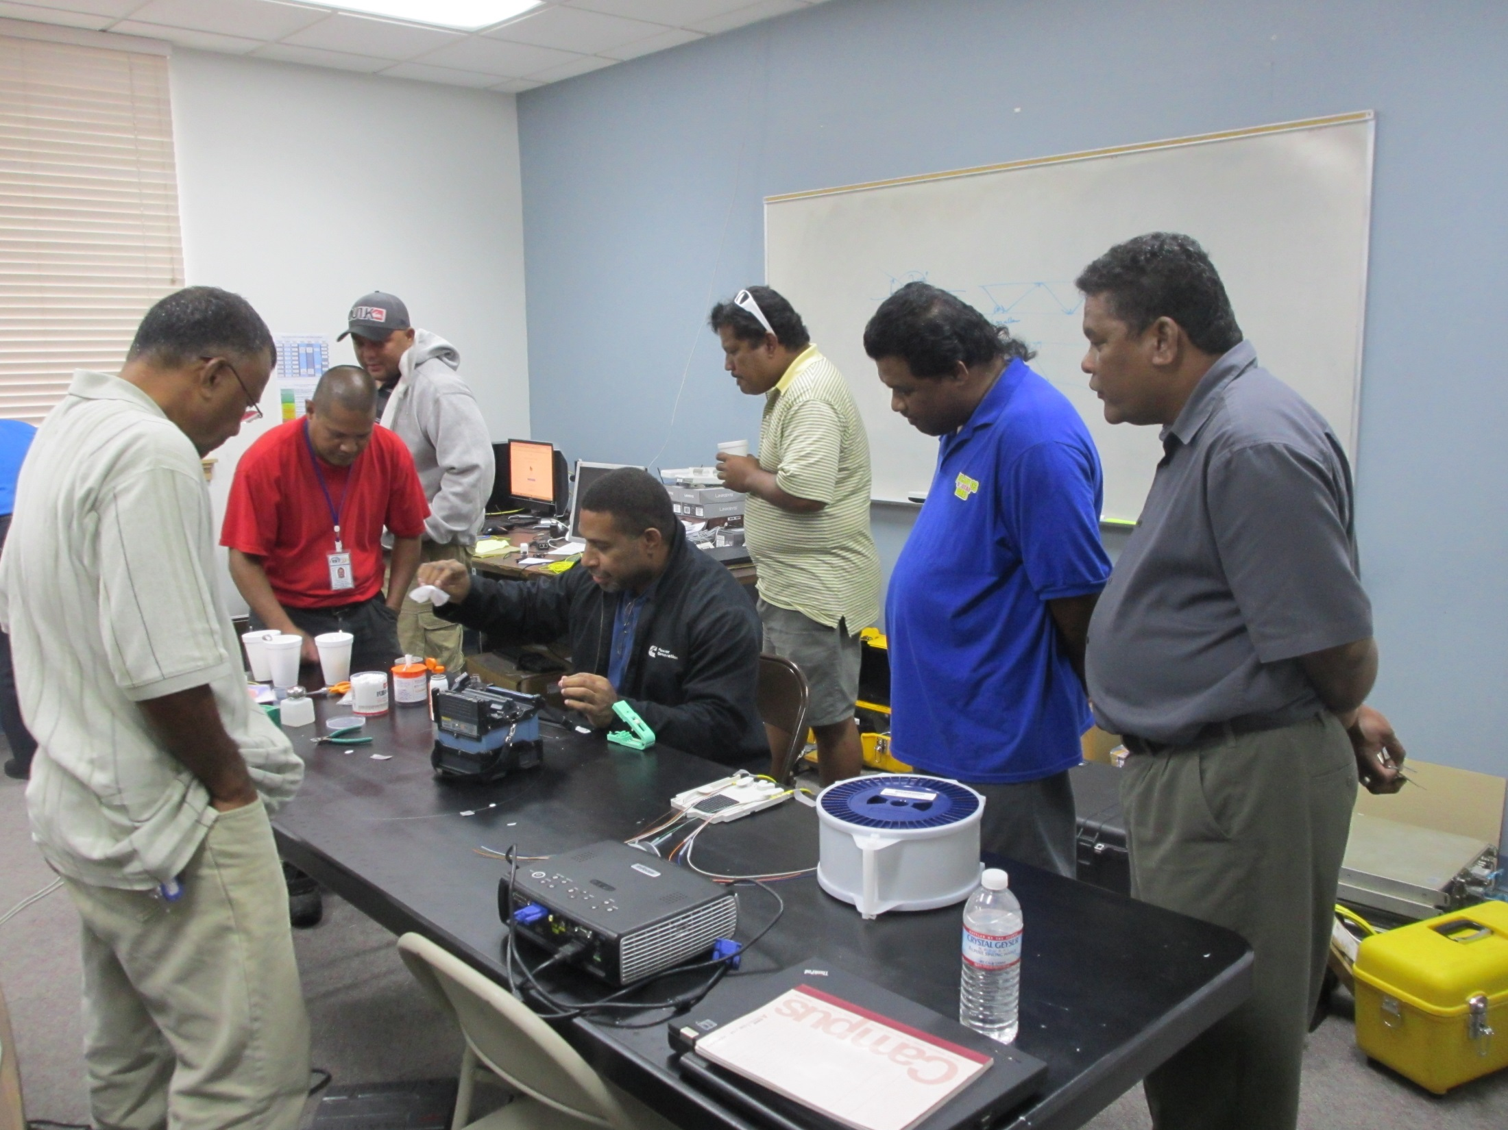

Slide 13
Case Study of RMI (continued-3)
Government offices, public offices, hospitals, school campuses, embassies, hotels, shopping complexes, office/apartment complexes are clustered alongside the inland optical backbone.
Easy reach by optic fiber to the customer’s premises.
Modest investment for FTTx will contribute to the migration from thin last mile to broadband last mile and for building smart society.
Low maintenance cost, stable, high quality of service and high data speed.

Slide 14
An Example of Smart City in Thailand
Quoted from Fujikura’s Booklet Hikarinokuni

Slide 15
Proposal for the connectivity to SIDS of ASP
Considering that;
ASP SIDS connected by the Submarine Optic Fiber Cable are supposed to be in the similar situation like RMI, which are suffering from inefficient use of obtained large cable capacity.
They need broadband last mile to generate the traffic to be put through the international backbone whether it may be optical fiber or satellite link.
In municipalities of SIDS, customers premises are clustered alongside the inland backbone and are within easy reach by optic fiber extension.
However, lack of technicians for indoor and outdoor fiber splicing and machines is vital issue raised by SIDS such as RMI.
By Providing the ICT platform for various e-services listed in the action line C7 of WSIS Tunis Agenda 2005, it will be the way forward to the building of smart society in ASP SIDs.

Slide 16
Proposal
1) Feasibility study in municipalities of SIDS (RMI,
FSM, Tonga, Fiji etc.) where connected by
SFOC for the investment on building
broadband last mile by FTTx and/or wireless
access.
Socio-economic study of the effect of building broadband last mile by FTTx and/or wireless access and sustainability, and needs of various e-services towards smart society
Tariff and pricing policy study to augment the traffic demand.
Organizing training workshop for the fiber networking and fiber splicing for the technicians in each SIDS as necessary.

Slide 17
Thank you!!
Kawasumi-yasuhiko@s3.dion.ne.jp

