Slide 1
Low cost optical cable solution
for rural areas in developing countries
Haruo Okamura
Global Plan Inc., Japan
okamura@globalplan.jp
ADB HQs, Manila, Philippines
29, April 2014

Slide 2


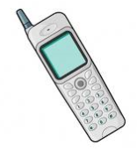
Trend in Mobile Handsets
Mobile Phones to Smart Phones & Tablets
2013
Population 7.3 B
Mobile Phones 6.4 B
2018
Population 7.5B
Smart Phones 4.5 B
2013
>256 kbps
Developed Countries 51 %
Developing Countries 8 %
“Quality”
in
e-Diagnosis
e-Education
BroadBand will be really needed to connect rural, remote areas

Slide 3

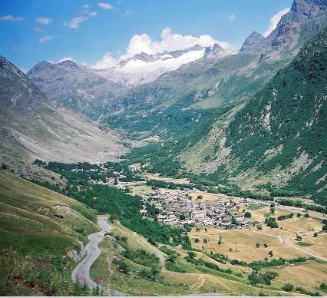



Broadband “Backhaul”
From Cities to Rural Areas
LTE, 4G
Microwave
Optical Fiber
Mobile Base Station
TeleCenters, Schools
Hospitals,,,
Trank Line

Slide 4
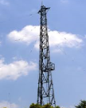


Microwave ? Optical Cable ?
Microwave Solution
Data Capacity < 1 Gbps (Upgrading difficult)
Antenna spacing : direct view, a few kilometers
(Air Transmission with Tower, Antenna and Power)
Optical Fiber Solution
Data >> 1 T bps
Cable Span > 100 km
U.S. FCC defined
"Basic Broadband (downstream )”
as at least 4 Mbit/s (2010)
Technol. is Available
for long-span air link
Power line span
ave. 630m
Rope Way span
max. 1.7 km
Microwave
Optical Cable

Slide 5
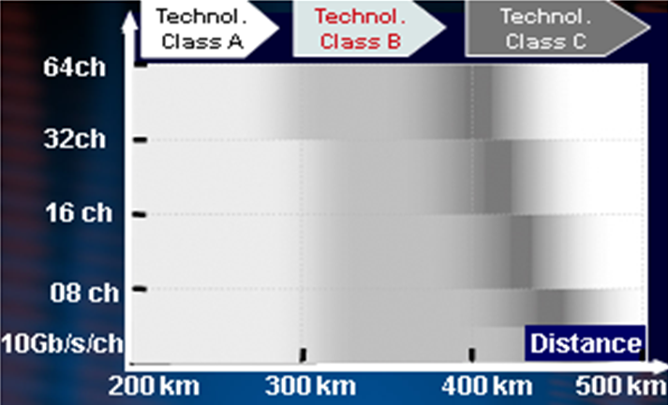
Optical Cable Solution
Signal Capacity vs. Transmission Distances
without demanding Electric Power Supply
Difficult
Terrain
More
Cable Splices
Shorter
Cable Span
~ 300 km
@ 640 Gbps
Per
One Fiber
Notes:
お義務

Slide 6
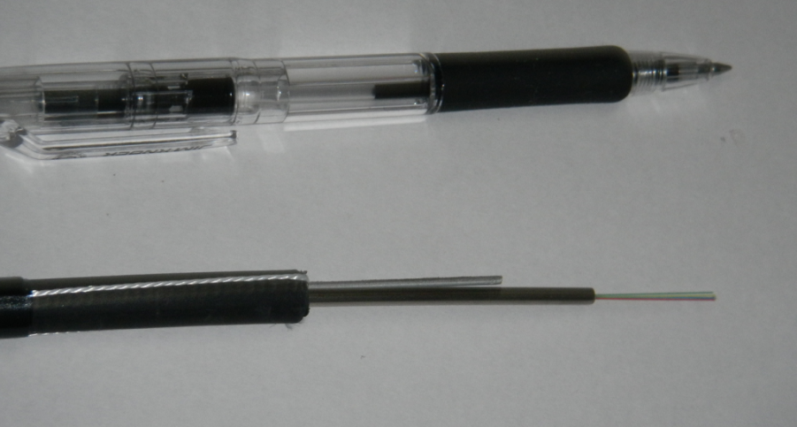
Optical Cable for aerial wiring, direct burying,
submerging (or, open-air installing)
Tension Member
Optical Fibers
Steel Pipe
PE Jacket Φ 8mm
Outer diameter Φ8 mm
Tensile Strength 90 kg
Lateral pressure 200kg/100mm
Weight 85 kg/km
Ease of route planning
constructing, repairing

Slide 7
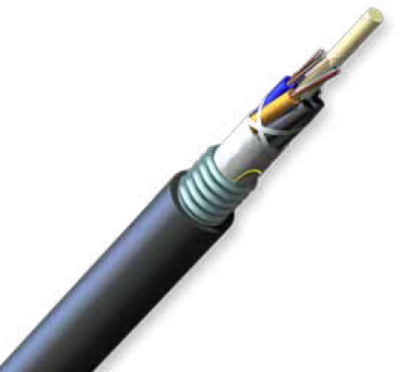
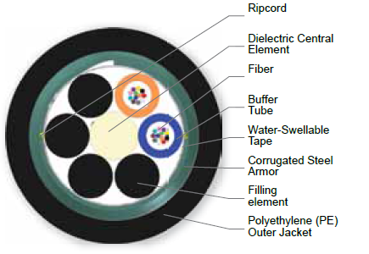
Optical Cable for Direct-Buried Installation
with corrugated steel armor
Fiber count: <24, Weight 129 kg/km
Φ12.1 mm
Fully waterblocked for direct-buried installation
Outer diameter Φ12.1 mm
Tensile Strength 90 kg

Slide 8

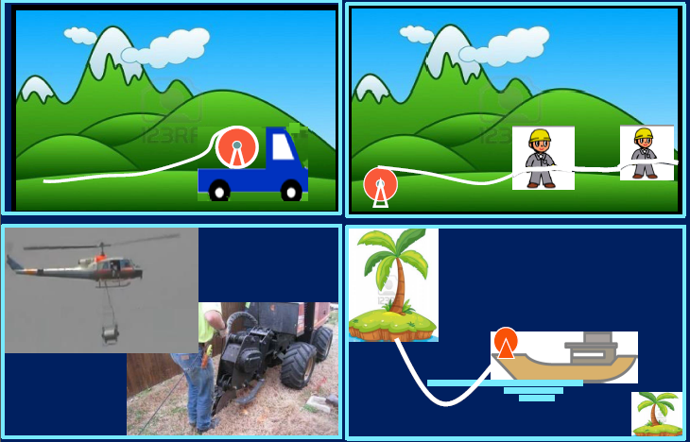
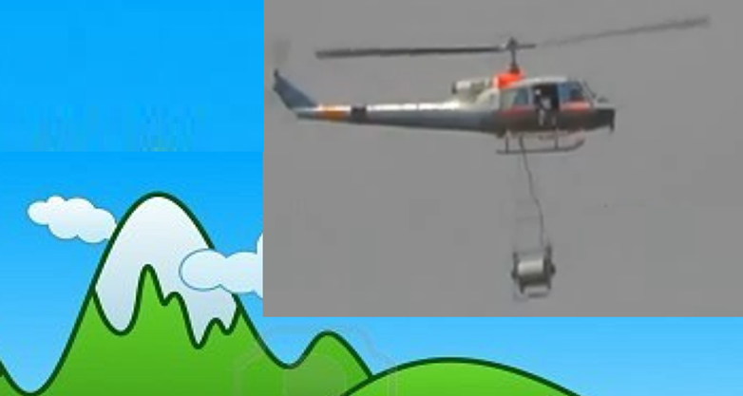

Slide 9
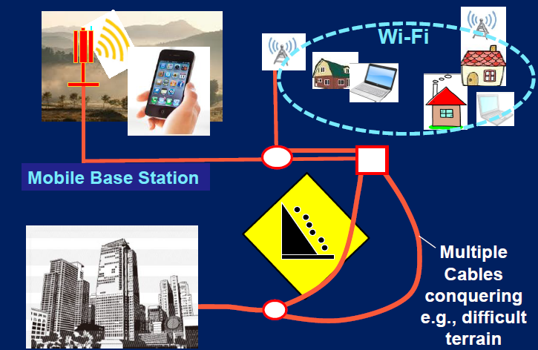
Multiple Links to secure Optical Cable Backhaul

Slide 10
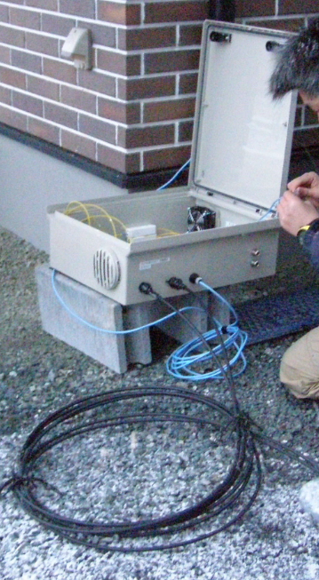
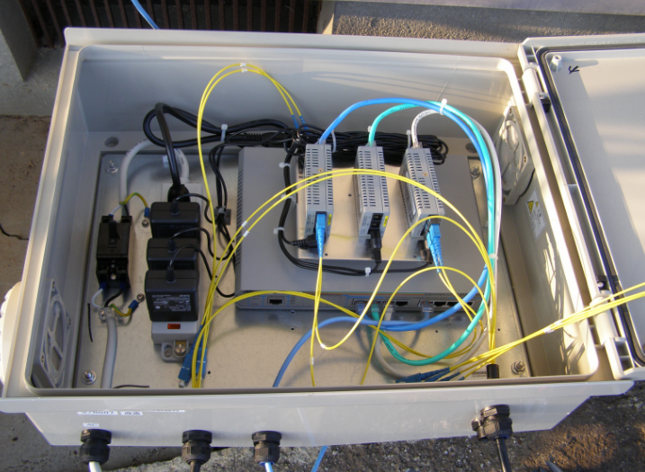
Transmission Equipment (Outdoor)
Air-conditioning not needed.
・ Anti-corrosion film
・ Moisture absorber
can be used, where necessary.
Unmelted snow
Optical Cable

Slide 11
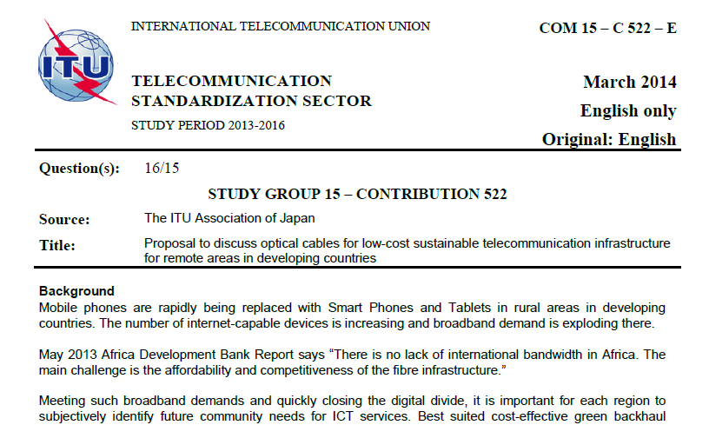
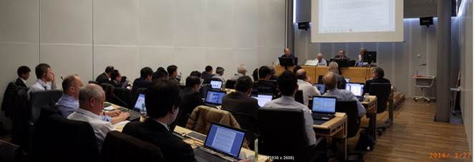
March 2014, ITU-T SG15 agreed to discuss
Requirement for “Optical Cables for Backhaul”
March 2014 SG15 meeting report: Lightweight cables with stainless steel armor for aerial, direct buried, and submerged deployment applications was discussed in detail. Mr Okamura agreed to prepare a draft with proposed requirements for presentation at the next meeting.

Slide 12
Summary (1)
“Broadband (4 Mbps downstream)” will be “MUST” tomorrow morning even in remote areas in
developing countries
How to quickly introduce broadband from cities to
remote areas at a low cost.
Optical Fiber or Microwave ?
A proposal was discussed to Quickly/Widely
penetrate Optical Fiber Cables into remote areas
in developing countries

Slide 13
Summary (2)
- March 2014, agreement was reached to initiate
Standardization of a new category Opt. Cable
at ITU-T SG15 Q16 (Outside plant)
A New category cable
Allowing simple/low-cost “do-it-yourself” installation for aerial wiring, direct burying, submerging or even open-air installation (if needed), no need of costly heavy machines
One Example;
Thin, lightweight, heavy-duty and easy-handling cable with a welded stainless-steel pipe
accommodating <24 fibers

Slide 14
Thank you

