Slide 1
ASEAN-ITU Seminar on ICT Accessibility and
Assistive Technologies for Equity in Society
25-26 August 2014
Bangkok, Thailand
Session 6
Approaches to Mainstream ICT Accessibility in the Policy, Legal and Regulatory Framework
Mandla Msimang
mmsimang@pygmaconsulting.com

Slide 2
Introduction
Range of Regulatory Options
Updating Disability Legislation
ICT Framework
Relevant definitions
Promoting effective participation
Universal access and service
Consumer Protection
Targets and Reporting Requirements
Conclusion

Slide 3
Range of Regulatory Options
Policy
Legislation
Overarching Disability Policy
ICT Policy
Overarching Disability Law
ICT Law
Codes of Conduct (France, UK, Australia, Zambia, SA)
ICT Regulation
“Hard”
“Soft”
Guidelines and checklists
Licenses (SA, UK)
Standards (Korea,, US)
Regulations (EU, UK)

Slide 4
Beyond the ICT framework – Updating Disability Legislation
Disability legislation generally:
covers non-discriminatory access and opportunity throughout society (procurement, education, employment, etc);
Older Disability laws need to be reviewed
does not always cover access to ICTs, mobile communications, video programming, TV, or internet (which have a cross cutting impact on society) – should be updated
Definitions such as ‘premises’, ‘facilities’, ‘places of public accommodation’ should recognize impact of ICTs and thus that they may not be physical’ spaces and facilities (reflect language of Article 9 of UN CRPD)

Slide 5
Relevant Definitions Promote Inclusivity at the Outset
Definitions in law and regulations, such as
“ICT Accessibility”
“universal design”
“persons with disabilities”
“ICT users” which includes PWD
“underserved communities” which include PWD
“effective communications”
“accessible publication formats” and “accessible publishing”
“assistive technologies”
“Committee on ICT Accessibility”
Expand “universal access” and “universal service” definitions to also include ICT accessibility for persons with disabilities

Slide 6
Promoting Effective Participation Nothing About Us Without Us
Use “effective communications” and “publication”
Notification
Accessible electronic publications
Braille
Ensure PWD included in public consultation stages of policy/legislation/regulation development
Invitations to comment on draft documents
Ensuring representation in public hearings
Focus group sessions
Establish formal consultation processes with PWD
Committee on ICT Accessibility (depending on institutional framework) – e.g. OFCOM Advisory Committee

Slide 7
Universal Access and Service Expand Goals and Definitions
UAS is a key objective of most ICT policy frameworks, but not sufficient:
PWD need barrier free devices and services to access ICTs on an equal basis
Additional policy steps needed such as
Expanded goals – beyond networks, to end users, including PWD (e.g. USA), including ‘universal design’ as a principle
Expanded definitions – such as ‘underserviced community’ to expand the scope of beneficiaries of USAFs (e.g. Malaysia, Thailand, South Africa)
Subsidization frameworks – to include accessible handsets, AT, relay services, customization, etc (e.g. USA)
Non-discrimination to be applied for all funded projects and USOs

Slide 8
Consumer Protection Quality of Service
QoS should not compromise accessibility, particularly important for persons with disabilities :
PWD may have a greater reliance on a given service for communications (e.g. impact of non-delivery of text messages for the deaf, and the effect of poor quality of relay services)
The impact of bad quality on a category of users may be more significant than on others (e.g. impact of ‘snowy’ TV screens on partially sighted users; impact of poor network quality on persons with hearing loss)
Audio-visual content delivered over Internet networks (both Internet-enabled TV [IPTV] and webcasts on the open Internet) can suffer from jitter, leading to the picture and sound freezing or suffering delays.

Slide 9
Consumer Protection Emergency Services
Equal access to emergency services by all
Public awareness of available emergency services
Model Text: Emergency Services
Sample text to be included in ICT legislation to ensure that the needs of persons with disabilities are considered when emergency services are addressed is as follows:
“Service providers and video programmers must –
(1) make emergency announcements publicly available on all networks and video programs in alternative communication modes.
(2) in the case of electronic communications services, unless it is technically infeasible,
(a) make automatic number identity, such as caller line identity, and automatic location
identity available to emergency centres;
(b) carry communications to emergency centres.
And
“The NRA must make regulations to ensure access to emergency services via electronic communications, audio visual networks, and the web, where applicable, by the public, including persons with disabilities”.

Slide 10
Targets and Reporting Requirements Measurable Targets
NRAs should establish annual measurable targets, issue an annual public report on implementation, and take necessary enforcement action when appropriate.
Sample targets for ICT policy makers, legislators and regulators include:
Disability legislation updated with the inclusion of ICTs in the definition of accessibility.
Mainstreaming ICT accessibility into standards;
Existing ICT definitions amended and new definitions added to ICT legislation to promote ICT accessibility;
Universal access and service framework includes ICT accessibility as a goal;
QoS and other regulations take into account the specific needs of PWD
Emergency services’ legal and regulatory framework takes into account the needs of PWD

Slide 11
Targets and Reporting Requirements Periodic and Meaningful Reporting
Key Indicators and Reporting (at least every 2 years)
Access to ICTs based on type of disability per technology (public access, mobile telephony, websites, TV)
Availability of accessible ICT products and services across markets
Affordability of ICTs for persons with disabilities
Proportion of ICT products and services with built-in accessibility functions
Percentage of staff trained on serving customers with disabilities
Awareness rate of persons with disabilities on the use of ICTs to improve their economic and social inclusion
GDP proportion spent on research and development relating to ICT-enabled solutions for persons with disabilities
Total number of patents filed/awarded to ICT-enabled solutions for persons with disabilities

Slide 12
Targets and Reporting Requirements Set Milestones
In addition, milestones should be set to measure progress in
implementing legal provisions, regulatory or codes of conduct,
capacity to implement policy (e.g. establishing necessary budgets and training programmes)
availability of accessible ICTs for PWD, including access to, availability, and affordability of ICTs based on type of disability per technology (public access, mobile telephony, websites, television/video programming).
Milestones and targets should include operators, licensed service providers of video programming, ICT vendors, assistive technology professionals, emergency response services, NGOs, and DPOs, .

Slide 13
Conclusion & Next Steps Summary of Good Practice (1)
Assign a lead government executive to oversee the process of promoting accessibility (Ministry? regulatory authority?)
Get baseline statistics on PWD in the country
Get baseline statistics on accessibility in the country
Check (and update) existing policy and regulatory frameworks applicable to accessibility.
Set up a process involving organizations representing persons with different types of disabilities, operators and regulatory authorities to provide feedback and recommendations on potential accessibility gaps, and monitor progress made in closing these gaps.
Develop a roadmap with industry, supported by organizations of persons with disabilities, to fill accessibility gaps and determine an on-going process to monitor progress.

Slide 14
Conclusion & Next Steps Summary of Good Practice (2)
Encourage leading manufacturers to offer existing accessible products already marketed around the world.
Facilitate capacity building programs with industry on disability awareness and ways to reach out and serve persons with disabilities.
Identify areas for which Universal Service/Access Funds may intervene to equalize access for users with disabilities.
Explore opportunities to accelerate the localization of services such as voice recognition and text-to-speech interfaces if not available in local languages.
Use regulatory means when consensus building is not producing results or to establish a level playing field among competitors when investments to implement solutions are necessary.

Slide 15
Conclusion
Important to use appropriate legal, regulatory and policy tools to implement ICT Accessibility commitments and intentions
Collaboration between all stakeholders must be encouraged
Consultation is key to ensuring practical and relevant implementation
On-going reporting and review is an important component of effective policy

Slide 16
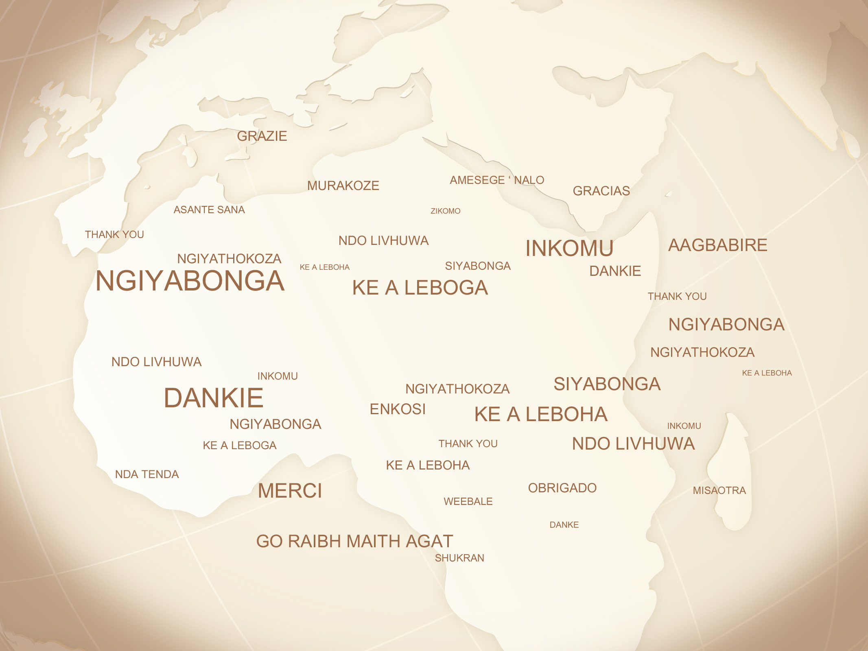
www.pygmaconsulting.com
info@pygmaconsulting.com

