Slide 1
ISCEC-Japan Corporate introduction
ASEAN-ITU Seminar
2014/08
ISCEC-Japan Corp.Ltd
CEO,President Muneya Ichise

Slide 2
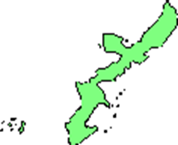
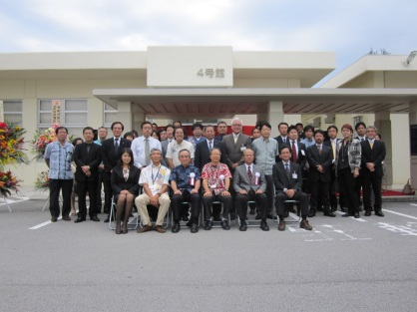
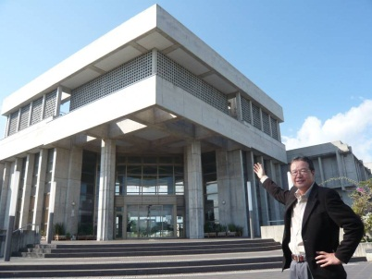
1. Overview
Name | ISCEC-Japan Corp.ltd
Address(HQ) | Ichui-Gushikawa-Jinbunkan 1F 468 Kawasaki, Uruma City, Okinawa Pref. Japan
Address(Center) | 4th Bld. IT Business Support Center 2-20-1 Ishikawa-Akasaki, Uruma City, Okinawa Pref. Japan
Established | Sep. 1, 2008
Capital | 17 Million Yen
CEO/President | Muneya Ichise
Main Business | “e-mimi” real time caption service Telephony Relay service（TEXT Relay Service） IT education service Internet shopping Software Development
Contact | TEL: +81-98-972-6888 FAX: +81-98-987-5627 E-mail：iscec-j@iscecj.co.jp
（e-mimi Center Uruma）
（HQ）

Slide 3
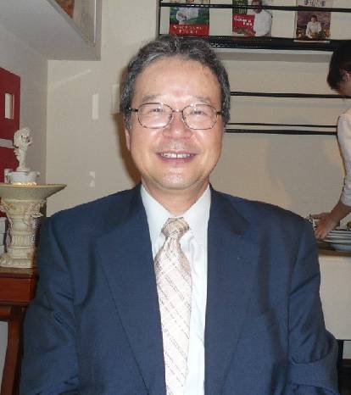
CEO Profeel
Address: Uruma City, Okinawa Pref. Japan
Born: Apr.18,1956 in Obama City, Fukui Pref. Japan
Graduate: Mathematics, Nagoya Univ. on Mar.1979
Business Experience
  IBM Japan Corp. 1979-2005
  Sales Manager of Retail section in Osaka
  Executive Assistant of Dist. Industry Director
  Sales Manager of Store Solution Dept.
  Sales Manager of ibm.com Dept.
  Director of ibm.com Mid & Small Business division
  Loan to 2003 IBM Asia Pasiphic as ibm.com Sales Initiative
2004 President & CEO IBM-Japan e-communications Corp. ltd
2005 Project Manager of IBM Japan BTO
2006 Representative of ISCEC Business Office
2008/9 President/CEO ISCEC Japan Corp. ltd.
2012/4 Director of The Okinawa Conference of the Association of Small Business Entrepreneurs
Notes:
私自身の紹介を簡単にさせていただくと、オバマ大統領で有名になった福井県小浜市の出身です。
大学卒業後、日本アイ・ビー・エムに28年間勤務し、子会社の社長等歴任いたしました。
平成20年に沖縄県のベンチャー育成事業の採択を受けて起業し現在に至っております。
昨年から同友会中部支部の副支部長をさせていただいております。

Slide 4
Company History
Sep, 2008 | Establish ISCEC-Japan Corp. ltd as trustee Okinawa-Pref Public corporation
Jun, 2010 | Job training for Deaf & hard to hear person as trustee of Okinawa pref.
Jun, 2011 | Start remote real time caption service(e-mimi) as trustee of Okinawa Pref.
Apr, 2012 | Authorized company for Privacy mark
Apr, 2012 | Start remote real time caption service for sight-seeing as Okinawa-Pref Public corporation
Jun, 2012 | Start remote real time caption service to students in high school supported by National Institute of Information and Communication Technology
July, 2012 | The prize of Okinawa Promotion Fund by the bank of Okinawa
Oct, 2012 | The prize of “Selected 100 venture companies of saving Japan next generations” by Nikkei Business magazine
Mar, 2013 | Start “One touch e-mimi” for aged person & deaf person as BARRIER FREE of service at counter (government office, bank, GMS, shops)
Jun, 2013 | The first real time caption service in a municipal city council, Takeo city
Sep, 2013 | Start feasibility study of caption telephone as trustee of Small & Mid Enterprise Agency
Dec, 2013 | The prize of contribution company for Okinawa welfare

Slide 5

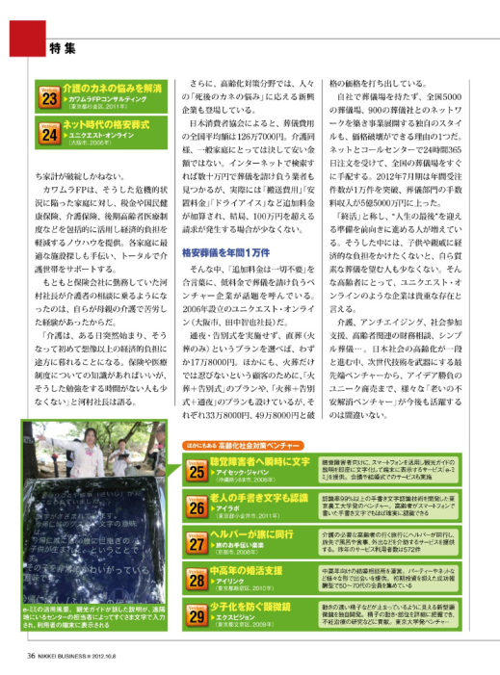
Refference
Oct.8, 2012 Nikkei-Business Magasine
Notes:
日経ビジネスの記事をご参考までに表示いたしました。日本全国の中の1つとして選ばれております。

Slide 6
Current Staff Overview
All members 92 (Male 26, Female 66)
  Regular: 29 (Male 12, Female 17)
  Contractor: 63 (Male 14, Female 49)
  ( Part Timer: 3 (Male 2, Female 1)
Age
  20 s: 48 (Male 11, Female 37)
  30s: 24 (Male 7, Female 17)
  40s: 17 (Male 5, Female 12)
  50s: 1 (Male 1)
  60s: 2 (Male 2)
What Area
  Okinawa: 80 (Male16, Female 62)
  From Out of Okinawa: 12 (Male 6, Female 5)
Notes:
現在のアイセック・ジャパンの社員構成です。
所属社員は私を入れて、24名、うち男性7名、女性17名と女性の多い職場です。
年齢も20歳～30歳代が多い職場です。
ほとんどが県内出身者です。

Slide 7
2. Back Grand
Deaf & Hard hearing persons Analysis
Sign language
Authorized Deaf and Hard hearing
Unauthorized hard hearing
Need Captions
60~70 K Men
360 K Men
More than 6 M Men

Slide 8
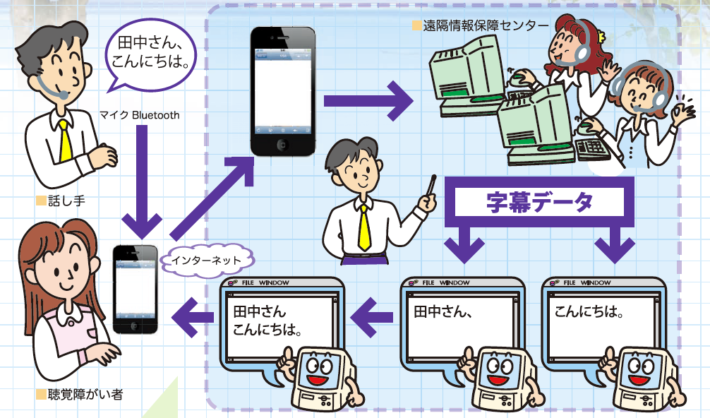
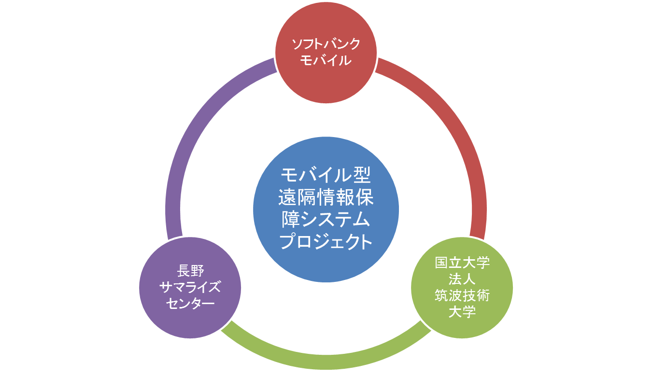
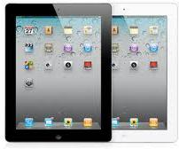
What is “e-mimi” remote real time caption service
Create captions by 2 persons pair and change another pair by each 10 minutes
Original system made by national University of Tsukuba Technology with Nagano NPO and Softbank mobile from 2009-2010
ISCEC-Japn joined this project on 2011
支援
<Advantage>
Easy to get caption service with smart phone and/or Tablet PC
Correct & Speedy compare to Voice recognition
Remote Capabilities: service to all Japan and other countries
Caption to all statement

Slide 9
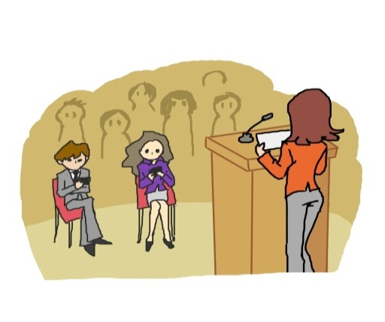
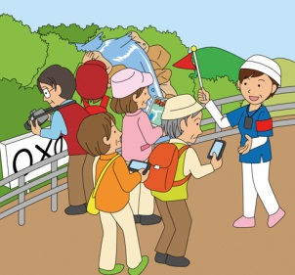

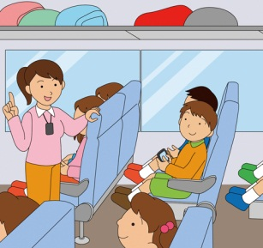

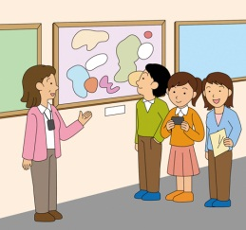
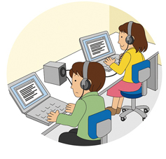


What area our caption service appricable
＜Sight Seeing＞
Seminar
Tour
Caption to all TV by 2017
In Bus
Museum
Live caption on TV
Lesson
Counter service (government office, bank, GMS, shops)
municipal city council
Remote caption center

Slide 10
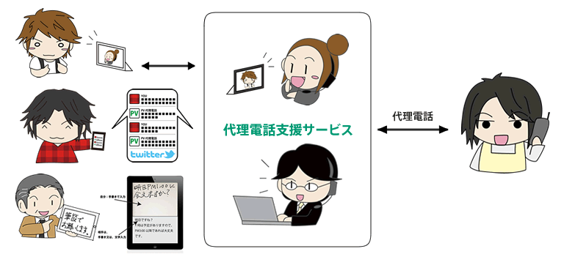
Telephoney relay service
e-mimi CTR uruma
A
電話
C
B
Start telephone relay service as trustee of Nippon Foundation from Sep 2013 to Mar 2014.
Recently, this service will continue from Apr 2014.

Slide 11
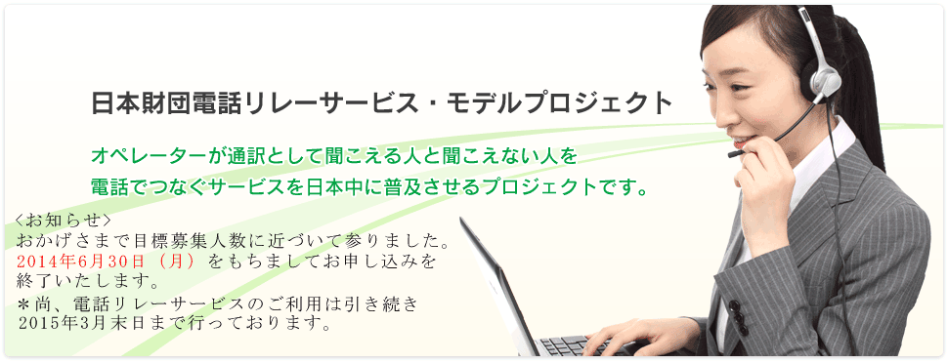
The Nippon Foundation Telephone Relay Service Model Project
Available:
from April 1st to March 31st
The number of users(aim) : 2,000
Types of Relay Service
Text Relay Service
Video Relay Service
Test & Relay Service

Slide 12

The Nippon Foundation Telephone Relay Service Model Project
Business hour :
・8:00am-9:00pm
・365days
Software /Applications:
・Skype ･Yahoo!Messanger
・Facetime ・ iChat ・iMessage,
・LINE, ・Tango ･ TeleBB,
etc…
Providers
3 companies, 3 parties

Slide 13
Monthly Data
(2014/05/01-05/31)
The number of calls： | 3,848
(Connect) | 3,239
(Not connect) | 609
Total minutes： | 43,617
Registered users： | 1,450
Real number of users： | 657

Slide 14



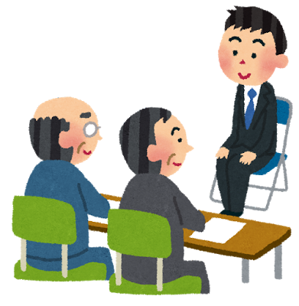

User Comments
I had to go the hospital to reserve.
After using TRS, I can solve many things by myself.
I realized that I have given up a lot of thing because I could not use the telephone.
Thanks to TRS, I can communicate with hearing people directly.
I can see the part of society of hearing people.
It is good service for deaf family.
When I forgot something on the train, TRS was so useful.
I could ask the station staff and get it soon.

Slide 15




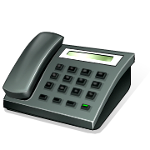
Caption Telephony System
Under developing
MMX
e-mimi CTR uruma
Caption
Display

