Slide 1

Web Accessibility: ASEAN and Thailand practices
ASEAN-ITU Seminar on ICT Accessibility and Assistive Technologies for Equity in Society
25-26 August 2014, Bangkok, Thailand
Mr. Sawang Srisom
Web Accessibility Resource Person, MICT Thailand

Slide 2
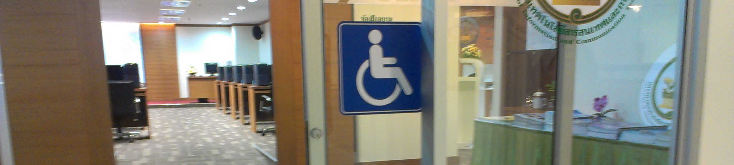
Presentation Outlines
What we have done and achieved in Thailand and ASEAN
What’s in place for ICT Accessibility
Challenges and Gaps + Recommendations

Slide 3

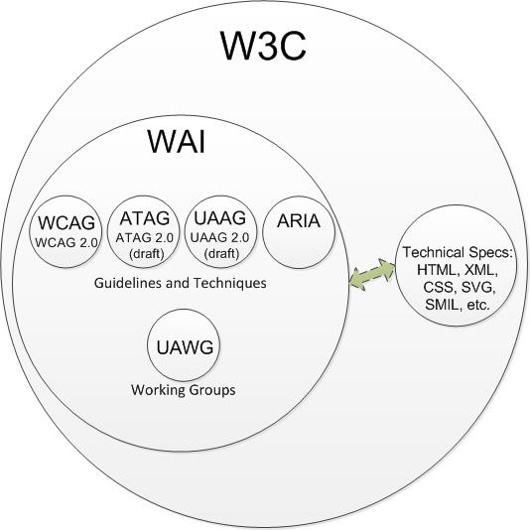
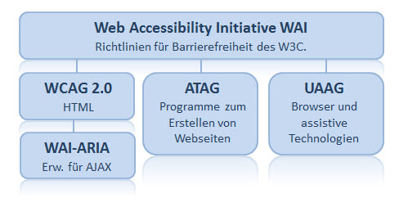
The Beginning!!!
- WAI in 1997

Slide 4
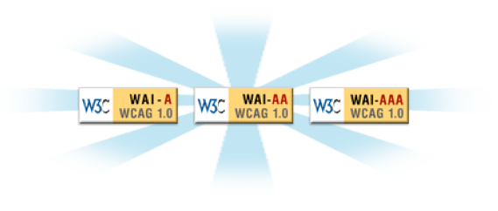
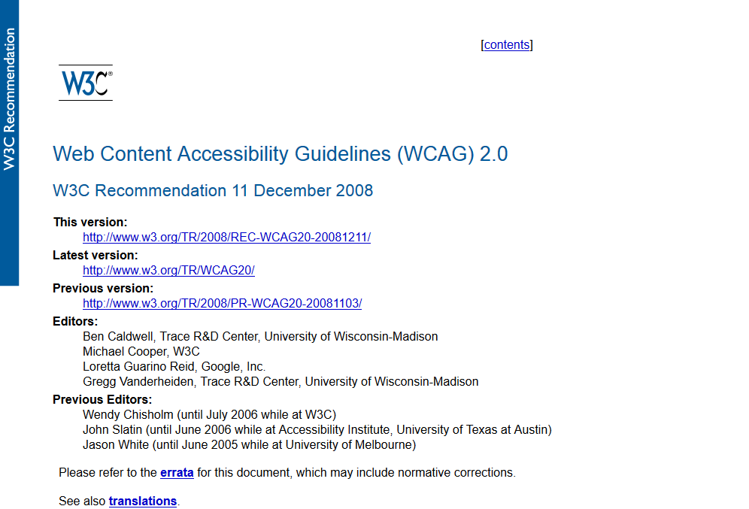
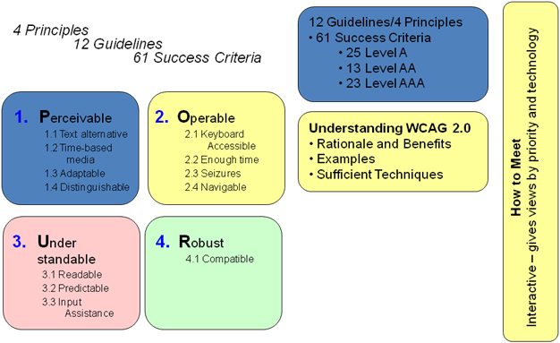
The Beginning!!!
- WCAG 2.0
http://www.w3.org/TR/WCAG20/

Slide 5
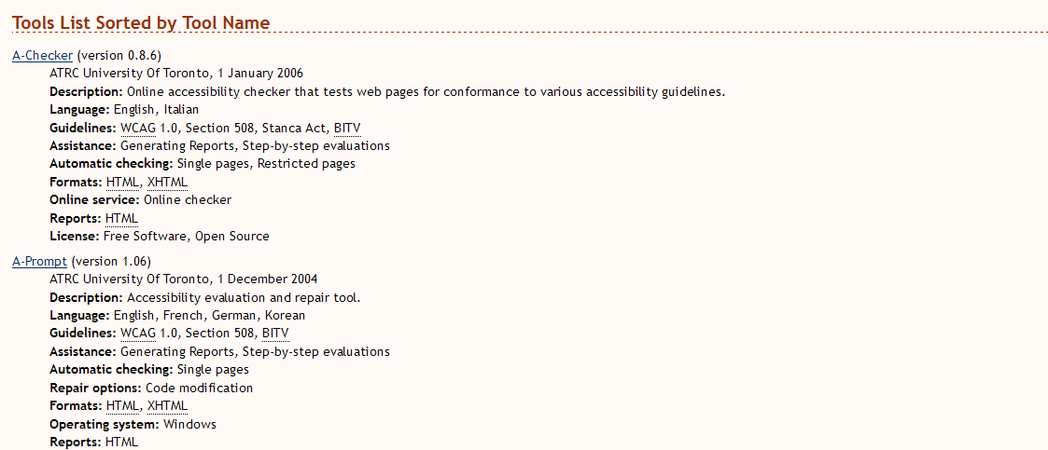
The Beginning!!!
- WCAG 2.0 Evaluation Tools
http://www.w3.org/WAI/ER/tools/complete

Slide 6

What we have done in Thailand
- Establishment of Ministry of ICT in 2002

Slide 7
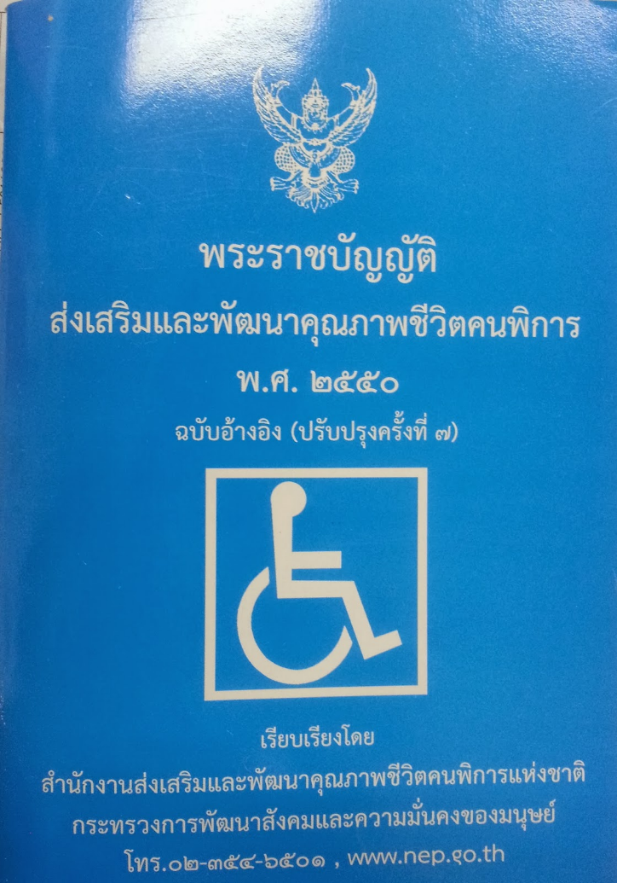

What we have done in Thailand
- Starting point
The Act of Empowerment of Persons with Disabilities B.E 2550 (2007)
Article 20: persons with disabilities have access to and utilize public services as well as government welfare and supports… … …
(6) Information, communication/telecommunication services, ICT, assistive technology…

Slide 8
What we have done in Thailand
- ICT Accessibility Initiatives 2007-2013
ICT/Web Accessibility Training/Competition (2007-2013)
TWCAG2010 (Thai Web Content Accessibility Guidelines 2010)
Ministerial Regulations on Crietria, Procedures and Requirements to Access and Utilize Information, Communication, Telecommunication Services, Assistive Technology and Public Media Services for Persons with Disabilities by Ministry of ICT (2011)
Establishment of ICT Service Training Center, Ministry of ICT

Slide 9
What we have done in Thailand
- Initiatives: Websites (1)
http://www.equitable-society.com (Project Website)
http://www.pwdsthai.com/ (Web portal on disability)
http://asean4all.org (ASEAN ICT Accessibility Project)

Slide 10
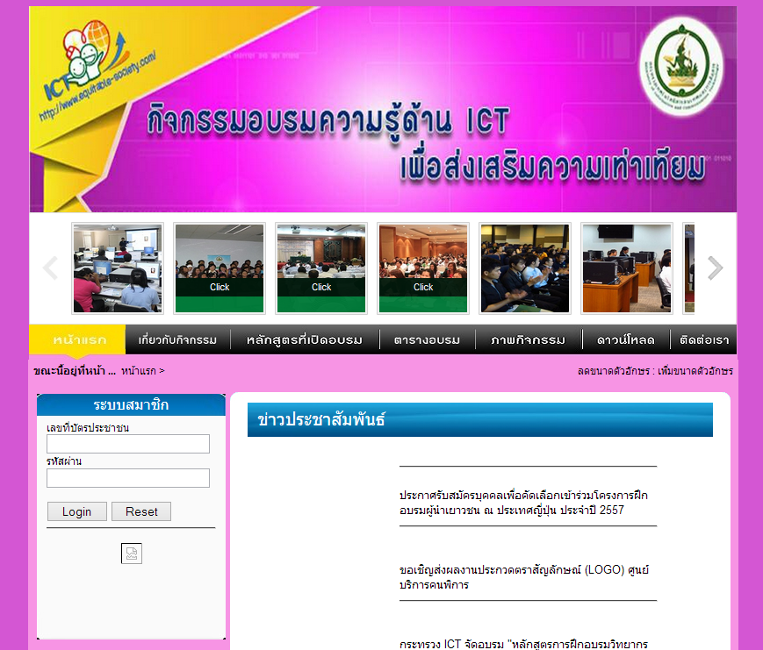
What we have done in Thailand
- Initiatives: Websites (2)
http://www.equitable-society.com

Slide 11
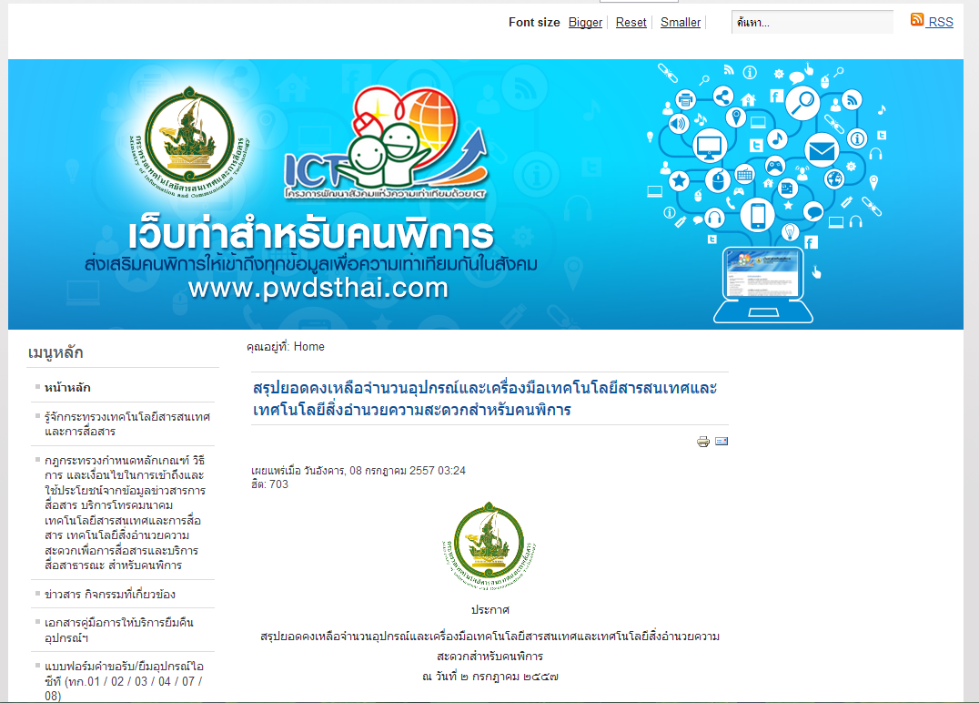
What we have done in Thailand
- Initiatives: Websites (3)
http://www.pwdsthai.com/

Slide 12
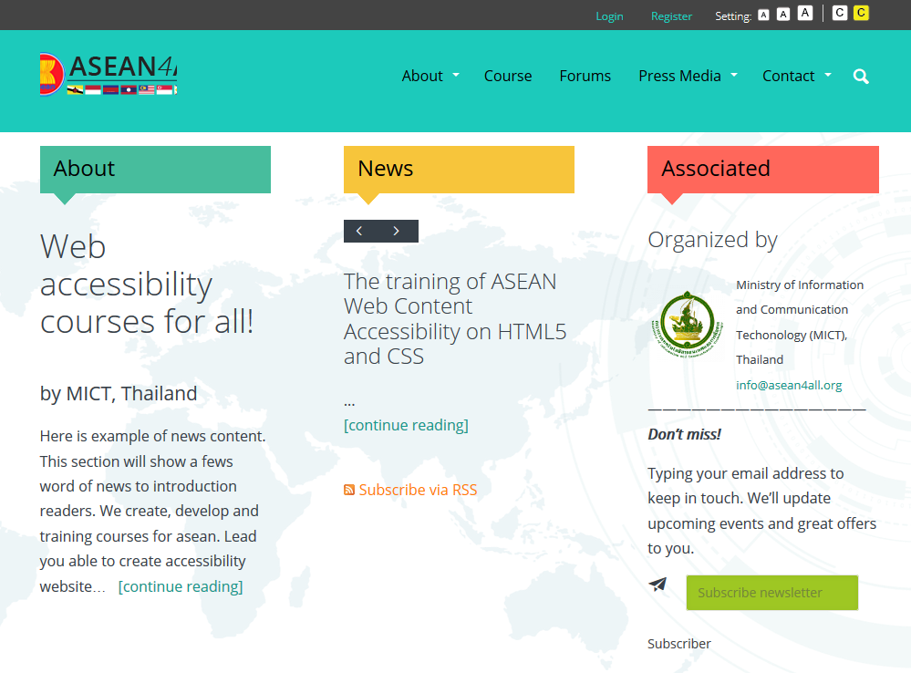
What we have done in Thailand
- Initiatives: Websites (4)
http://asean4all.org

Slide 13
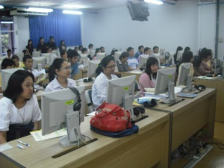
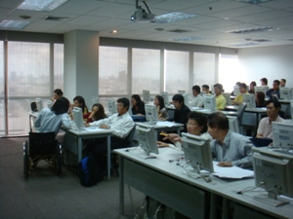
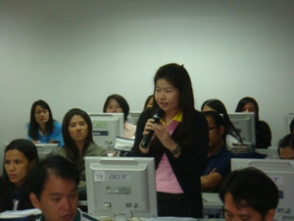
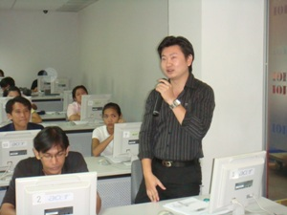
What we have done in Thailand
- Web Accessibility Training (2007-2013)
Target Groups: programmers, general users, multimedia producers, system administrators, content producers, CMS users, TOTs, people with disabilities
From: government/private agencies
Where: nationwide
Number of trained participants: 2100+

Slide 14
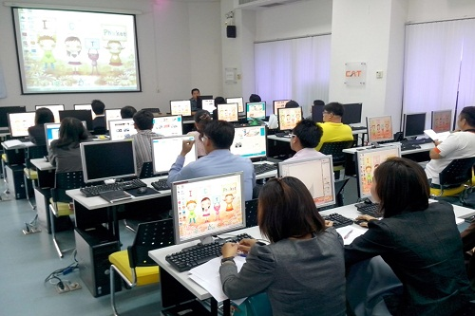
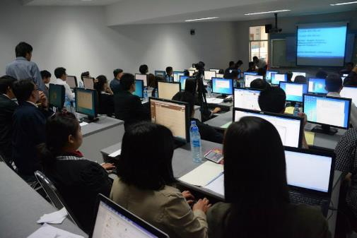
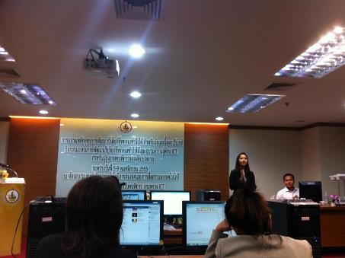
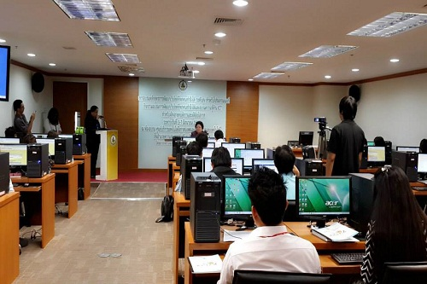
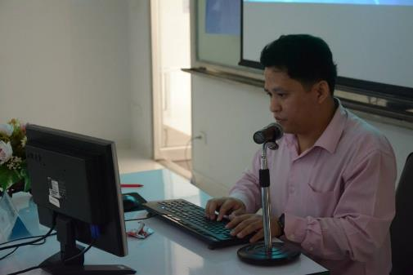
What we have done in Thailand
- Web Accessibility Training (2007-2013)

Slide 15
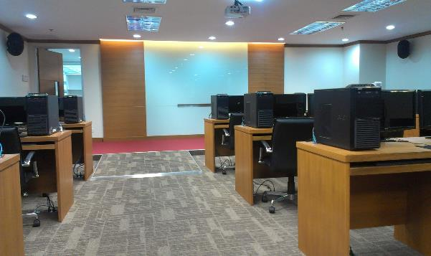
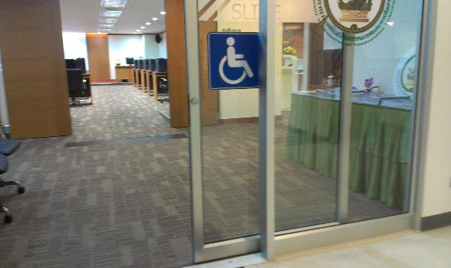
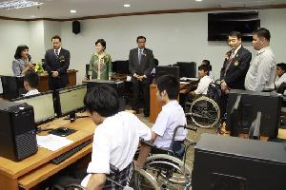
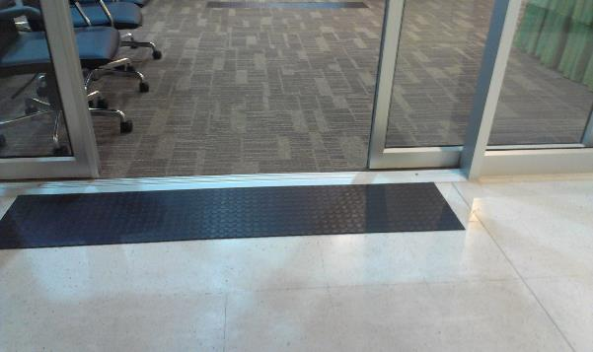
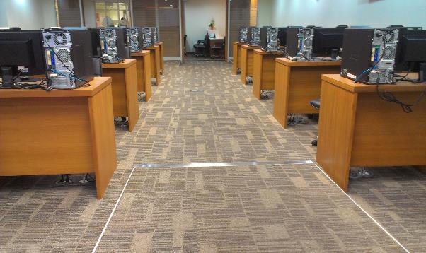
What we have done in Thailand
- Accessible ICT Service Training Center (2012)

Slide 16
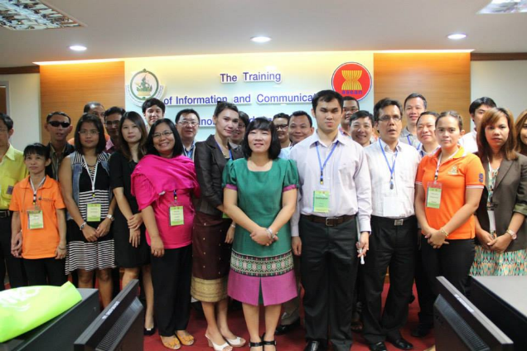
What we have done in ASEAN
- The training of “Daisy Books usages” and “AT for Person with disabilities”, October 2013

Slide 17
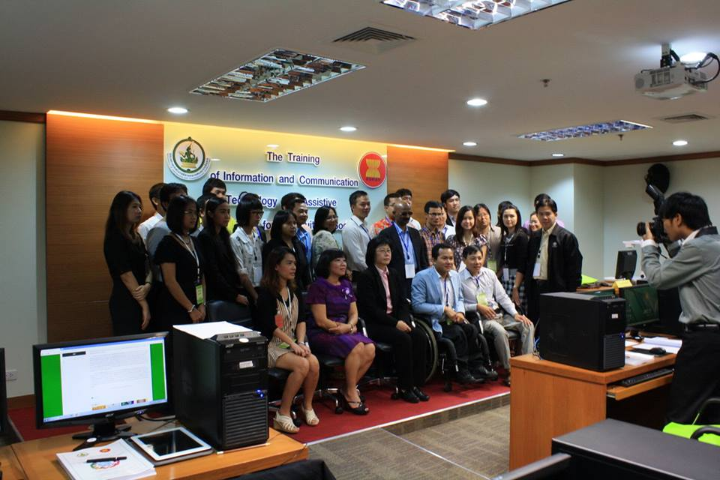
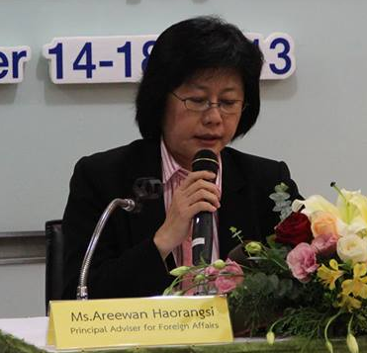
What we have done in ASEAN
- The training of ASEAN Web Content Accessibility on HTML5 and CSS, October 2013

Slide 18
What we have done in ASEAN
- The training of ASEAN Web Content Accessibility on HTML5 and CSS, October 2013

Slide 19
Examples of web pages created (training)
Web page 1
Web page 2
Web page 3
Web page 4
Web page 5
Web page 6
Web page 7
Web page 8
Web page 9
Web page 10

Slide 20
What’s in place for ICT Accessibility
International Instruments/Guidelines (W3C/WAI, CRPD)
Laws & Legislation on ICT Accessibility (Empowerment Act, Ministerial Regulations)
National Guidelines on ICT Accessibility (TWCAG 2010)
Implementing/Promoting Agency (Ministry of ICT)
Training and Promotional Activities
Networking and Alliances on ICT Accessibilities (National, International)

Slide 21
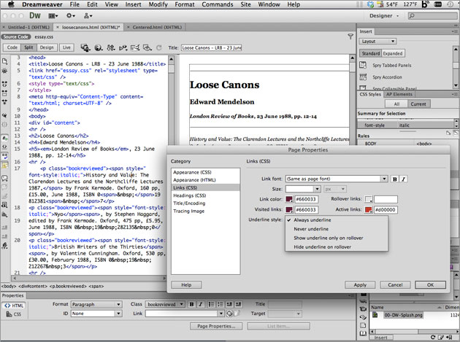

Challenges and Gaps + Recommendation (1)
Authoring Tools are not designed with accessibility in the first place or improperly incorporated.
e.g. Web Editors, CMS, Web Templates, etc.
Recommendation: More advocacy on accessibility for authoring tools developers

Slide 22
Challenges and Gaps + Recommendation (2)
Law enforcement not in place or no/less enforcement
Recommendation:
  Establish an implementing/promoting organization
  National guidelines, working group, training & promotional activities, etc. in place
  Work with DPOs, academic institutes, GOs, etc. for law enactment

Slide 23
Challenges and Gaps + Recommendation (3)
Web Accessibility Curriculums in Academic Institutes
Recommendation:
  Advocate and work with academic institutes for web accessibility curriculums
  Provide training on web accessibility to universities’ students

Slide 24
Challenges and Gaps + Recommendation (4)
Misconception of Web Accessibility
e.g. not interactive, less pictures and decoration, difficult, expensive, etc.
Recommendation:
  Social network on web accessibility
  Training & promotional activities
  Laws & legislation
  University curriculums

Slide 25
Challenges and Gaps + Recommendation (5)
Resource Persons (rare)
Recommendation:
  Have more Training of Trainers (TOT) (once a year) + continuous plan for capacity development
  As job opportunities (e.g. persons with disabilities)
  ICT learning centers at local communities

Slide 26
Challenges and Gaps + Recommendation (6)
Involvement of DPOs and Their Interest
“Nothing about Us without Us”
Recommendation:
  Work closely with DPOs as the first priority partners
  Working group with DPOs in place
  Twin-track approach (empowerment + barrier-free society) -> Disability Inclusive Development (DID)

Slide 27
Q & A

Slide 28
Thank You for
Your Attention

