Slide 1

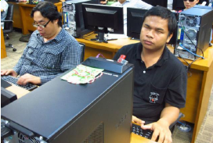
ICT Accessibility and Assistive Technology in Thailand
ICT Usage Promotion and Development Bureau
Ministry of Information and Communication Technology
Thailand
Notes:
Good afternoon, ladies and gentlemen. Let me introduce myself. I’m Prasert Sripanaratnakul, the executive director of ICT Usage Promotion and Development Bureau, Ministry of Information and Communication Technology, Thailand. What I would like to present to you today is ICT Accessibility and Assistive Technology in Thailand. The topic is very important for you because all of us live in social that have many type of people include person with disabilities.

Slide 2
Outline
Act, Policy and regulatory framework
ICT accessibility
Issues and challenges
Suggestions or proposals
Notes:
I have divided my presentation into four main points. First is policy and regulatory framework, next is ICT accessibility and then issues and challenges, finally I will offer suggestions.

Slide 3

Act, Policy and Regulatory framework
The Act of Quality of Life of People with Disabilities 2007
Empowerment of Persons with Disabilities Act 2007, Section 20 (6) has been given the right for people with disabilities to access and use Information, News, Communication, Telecommunications services, Technology and Information, and Assistive Technology for any kind of disabilities.
Notes:
ACT, Policy and regulatory framework
There is an ACT from Ministry of Social Development and Human Security to secure human right namely, the Act of Quality of Life of People with Disabilities which was enacted in 2007. In Section 20 (6) of this Act is to promote and develop ICT usage for People with disabilities including the elderly, and the disadvantages in society according to Human Rights to access online information and valuable learning in order to enhance quality of life.

Slide 4
ACT, Policy and Regulatory framework
Thailand Information and Communication Technology Policy Framework (ICT 2020)
Universal and secure ICT and broadband infrastructure
ICT Human Resources and ICT Competent workforce
ICT industry competitiveness and ASEAN integration
Smart government: ICT for government service innovation and good governance
ICT for Thailand competitiveness and vibrant economy
ICT to enhance social equality
ICT and Environment: the Green ICT
Notes:
ACT, Policy and regulatory framework
Next, I will focus on Thailand information and communication technology policy framework 2011-2020 as called ICT 2020
As you can see from screen, there are 7 strategies and I will emphasize on strategy number 2 and number 6 which is ICT Human resources and ICT competent workforce and ICT to enhance social equality.
The action of strategy number 2 is to create opportunities in accessing and making use of ICT for people, especially the disadvantaged, the elderly and the PWD by using telecenter or community ICT centers in providing ICT training for the community. Curricula and training in ICT knowledge and applications in daily life for the elderly should be developed.
The action of strategy number 6 is to provide electronic government services through various access channels and ensure that these services meet the needs of people in their daily life. This in order to facilitate people’s access to information and social services and increase their participation in public administration and services. In any case, appropriate ICT standards should be used, for instance, standards for web accessibility that allow the PWD and elderly to access the government information and services on an equitable basis.
In doing so, the concept of universal design needs to be taken into consideration. Develop ICT tools and devices that are affordable and easy-to-use, along with assistive technologies.

Slide 5
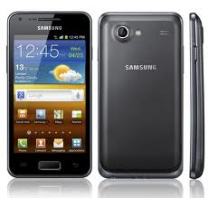



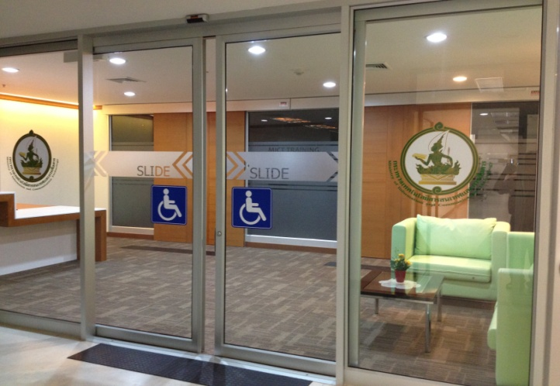
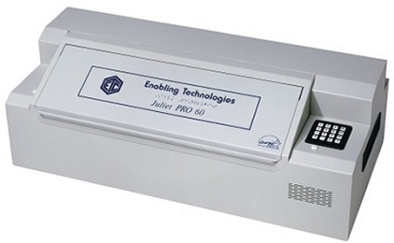
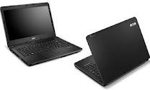
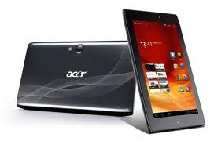
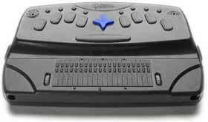
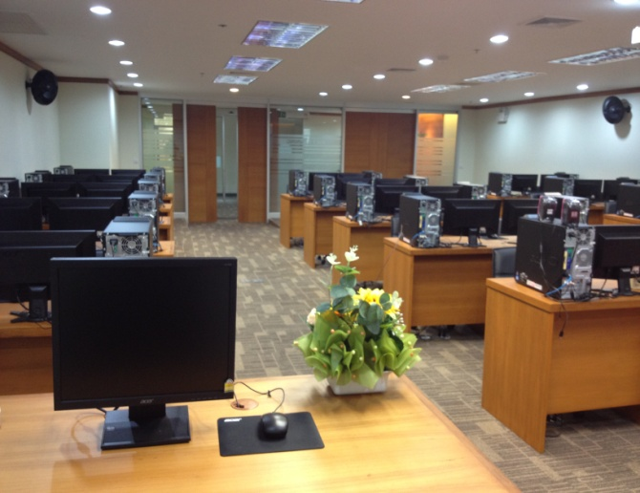
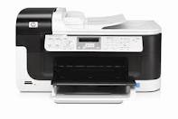
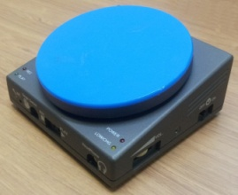
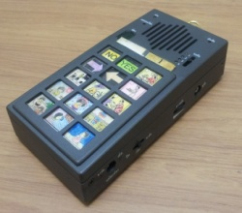
ICT Accessibility
Notes:
Now, I would like to draw your attention to ICT accessibility and Assistive Technology which is in progress at present.
Ministry of ICT has been implementing the capability development of person with disabilities, the elderly and the vulnerable groups through the provision of ICT and assistive devices, ICT training courses for people with disabilities, children, women and elderly people as well as the promotion of web accessibility among the government and private agencies. Moreover, the Ministry of ICT has established the ICT Service Centre for people with disabilities to provide services on ICT and AT devices so that people with disabilities have more access to the use of ICT in their daily life and work.

Slide 6
ICT Accessibility
Workshop on The Training of ICT & AT for the Equity in Society
Web Content Accessibility on HTML5 and CSS
For Beginners
For Intermediate
Daisy Books usages, production of the Braille materials and Basic Screen Readers
Assistive Technology for Persons with Disabilities
Notes:
Next, I would like to share with you what Thailand has done so far with this topic among ASEAN member countries.
Ministry of ICT has organized workshop on training of ICT & AT for the equity in society during 17 – 19 June, 2013. There were 7 ASEAN Member States participated in this workshop (Cambodia, Indonesia, Malaysia, Myanmar, Philippines, Singapore and Thailand). The outcome of this workshop are content of 3 courses: 1. Web Content Accessibility on HTML5 and CSS for beginners and for intermediate 2. Daisy Books usages, production of the Braille materials and Basic Screen Readers and 3. Assistive Technology for Persons with Disabilities. In addition, there is a suggestion to organize the policy level meeting.

Slide 7
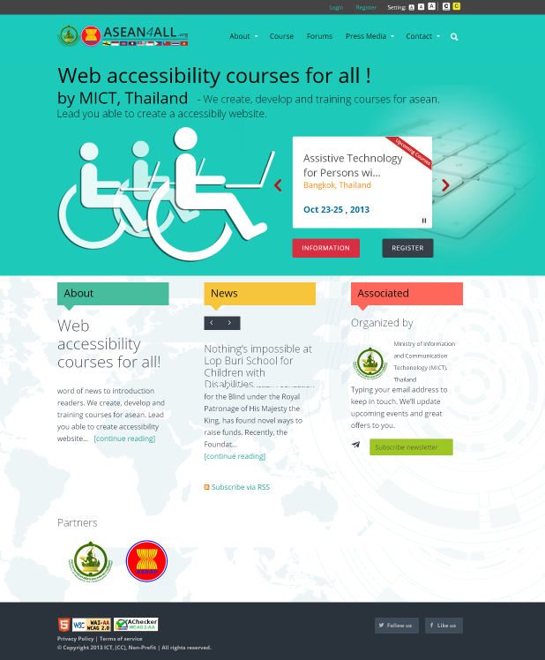
ICT Accessibility
www.asean4all.org
Notes:
Moreover, we created one website namely asean4all to provide news and curriculum for person with disabilities. This website was implemented followed the WCAG 2.0 level 2.0 of World Wide Web Consortium guidelines.

Slide 8
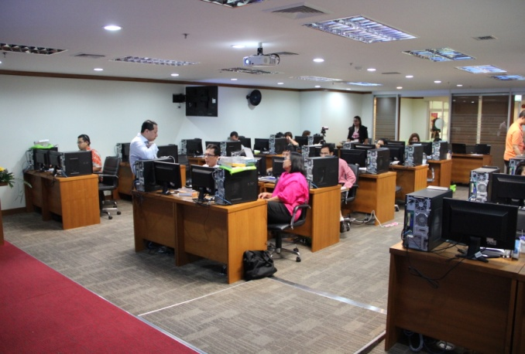
ICT Accessibility
Web Content Accessibility on HTML5 and CSS for Beginners and Intermediate.
Daisy Books usages, production of the Braille materials and Basic Screen readers
The usage of NVDA with Microsoft Excel
The usage of NVDA with Microsoft Power Point
Assistive Technology for Persons with Disabilities
The usage of Open Source Software
Production of DAISY audio book
Notes:
After that, Ministry of ICT have organized the Training Course on creating accessible website and using ICT & AT during 14 – 25 October, 2013. There were 8 ASEAN Member States participated in this training (Cambodia, Indonesia, Laos, Malaysia, Philippines, Singapore, Thailand and Vietnam). There were trained on how to create accessible website, how to use NVDA and the usage of open source software and how to create daisy book.

Slide 9
Issues and challenges
Strong political will
Coordinating work across agencies effectively
Notes:
Let’s now move on to the next point which is issues and challenges.
First is strong political will. It make ICT and AT development an important agenda. It would also lift the well-being and quality of life of the people, and can help bring about equality.
And coordinating work across agencies effectively. There must be a mechanism in coordinating work across agencies effectively, leading
to lateral integration. This will allow delivering services in a seamless manner and keeping a user-centric approach.

Slide 10
Suggestions
Set up a research team
Standard of ICT and AT
Common curriculum
Notes:
Let me briefly summarize what I have said so far.
First, I shared information about Act and policy framework for ICT accessibility and Assistive Technology in Thailand, then I told you what we are doing to support human rights, after that I indicated some issues and challenges.
Those bring me to the last point which is suggestions. So I would suggest that we set up a research team to figure out what should be standard of ICT and AT devices and common curriculums that ASEAN member states can be used to access and utilize information and services among ASEAN member countries.

Slide 11
Q & A
Notes:
Many thanks for your attention.

