Slide 1
Country Report on Disability Issues in Cambodia
Based on ILO report on “Inclusion of People with
Disabilities in Cambodia”, 2009
Present by - Mrs. Tan Sodany, Deputy Director of ICT Policy Department,
General Department of ICT, MPT
- Mrs. Mak Monica, Program Coordinator, National Center of Disabled Persons(NCDP)

Slide 2
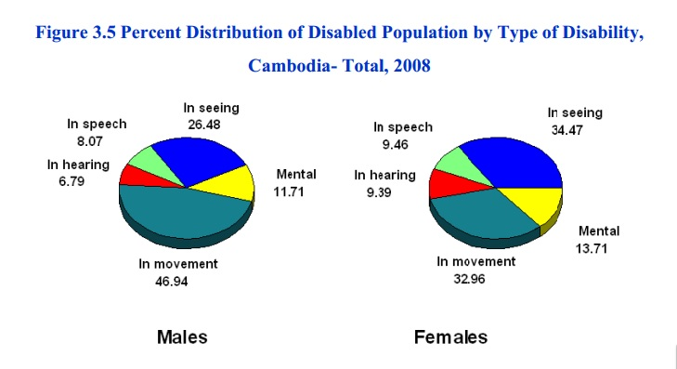
Disabled Population in Cambodia
According to 2008 consensus, the total disabled population is 192,583 persons. It is about 1.44% of the country’s population.

Slide 3
Laws, Regulations and Actions
Constitution of the Kingdom of Cambodia (amended 1999)
Law on the protection and Promotion the Rights of People with Disabilities(2009)
Cabinet Resolution on Principles of Rehabilitation, Vocational Training and Job Placement for Persons with disabilities(No.181/SSR, 1990)
Ministerial Decision on Establishment of National Center of Disabled Persons (NCDP)(No.757, 1997)
Royal Decree on the Establishment of the Ministry of Social Affairs, Labor, Vocational Training and Youth Rehabilitation (NS RKM 0699/60, 1999).
Ministerial Decision on Establishment of the Disability Action Council(DAC, 1999)
Government Sub-decree on the Investments(No.88/ANK/BK, 1999)
National Education Law(2008)
National plan of action for persons with disabilities including landmine/ERW survivors (2009-2011)
Policy on Education for Children with Disabilities(2008) and Master Plan(2009)
Circular on Improving the Quality Standard for Vocational Training Center(2008)

Slide 4
Key Ministries Responsible for Disability Issues
Ministry of Social Affairs, Veteran and Youth Rehabilitation
Ministry of Education, Youth and Sport(MoEYS)
Ministry of Women’s Affairs(MoWA)
Ministry of Health
Ministry of Rural Development
Ministry of Labor and Vocational Training
Ministry of Planning.

Slide 5
Key Organizations for persons with disabilities
Action on Disability and Development
Association for Aid and Relief-Vocational Training for the Disabled
Association for Aid and Relief- Wheelchair
Association of the Blind in Cambodia
Australian Red Cross
Cambodia Trust
Cambodian Volunteers for Community Development
Cambodian War Amputees Rehabilitation Society
Capacity Building of Disabled People in the Community Organization
Comité Exécutif International De l’Ordre de Malte Pour l’assistance aux Lépreux
Deaf Development Program of Maryknoll
Disability Development Service Pursat
Epic Arts
Hagar International
Handicap International
Helen Keller International Cambodia

Slide 6
Issues and Challenges on Digital Inclusion
No specific policy on Digital Inclusion and Assistive Technology for disabled people.
Lack of communication and advocating between relevant institutions working for people with disability and Ministry of Post and Telecommunication.
Limit knowledge on the Assistive Technologies among disabled people, people working with disabled people and policy makers.

Slide 7
Proposals
Knowledge and experience sharing on Assistive Technology and Policy formulation of this area.
Technological Transfer to local institutions to produce the ICT tools and services for people with disability.

Slide 8
Thanks you.

