Slide 1
ASEAN-ITU Seminar on ICT Accessibility and
Assistive Technologies for Equity in Society
25-26 August 2014
Bangkok, Thailand
Session 1
Model ICT Accessibility Policy
Mandla Msimang
mmsimang@pygmaconsulting.com

Slide 2
Introduction
Model ICT Accessibility Policy
Background and Objectives
UN Convention on the Rights of Persons with Disabilities
Overview
Approach taken
Current Key Issues in ICT Accessibility
Overview of Modules
ICT Legal, Policy and Regulatory Framework
Public ICT Access Framework
Accessibility Policy Framework
Television Accessibility Policy Framework
Web Accessibility Policy Framework
Model Policy forromoting ICT Accessibility in Public Procurement

Slide 3
Model ICT Accessibility Policy Background and Objectives
Model Accessibility Policy was developed pursuant to
UN Convention on the Rights of Persons with Disabilities (successful achievement relies on adoption and early implementation of policies by countries)
ITU and G3ict ICT Accessibility Policy Toolkit www.e-accessibilitytoolkit.org
A resource for ICT policy makers, regulators and other stakehodlers including NGOs, persons with disabilities and parliamentarians
Designed to assist in policy making in public access, mobile communications, TV/video programming, web accessibility and public procurement
Sets out principles for policy formulation and implementation through legilsation, regulations, standards and guidelines.
This tool will be published later this year

Slide 4
Model ICT Accessibility Policy UN Convention on the Rights of Persons with Disabilities
Article 9
defines ICT accessibility as an integral part of accessibility rights on par with transportation and the physical environment
requires all content, communication, hardware, software and interfaces to be accessible.
Article 30
requires State Parties to “take all appropriate measures to ensure that Persons with Disabilities . . . enjoy access to television programmes [and] films . . . in accessible formats.
Article 2
defines “communication” in an inclusive manner to include all possible means of communication- “languages, display of text, Braille, tactile communication, large print, accessible multimedia as well as written, audio, plain-language, human-reader and augmentative and alternative modes, means and formats of communication, including accessible information and communications technologies” …which can eliminate barriers for persons with disabilities in enjoying their fundamental freedoms and human rights (Article 3(f)).

Slide 5
Model ICT Accessibility Policy Transposing UNCRDP into ICT Policy and Law
States Parties have ICT policies, legislation and regulations
These key legal instruments must be updated to achieve the goal of promoting ICT accessibility
States Parties Disability laws also have to be updated to promote ICT accessibility
Updating States Parties Public Procurement laws may be one of the most effective ways to ensure the availability of accessible ICTs

Slide 6
Model ICT Accessibility Policy Overview
Module 1 - Model ICT Legal, Policy and Regulatory Framework Module 2 - Model Public ICT Access Framework
Module 3 - Model Mobile Accessibility Policy Framework
Module 4 - Model Television Accessibility Policy Framework
Module 5 - Model Web Accessibility Policy
Module 6 - Model Policy for promoting ICT Accessibility in Public Procurement

Slide 7
Model ICT Accessibility Policy Approach Taken
Each module is designed and drafted on the basis of a similar approach:
Explains the goals sough to be achieved and an overview of steps to be taken
Provides a generic approach and model text
Includes annotations to
assist with the understanding of the basis for some proposed clauses (and to link back to the UNCRPD)
Identify areas where country-specific issues must be taken into account (e.g population, literacy, institutional framework)
Includes appendices with supporting tools such as info for reader not familiar with ICT Accessibility policy, guidleines, checklists, etc

Slide 8
Current Key Issues in Promoting ICT Accessibility Key Issues (1)
Mainstreaming ICT Accessibility through inclusive language, definitions, and provisions in policies, laws & regulations;
Identifying key steps to promote ICT Accessibility, such as making accessible devices available, in the case of public and mobile phones and TV sets.
Awareness raising among key stakeholders – creating awareness about the need to promote ICT Accessibility
Consensus building and inclusive policy-making through encouraging national debate and discourse

Slide 9
Current Key Issues in Promoting ICT Accessibility Key Issues (2)
Promoting the setting of clear targets, and periodic monitoring and evaluation
Encouraging training, capacity building and educational programs on disability awareness
Promoting localization, for example of voice recognition and text-to speech interfaces – to ensure local relevance and uptake

Slide 10
Overview of Modules Legal, Policy, Regulatory – Content
Review of definitions in existing ICT/electronic comms law
Options for regulation
Public consultation
Universal access and service (“UAS”) framework
Consumer protection
Emergency services
Reporting requirements
Changes to disability legislation/ disability rights law

Slide 11
Overview of Modules Legal, Policy, Regulatory - Context
Options for Regulation –
License Conditions/ Authorisations
Regulations
Voluntary Measures – self/co -regulation
Definitions –
Include “persons with disabilities” definition
Include “ICT users” which includes PWD
Add “underserved communities” which include PWD
Expand “universal access” and “universal service” definitions to also include ICT accessibility for persons with disabilities

Slide 12
Overview of Modules Mobile Phone Accessibility
Availability
provide customers a range of accessible products, services and devices meeting the requirements of various types of disabilities
Affordability
offer special and/or discounted rates and plans for users with disabilities – i.e. text only plans for the deaf
Awareness
train staff on accessible products and services
Practical Tools:
Model Mobile Accessibility Policy
Model Code of Conduct (for mobile industry)
Model Regulations
(for regulators)

Slide 13
Overview of Modules TV / Video Programming (1)
Broadcasters to deliver closed captioning/ subtitling
Content creators are responsible for creating the content for these services and delivering the content along with the programming to the broadcaster or AV content provider
Sets targets for number of broadcasts to be made accessible in next three years
Calls for awareness raising to users are aware that accessible broadcasting services exist

Slide 14
Overview of Modules TV / Video Programming (2)
Audio Description to be provided in an official language of the country
The language of the AD should be the same as the program audio
Subtitling countries can use audio subtitles
Signing requirements to be developed through open consultation
Electronic Programming Guide (EPG) – e.g. symbols to denote accessibility - subtitling (S), signing (SL) and audio description (AD).
Consider migration of requirements from analogue to digital environment

Slide 15
Overview of Modules TV / Video Programming (3)
Licensed content providers required to develop a Code of Conduct on minimum standards for amount of programming with:
Subtitling
Visual signing
Audio descriptions and audio subtitling
Ability to adjust caption fonts, contrast and colors
Code to set 3, 5 and 10 year targets

Slide 16
Overview of Modules Public Access - Requirement Checklist
Module recognises that public access is provided:
as a licence condition (regulated)
(2) Via public/ USAF funding, e.g. telecntres (funded)
(3) By SMEs and entrepreneurs, e.g. internet cafes (unregulated)
PHYSICAL ENVIRONMENTS AND AWARENESS
Is it easy for public access facility visitors to know what assistive hardware and software is available in the public access facility?
Are parking areas, pathways, entrances to the building wheelchair-accessible and clearly marked?
Are there high-contrast, large-print signs to & throughout the public access facility?
Is at least part of a service counter or desk at a height accessible from a seated position/ accessible to persons in wheelchairs?

Slide 17
Overview of Modules Public Access - Requirement Checklist
HARDWARE Is at least one large monitor available so that a larger amount of screen can be viewed while magnified? Is equipment marked with large-print and/or Braille labels? Do you provide alternate hardware to replace the standard mouse and/or keyboard (e.g., a trackball, joystick, mini-keyboard, one-handed keyboard)? SOFTWARE Do you provide special software that is beneficial to persons with disabilities (e.g., screen readers) Do electronic resources, including web pages, adhere to accessibility guidelines or standards? (Refer to Web Accessibility Module)
STRATEGY, PLANNING, POLICIES, AND EVALUATION Are people with disabilities included in planning and evaluating public access facility products and services? PUBLIC ACCESS FACILITY STAFF TRAINING Are staff members familiar with the availability and use of accessible ICT features, assistive technology and alternate document formats? Have staff members received sensitivity training and training on use of ICTs by persons with disabilities?
17

Slide 18
Overview of Modules Web Accessibility – Content
Defines how to make web content more accessible to persons with a wide range of disabilities, and to older persons with changing abilities due to ageing
Based on Web Content Accessibility Guidelines (WCAG 2.0)- (ISO/IEC 40500:2012)
Focus is on public sector websites
Suggestion that industry professional associations issue voluntary codes of conduct reflecting conformance objectives and timelines similar to those for public sector sites

Slide 19
Overview of Modules Web Accessibility Objectives
Examples of Impairment or Disability addressed by the Four Principles and 12 Guidelines of WCAG 2.0 | Sight | Physical | Hearing | Cognitive | Speech | Neurological | Language | Learning
Perceivable
Provide text alternatives for non-text content. | X |  | X | X |  |  | X | X
Provide captions and audio descriptions for videos and other alternatives for multimedia. | X |  | X | X |  | X | X | X
Make it easier for users to see and hear content including separating foreground from background. | X |  | X |  |  | X |  | X
Operable
Make all functionality available from a keyboard. | X | X |  |  | X | X | X | X
Provide users enough time to read and use content. | X | X | X | X | X | X | X | X
Do not design content in a way that causes seizures. |  |  |  | X |  | X
Help users navigate and find content. | X | X | X | X |  | X |  | X
Understandable
Make web pages appear and operate in predictable ways. | X | X |  | X |  |  | X | X
Help users avoid and correct mistakes. |  |  |  | X |  | X | X | X
Maximize compatibility with current and future user tools, including assistive technologies. | X | X | X | X | X | X | X | X

Slide 20
Conclusion
Successful achievement of UNCRPD relies on adoption and early implementation of policies by countries
Model ICT Policy is designed to assist in policy making in public access, mobile communications, TV/video programming, web accessibility and public procurement
Each module is quite detailed and tries to set out key princples and provide tools for regulators, policy makers, and other stakeholders
Important to use appropriate legal, regulatory and policy tools to implement ICT Accessibility commitments and intentions

Slide 21
www.e-accessibilitytoolkit.org
Notes:
This includes the ITU-G3ict e-accessibility tool-kit

Slide 22
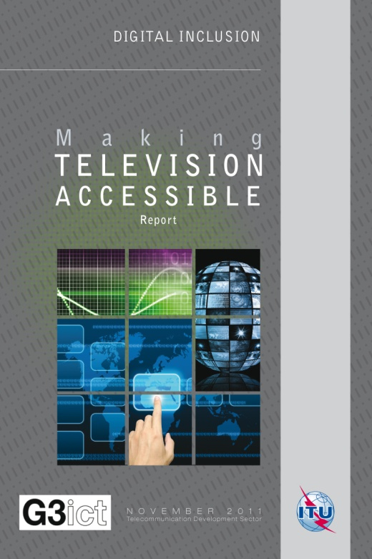
Making TV Accessible Report
http://www.itu.int/ITU-D/sis/PwDs/index.phtml
Prepared by Peter Looms, Chairman of ITU-T Focus Group on Audiovisual Media Accessibility
Looks at how TV can be made more accessible
Timely given the transition from analogue to digital TV
Notes:
The Making TV Accessible Report

Slide 23
Making Mobile Phones and Services Accessible Report
http://www.itu.int/ITU-D/sis/PwDs/index.phtml
Prepared by a team of experts
Explains in concrete terms, what is meant accessible mobile phones
Developments in accessible mobile apps
Business opportunities and case studies
Policy guidelines
Notes:
And the Making Mobile Phones and Services Accessible Report

Slide 24
www.pygmaconsulting.com
info@pygmaconsulting.com

