Slide 1
Arabic Bibliometrics
A Story of Big Data in Arabic
Ali Mazraeh, CEO, ADRI
4th ITU Annual Forum on “IoT, Big Data, Smart Cities and Societies” for Arab region
Dubai, UAE, 28-29 August 2019

Slide 2
The Problem
The Solution
Big Data in Arabic Research
Big Data for SDGs
4th ITU Annual Forum on “IoT, Big Data, Smart Cities and Societies” for Arab region
Dubai, UAE, 28-29 August 2019

Slide 3
Book Titles published in 2012 Arab States Vs Europe
Lebanon
17,000 Titles
=
Romania
Jordan
KSA
Egypt
UAE
Arab States
Populations 362 Mil
Romania
Populations 362 Mil
4th ITU Annual Forum on “IoT, Big Data, Smart Cities and Societies” for Arab region
Dubai, UAE, 28-29 August 2019

Slide 4
عدد الأبحاث
نسبة الأبحاث المتميزة في مجالها
Nature.com, 2012
4th ITU Annual Forum on “IoT, Big Data, Smart Cities and Societies” for Arab region
Dubai, UAE, 28-29 August 2019

Slide 5
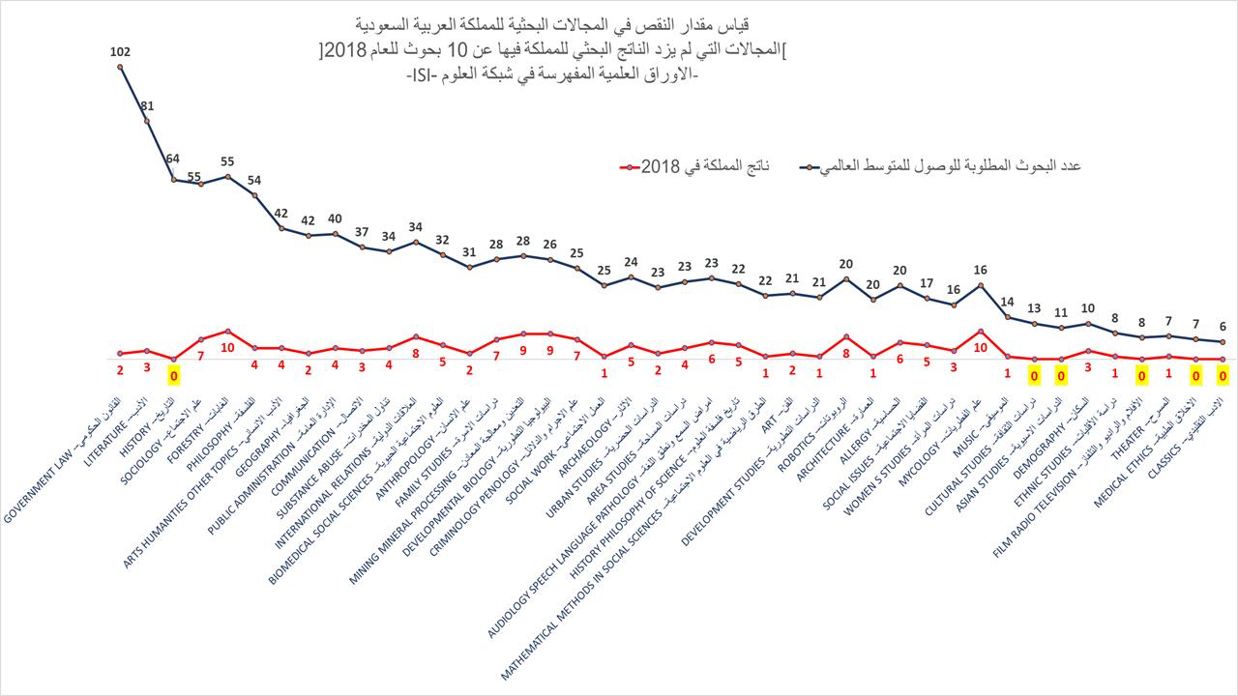
International Science Institute
4th ITU Annual Forum on “IoT, Big Data, Smart Cities and Societies” for Arab region
Dubai, UAE, 28-29 August 2019

Slide 6
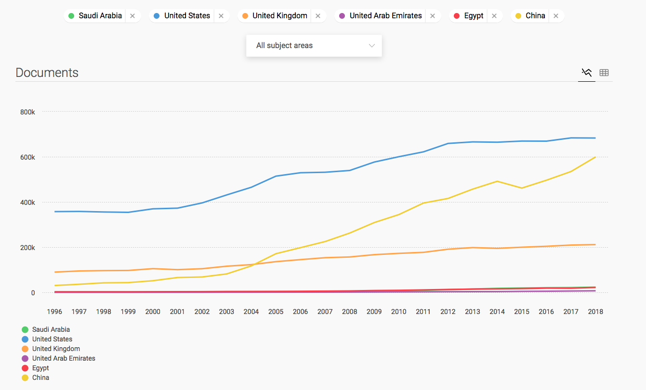
Published Research The Region Vs. The World
SCImago, (n.d.). SJR — SCImago Journal & Country Rank [Portal]. Retrieved 22, August 2019, from http://www.scimagojr.com
4th ITU Annual Forum on “IoT, Big Data, Smart Cities and Societies” for Arab region
Dubai, UAE, 28-29 August 2019

Slide 7
The Solution: Arabic Research and Data
4th ITU Annual Forum on “IoT, Big Data, Smart Cities and Societies” for Arab region
Dubai, UAE, 28-29 August 2019

Slide 8
Deep Learning
Digital Publication
Machine Translation
Machine Learning
&
Natural Language Processing
ADRI Platform
Review
&
Quality Assurance
4th ITU Annual Forum on “IoT, Big Data, Smart Cities and Societies” for Arab region
Dubai, UAE, 28-29 August 2019

Slide 9
Academic Ranking
1000+ Academic Journals
Academic Marketplace
International Interoperability and Integrability
Academic Social Media
ع
Millions of Articles
Ranked Journals only
Full-text search in Arabic
4th ITU Annual Forum on “IoT, Big Data, Smart Cities and Societies” for Arab region
Dubai, UAE, 28-29 August 2019

Slide 10
Processed Data
Millions of Researchers
Millions of Documents
Millions of Citations
Thousands of Authors
Hundreds of Journals
Tens of Publishers
4th ITU Annual Forum on “IoT, Big Data, Smart Cities and Societies” for Arab region
Dubai, UAE, 28-29 August 2019

Slide 11
4th ITU Annual Forum on “IoT, Big Data, Smart Cities and Societies” for Arab region
Dubai, UAE, 28-29 August 2019

Slide 12
4th ITU Annual Forum on “IoT, Big Data, Smart Cities and Societies” for Arab region
Dubai, UAE, 28-29 August 2019

