Slide 1
Table Of Content
IoT Definition
History of IoT
Basic Building Block of IoT
Architectural Layers of IoT
References

Slide 2
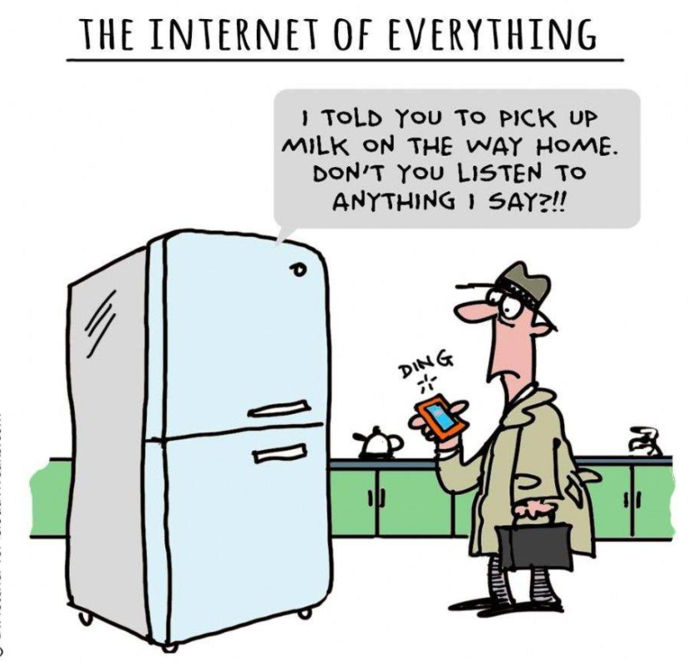

Slide 3
Internet of Things Definition by ITU
The IoT is a global infrastructure for the information society, enabling advanced services by interconnecting (physical and virtual) things based on existing and evolving interoperable information and communication technologies.

Slide 4
Internet of Things Cont.
Physical things exist in the physical world and are capable of being sensed, actuated and connected. Examples of physical things include the surrounding environment, industrial robots, goods and electrical equipment.
Virtual things exist in the information world and are capable of being stored, processed and accessed. Examples of virtual things include multimedia content and application software.

Slide 6
History of IoT

Slide 8
Basic Building Block of IoT –Architecture

Slide 9
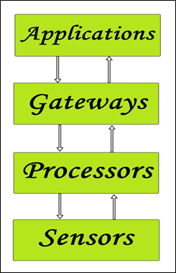
BUILDING BLOCKS of IoT
1) Sensors/Devices
2) Processors
3) Gate Ways
4)Applications

Slide 10
1) Sensors/Devices
Sensors or devices are a key component that helps you to collect live data from the surrounding environment.
These have to be uniquely identifiable devices with a unique IP address so that they can be easily identifiable over a large network.
These have to be active in nature which means that they should be able to collect real-time data. These can either work on their own (autonomous in nature) or can be made to work by the user depending on their needs (user-controlled).
Examples of sensors are gas sensor, water quality sensor, moisture sensor, etc.

Slide 11
2) Processors:
Processors are the brain of the IoT system. Their main function is to process the data captured by the sensors and process them so as to extract the valuable data from the enormous amount of raw data collected.
Processors mostly work on real-time basis and can be easily controlled by applications. These are also responsible for securing the data – that is performing encryption and decryption of data.
Embedded hardware devices, microcontroller, etc are the ones that process the data because they have processors attached to it.

Slide 12
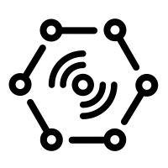
3) Gateways
Gateways are responsible for routing the processed data and send it to proper locations for its (data) proper utilization.
Network connectivity is essential for any IoT system to communicate.
LAN, WAN, PAN, etc are examples of network gateways.

Slide 13
Applications
Applications form another end of an IoT system. Applications are essential for proper utilization of all the data collected.
These cloud-based applications which are responsible for rendering the effective meaning to the data collected.
Applications are controlled by users and are a delivery point of particular services.
Examples of applications are home automation apps, security systems, industrial control hub, etc.

Slide 14
Architectural Layers of IoT
There is no single consensus on architecture for IoT, which is agreed universally.
The most basic architecture is a THREE LAYER defines the main idea of the IoT
Researchers often focuses on finer aspects of the IoT. Another proposed architecture is the FIVE LAYER
Business Layer
Application Layer
Application Layer
Network Layer
Processing Layer
Perception Layer
Transport Layer
Perception Layer

Slide 16
References
https://www.c-sharpcorner.com/uploadfile/f88748/internet-of-things-iot-an-introduction/
https://www.c-sharpcorner.com/UploadFile/f88748/internet-of-things-part-2/
"Internet of Things-IOT: Definition, Characteristics, Architecture, Enabling Technologies, Application & Future Challenges“ May 2016

Slide 17
Thank You

