Slide 1
Why ipv6
Presented by : Salih shihabeldin

Slide 2
agenda
IPv4 current status
Technology revolution
IPv6 in numbers
Why we need IPv6

Slide 3
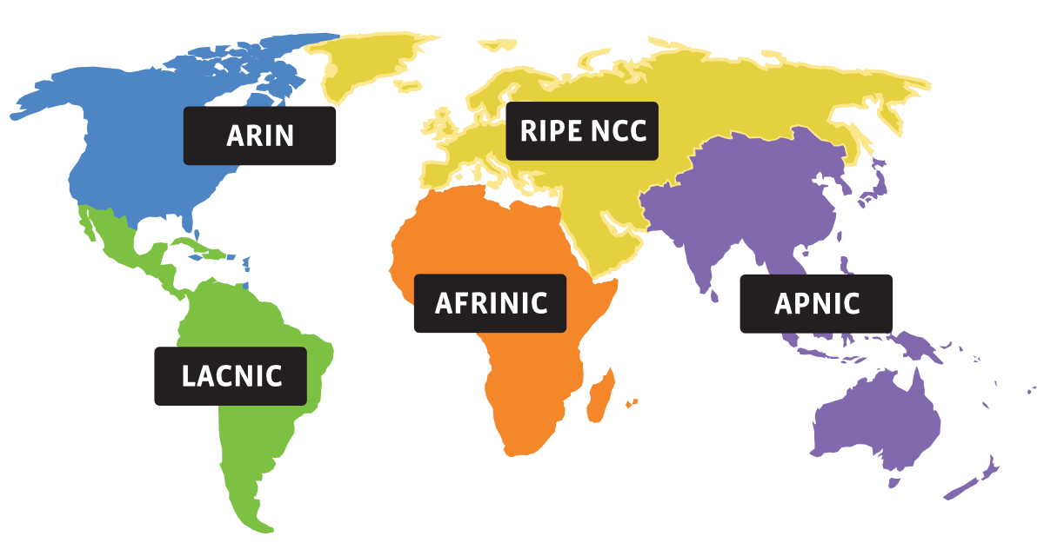
Global RIR

Slide 4
Ipv4 status
RIR | Projected Exhaustion Date | Remaining Addresses in RIR Pool (/8s)
APNIC: | 19-Apr-2011 (actual) | 0.1785
RIPE NCC: | 14-Sep-2012 (actual) | 0.0000
LACNIC: | 10-Jun-2014 (actual)
ARIN: | 24 Sep-2015 (actual) | 0.0003
AFRINIC: | 31-Dec--1 | 0.0925

Slide 5
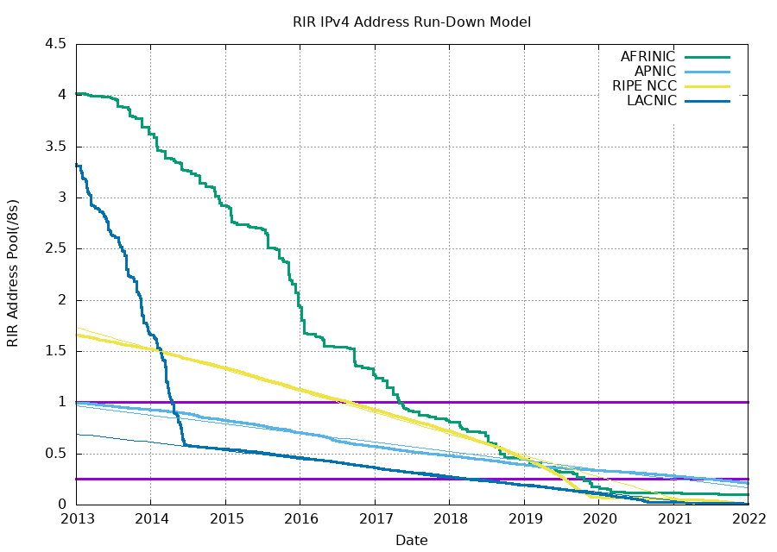

Slide 6
Afrinic IPv4 resource pool

Slide 7
Technology revolution

Slide 8
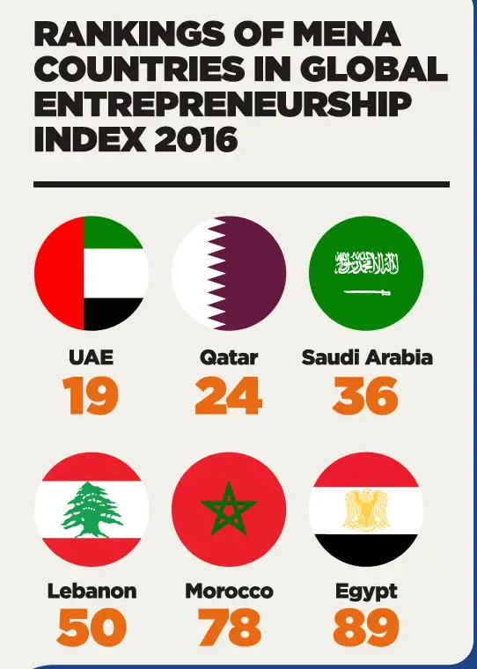
Start up business
With the number of start ups growing in MENA, the ecosystem for entrepreneurs in MENA is improving. Today, more than 64% of working-age respondents in MENA region want to start their own business

Slide 9
IoT in numbers
In 2021, there were more than 10 billion active IoT devices.
It’s estimated that the number of active IoT devices will surpass 25.4 billion in 2030.
By 2025, there will be 152,200 IoT devices connecting to the internet per minute.
The amount of data generated by IoT devices is expected to reach 73.1 ZB (zettabytes) by 2025.

Slide 10
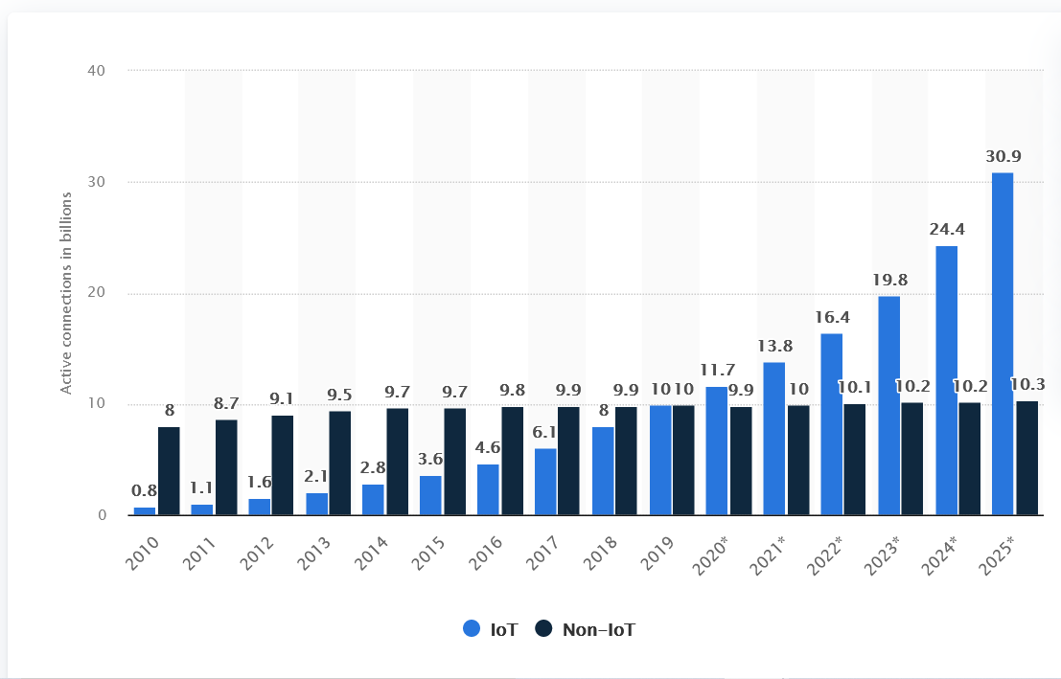

Slide 11
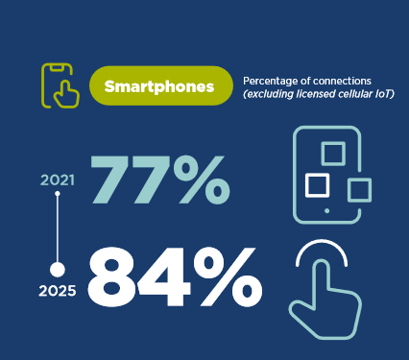
Number of internet users

Slide 12
Subscriber and technology trends

Slide 14
Why we need IPv6

Slide 15
Why we need IPv6
The IPs in IPv6 is:
3.4 x 10³⁸ unique IP addresses. This is equal to 340 trillion trillion trillion IP addresses.
IPv6 needed to
to overcome the IPv4 shortage
to cover the rabbit revolution in the technology
to let technology like IoT to be accessed globally

Slide 16
IPv6 in numbers
Code | Region | IPv6 Capable | IPv6 Preferred | Samples
XA | World | 31.22% | 29.94% | 479,942,720
XG | Unclassified | 64.44% | 64.37% | 183,295
XC | Americas | 36.84% | 36.08% | 85,421,741
XD | Asia | 36.79% | 35.01% | 273,254,499
XF | Oceania | 29.45% | 28.84% | 3,447,589
XE | Europe | 22.92% | 22.04% | 70,673,523
XB | Africa | 1.33% | 1.31% | 47,134,890
https://stats.labs.apnic.net/ipv6

Slide 17
Questions

Slide 18
Thank YOU

Slide 19
References
https://ipv4.potaroo.net/
https://stats.afrinic.net/ipv4/exhaustion/ipv4_available
https://www.iana.org/numbers
https://dataprot.net/statistics/iot-statistics/
https://www.gsma.com/mobileeconomy/wp-content/uploads/2022/05/GSMA_MENA_ME2022_R_WebSingles.pdf
The MENA Startup Ecosystem - Statistics and Trends [Infographic] (go-globe.com)

