Slide 1
IPv6 Implementation Plan in Sudan and SDv6TF role
Ahmed Tajelsir Atya Mohammed
SDv6TF

Slide 2
Agenda
Background.
SDv6TF initiation and early projects.
SudREN.
SDv6TF Re-establishment and work plan.
Way forward.

Slide 3
Background

Slide 4
Background 1
The idea of IPv6 deployment proposed by RFC 5211 [2008] expected that the Internet would be fully migrated to IPv6 in short time but this approach was too optimistic.
The main reason for the delay of full implantation is the division of responsibility among different stakeholders.
On country by country basis the status is different depending on other reasons related to each country.

Slide 5
Background 2
Sudan took the initiative starting from 2010 by building awareness among stakeholders and start programs of capacity building.
Sudatel was the first service provider to start IPv6 arrangements.
SDv6TF initiation in 2010.

Slide 6
SDv6TF initiation and early projects

Slide 7
SDv6TF initiation and early projects
Capacity building programs has started early in addition to ToT.
SDv6TF has formed with a mandate of building awareness and training.
NTC network was one of earlier projects 2011-2012.
+600 training certificates for different levels of IPv6 by end of 2015 including delegates from Arab Countries.

Slide 8
SudREN
Sudanese Research and Education Network

Slide 9
SudREN (Sudanese Research and Education Network) 1
The Sudanese Research and Education Network (SudREN) is a specialized Internet Service Provider dedicated to support the needs of the research and education communities within Sudan. SudREN found in 2009.
SudREN is a Licensed non-profit ISP operating under the umbrella of the Association of Sudanese Universities with +80 members.
All research and education institutions of Sudan are eligible to become members of SudREN.

Slide 10
SudREN (Sudanese Research and Education Network) 2
June 2014 SudREN completed IPv6 preparations with +30 members deploying IPv6.
2014-2015 SudREN’s traffic was 1/3 of IPv6 traffic in Africa! .. It was #1 ISP for IPv6 traffic not only in Sudan but in Africa.
Sudan was #23 country in the world for IPv6 traffic in Nov 2014.
For administrative reasons the IPv6 traffic of SudREN has degraded recently.

Slide 11
SDv6TF Re-establishment and work plan

Slide 12
SDv6TF Re-establishment and work plan 1
SDv6TF has re-established early 2017 with the following mandate:
Come up with an IPv6 Action Plan that other actors will implement.
Set up an evaluation framework to monitor, measure and report on progress of the plan and update the plan if needed.
Secure and manage resources for implementing the plan including capacity building.
Facilitate collaboration, clarify project specifications and resolve conflict between various stakeholders.

Slide 13
SDv6TF Re-establishment and work plan 2
SDv6TF has formed an action plan with the following main areas:
Training and capacity building.
Internet Service Providers.
Governmental Sector.
Private Sector.

Slide 14
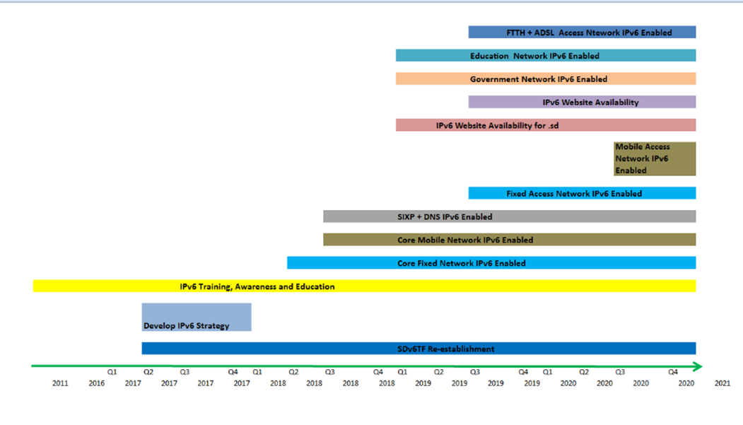

Slide 15
Way Forward

Slide 16
Way Forward
Focus on ISPs deployment.
Focus on capacity building and knowledge sharing especially RoI.
Empower Governmental projects.
Make necessary arrangements with private sector to create demand.
Utilization of facilities of ITU Regional Center.

