Slide 2
A quick look into today’s APTs
Bogdan BOTEZATU – Senior e-threat analyst, Bitdefender
bbotezatu@bitdefender.com
Twitter: @bbotezatu
Notes:
What is an APT

Slide 3
Intro to Targeted Attacks
Pick up an entity to breach
– the larger it is, the higher the chances to find out more information
Do your homework: what software / hardware are they using. Do they use applications that are known to be vulnerable?
Pick an employee as target. And by the way, picking a target is as easy as this:

Slide 4
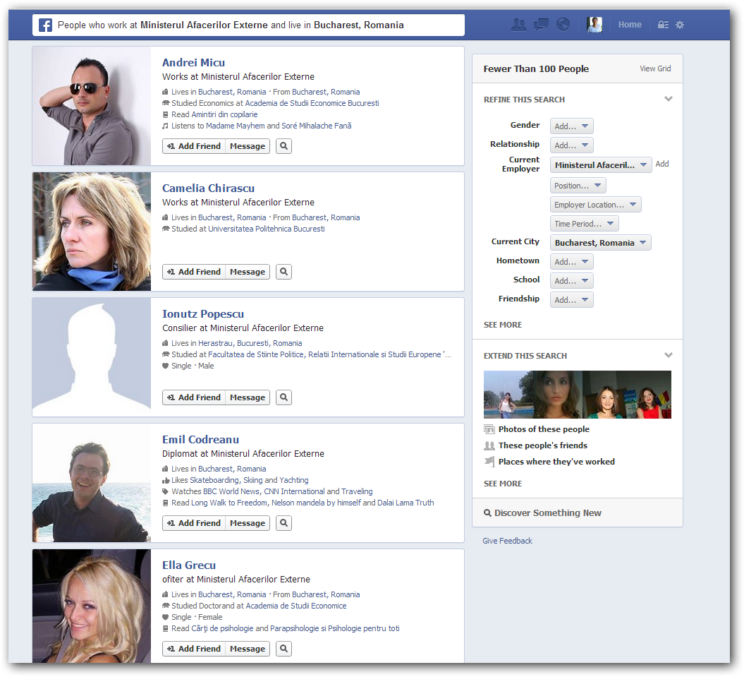
Targeted Attacks

Slide 5
If that doesn’t work, target their spouses

Slide 6
What makes cyber-criminals worth their while?
Information is power, it brings in intellectual property and allows attackers to PLAN COUNTER-INTELLIGENCE DEFENSE (See the Aurora APT in 2008).
To create international incidents on other countries’ expense
Create PANIC: why smash a plane into a building, when you can trigger panic by just disconnecting people from the power grid?

Slide 7
This is just supposition, right?
1982 – Trans-Siberian gas pipe blown up via SCADA bug
2009 – 2010 – Uranium enrichment facility at Natanz taken out of production via master compromise of SCADA
2007 – 2012 – Flamer subverts isolated networks and exfiltrates data in a manner never seen before.
2007 - 2012 – Red October targets state infrastructures, including Romanian agencies and plants
2012 – MiniDuke – Highly targeted attack to make sure malware does not infect beyond scope or gets analyzed

Slide 8
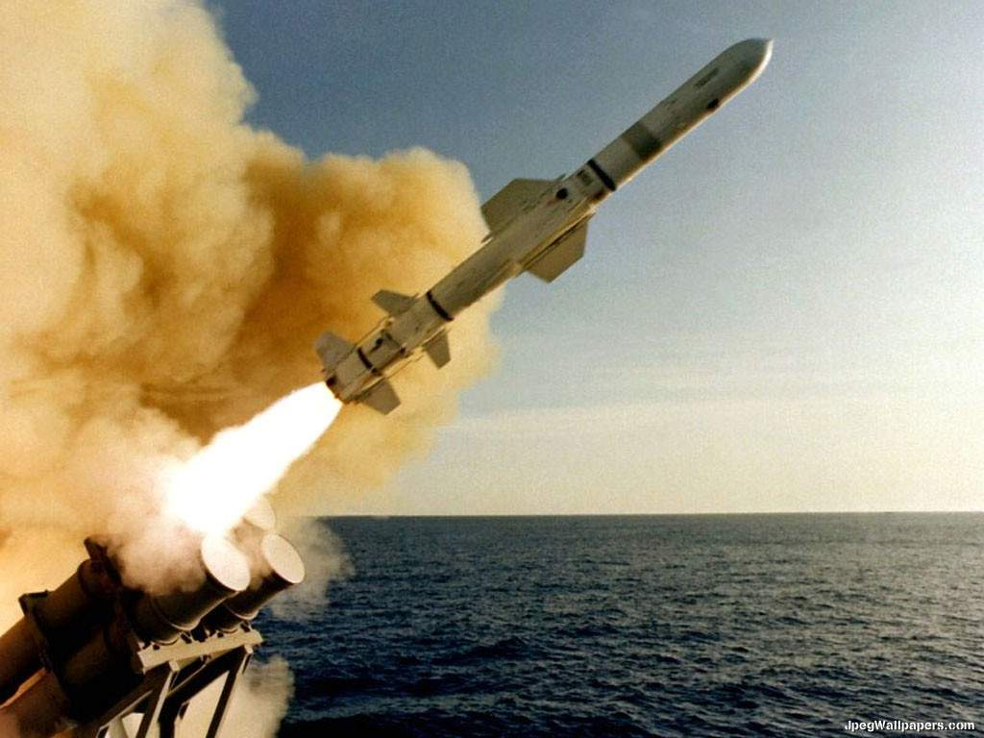
On the bright side… There is no bright side. Period.
Nuclear missiles can’t be launched or controlled via Internet by unauthorized people. Command mechanisms reside in ISOLATED networks.
SCADA systems are also isolated from the Internet. This doesn’t mean that the attackers did not manage to take complete control over them. What would happen if FLAMER hit a war control room instead of a power plant?

Slide 9
Today’s mantra
State agencies can’t safeguard a nation’s security if they can’t protect THEMSELVES

Slide 10
Still, it’s not going to happen to us
Please tick the things that apply to your organization:
We run a computer network on the premises
(Some of) these computers are operated by humans
They store information / data that we’d like to keep away from public or that we monetize one way or another.
They run an operating system that is not custom-made for our organization

Slide 11
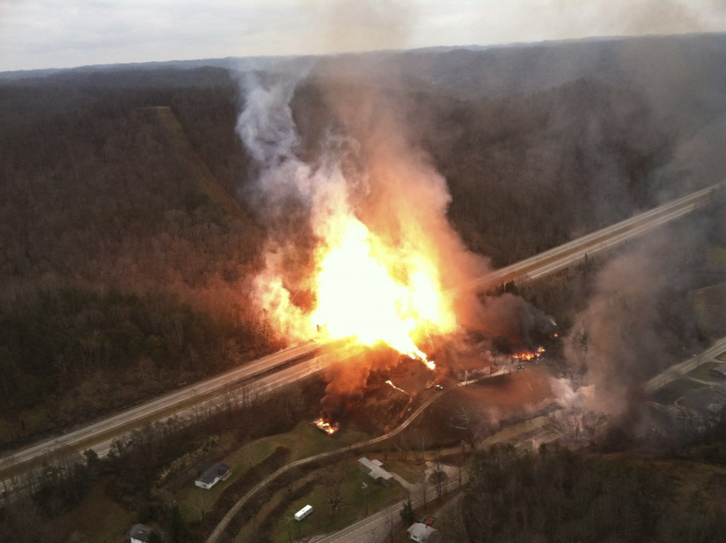
Test results
The question is not if an attack is going to happen, it’s more when you’re going to detect the attack that is currently ongoing in your organization.
Recent history shows that HIGH PROFILE attacks have been going on for more than five years until they were identified.
Modern malware is not going to show any infection symptoms. Unless they’re designed to blow up gas pipes. Or sabotage your country’s nuclear program.

Slide 12
Now ask yourselves…
…How am I contributing to my organization’s compromise by not taking measures?
Exposing your employment relationship with the organization
I’m straying from security best practices at work.
I’m straying from security best practices AT HOME
I’m not reporting to IT phishing / malware attacks which I did NOT fall for. Some other users might have fallen for that.

Slide 13
Mitigation
Tighten security everywhere:
Firewall gateways and isolate exposed services.
Run anti-malware / anti-spam solutions on mail servers
Enforce policies – DON’T EXPECT THE USER to obey them by themselves (no USB, no Wi-Fi – AT ALL)
Don’t allow telecommuting or work from home – Especially if you are a GOV’T agency.
Monitor network activity in search of strange patterns. The Twitter connections you see may be C&C traffic.
Plan in advance: security is not an afterthought.
Minimize exploitation time: patch early or uninstall product.

Slide 14
Questions?

