Slide 1
ITU Regional Workshop on SMS4DC for English Speaking countries in Africa, Abuja, Nigeria , 20-31-May 2013

Slide 2
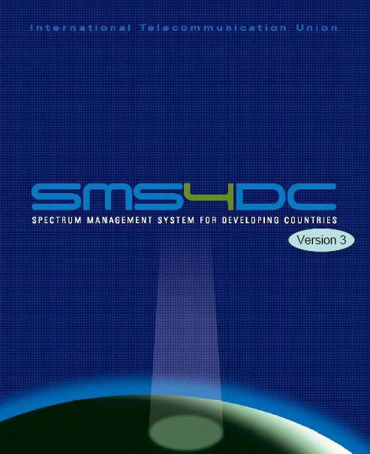
Earth Station Using SMS4DC
Prepared by :
Eng.yasir Mohammed Bashar
Yasir_192@ntc.gov.sd

Slide 3
Import Space Radio-communication Station (SRS) Database
into SMS4DC

Slide 4
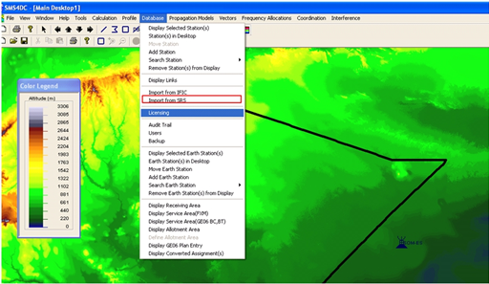
Import (SRS) Database
into SMS4DC
Step1: choose (Import from SRS) opting from Database menu

Slide 5
Import (SRS) Database
into SMS4DC
Import from SRS: This item imports information of Earth stations which belong to one or more administrations, into the SMS4DC database. The information source must be an “mdb” file having a data format identical with the BR SRS database format (including space BR IFIC and electronic notices).
As will be displayed in the next slide, choosing this item opens the “SRS import” dialogue box and provides a mask to specify the source database (with mdb extension) and one or more administrations whose Earth station information is to be imported. The browse button enables the user to find the correct “mdb” file location.
After choosing the administration(s) of interest and pushing the “Import” button, SMS4DC displays a Yes/No dialogue screen and the number Earth station records available for import (according to the administrations selected). This screen enables the user to continue or abandon the data import. A progress bar is included at the bottom of the main import screen.

Slide 6
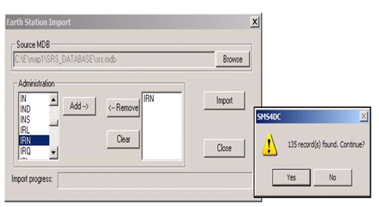
Import (SRS) Database
into SMS4DC
Step2: select the MDB source and the administration

Slide 7
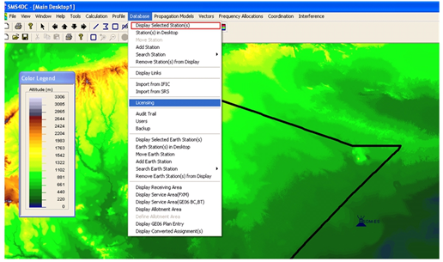
Import (SRS) Database
into SMS4DC
Step3: choose (Display selected Stations) option from Database menu

Slide 8
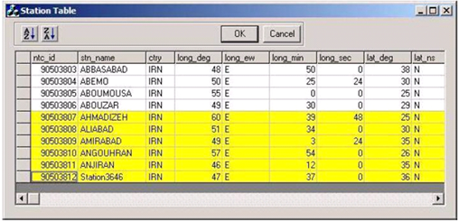
Import (SRS) Database
into SMS4DC
Step4: select any number of selected earth stations to be Shown

Slide 9
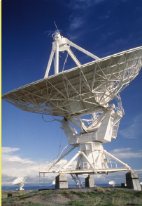
How to Create a new earth Station with SMS4DC

Slide 10
Creation of Earth Station
Steps to Create a new earth Station with SMS4DC in Brief
 First: Create an Earth Station with general Information (Station Information).
 Second: Create the Uplink or Downlink beams for the Earth Station (Antenna Information).
 Third: Establish the frequencies for each beam (Downlink or Uplink)(frequencies Information).

Slide 11
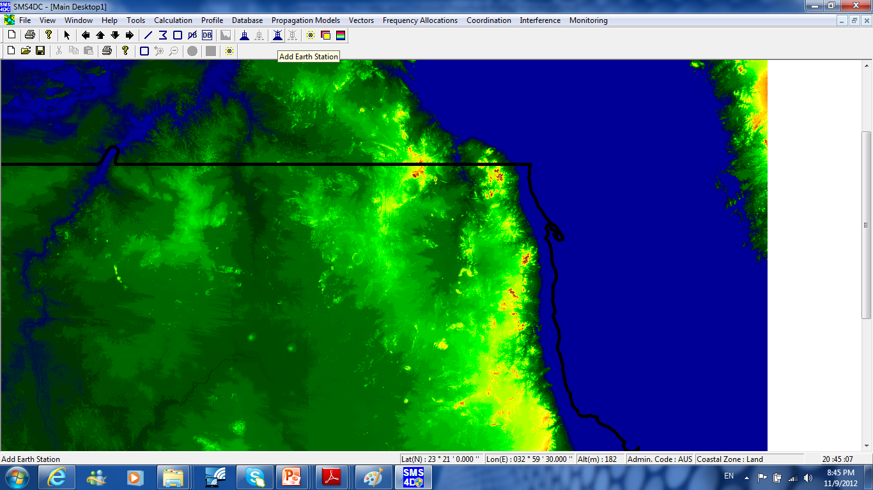
Add new Earth Station
1: Create Earth Station by pressing and moving earth station symbol button a and place “Earth Stations icon in DEM map.

Slide 12
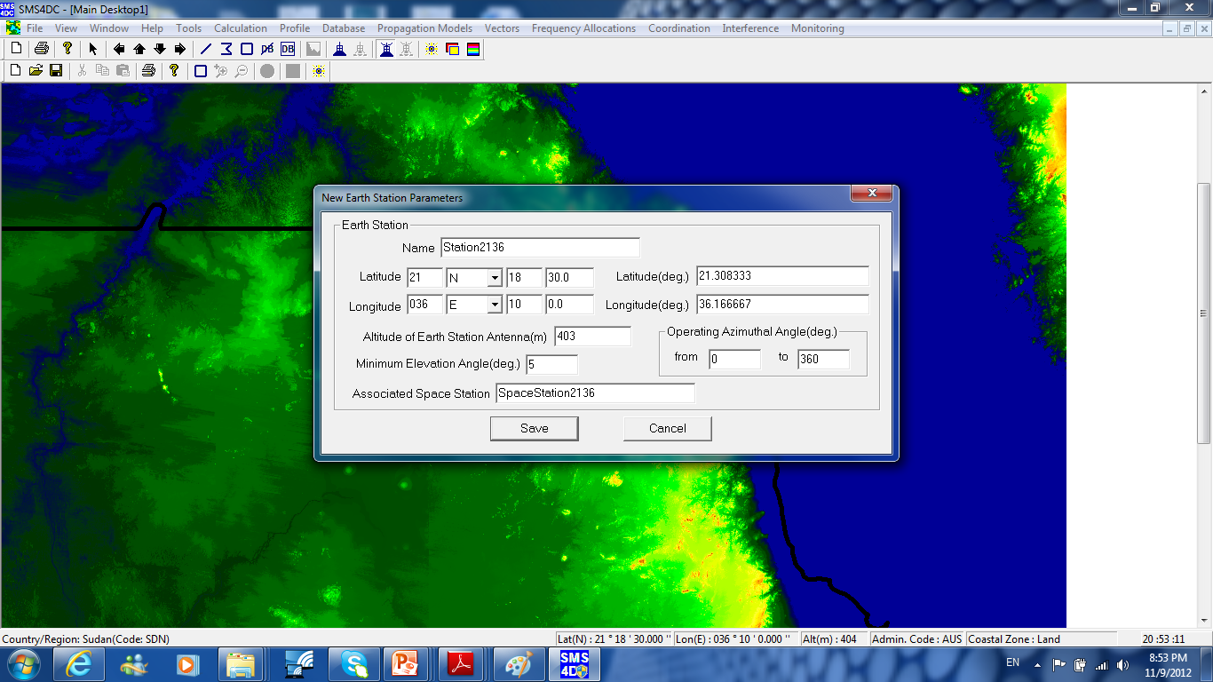
Earth Station General Parameters
2: Set the general parameters of new earth station

Slide 13
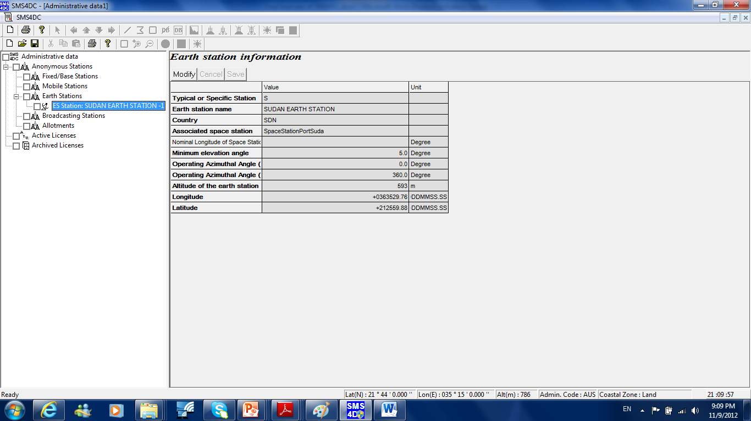
Earth Station Information (1/2)
3 : Go to Database>> license and find your station under anonymous station to set additional parameters

Slide 14
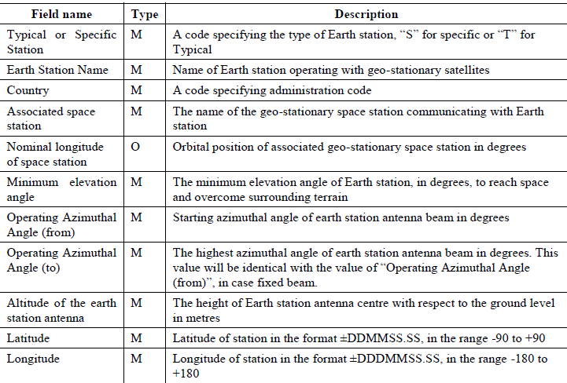
Earth Station Information (2/2)

Slide 15
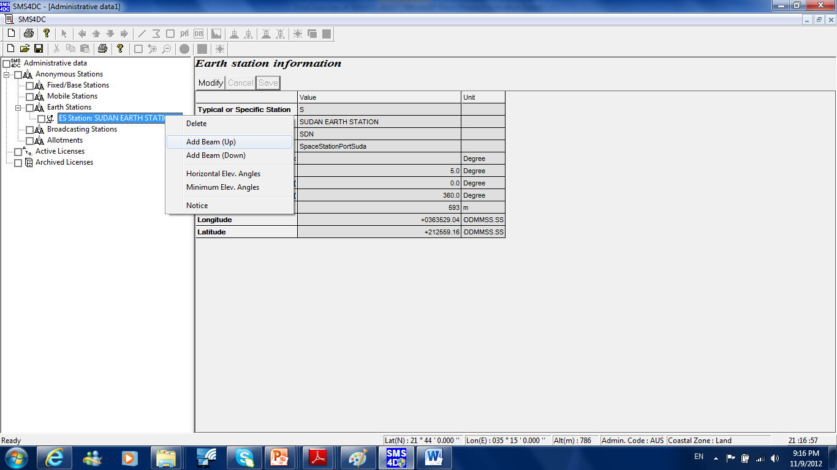
Add Beam (UP)
4. Right Click on your Earth Station Name and then Press Add Beam in order to establish new Uplink beam

Slide 16
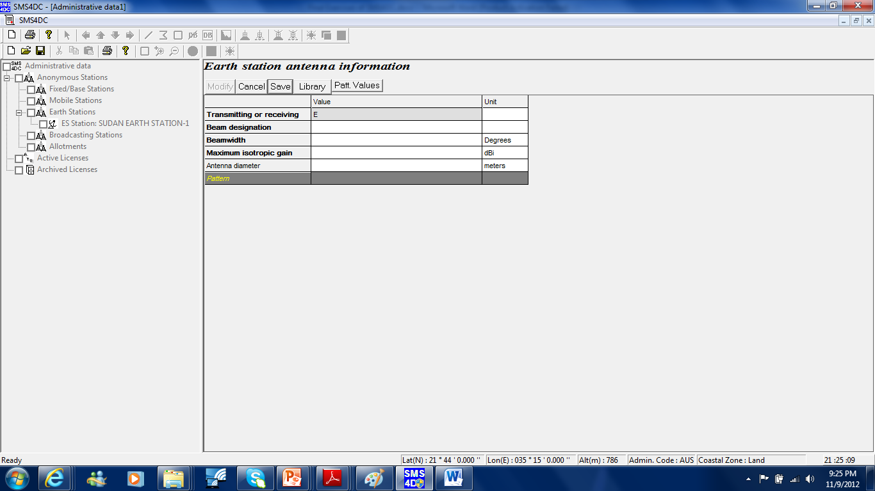
Earth Station antenna information
4. Right Click on your Earth Station Name and then Press Add Beam in order to establish new Uplink beam

Slide 17
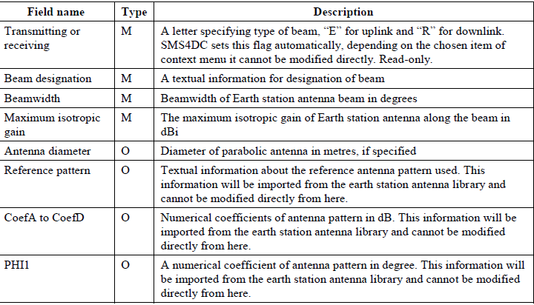
Earth Station antenna information
4. Right Click on your Earth Station Name and then Press Add Beam in order to establish new Downlink beam

Slide 18
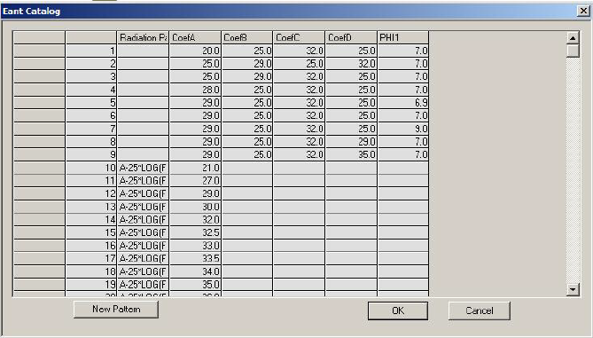
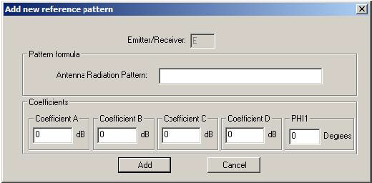
Antenna Pattern (1/2)
4. Right Click on your Earth Station Name and then Press Add Beam in order to establish new Uplink beam
By using the “Library” push button, a library of Earth station antenna patterns is opened and the user may select an existing antenna or define a new pattern, using the push button “New Pattern”. A new antenna pattern will be characterized by a set of new coefficients and, after definition, will be added to the library for selection.
Entry mask of coefficients for a new antenna pattern
Library of antenna patterns of earth station

Slide 19
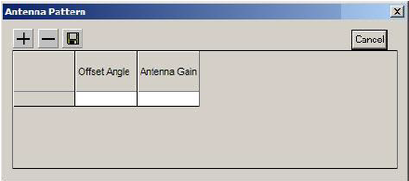
Antenna Pattern (2/2)
In case of having no reference coefficients for earth station antenna pattern, the antenna gain values for different offset angles with respect to the antenna main beam direction may be entered directly into the SMS4DC database
The earth station antenna pattern definition entry table

Slide 20
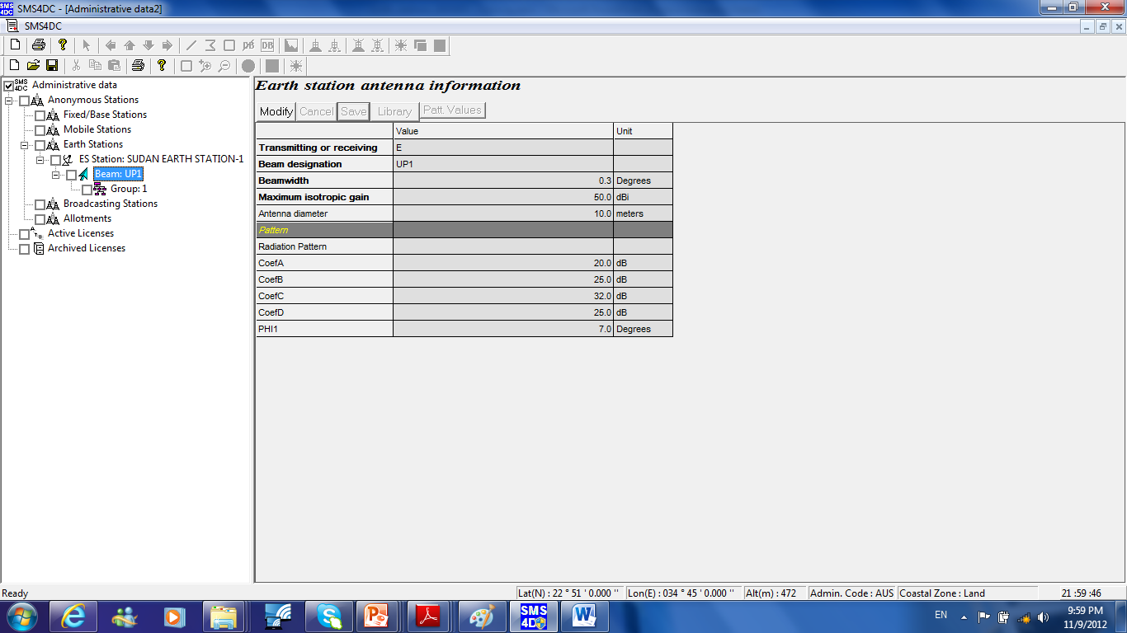
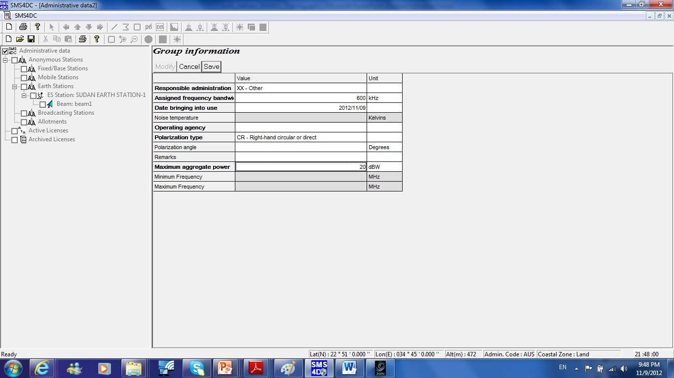
5. Under your Earth Station Name “UAE EARTH STATION NO 1” >> beam: beam 1 Press right click to establish a group of frequencies for the new Uplink.

Slide 21
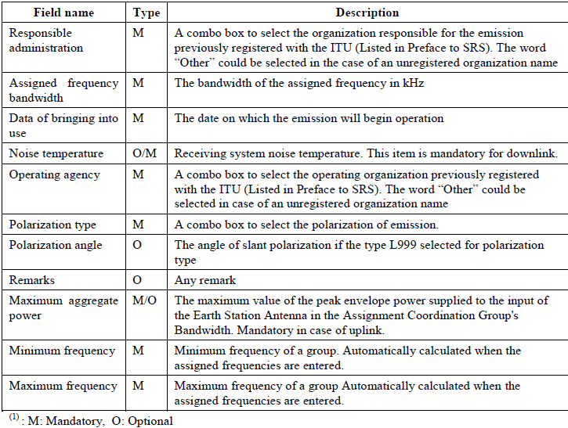
Description of fields in the entry table of Group Information
5. Under your Earth Station Name “UAE EARTH STATION NO 1” >> beam: beam 1 Press right click to establish a group of frequencies for the new Uplink.

Slide 22
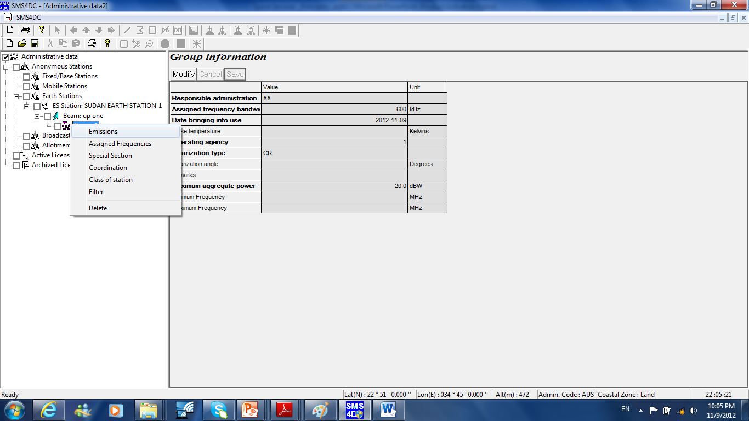
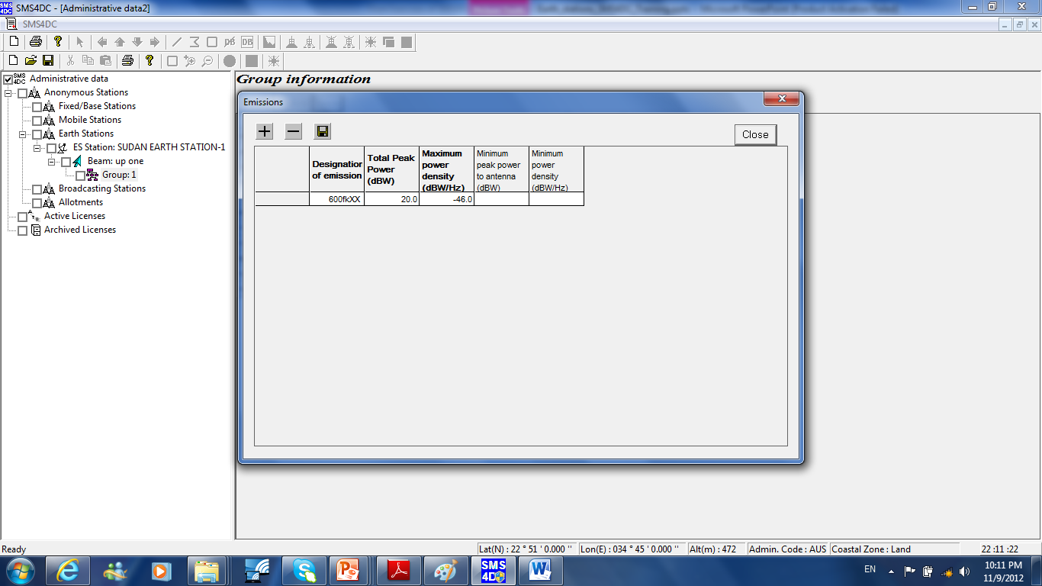
Description of fields in the entry table of Emission Information
6: Set the emissions for the established group (UL)

Slide 23
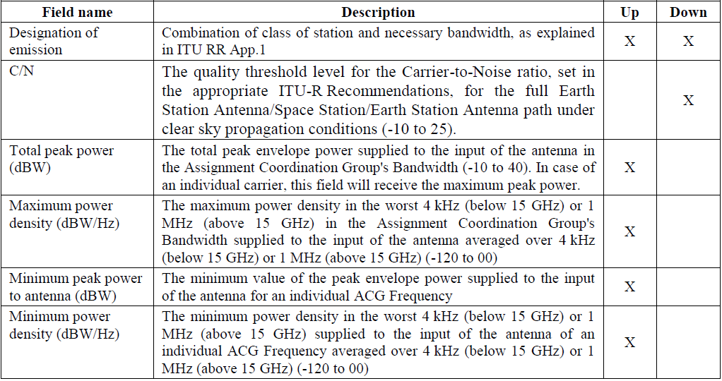
Description of fields in the entry table of Emission Information
Emissions: This item provides a list of emissions in the downlink and uplink directions. Selecting this item opens an entry table to define a multiple emission specification. At the top of table there are three push buttons to add new emissions, to delete registered emissions in the table and to save entered emissions into the database.

Slide 24
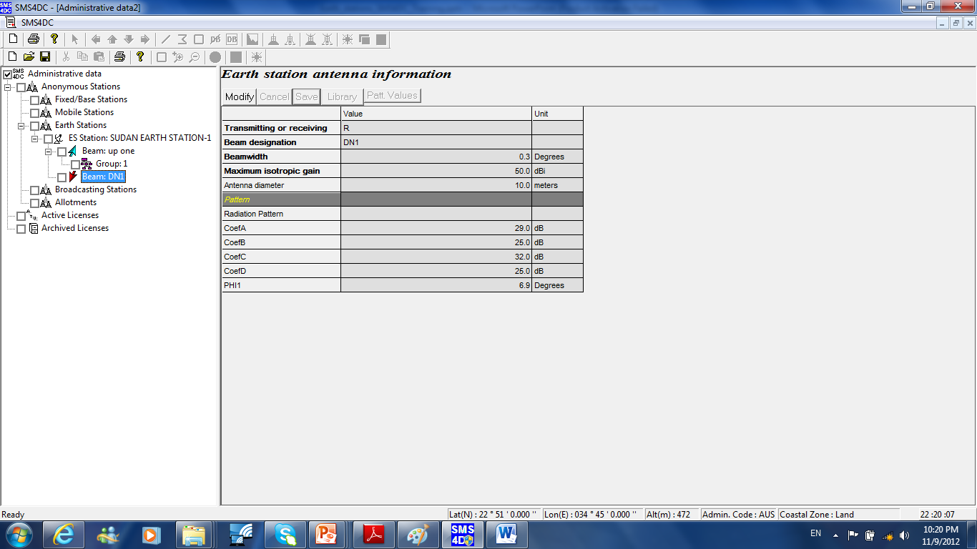
7. Right Click on your Earth Station Name “UAE EARTH STATION NO 1” and then Press Add Beam in order to establish new Downlink beam as follows

Slide 25
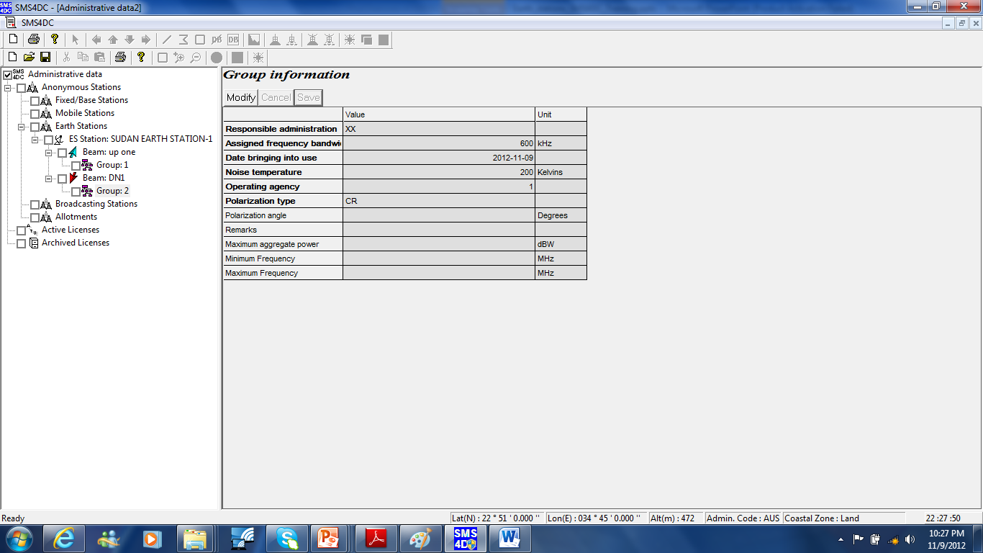
9. Under your Earth Station Name “SUDAN EARTH STATION NO 1” >> beam: beam 1 Press right click to establish a group of frequencies for the new Downlink

Slide 26
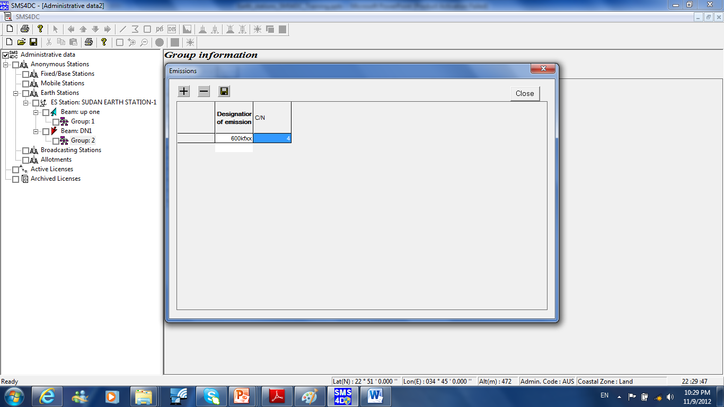
10. Set the emissions for the established group (Downlink).

Slide 27
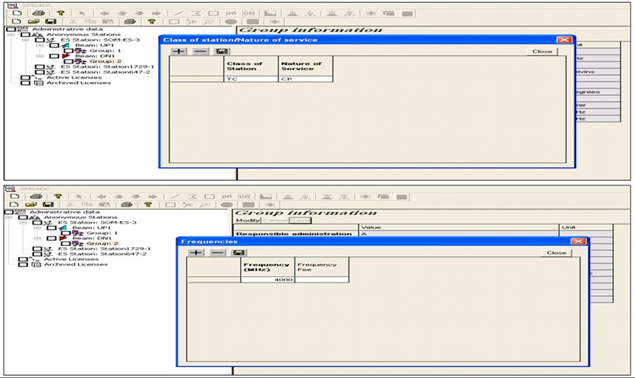
11: Set the class of station and nature of service and frequencies for the established group

Slide 28
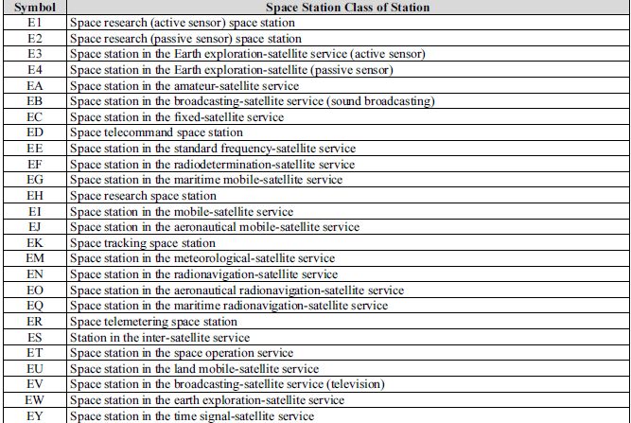
Class of Station (1/2)
This item sets class of stations and nature of services applicable to the group of beams. Selecting this item opens an entry table to define class of stations and nature of services using the relevant combo box.

Slide 29
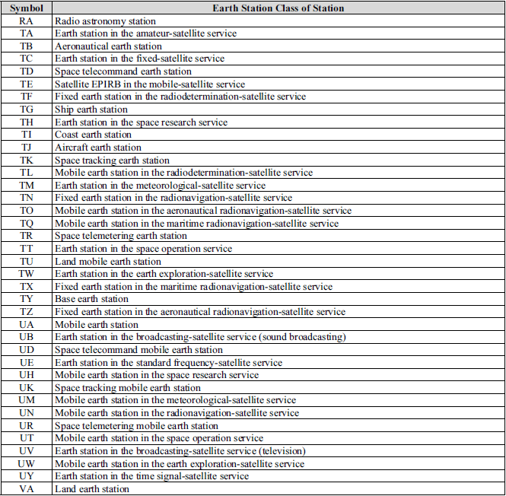
Class of Station (2/2)

Slide 30
Nature of Service
This item sets class of stations and nature of services applicable to the group of beams. Selecting this item opens an entry table to define class of stations and nature of services using the relevant combo box.

Slide 31
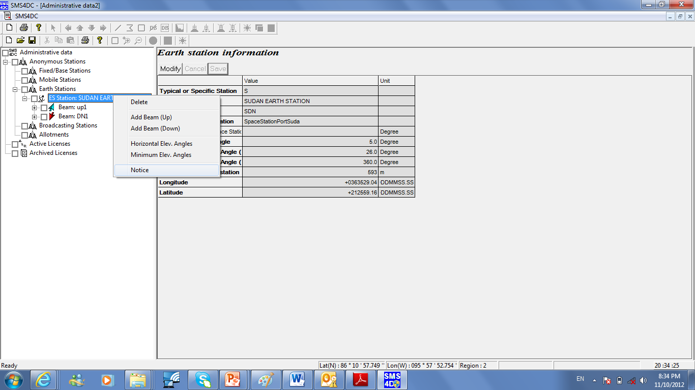
Class of Station
12. Right Click on your Earth Station Name “UAE EARTH STATION NO 1” and then Press notice in order to create notice

Slide 32
Earth Station Coordination Contours

Slide 33
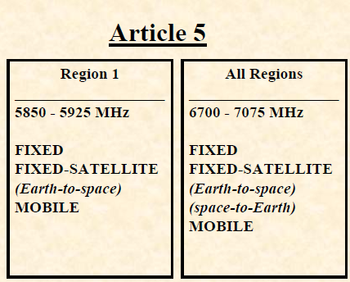
COORDINATION OF EARTH STATIONS
WITH RESPECT TO TERRESTRIAL STATIONS
AS WELL AS (other) EARTH STATIONS
When ?
• Frequency bands allocated with equal rights to space and terrestrial services or earth stations operating in the Opposite Direction of Transmission (ODT)
The coordination area includes the territory of another country

Slide 34
COORDINATION Area and Coordination Contours OF EARTH STATIONS
 Appendix
7 of the Radio Regulations
(RR)
contains the method for the determination of the
coordination area around a transmitting or receiving earth station that is sharing spectrum in frequency bands between 100 MHz and 105 GHz
with terrestrial radiocommunication services or
with earth stations operating in the opposite direction of transmission.
 Appendix
7 is based on ITU-R SM.1448
recommendation

Slide 35
How to determine the coordination area around an earth station (1)
 The coordination area is determined on the basis of :
known characteristics for the coordinating earth station .
Conservative assumptions for the propagation path.
Conservative assumptions for the system parameters for the unknown terrestrial stations, or the unknown receiving earth.

Slide 36
How to determine the coordination area around an earth station (2)
 Calculations are performed separately for great circle propagation mechanisms(propagation
mode (1)) and, if required by the sharing scenario for scattering from hydrometeors(propagation
mode (2)).
 The coordination contour is then determined using the greater of the two distances predicted by the propagation mode (1) and propagation mode (2) calculations for each azimuth around the coordinating earth station.

Slide 37
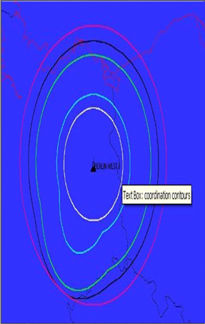
Coordination Contours around an earth station using
SMS4DC

Slide 38
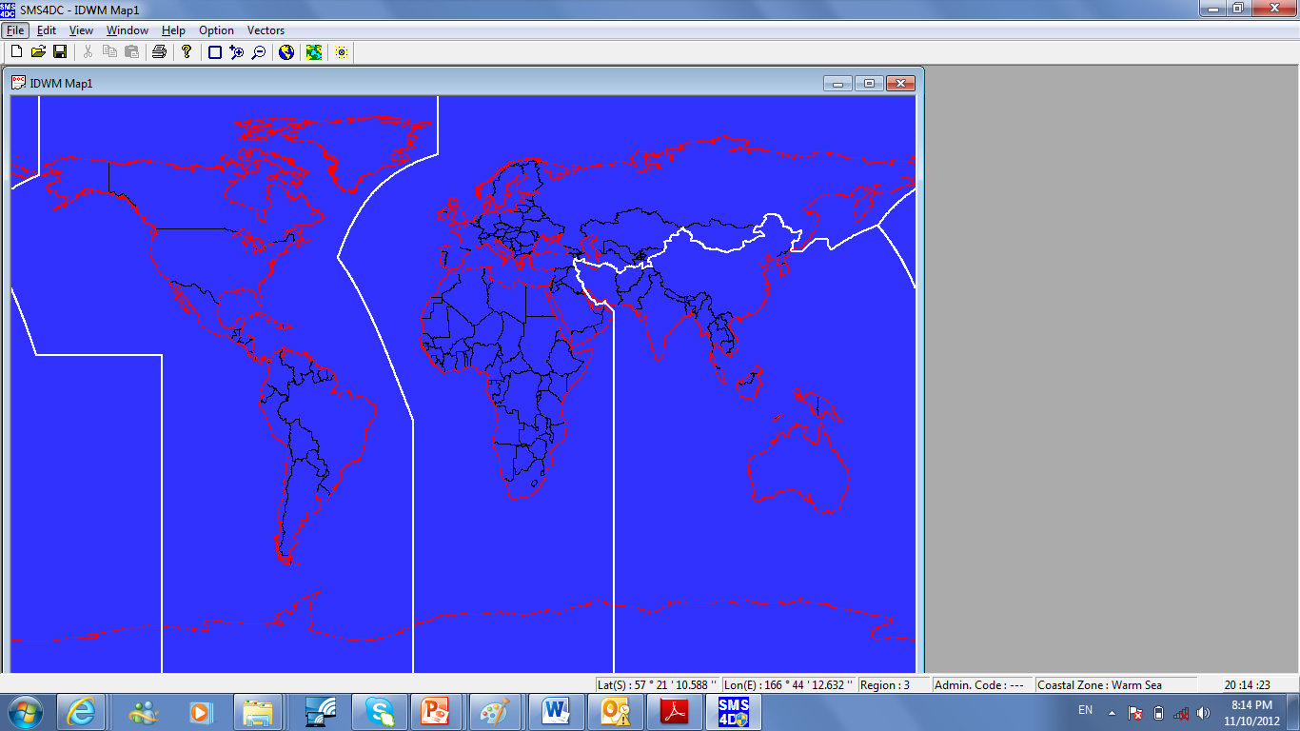
Step one
From Window bar >> Launch IDWM Map1 by selecting IDWM Map1

Slide 39
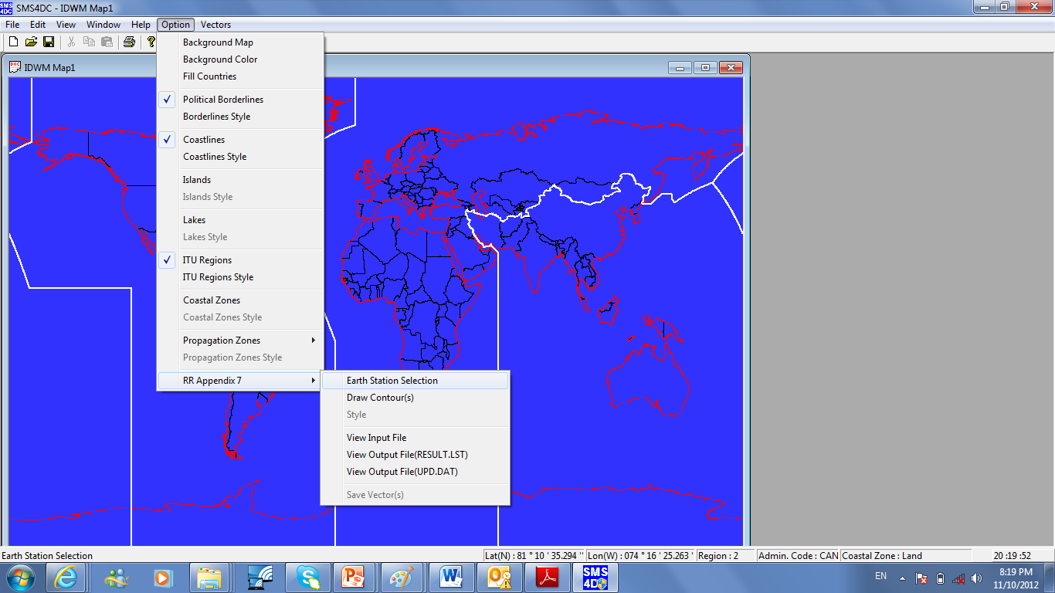
Step Two (1/4)
From option bar select >> RR appendix 7 >> Earth Station in order to choose the transmitting earth station.

Slide 40
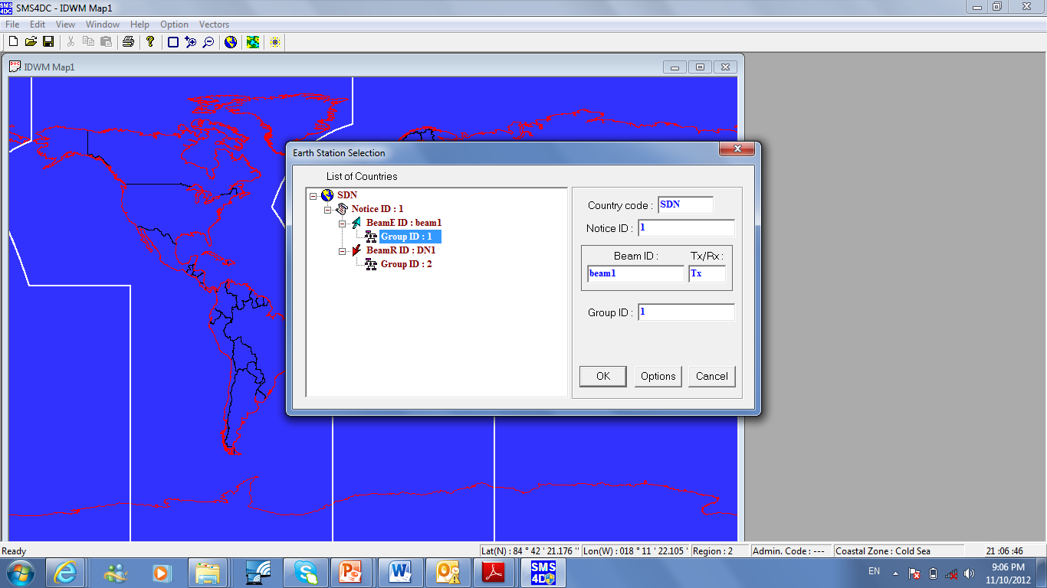
Step Two (2/4)
From option bar select >> RR appendix 7 >> Earth Station in order to choose the transmitting earth station.

Slide 41
Step Two (3/4)

Slide 42
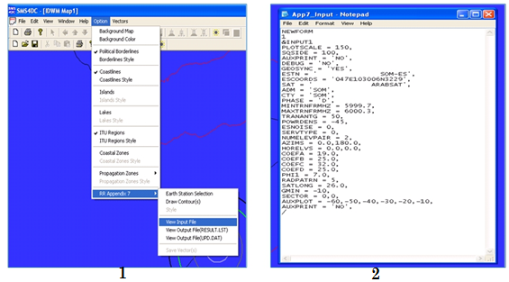
Step Two (4/4)
optionally: you may want to view the input file which contains the selected earth station parameters needed to determine the coordination contour

Slide 43
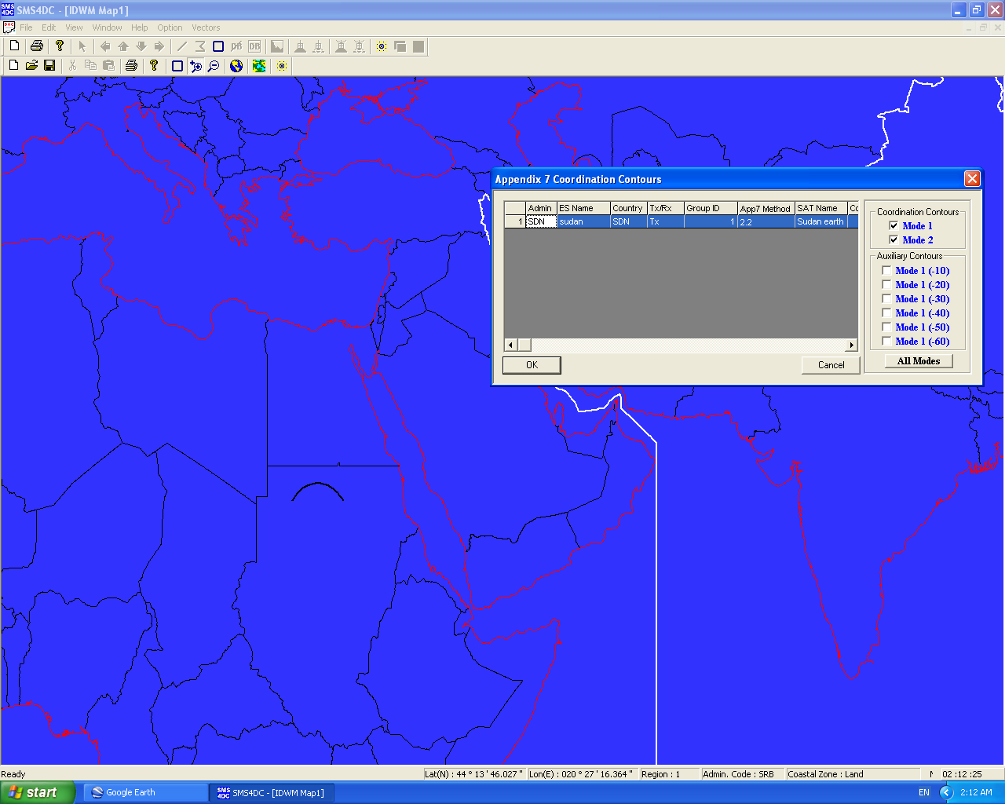
From option menu select >> RR appendix 7 >> Draw Contour
Step Three (1/2)

Slide 44
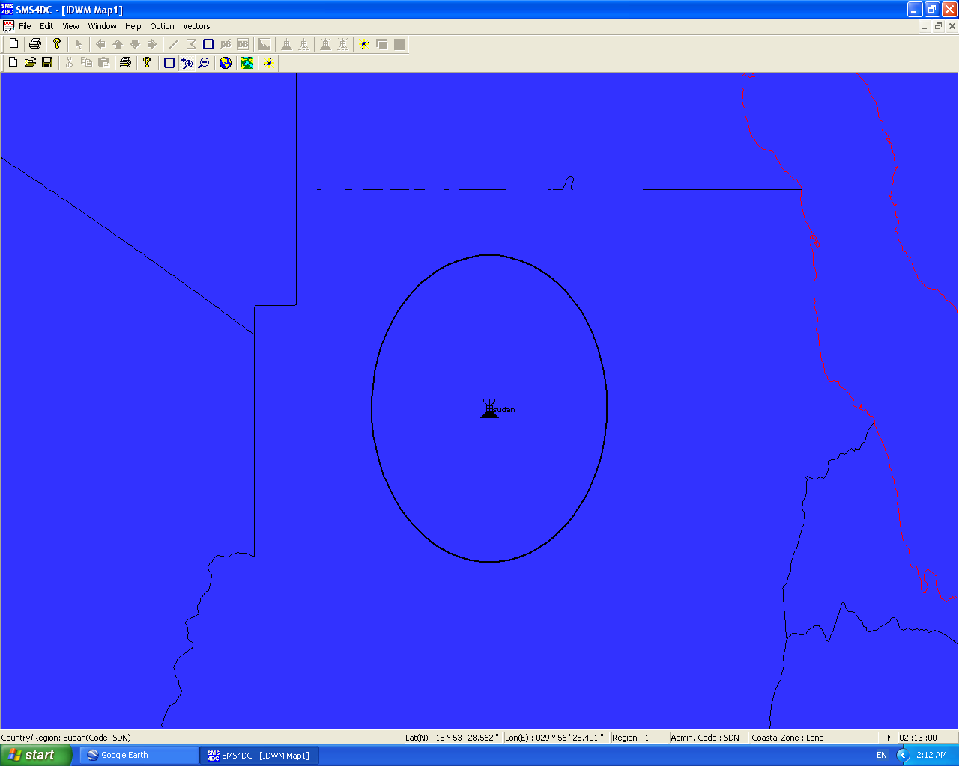
Step Three (1/2)
From option menu select >> RR appendix 7 >> Draw Contour

Slide 45
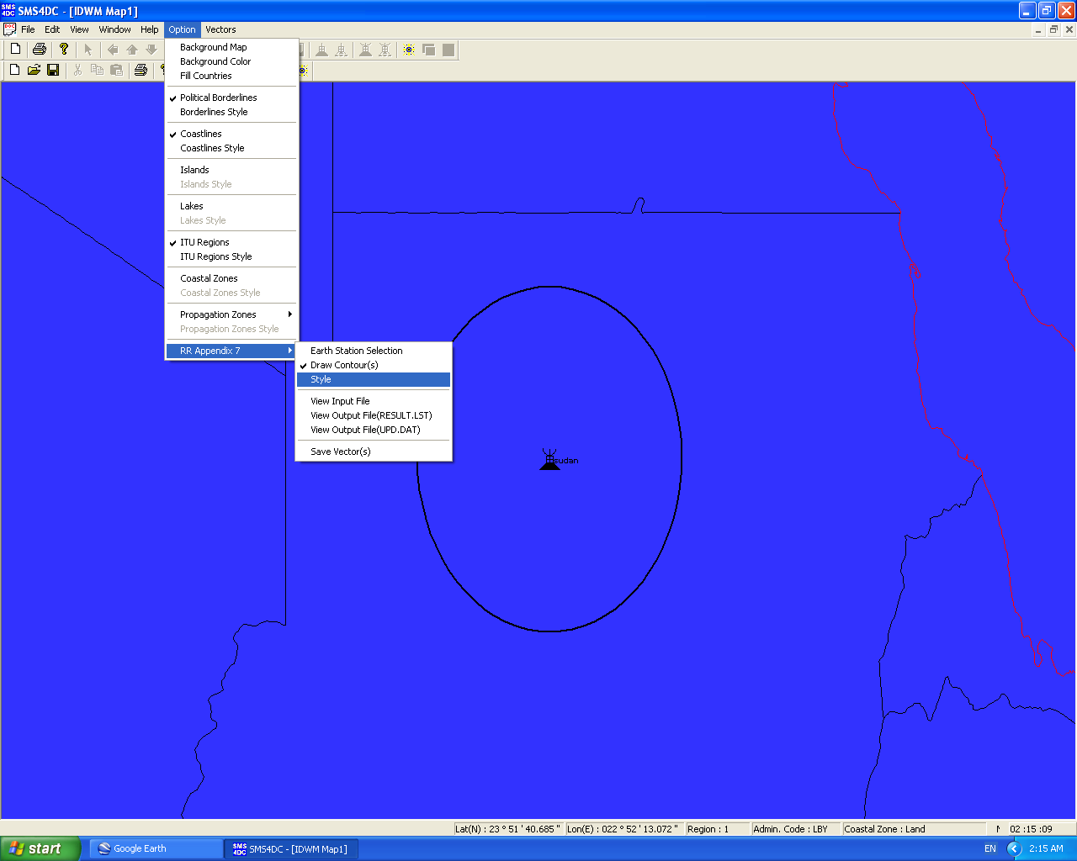
Step Four (1/3)
optionally you may need to change the contours styles for clarification

Slide 46
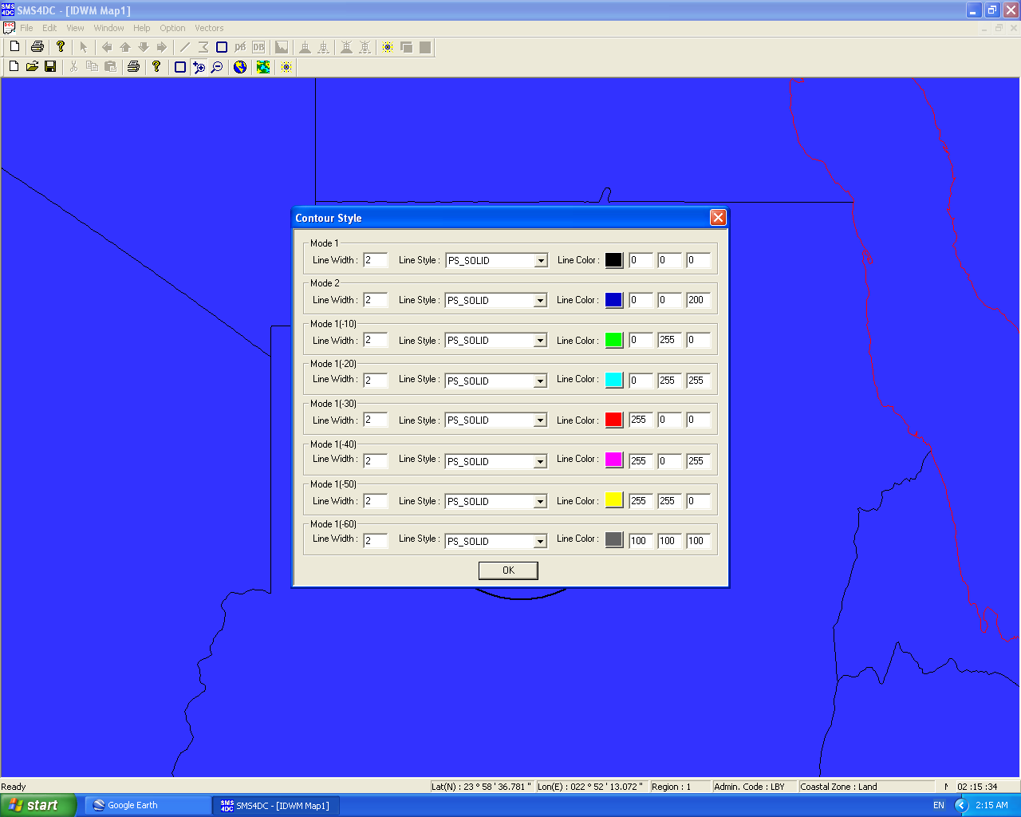
Step Four (2/3)
optionally you may need to change the contours styles for clarification

Slide 47
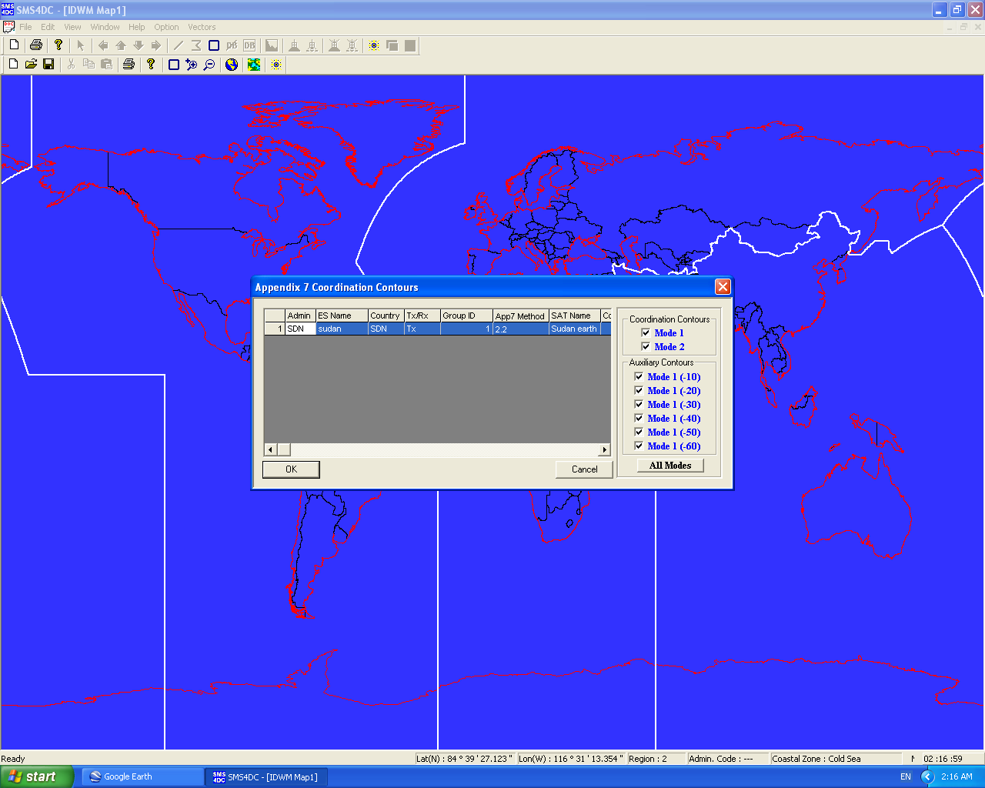
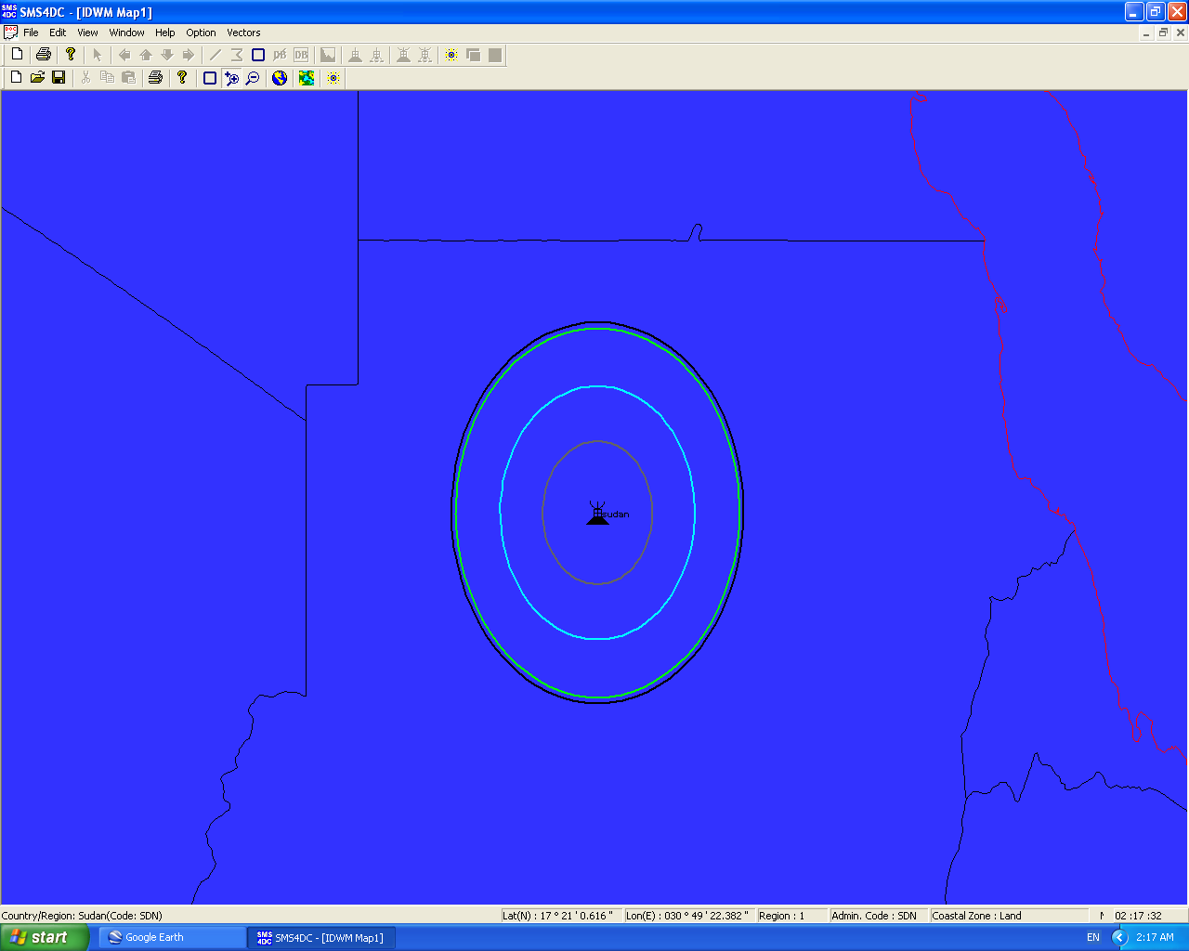
Step Four (3/3)
optionally you may need to change the contours styles for clarification

Slide 48
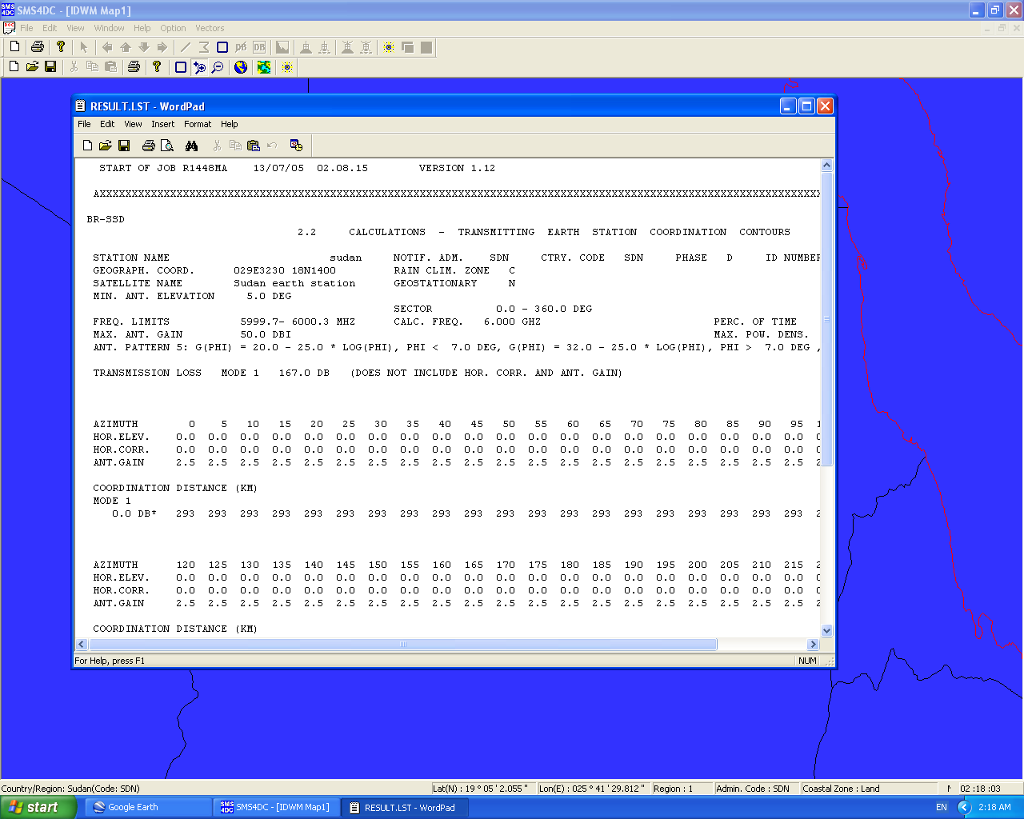
optionally: you may want to view the Output file (RESULT.LST) to show details of calculation result

Slide 49
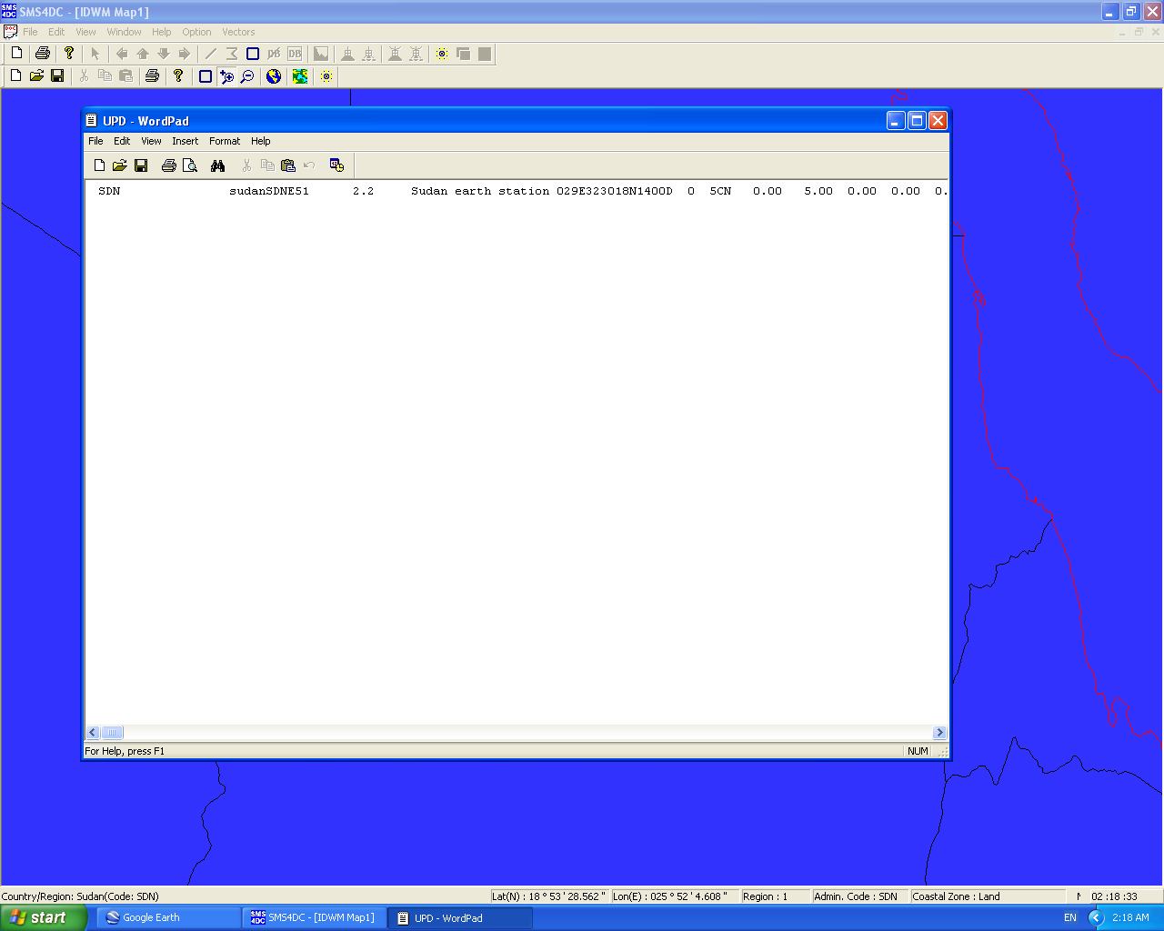
Step Six
optionally: you may want to view the Output file (UPD.DAT) to show contour data

Slide 50
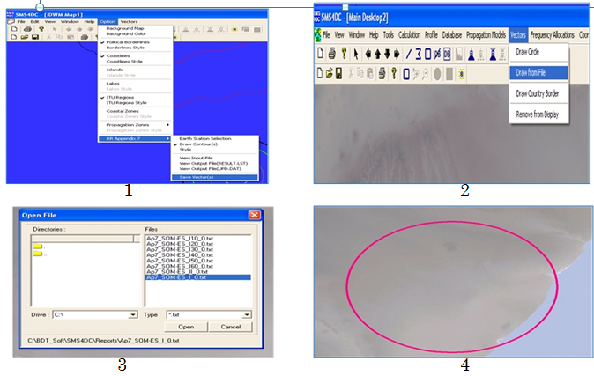
Step Seven
Optionally: you may want to draw these contours on DEM Map

Slide 51
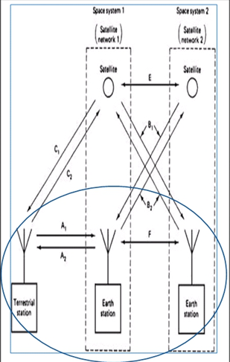
Earth Stations
Inference Calculation using
SMS4DC

Slide 52
Types of Interference Calculation
 Interference from selected transmitting earth station to receiving Fixed terrestrial Stations above 1 GHz.
 Interference to selected receiving earth station from transmitting Fixed terrestrial Stations above 1 GHz.
 Interference from selected transmitting earth stations to receiving earth stations

Slide 54
References
Main References
2. ITU Training on Space Services (Bangkok, 24-27 April 2012).
3. ITU SMS4DC Training ( Jordan 2008).
4. SMS4DC V4 manual.
5- ITU-R, Radio Regulation BOOK

