Slide 1


ITU Regional Workshop on SMS4DC for
English Speaking countries in Africa,
Abuja, Nigeria , 20-31-May 2013

Slide 2
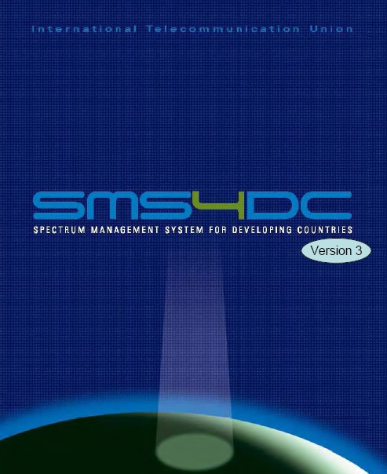
Notification of frequency Assignments for recording in the Master Register
Prepared by :
Eng.yasir Mohammed Bashar
Yasir_192@ntc.gov.sd

Slide 3
Spectrum management
The ever-increasing global application of different means of radiocommunications and a need for correct management of intensive use of radio frequencies requires a high level of international cooperation.
One of the principal tasks of ITU-R is to administer and facilitate the complex intergovernmental relations needed to develop legally binding agreements between sovereign States.

Slide 4
The Importance of Notification
Radio frequency spectrum is a limited natural resource that must be used rationally, efficiently and economically, inconformity with the Radio Regulations, so that countries and groups of countries may have equitable access to it.
It is therefore important to notify the BR about the bringing into use or the planned bringing into use of the radio-frequency, so as to:
Allow the BR to apply the appropriate procedure(s);
Inform other possibly affected Administrations about the actual use of the radio-frequencies;
Initiate and complete any required coordination;

Slide 5
Master International Frequency Register
The Master International Frequency Register (MIFR) is the formal database of satellite and terrestrial frequency assignments maintained by the International Telecommunication Union (ITU). Recording in the MIFR is the final stage of the frequency coordination process, and confers international recognition and protection from interference for those frequency assignments.

Slide 6
General Notification procedure
In conformity
RR 11.31
Notified
assignment
Part I
N
Y
Assignment
covered by
a Plan?
Acknowledgment
N
Y
In conformity
RR 11.34
N
Returned
Y
Recorded in MIFR
Part II
Part III

Slide 7
Electronic Notification Format
Following RESOLUTION 906 (WRC07), as from 01/01/2009, notices for Terrestrial Services are submitted to the BR in electronic format only.
One of the major reasons is that there is a quite large number of notice types, of different complexity, used for the notification of radio-stations in the Terrestrial Services. The nature of data to be provided and its completeness vary considerably from one notice type to the other.
It is therefore very important to use the correct notice type with the correct intent according to the effective purpose of the notification and the fragment to which it refers.

Slide 8
Terms & Definitions
Electronic notification: a given “electronic notification file”, following the BR format, which contains one or more “notice(s)”.
In addition to its notice type, each “notice” must have a set of two elements which clarify to the Bureau the concerned radio communication service together with the purpose of the notice, so as to apply the appropriate procedure. These are namely the fragment and the action.
Fragment: a coded indicator defining the scope under which the proposed notice applies.
Acceptable values are:
    1.NTFD_RR (notified under RR, synonym to ART11), for the MIFR scope.
    2.Abbreviated plan names for the Plans (i.e. GE84, GE06A, GE06D, GE75, AP25, etc.)

Slide 9
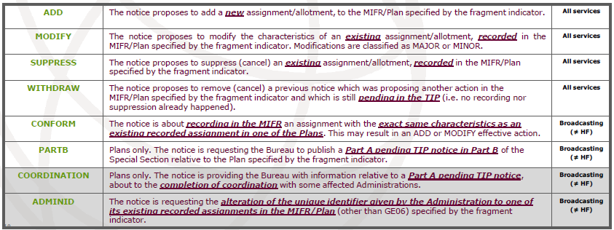
Terms & Definitions(2)
Action: Some times also called “intent”, this is a coded indicator specifying the purpose of the proposed notice.

Slide 10
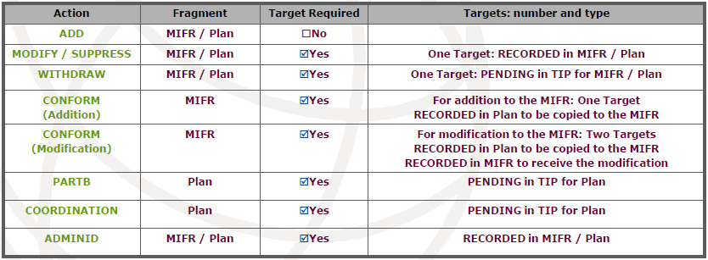
Terms & Definitions(3)

Slide 11
Selecting the appropriate Notice Type
The identification and selection of the correct notice type to use is done in accordance with several criteria, starting from a “large segmentation” and then restricting the scope until the correct type is found:
1.Partition by “Segments”.
2.Partition by “Fragments” inside the “Segments”.
And these “partitions ”are based on:
→ The corresponding radiocommunication service.
→ Or appropriate class of station,
→ The geographical zone and frequency band,
→ The applicable provision of the RR or the Regional Agreement,
→ The action (or intent) requested by the notice.

Slide 12
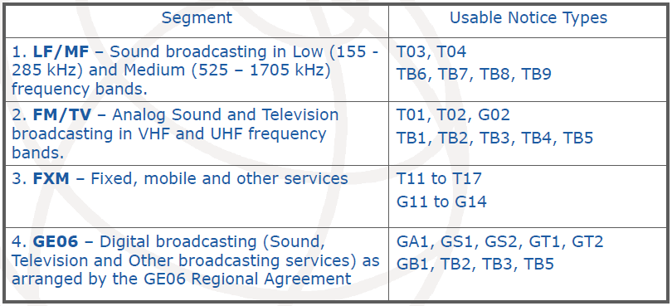
Partition by “Segments”
Selecting the appropriate Notice Type(2)

Slide 13
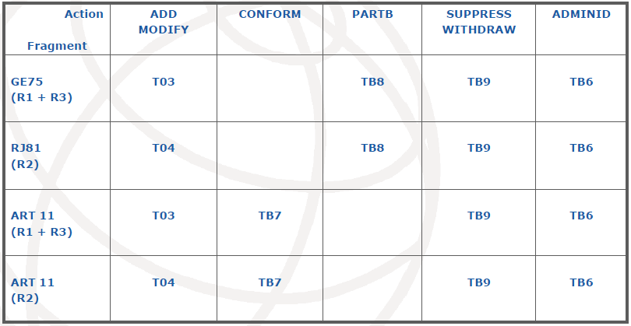
Selecting the appropriate Notice Type(3)
Type LF/MF Segment -Partition by “Fragments”
LF/MF Segment -Partition by “Fragments”

Slide 14
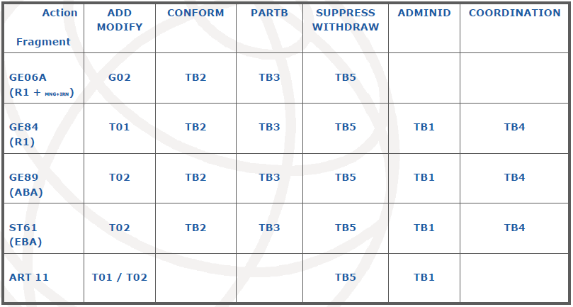
Analog FM / TV Segment - Partition by “Fragments”
Selecting the appropriate Notice Type(4)

Slide 15
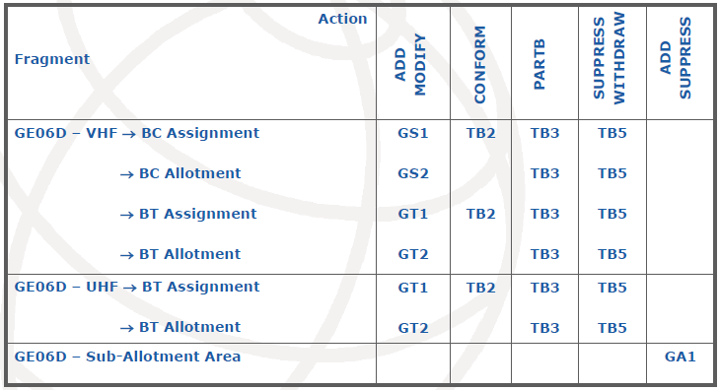
GE06 Digital Broadcasting - Partition by “Fragments”
Selecting the appropriate Notice Type(5)

Slide 16
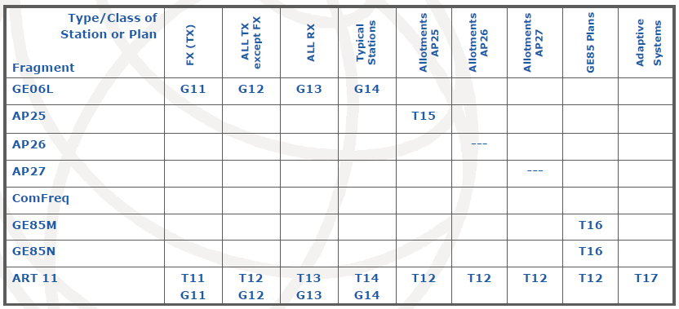
FXM Segment -Partition by “Fragments”
Selecting the appropriate Notice Type(6)
All Notice types are applicable for all relevant actions (ADD/MOFIDY/SUPPRESS/WITHDRAW)

Slide 17
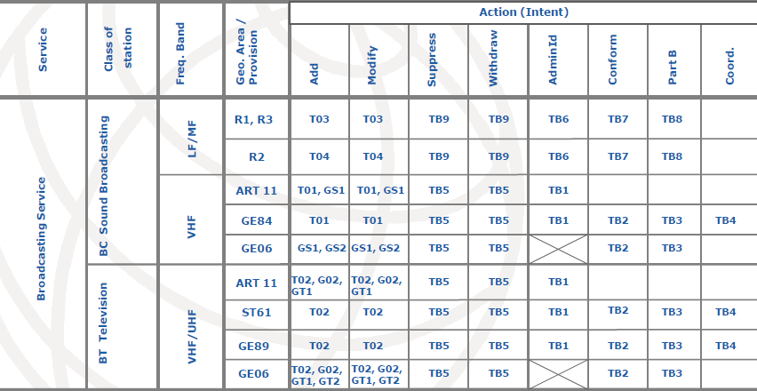
Broadcasting Service – [Notice Type ↔ Action] Combinations
Selecting the appropriate Notice Type(7)

Slide 18
SMS4DC Electronic Notice
SMS4DC is able to generate T01, T02, T11, T12, T13, T14, TB1, TB2, TB3, TB4, TB5, G11, G12, G13, G14, GS1, GT1, G02 and GB1 electronic notices.
No notice form could be generated if mandatory fields in consequent levels of tree view are incomplete. Therefore, users need to complete all mandatory information; including frequency(s), receiver information and antenna characteristics.

Slide 19
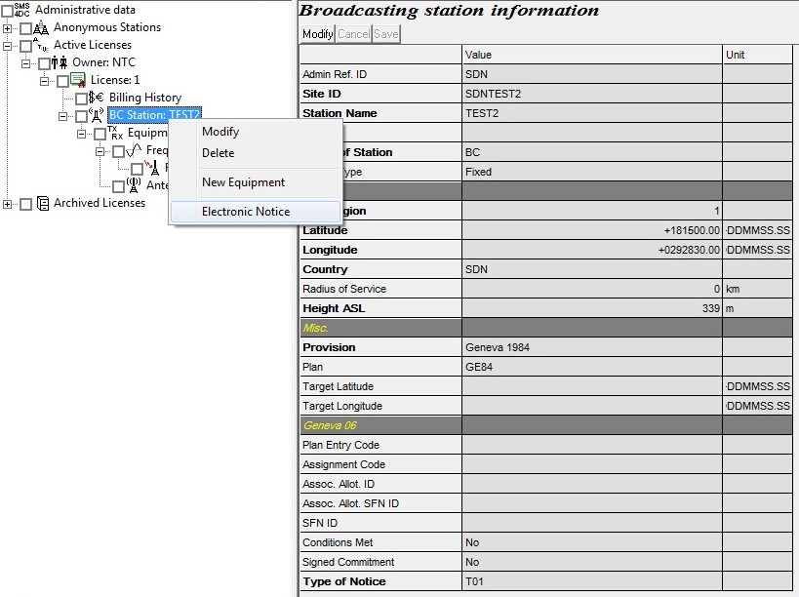
SMS4DC Electronic Notice(2)

Slide 20
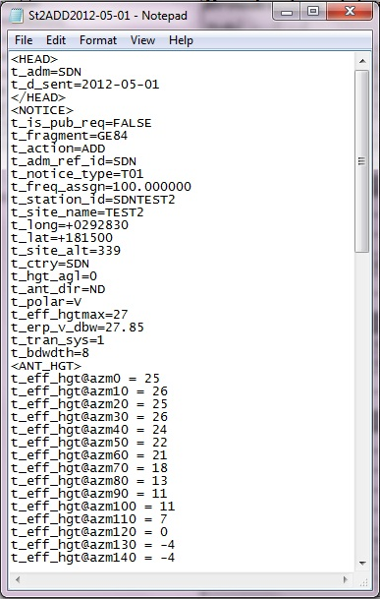
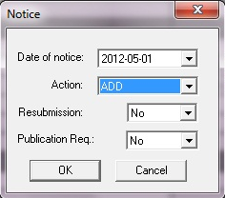
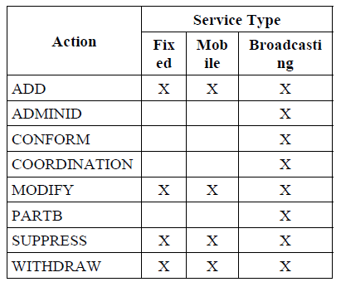
SMS4DC Electronic Notice(3)

Slide 21
EXCERSISES

Slide 22
Thank you

Slide 23
