Slide 1
HIPSSA Project
Support for Harmonization of the ICT Policies
in Sub-Sahara Africa,
TRAINING /DATA PROTECTION LAW
Zambia, August 2013
Pria Chetty,
ITU International Expert on Data Protection
Notes:
.

Slide 2
Summary of the Content
Revisit and explain key concepts and definitions
Examples and cases of principles of data protection law in practice
Explanation of Transborder Flow restrictions in data protection law

Slide 3
WHY ENACT DATA PROTECTION LAW IN
Zambia?

Slide 4
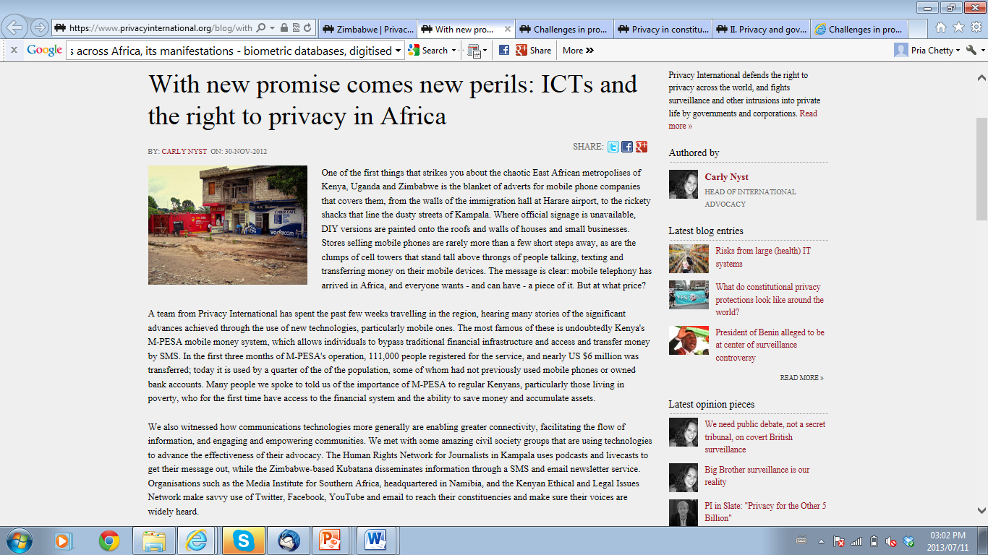
“As the tide of technology sweeps across Africa, its manifestations - biometric databases, digitised border systems, electronic voting, communications surveillance, e-Health systems, mobile money - are being designed and implemented with little consideration for how such systems will protect the personal information of individuals and respect their private lives and decisions. Even more worryingly, these "advances" are being adopted without accompanying legal protections and safeguards to ensure that individuals' basic rights are protected. Such safeguards include data protection legislation…””
https://www.privacyinternational.org/blog/with-new-promise-comes-new-perils-icts-and-the-right-to-privacy-in-africa

Slide 5
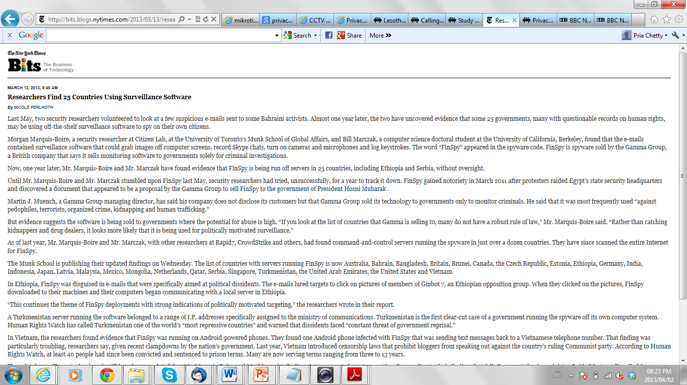
25 governments, many with questionable records on human rights, may be using off-the-shelf surveillance software to spy on their own citizens
E-mails contained surveillance software that could grab images off computer screens, record Skype chats, turn on cameras and microphones and log keystrokes
frequently used “against paedophiles, terrorists, organized crime, kidnapping and human trafficking
http://bits.blogs.nytimes.com/2013/03/13/researchers-find-25-countries-using-surveillance-software/?pagewanted=print

Slide 6
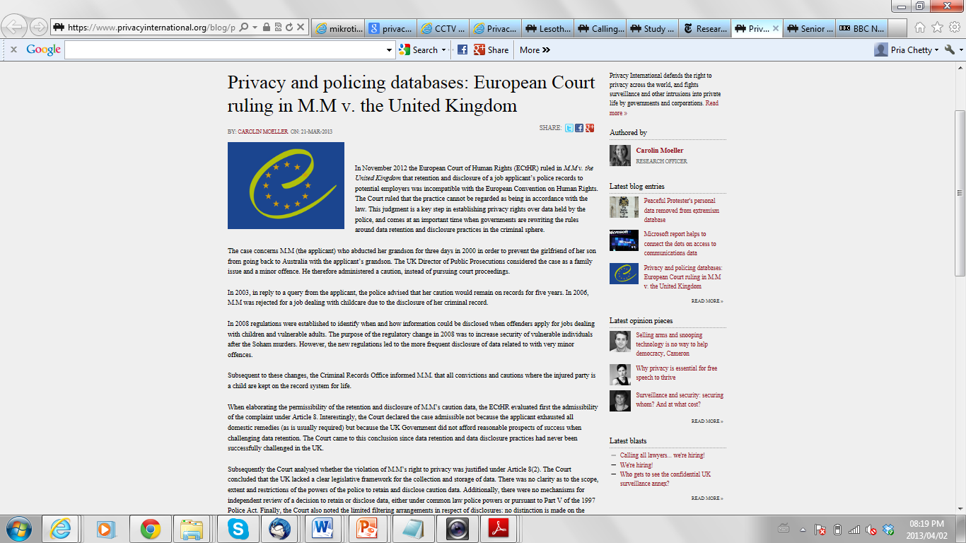
Case shows the reliance on personal information for decision making and negative impact
M.M abducted her grandson for 3 days to prevent son’s girlfriend from leaving country with grandson
Minor offence an caution but on record for 5 years
M.M was rejected for a job dealing with children
Records kept for life
https://www.privacyinternational.org/blog/privacy-and-policing-databases-european-court-ruling-in-mm-v-the-united-kingdom

Slide 7
CONCEPTS IN PERSONAL INFORMATION
PROCESSING

Slide 8
Data Controller Retains Ultimate Responsibility despite other persons acting on its behalf
“data processor” refers to a natural person, legal person, or public body which processes personal information for and on behalf of the controller and under the data controller’s instruction, except for the persons who, under the direct authority of the controller, are authorised to process the data; “data protection officer” or “DPO” refers to any individual appointed by the data controller charged with ensuring, in an independent manner, compliance with the obligations provided for in this law; “data controller's representative” or “controller's representative”: refers to any natural person, legal person or public body permanently established on the territory [of the concerned country], who takes the place of the data controller in the accomplishment of the obligations set forth in this law;

Slide 9
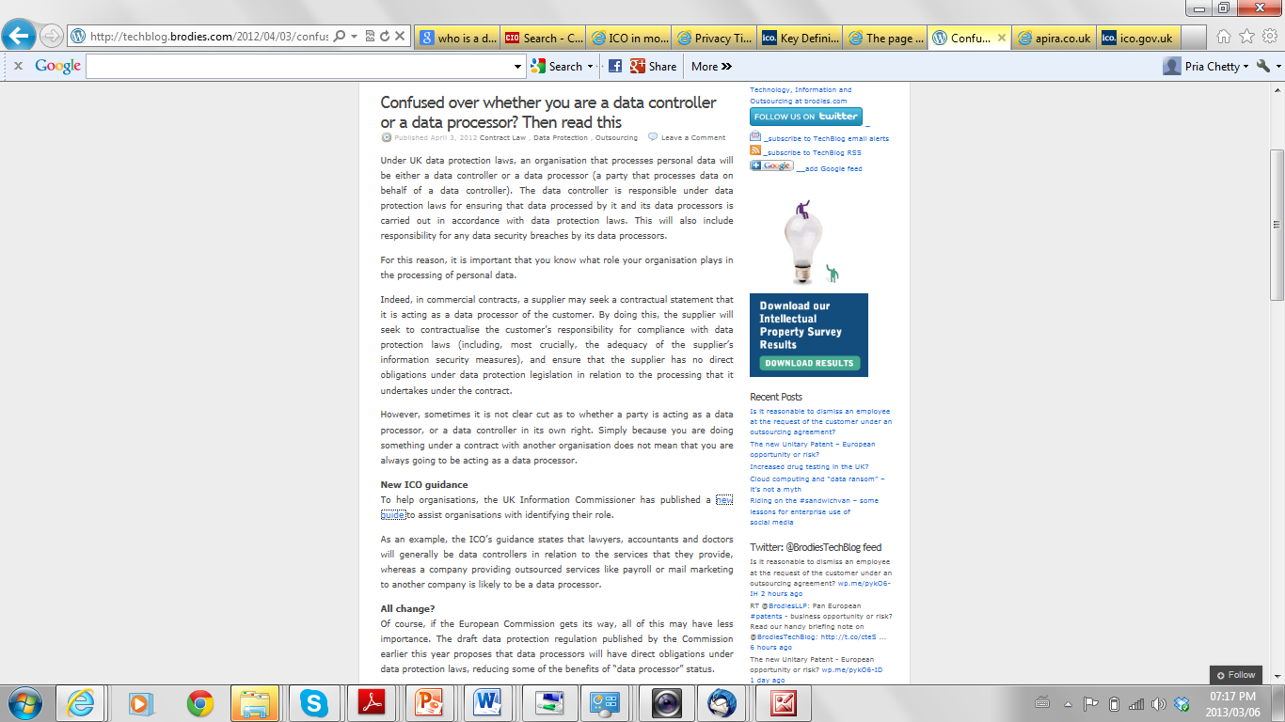
Who is controller and processor?
Organisations that process personal data –= data controller or data processor or representative.
Data controller – responsible for compliance including security breaches.
In Contracts – a statement that a supplier is acting as a data processor must be in pace and confirmation of responsibility of data controller to customer
People remain unclear as to roles and how to determine
Lawyers, accountants and doctors are data controllers
Outsourced service providers are data processors acting on behalf of data controllers
http://techblog.brodies.com/2012/04/03/confused-over-whether-you-are-a-data-controller-or-a-data-processor-then-read-this/

Slide 10
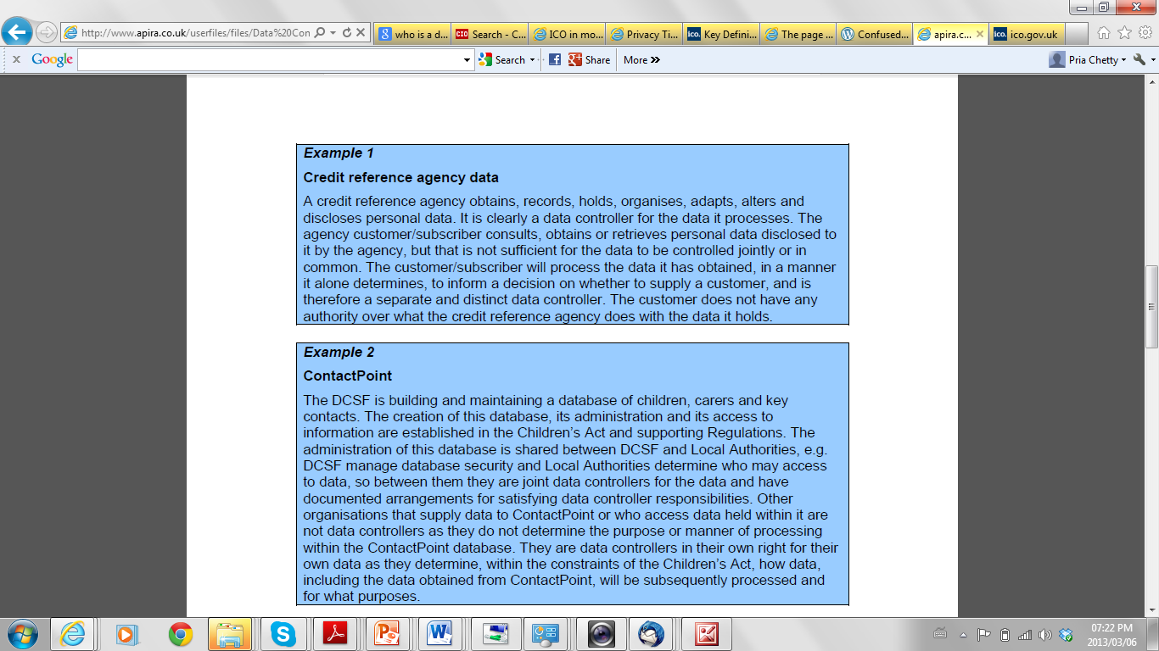
Agency obtains, records, holds, alters, discloses data
Customer consults, obtains, retrieves data
Agency – data controller
Customer – separate and distinct data controller
____________________
Data controller established in regulations
2 Public Bodies administer database of children, carers and contacts – joint data controllers
http://www.apira.co.uk/userfiles/files/Data%20Controllers%20in%20common.pdf

Slide 11
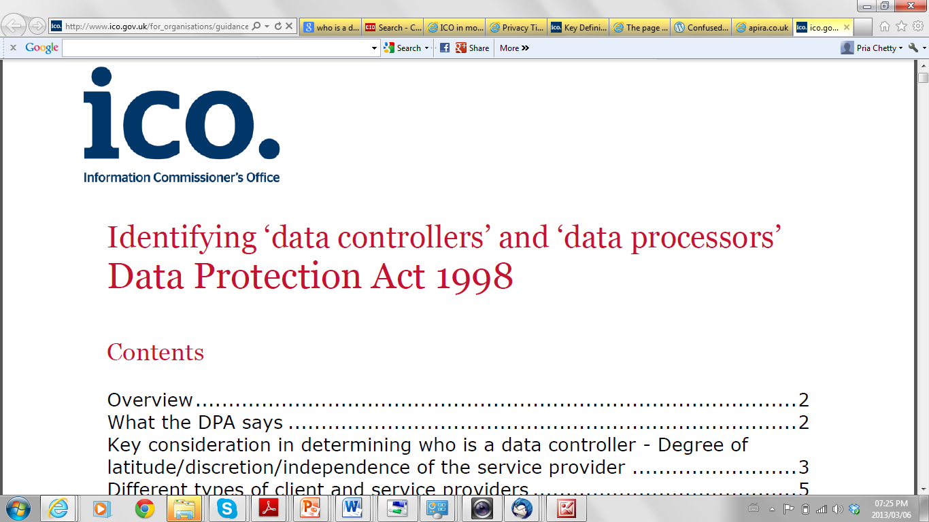
http://www.ico.gov.uk/for_organisations/guidance_index/~/media/documents/library/Data_Protection/Detailed_specialist_guides/data_controllers_and_data_processors.ashx

Slide 12
Defining Personal Information
Identifiable Information
Examples:
Personal Descriptors | Name, age, place of birth, date of birth, gender, weight, height, eye color, hair color, fingerprint
Identification Numbers | Health IDs, Social Insurance Numbers (SIN), Social Security Numbers (SSN), PIN numbers, debit and credit card numbers
Ethnicity | Race, colour, national or ethnic origin
Health | Physical or mental disabilities, family or individual health history, health records, blood type, DNA code, prescriptions
Source: Privacysense.net

Slide 13
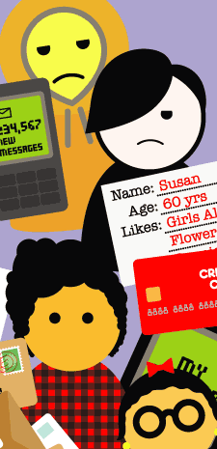
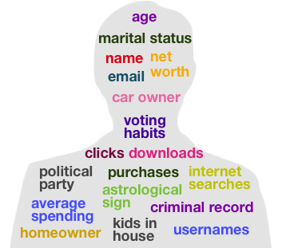
BUT in addition to information about you, personal information includes information about what you do, what you like, your preferences, behavioural data and your personal profile. Companies have a commercial interest in knowing you.

Slide 14
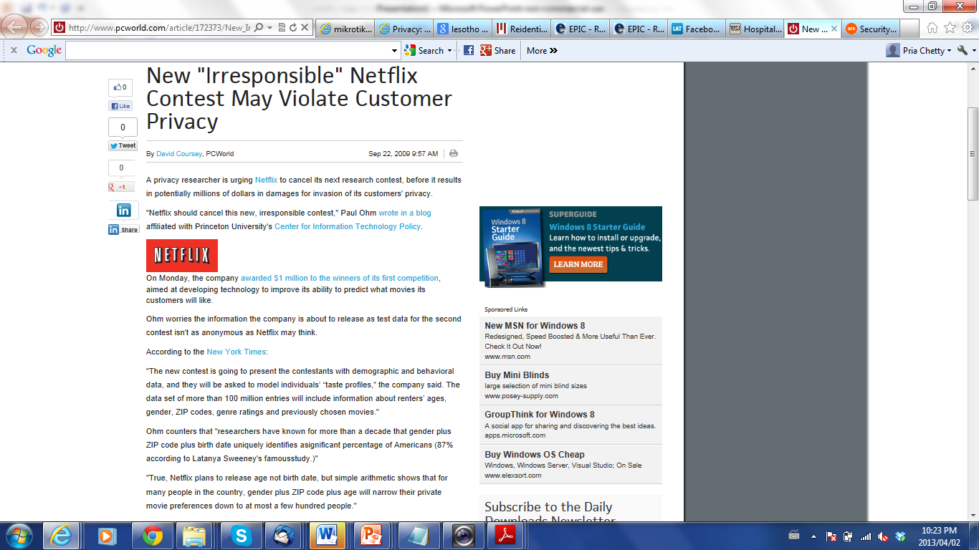
Netflix – research contest
Awarded $1 million – competition to develop technology to improve the ability to predict what movies customers will like
Test data for second competition is not sufficiently anonymous?
Demographic and behavioural data to model individual profiles. Data set of 100 million entries – ages, gender, ZIP codes, genre ratings and chosen movies
Gender, birth date, ZIP code – ID 87% of Americans
Gender, ZIP code and movie preferences – narrow to a few hundred people.
http://www.pcworld.com/article/172373/New_Irresponsible_Netflix_Contest_May_Violate_Customer_Privacy.html

Slide 15
Processing of Personal Information
The Act limits processing of personal information to place conditions on how personal information may be used.
To prevent unintended uses of personal information
To prevent abuse of personal information

Slide 16
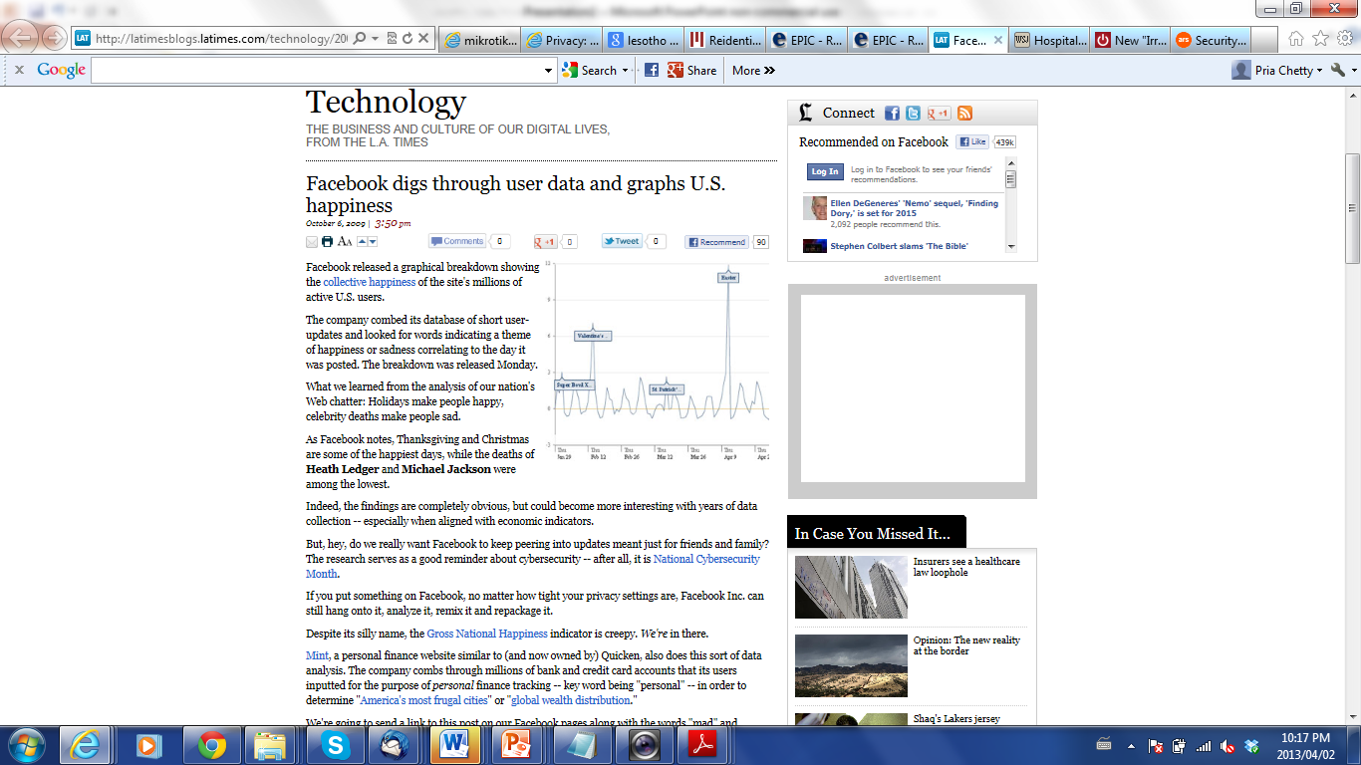
Facebook processing data for happiness index
What makes people happy?
Data aligned with economic indicators can be of interest
No matter how tight the privacy settings are, Facebook Inc. can use it, analyse it, remix it and repackage it.
Mint processes millions of bank and credit card accounts for personal finance tracking.
How comfortable are we with back-end processing?
http://latimesblogs.latimes.com/technology/2009/10/facebook-happiness.html

Slide 17
What is sensitive?
(a) information or an opinion about an individual which reveals or contains the following
(i) racial or ethnic origin;
(ii) political opinions;
(iii) membership of a political association;
(iv) religious beliefs or affiliations;
(v) philosophical beliefs;
(vi) membership of a professional or trade association;
(vii) membership of a trade union; (viii) sex life;
(ix) criminal, educational, financial or employment history;
(x) gender, age, marital status or family status,
(b) health information about an individual;
(c) genetic information about an individual; or
(d) information which may be considered as presenting a major risk to the rights of the data subject.
Often this information is used against the person when making a decision e.g. whether to employ or do business with a person
Information should not be used for purposes that the data subject has not consented to (with exceptions)

Slide 18
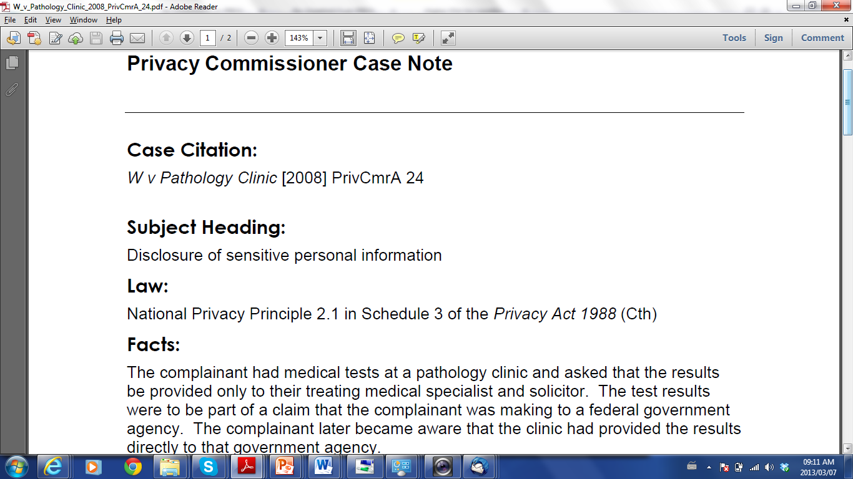
Australian Privacy Commissioner case
Information was disclosed for a purpose other than the primary purpose for which it was collected, and the disclosure was not permitted by any of the exceptions
The Commissioner formed the view that the disclosure was an interference with the complainant's privacy
Conciliation and Settlement
http://www.privacy.gov.au/materials/types/casenotes/view/5977

Slide 19
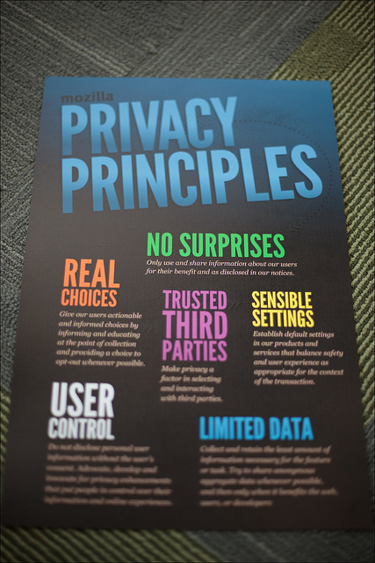
PROTECTION OF PERSONAL INFORMATION

Slide 20
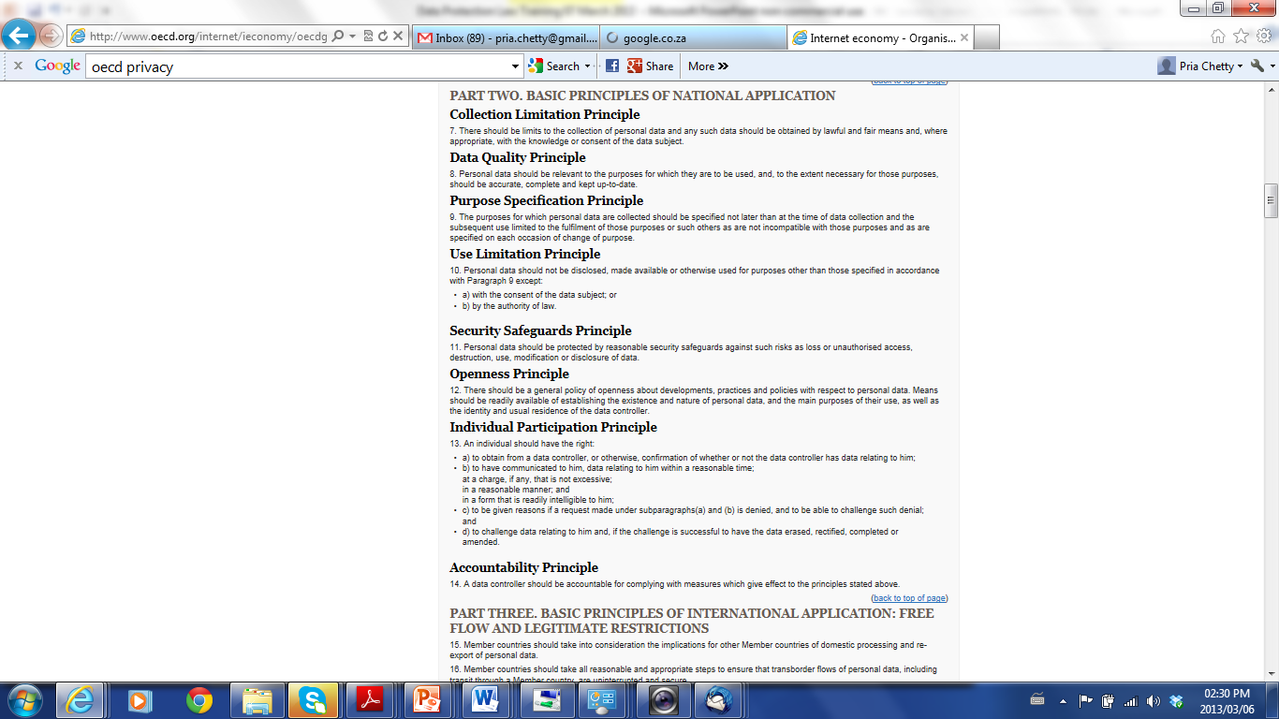
Original OECD Principles
Source: OECD
www.oecd.org

Slide 21
Key Provision Principles of Data Protection Bill
Processing of personal information (General Limitations)
Minimality, Retention of records
Collection directly from the data subject
Purpose specification and further processing limitation
Security measures on integrity of personal information
Information processed by an data processor of the data controller
Security measures regarding information processed by an data processor
Notification of security compromises
Quality of information
Notification to the Commission and to the data subject
Access to and challenges of personal information
Correction of personal information
Data controller to give effect to principles
Prohibition on processing of sensitive personal information

Slide 22
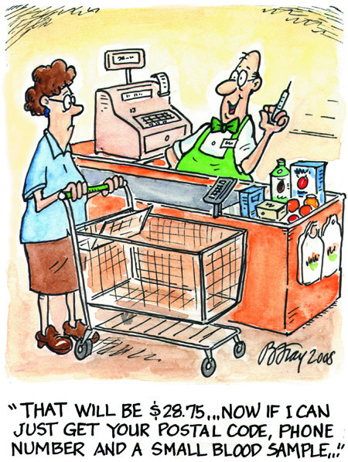
Example:
You should notify the data subject of the Purpose of Collection of information
Image Source: Office of Privacy Commissioner (OPC)

Slide 23
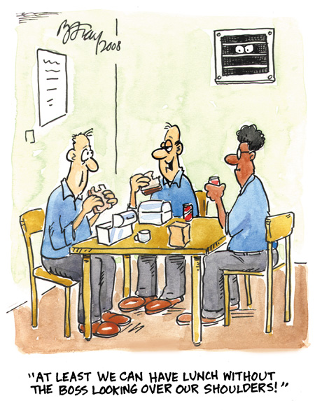
Has the employer notified the employees?
Are employees (also data subjects) aware of Purpose of Collection?
Image Source: Office of Privacy Commissioner (OPC)

Slide 24
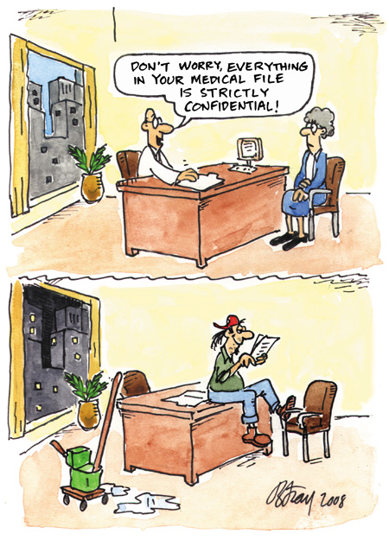
Example:
Data controllers should have necessary
security safeguards
to protect personal information
Image Source: Office of Privacy Commissioner (OPC)

Slide 25
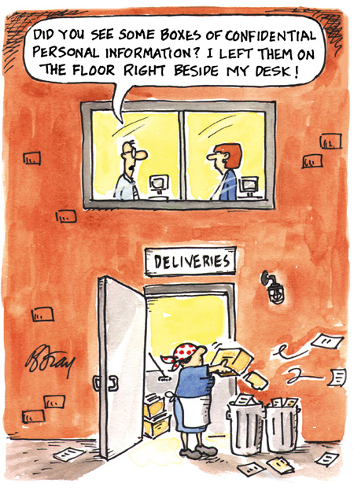
Principle:
Security Safeguards
Image Source: Office of Privacy Commissioner (OPC)

Slide 26
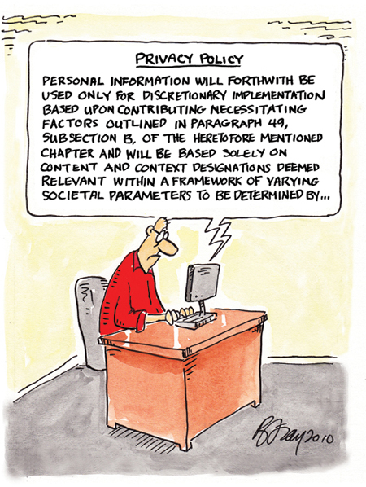
With the principle of
notification, the data subject must understand the purpose of collection and how it will be used (not complicated legalese)
Image Source: Office of Privacy Commissioner (OPC)

Slide 27
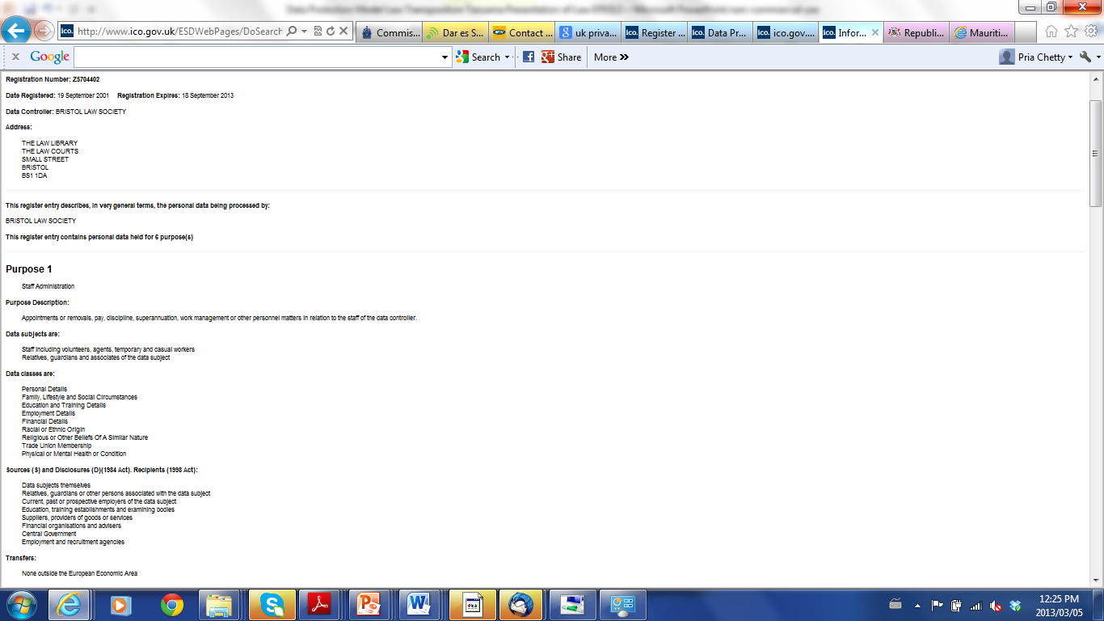
An example of notification by a controller to the Commission (Authority) of information collected and how it is processed.
= Principle of Transparency
Image Source: Office of UK Privacy Commissioner Website

Slide 28
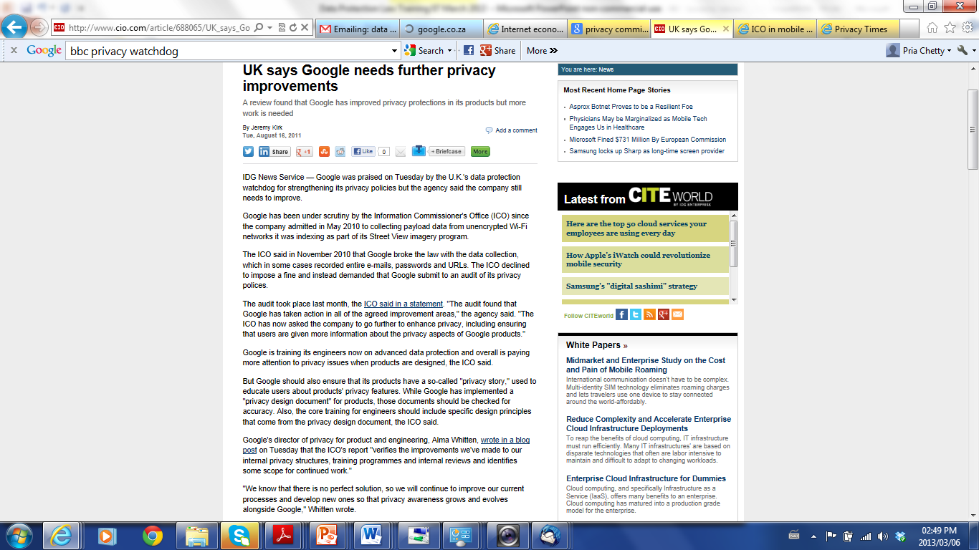
Principles: TransparencySecurity Safeguards
Source:
www.cio.com

Slide 29
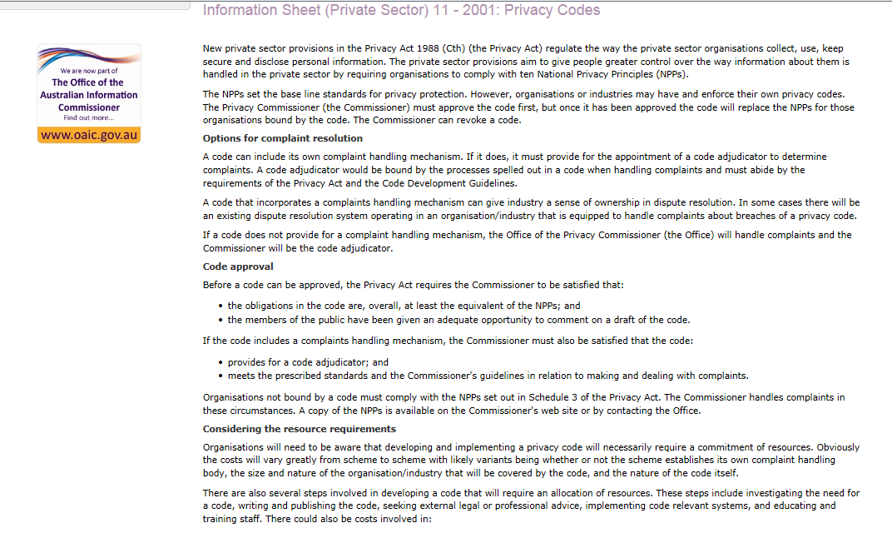
ËXAMPLE OF CODES OF CONDUCT BEING DEVELOPED BY INDUSTRIES,
IN Zambia INDUSTRIES CAN DEVELOP CODES ON HOW PERSONAL INFORMATION WILL BE TREATED
Organisations and industries develop codes of conduct
Complaint Resolution
Adjudicator
Obligations at least equal to principles
Members of public have an opportunity to comment
Resources

Slide 30
Implementation
Policies
Contracts
Privacy Policy (internal)
Privacy Policy (external)
Information Security Policy
Monitoring Policy
Records Management Policy
Consent
Third Parties
Data Processors
Data Controller’s Representative
Employees/ Contractors
Assessments
Technical
Compliance Assessments

Slide 31
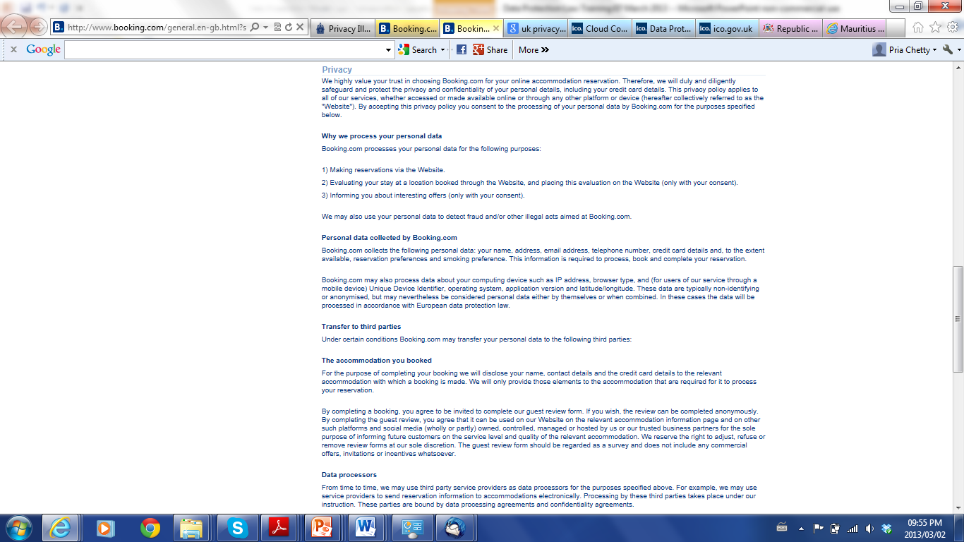
Example of Privacy Policy of Booking.com
www.booking.com
Last update: July 2012

Slide 32
TRANSBORDER FLOW OF PERSONAL INFORMATION

Slide 33
Transborder Flow
"transborder data flow" term that arose in the 1980s following concerns in the EU regarding the value of information and the exchange of information across countries
between business units of one company, data processing services or purposes ancillary to the commercial engagement.
Includes transfer of human resources, financial records customer information: marketing and travel, and for public sector agencies (law enforcement, border controls and tax agencies).
In Zambiaan Bill, restrictions are placed on personal information sent outside Zambia
Reference:TRANSBORDER DATA FLOW: EU DIRECTIVE AND IMPLICATIONS FOR INTERNATIONAL BUSINESS
Elizabeth Longworth, New Zealand

Slide 34
Application
An adequate level of assurance is needed as to how information will be treated
Countries - adequate level of protection – determined by assessment of e.g. the laws and policies of country
Where country does not have adequate laws:
  Data Subject Consent
  Transfer is necessary ….(for specific legitimate reasons)
  Other Authorisation
Contracts can be used to place obligations on foreign recipient
Article 26(2) of the EU Directive: Three conditions in order to guarantee a minimum level of protection: the purpose limitation principle, restrictions on onward transfers and the data importers' undertaking of providing the data subjects with the rights of access, rectification, deletion and objection
Reference:TRANSBORDER DATA FLOW: EU DIRECTIVE AND IMPLICATIONS FOR INTERNATIONAL BUSINESS
Elizabeth Longworth, New Zealand

Slide 35
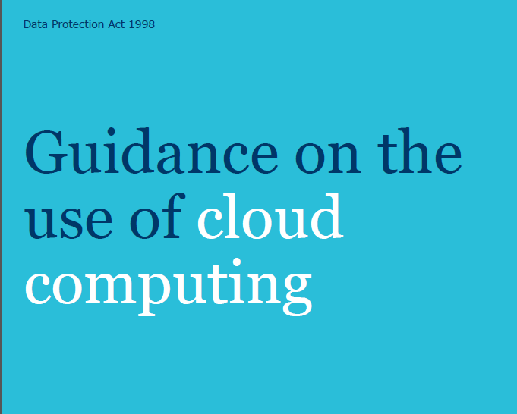
Cloud computing is an example of transborder flow of personal information as information is hosted at a foreign destination
Consult Guide Issued by the UK Information Commissioner
http://www.ico.gov.uk/
Notes:
Cloud compu

Slide 36
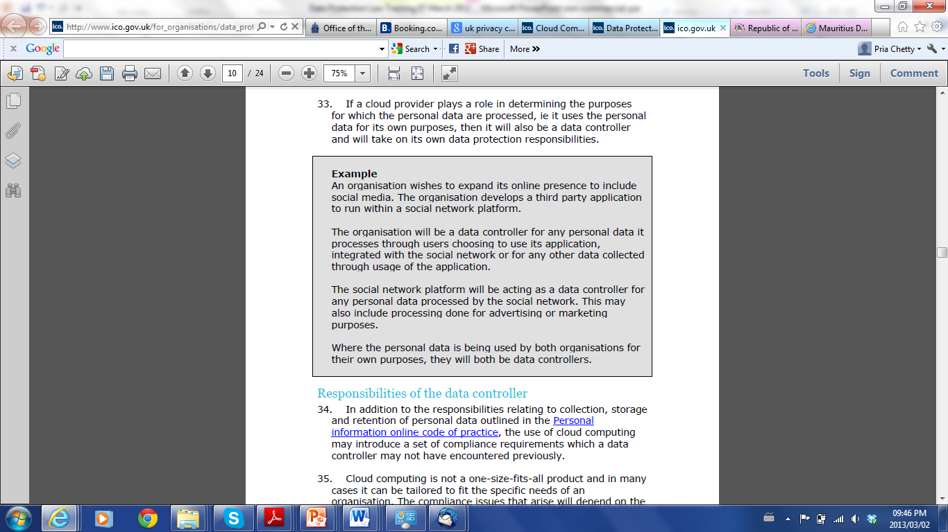
N.B. With transborder flow, data protection responsibilities still reside with the data controller.
Source: Guidance on the use of Cloud Computing, issued by the UK Information Commissioner
http://www.ico.gov.uk/

Slide 37
In closing: TRENDS/ CHALLENGES

Slide 38
Worldwide, approximately 1.1 million identities were exposed per breach, mainly owing to the large number of identities breached through hacking attacks. More than 232.4 million identities were exposed overall during 2011. Deliberate breaches mainly targeted customer-related information, primarily because it can be used for fraud.
Internet Security Threat Report Volume 17, Symantec, April 2012
Drone Surveillance
Re-identification
Facial Recognition
Behavioural Advertising
Location Data

Slide 39
Thank You
Questions?
Pria Chetty
International Legal Expert on Data Protection
(e) pria.chetty@gmail.com
(t) +27 (0) 83 384 4543

Slide 40
Image Credits
Slide 22
photo credit: <a href="http://www.flickr.com/photos/lhirlimann/6161838643/">Ludovic Hirlimann</a> via <a href="http://photopin.com">photopin</a> <a href="http://creativecommons.org/licenses/by-sa/2.0/">cc</a>

