Slide 1
HIPSSA Project
Overview of the Electronic Transactions and Communications Bill
MINISTRY OF COMMUNICATION, SCIENCE AND TECHNOLOGY (MCST)
2nd STAKEHOLDER WORKSHOPT e-COMMERCE SADC Model Law on Electronic Transactions and Electronic Commerce
28 AUGUST 2013
Support for Harmonization of the ICT Policies
in Sub-Sahara Africa
Notes:
Bonjour à tous,
Je suis tres heureux d‘être parmi vous aujourd‘hui.
Je voudrais remercier Mr. Kamdem pour son invitation a l‘atelier.
Permettez-moi de me presenter.
Je viens de rejoindre le bureau de regional de l‘UIT pour l‘Afrique d‘Addis Abeba pour coordonner le projet d‘harmonisation reglementaire de l‘UIT et de la CE en Afrique sub-saharienne
Je travaillais precedemment chez le regulateur français l‘ARCEP au service economique.
Je m‘occupais de travaux de modelisation technico-economique et j‘etais plus particulièrement en charge de l‘évaluation du cout du service universel et de la terminaison d‘appel mobile dans les departements français d‘outremer.

Slide 2
CONTENTS
  BACKDROP – ON THE GROUND
  PLAYERS (Consumers, sellers, service providers and their roles)
  OBJECTIVES
  DRAFT MODEL LAW PROVISIONS
    PART I – PRELIMINARY
    PART II – LEGAL EFFECT
    PART III – E-TRANSACTIONS
    PART IV – E-COMMERCE
    PART V – CRYPTOGRAPHY
    PART VI - E-GOVERNMENT
    PART VII – CONSUMER PROTECTION
    PART VIII – SERVICE PROVIDER LIABILITY
    PARTS IX +
Notes:
Bonjour à tous,
Je suis tres heureux d‘être parmi vous aujourd‘hui.
Je voudrais remercier Mr. Kamdem pour son invitation a l‘atelier.
Permettez-moi de me presenter.
Je viens de rejoindre le bureau de regional de l‘UIT pour l‘Afrique d‘Addis Abeba pour coordonner le projet d‘harmonisation reglementaire de l‘UIT et de la CE en Afrique sub-saharienne
Je travaillais precedemment chez le regulateur français l‘ARCEP au service economique.
Je m‘occupais de travaux de modelisation technico-economique et j‘etais plus particulièrement en charge de l‘évaluation du cout du service universel et de la terminaison d‘appel mobile dans les departements français d‘outremer.

Slide 3
BACKDROP – ON THE GROUND
FAIR TRADING ACT, 2001(Consumer protection)
COMPETITION ACT, 2007 (Consumer Protection, liability of service provider, enforcement measures)
ELECTRONIC RECORDS (EVIDENCE) ACT, 2009 ( e-record, admissibility of evidence, evidential weight)
REGULATIONS ON APPROVED PROCESS
REGULATIONS ON SECURE ELECTRONIC SIGNATURE

Slide 4
BACKDROP – RECOMMENDATIONS
  A BILL ON ELECTRONIC TRANSACTIONS AND ELECTRONIC COMMERCE
  AMENDMENT OF THE ELECTRONIC RECORDS (EVIDENCE) ACT, 2009

Slide 5
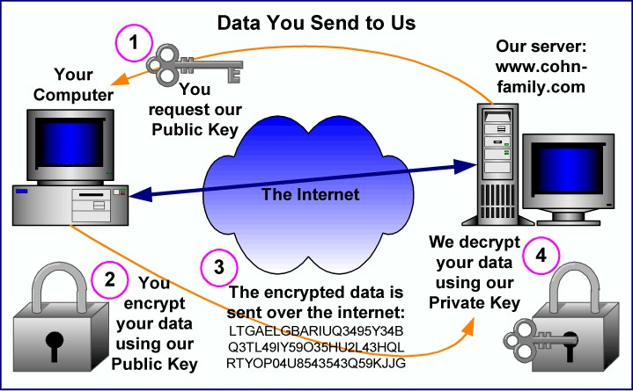
SECURE TRANSACTIONS PROCESS

Slide 6
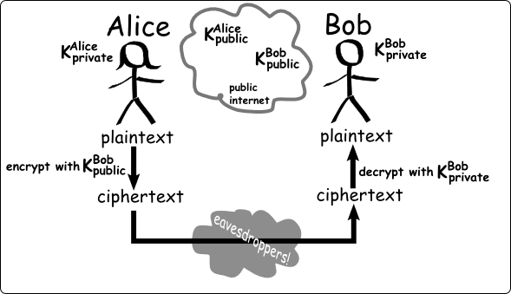
PLAYERS – CRYPTOGRAPHY

Slide 7
Objectives
  to facilitate the appropriate use of secure electronic transactions;
  to promote technological neutrality foster the development of e-commerce through the use of secure e-signatures;
  provide for e-filing and submission of documents through e-government services
  to remove legal uncertainties over writing, original documents admissible evidence
  promote the public and consumer confidence in the use
  Define responsibilities of Service Providers in e-Commerce

Slide 8
PART I – PRELILIMINARIES S.1 - 4
  Definitions (what, who i.e. consumers, service providers and Public Bodies)
  Exclusions – wills, bills of exchange & immovable property transactions etc
  Interpretation Rules
  Scope of application (persons, public bodies save intelligence agencies & those prescribed by law)
  Variation by Parties - Legal Recognition – (Parties right to opt out
  Notes: only inclusions for e-government services

Slide 9
CORE Definitions
Definitions (Who & What)
  DATA MESSAGE
  ELECTRONIC COMMUNICATION
  ELECTRONIC SIGNATURE
  INFORMATION SYSTEM / SERVICES
  AUTOMATED MESSAGE SYSTEM

Slide 10

INTERPRETATION
KEY DEFINITIONS
“electronic transaction” means a transaction, action or
set of actions of either a commercial or non-
commercial nature, and includes the provision of
information or e-government services;
“data message” means information generated, sent, received, or stored by electronic, magnetic, optical or similar means including, but not limited to, electronic data interchange (EDI), electronic mail, mobile communications (such as SMS messages) and audio or video recordings;
“electronic communication” means communication made by means of a data message;
“e-government services” means any public service provided by means of electronic communications by any public office

Slide 11
INTERPRETATION APPLICABILITY
Interpretation – applies to all law
  RULE OF LAW INTERPRETED TO ACCOMMODATE AND FACILITATE
Applicability –
  all law unless excluded
    No person forced
    Agreement may be inferred
Parties may vary

Slide 12
PART II – LEGAL EFFECT
  Functional Interpretation - message not to be denied legal effect simply by virtue of their nature
  Writing – where law requires writing & consequences result therefrom (record accessible and re-usable in future)
  Electronic Signatures – Recognition of E-Signatures application & conditions to be met:
    Identification of originator, reliable & appropriate in the circumstances
    Burden of proof on e-signatures (presumption)
    Note: Alignment of the legal recognition of the E-signatures under the E-Evidence Act 2009 on an equal footing as well regulations relating to requirements for same as may be prescribed under this Act.

Slide 13
PART III – E-TRANSACTIONS
  Formation & Validity of Contracts
      Variation by Agreement
      Time of dispatch (dispatch when originator and recipient on different system – when it enters information system beyond control of sender i.e f (Ezemvelo) in same system – capable of retrieval)
      Time of receipt (enters system of recipient if designated/ if not reasonably capable of retrieval
      Ezemvelo – the fact that Jafta’s e-mail was never received by the HR manager who was herself on her way out the court ruled it to have been received when it entered the Ezemvelo e-mail system as the designated system

Slide 14
PART III – E-TRANSACTIONS
  Place of Dispatch & Receipt – place of business/closest relation to underlying transaction/principal place of business (habitual residence etc)
  Time of Contract Formation – acceptance of offer i.e on receipt by offeror
  Input errors – define and provide remedies including conditions to be met for remedies to be applied (e.g. time limit, what happens if goods & services have been received, what happens if a benefit is derived, what are conditions if system does not provide for rectification of errors)

Slide 15
JAFTA VS EZEMVELO WILDLIFE 2008 SA
Offer of employment communicated via e-mail
Subsequent communications via e-mail and Jafta confirmed that he will be travelling and have no access to e-mail
SMS communication from employer requesting Jafta to confirm acceptance by defined date
SMS acceptance of offer
E-mail communication failed to reach employer but SMS message was received – Court held a contract had validly been created

Slide 16
JAFTA VS EZEMVELO WILDLIFE 2008 SA
Offer of employment communicated via e-mail
Subsequent communications via e-mail and Jafta confirmed that he will be travelling and have no access to e-mail
SMS communication from employer requesting Jafta to confirm acceptance by defined date
SMS acceptance of offer
E-mail communication failed to reach employer but SMS message was received – Court held a contract had validly been created

Slide 17
PART IV – E- COMMERCE
  Attribution rule – communication sent by originator unless contrary is proven & by infor system of originator if programmed to operate automatically
  Secure Electronic Signatures – presumption
  Original information (assurance of integrity as at time of generation & capable of display
  Criteria for integrity (complete, unaltered, reliable considering all circumstances)

Slide 18
PART IV – E- COMMERCE
  Hopewell & Nyamakazi – Hacking AR215/08
  Defendant unlawfully and intentionally utilized a device or computer programme in order to unlawfully overcome security measures designed to protect data or access to data, known as a “Skimming Device”, in order to gain unauthorized access to account information encoded on the magnetic to duplicate cards both debit and credit for his personal use.

Slide 19
PART IV – E- COMMERCE
  Retention of Records – conditions to be met for electronic records (retained in form sent/received, accuracy, identification of origin & destination & recognition of 3rd party providers for transmission)
  Production of Documents – conditions (relevance, circumstance, integrity, usable for future reference)
  Notarisation (role of electronic signatures & certification requirements)
  Other Requirements – lodging, filing, writing etc by law includes secure signatures

Slide 20
PRICILLA THAKELI Vs REX CA (CRI 11/2009
FALSE FAX PAYMENT INSTRUCTIONS BY AN EMPLOYEE OF LHDA OF 2.4 MIL
INSTRUCTION GENERATED ON COMPUTER SYSTEM OF LHDA & DULY SIGNED
TRANSMITTED OVER BOGUS COMMUNICATION SYSTEM THAT RE-DIRECTED AUTHORISATION TO ABSA BANK
INSTRUCTION FOLLOWED BY TELECON TO BANK CONFIRMING RECEIPT
Authentication, Integrity of data under circumstances & Records Retention
Originator of telecoms identified thru pins generated to identify each employee – Call data records adduced
Password access to LHDA systems to create and authorise transactions validated expert evidence of IT administrator who controlled authorisations & storage of information

Slide 21
SHERRYL CWELE & NABOLISA VS STATE – SCA 671/11
ORIGINALITY, INTEGRITY & AUTHENTICITY OF DATA
Case for contravention of the drug offences Act where call data records of the convicted Tessa was objected to on the grounds that it had not been established that the source from which the transcripts were made was the original recording.
Proof of the authenticity and reliability of the transcripts was therefore found to be lacking.

Slide 22
PART VI – CRYPTOGRAPHY PROVIDERS
  Registration of Service Providers – requirements (Minister to register details of registered providers & protection for their trade secrets on cryptography services & products)
  Compulsory registration (from within SW, to residents for business in SW)
  Exceptions for disclosure of information relating to the services/Products & information for law enforcement

Slide 23


PART V
CRYPTOGRAPHY PROVIDERS
“cryptography provider” means any person who provides or who proposes to provide cryptography services or cryptography products or systems;
“cryptography service” means any service which is provided to a sender or a recipient of an electronic communication or to anyone storing an electronic communication, and which is designed to facilitate the use of cryptographic techniques for the purpose of ensuring that-
  such data or electronic communication can be accessed or can be put into an intelligible form only by certain persons;
  the authenticity or integrity of such data or electronic communication is capable of being ascertained,
  but does not include the supply of, or of any right to use, computer software or computer hardware except where the supply is integral to the provision of cryptography services not consisting in such supply;

Slide 24
PART VII – E- GOVERNMENT SERVICES
  Filing, lodging and authorizations (permits, licenses etc) of documents with & by public bodies
  Requirements to be specified by notice in gazette (how, signature, certification, control processes & confidentiality etc
  No authority compelled
  Authorisation for use of IT equipment & services by public bodies

Slide 25
PART VIII – CONSUMER PROTECTION
  Scope – Consumers e-services & goods
  Exclusions – Financial Services, Auctions, Goods made to order, on-line gaming & lottery, perishables, media (audio, visuo, print) goods subject to market fluctuations & accomodation, leisure, transport etc time specific
  Supplier Obligations – Details, description of goods & services, terms & conditions & incorporation by reference, right of review
  Performance - 30 days (right of cancellation/return

Slide 26
PART VIII – CONSUMER PROTECTION
  Cooling-off Period (7 day of receipt/conclusion of contract / right of return/cancellation save direct costs for returns)
  Applicability of Foreign law – no exclusions for any legal system applied
  Unsolicited Messages – Criminalization & conditions for allowed marketing information
  Opt-in for marketing communications (conditions - info provided, similar products, provision for opt out & criminalization of failure to meet Opt in req.
  Consumer Complaints – to Commissioner

Slide 27
PART IX LIMITATION OF LIABILITY – SERVICE PROVIDERS
  Exception from liability for service providers for transmission & storage
    Mere conduit
    Caching
    Hosting
    Information location
  Obligations for take-down once infringing material is notified
  No obligation to monitor
  Legibility – service provider is member of representative body that has adopted codes of conduct

Slide 28
PART IX LIMITATION OF LIABILITY – SERVICE PROVIDERS
  Limitation applies where the storage at the direction of a user of material that resides on a system or network controlled or operated by or for the service provider, if the service provider:
  does not have actual knowledge that the material or an activity using the material on the system or network is infringing;
  in the absence of such actual knowledge, is not aware of facts or circumstances from which infringing activity is apparent; or
  (iii) upon obtaining such knowledge or awareness, acts expeditiously to remove, or disable access t, the material;.

Slide 29
PART IX LIMITATION OF LIABILITY – SERVICE PROVIDERS
  does not receive a financial benefit directly attributable to the infringing activity, in a case in which the service provider has the right and ability to control such activity; and
  upon notification of claimed infringement as responds expeditiously to remove, or disable access to, the material that is claimed to be infringing or to be the subject of infringing activity

Slide 30
PART IX LIMITATION OF LIABILITY – SERVICE PROVIDERS
  Viacom Vs You Tube & Google
    Video sharing platform provided by You Tube & google challenged on the grounds that they wilfully infringed copy right material depriving artists of due rewards. - Not liable
    Napster – supra challenged on same grounds– Wholesale distribution held intentional notwithstanding the fact that Napster derived no financial benefit in the transmission Liable. Napster represents a tool for sharing information. But this tool can generate legal problems when the files are protected by copyright law and the owner of the copyright has not given permission for the dissemination of the works.

Slide 31
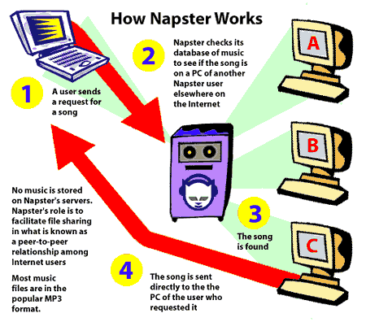
TRANSMISSION – NAPSTER
Notes:
e-mail followed by SMS notification of acceptance of offer. E-mail not received but reflecting as sent.
Durban Water Wonderland vs Ingrid & Jaques Botha (South Africa) – Disclaimers

Slide 32
PART IX & X - GENERAL PROVISIONS
  Savings for Agreements /obligations under license
  Exception for Common Law & Constitutional rights & Civil liability in terms of common law/statute
  Offences for body corporate
  Limitation of liability for state organs
  Ministerial powers to exempt from provisions of the law
  Regulatory Powers

Slide 33
?…
Nthabiseng Motjolopane
motjolopanen@etl.co.ls
ITU International Expert- Electronic Transactions
ITU Local Expert – Zandile Matshe
Union Internationale des Télécommunications International Telecommunication Union
Notes:
Merci de votre attention.
Je me tiens a votre disposition pour repondre a vos questions.
Je peux vous faire parvenir par email une version electronique de ce support de presentation.
Sachant que nous abordons tout juste le lancement de ce projet, les informations contenues dans cette presentation sont susceptibles a certaines evolutions.

