Slide 1
EXPERT LEVEL TRAINING ON TELECOM NETWORK COST MODELLING FOR THE HIPSSA REGIONS
Arusha
15-19 July, 2013
David Rogerson, ITU Expert

Slide 2
Session 8: Costing approaches – a practical exercise

Slide 3
Agenda
Describe the scenario
Work in groups
Present and discuss findings
Explain the exercise
Aims and objectives for this session

Slide 4
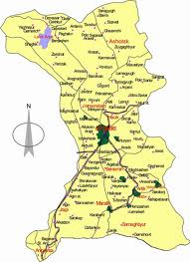
Remember Normalia
All the practical exercises in this workshop concern the fictitious African country of Normalia.
The details are contained in the Case Study document that has been handed out.
Normalia is a typical (“normal”) country with regulatory challenges similar to those in your country.

Slide 5
Telecoms in Normalia
Telecom Sector Regulator
(TRAN)
Fixed Telecoms
15% teledensity
Telecom (100%)
Mobile Telecoms
40% teledensity
Telecom (70%)
Normcell (30%)
Mobilco (new)

Slide 6
Interconnection negotiation
Telecom and Mobilco are now negotiating an interconnection agreement.
Mobilco has not yet started operations but urgently needs an interconnect agreement so as not to delay launch
Telecom is aware of Mobilco’s reputation from other markets as the “scourge of incumbents” so does not want to give away any advantage though an early or favourable interconnect agreement.
Negotiations have broken down and the case has been referred to TRAN.

Slide 7
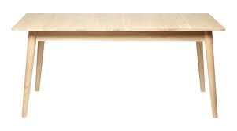
Latest offers on the table
Mobilco offers
To pay: 6cpm (fixed)
15 cpm (mobile)
To receive:
20cpm (year 1)
18cpm (year 2)
15cpm (year 3)
Telecom offers
A single reciprocal charge for all termination (fixed and mobile) on both Telecom and Mobilco:
10cpm

Slide 8
The regulator gets involved
TRAN is concerned that negotiations are dragging on and now threaten the development of a competitive market
It requests that each party prepare a fully-argued case in response to 5 questions (see next slide) and present their views at a 3-party hearing.
Your task (Team A is Telecom and Team B is Mobilco) is to build your arguments and prepare for group discussion.
Each team will need to appoint a team leader and present their case to the TRAN Board

Slide 9
The 5 questions
Whether benchmarking will solve the matter satisfactorily and if so, for how long?
Whether a network cost model should be developed and, if so, what kind?
Whether each of the operators should build its own model, and if so, what should it be a model of in each case?
Whether the regulator should build a model, either as well as or instead of operator models?
Whether the industry (regulator and operators) should band together to develop a single industry model or models?

Slide 10
Group presentations and discussion

