Slide 1
EXPERT LEVEL TRAINING ON TELECOM NETWORK COST MODELLING FOR THE HIPSSA REGIONS
Arusha
15-19 July, 2013
David Rogerson, ITU Expert

Slide 2
Session 7 – Approaches to cost modelling and their regulatory function

Slide 3
Agenda
Identifying types of cost models
Knowing when to apply them
Effective regulation
Understanding cost modelling approaches
Aims and objectives for this session

Slide 4
Identifying and understanding different types of cost model

Slide 5
Four basic types of cost model
BRAINSTORM
What does each term mean?
What are the 2-3 key features of each?
How would you go about constructing each model?
Top-down
Bottom-up
Hybrid
Benchmarks

Slide 6
Top-down cost model
Top Down Models Characteristics
PURPOSE: derive cost estimates from accounting data provided by incumbent
Often confidential company data
Based on existing network, potential inefficiencies
Embedded historical cost
Critical issues
exact separation between core and access network
depreciation period
rate of return
Valuation of assets
Real World Data (no assumptions)
Source: RTR

Slide 7
Top down model flowchart
Step 1: Take costs from GL and determine relevant costs
Fixed assets
Depreciation
Operating
expenditure
Step 2: Group costs into Homogeneous Cost Categories
Step 3: Group relevant costs into network elements and common costs
Retail
activities
Access
elements
Network
elements
Common
costs
Step 4: Revalue fixed assets on a current cost basis
Revalue
assets
Fixed assets
Fixed assets
Step 5: Calculate CCA depreciation
Depreciation
Depreciation
Opex
Opex
Step 6: Construct Cost-Volume Relationships
CVRs
Network
elements
Common
costs
Step 7: Group operating expenditure, depreciation and NBV of fixed assets by network element. Convert to annual costs
Route
factors
Step 8: Divide network elements by minutes of traffic using route factors
Per minute
costs
Step 9: Bundle network element minutes into standard interconnection service
Step 10: Apply mark-up to recover common costs
Mark-up
Step 11: Calculate charges
Cost-based
charges

Slide 8
Pros and cons of top-down models
Advantages
Takes General Ledger as the starting point, which provides a real basis for reconciliation.
In turn, this encourages buy-in; often essential for a successful project.
Asset Values can use any relevant methodology from NBV to GRC.
Uses “Real” sales traffic.
Disadvantages
Value of the Network Assets may not represent the economic value.
Depends very much on the quality of the Fixed Asset Register (FAR)
FAR
Opex
Switches
IN
Cells
RNU
MSC
Node B
BTS
RAN
CN
RTU
PC Card
Blackberry
Voice

Slide 9
Top-down models in telecommunications
Top-down models have to be built from the base accounting data of the network operator
Close co-operation from the operator is essential
Almost always the model is constructed by the operator
Regulatory control of the process involves:
Establishing clear cost allocation guidelines
Requiring the model to be updated and submitted to the regulator annually
Ensuring that the final model is independently audited for consistency with the guidelines and accuracy of the data.

Slide 10
Typical cost allocation guidelines
Establish required services to be costed
Identify main cost pools (e.g. Network, Retail, Common)
Establish any costs that should be excluded
Describe allocation keys for assets and operating expenditure to be used where direct allocation is not possible
e.g. Staff, Buildings, Vehicles, Software
Cost of capital
Routing tables – for converting cost pools (by equipment) onto cost pools (by services).

Slide 11
Bottom-up cost models
Bottom Up Model Characteristics
PURPOSE: To estimate the infrastructure investments of an efficient network from an engineering type model.
Analytical model to determine an abstract state-of-the-art network with an optimal network topology.
Different degrees of freedom possible:
Scorched node approach: geographical location of high level network elements and main distribution frame/base station sites are given.
Scorched earth approach: all locations optimised.
Source: RTR

Slide 12
Bottom up model flowchart
Step 1: Establish network design
Establish
network design
Step 2: Identify and determine capital cost of network elements
Access
elements
Switching
elements
Transmission
elements
Common
costs
Opex
Opex
Opex
Step 3: Calculate operating expenditure
Access
elements
Network
elements
Common
costs
Step 4: Combine capital and operating costs into an annual costs per network element
Network
elements
Network
element minutes
Convert to
minutes
Step 5: Divide network elements by minutes of traffic
Mark-up
Step 6: Bundle network element minutes to calculate LRIC of each interconnect service
LRIC of IC
services
Step 7: Mark-up to set interconnect charge
IC charges

Slide 13
Pros and cons of bottom-up models
Advantages
Often preferred by regulator, who also allows Weighted Average Cost of Capital (WACC) = Interest on investment.
Useful if there are doubts about the existing infrastructure
Disadvantages
Harder to compare to the real organisation.
Far more complex to implement than Top Down.
Uses Traffic estimates.
Results DO NOT agree with any other financial analysis.
Theoretical network
Opex
Switches
IN
Cells
RNU
MSC
Node B
BTS
RAN
CN
RTU

Slide 14
Pros and cons of bottom-up models (2)
Bottom Up approach assumes we start with nothing and rebuild the network from scratch.
“Scorched Node” Replace existing assets with Modern Equivalent Assets (MEA).
Advantages
Can use real sales data
Can use existing network structure
Disadvantages
Might not be suitable for very old fixed networks
“Scorched Earth” assume a green field optimal network, with MEA.
Advantages
Useful for comparing different operators.
Disadvantages
Difficult to do
Results are easy to challenge as it relies on so many assumptions.
Theoretical network
Opex
Switches
IN
Cells
RNU
MSC
Node B
BTS
RAN
CN
RTU
PC Card
Blackberry
Voice

Slide 15
Gap between top down and bottom up results.
Range of costing approaches
Top down
Uses existing historic cost accounting data
Upper bound cost
GAP
Regulatory
challenge
Lower bound cost
Bottom up
Investment cost calculated by a theoretical model
Source: RTR

Slide 16
Closing the Gap – Hybrid models
Hybrid models seek to close the gap between top-down and bottom-up results
They can start at either end, adding functionality from the other side:
Start from top-down:
Revalue assets on a modern equivalent assets (MEA) basis
Recalculate depreciation on an economic basis (or proxy for economic depreciation)
Start from bottom-up:
Calibrate total network investment and direct operating expenditure from accounting data
Derive mark-ups for common costs from actual opex

Slide 17
Overview of three cost model types
Top-down models
Good at:
Accurately capturing total historical costs
Poor at:
Transparency
Dis-aggregation
Efficiency
Bottom-up models
Good at:
Transparency
Efficiency
Future projections
Poor at:
Ensuring cost recovery
Estimating opex
Hybrid models
Combine good points of each approach:
Accurately capturing total costs (with efficiency adjustments)
Transparency
Future projections

Slide 18
Where does benchmarking fit in?
Calculation method
There are many levels at which benchmarking can contribute to regulatory pricing:
Total calculation – no need to model
To test or provide input data for BU Model
To provide data for a Hybrid Model
To test other data and calculations
Top Down
Bottom Up
Hybrid Model
Benchmarking

Slide 19
Benchmarking as a tool in cost modelling
Top down modelling
Cost allocation rules
Routing factors
Efficiency adjustments (hybrid)
Bottom up modelling
Unit asset prices, price trends and asset lives
Installation and operating expenditure
WACC
Mark-ups
Benchmarking is often used to:
verify data in top-down models
supply input assumptions in bottom-up models

Slide 20
Benchmarking as a proxy cost model
Establishes an estimate of cost-based prices by comparison of similar service prices in other countries
Choosing the benchmark set is critical
consider the comparability with the home country
make sure that the charges being compared are themselves cost-based
Benchmarking can also be used as a proxy cost model:
As an alternative to other methods
To cross-check results obtained from other methods

Slide 21
The pros and cons of benchmarking
Advantages
can be implemented quickly and with minimal development cost
compares to actual practice
useful for setting initial costs and to check the output of models
Disadvantages
difficult to take into account the variations in operating conditions of the other countries
choice of the benchmark set is often contentious
does not directly examine local cost considerations

Slide 22
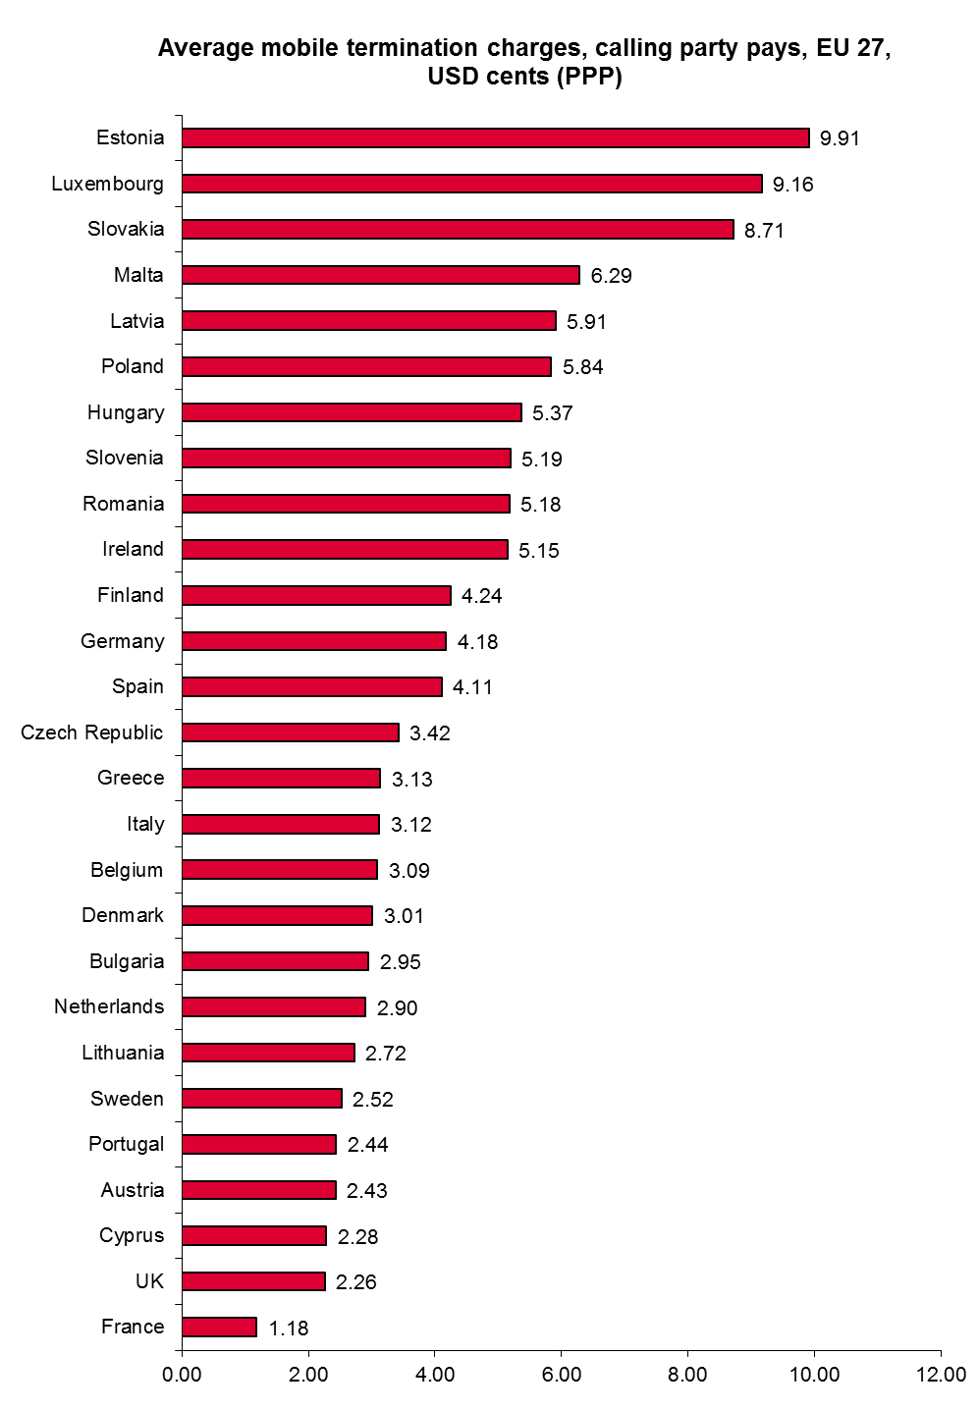
A typical benchmark
Range 1.18 to 9.91cpm
Some use pure LRIC some use LRAIC
Variations in scale of country, urbanisation, mobile penetration, GDP, wage rates – all of which affect unit costs
How might the benchmark be set:
Average
Median
Average of lowest quartile
Average of 10 most similar countries
etc
Source: Ovum

Slide 23
Relationship between cost model types
Top down
Upper bound cost
GAP
Upper bound cost
Upper bound cost
GAP
GAP
Lower bound cost
Lower bound cost
Hybrid model
with benchmarks
Lower bound cost
Hybrid model
Bottom up

Slide 24
How to apply different cost model techniques for effective regulation

Slide 25
The best choice is the practical choice
Effectiveness and defensibility
Hybrid
Bottom-up
Top-down
Benchmark
Cost to regulator ($ and staff resources)

Slide 26
The best choice is the practical choice
Effectiveness and defensibility
Hybrid
Choose benchmarks if resources are limited: but expect legal challenge if rates are pushed too low
Bottom-up
Top-down
Benchmark
Cost to regulator ($ and staff resources)

Slide 27
The best choice is the practical choice
Effectiveness and defensibility
Choose top-down if legal framework is strong enough to ensure operator co-operates. Don’t expect significant price falls
Hybrid
Bottom-up
Top-down
Benchmark
Cost to regulator ($ and staff resources)

Slide 28
The best choice is the practical choice
Effectiveness and defensibility
Hybrid
Choose bottom-up if you can afford the consulting fees. Expect minimal data from operators; good alternative data sources needed (benchmarks).
Bottom-up
Top-down
Benchmark
Cost to regulator ($ and staff resources)

Slide 29
The best choice is the practical choice
Effectiveness and defensibility
Hybrid
If bottom-up models are calibrated against top-down data the results are highly defensible. Worth the incremental investment if top-down data is available.
Bottom-up
Top-down
Benchmark
Cost to regulator ($ and staff resources)

Slide 30
Mini-case study
Mobile termination rates (MTRs) in A-land currently stand at 5.5cpm (USD cents per minute)
Respondents to a public consultation have said that:
A regional benchmark of 18 countries shows that MTRs range from 2cpm to 12 cpm, with an average of 5.1cpm and a median of 4.2cpm.
One mobile operator claims it has a top-down model which shows its costs at 4.8cpm
The regulator in a neighbouring country has recently completed a bottom-up model estimating costs of 1.8cpm. This is being challenged in court.
Consultants responding to a recent RFP for bottom-up models quoted $100k – 20% over your budget.

Slide 31
Your task
The Chairman of the Regulatory Authority has asked you to consider the facts and make a reasoned recommendation on the way forward.
Evaluate the options
Propose a course of action
You may include any or all of the four main modelling approaches
Top-down
Bottom-up
Hybrid
Benchmarks

Slide 32
Effective cost-based regulation
The domain of effective cost-based rates
Top-down cost model
Benchmarking
Bottom-up cost model

