Slide 1

EXPERT LEVEL TRAINING ON
TELECOM NETWORK COST MODELLING
FOR THE HIPSSA REGIONS
Arusha
15-19 July, 2013
David Rogerson, ITU Expert

Slide 2
Session 5 – Cost standards and their application

Slide 3
Agenda
Identifying types of cost
Knowing when to apply them
Effective regulation
Understanding cost standards
Aims and objectives for this session

Slide 4
Identifying types of cost

Slide 5

How much does a pint of milk cost?
List as many types of cost as you can think of that might affect the cost (or cost-based price) of milk

Slide 6
Examples of cost categories
Production costs:
  Land, cows, feed, fertilisers, labour
Distribution costs:
  Transport, packaging, refrigeration, logistics
Processing costs:
  Equipment and labour for milking, pasteurising, skimming
Retail costs:
  Shops, staffing, marketing, branding, billing

Slide 7
Four key types of cost
Fixed costs
Variable costs
Capital costs
Operating expenditure
Cost which must be incurred if any non-zero quantity is supplied
Cost whose magnitude changes when output changes
Assets purchased for use in more than one year
Costs consumed entirely within the current year

Slide 8
Categorisation of costs
Fill in examples of each cost type relevant to the cost of milk
 | Fixed capital costs | Variable capital costs | Fixed operating expenditure | Variable operating expenditure
Production
Processing
Distribution
Retail

Slide 9
Categorisation of costs
Possible categorisation of the costs of milk supply
 | Fixed capital costs | Variable capital costs | Fixed operating expenditure | Variable operating expenditure
Production | Land | Cows | Fertilisers | Labour
Processing | Buildings | Equipment | Rates | Labour
Distribution | Logistics | Vehicles | Insurance | Staff and fuel
Retail | Shop | Display shelving | Billing | Marketing
The extent to which costs are fixed or variable depends on the time horizon. Economists define the long run as the shortest period of time necessary for all the fixed costs to become variable.

Slide 10
How each cost type is treated in cost models
Fixed costs
Variable costs
Capital costs
Operating expenditure
Excluded from marginal and incremental cost calculations
Part of all cost standards, but may be treated differently
Need to be annualised for pricing: different approaches apply
May be direct or joint/common. The latter may be excluded depending on the mark-up regime.

Slide 11
Understanding cost standards

Slide 12
Four key cost standards
Fully Allocated Costs (FAC)
Long Run Incremental Costs (LRIC)
Stand Alone Costs
Marginal Costs
An accounting method to distribute all costs among a firm's various products and services
An accounting method to calculate the cost caused by the provisioning additional units (the “increment”) or by an extension of the service portfolio
The costs of supply assuming a firm only provides one service
Cost caused by the provisioning of one additional unit of service

Slide 13
Fully Allocated Costs (FAC)
  All costs have to be taken into account and allocated to the products and services of a company
  The concept is neutral with regard to valuation principles, depreciation and cost of capital calculation methods
  The art of fully allocated costs is to identify direct cost, joint (service family) cost and common cost and to find ways to properly allocate the latter two categories to services.
  Can be used with either historic costs (actual costs incurred) or current costs (revalue assets at their replacement costs)

Slide 14
Long Run Incremental Costs (LRIC)
Estimates the incremental cost of providing the service under consideration
Defined as the total cost when the service is provided less the cost when the service is not provided
By measuring over the long run, infrastructure investment is variable rather than fixed and can be matched to capacity
If common costs are to be recovered, then a mark-up is required
  LRIC typically uses current or forward looking costs (cost of an efficient firm using new infrastructure)

Slide 15
FAC v LRIC: a two product example

Slide 16

LRIC variations
TSLRIC
  Total Service LRIC
LRAIC
  Average LRIC
LRAIC+
  LRAIC plus mark-up for joint and common costs
Pure LRIC
  LRIC of a specific service (usually call termination)

Slide 17
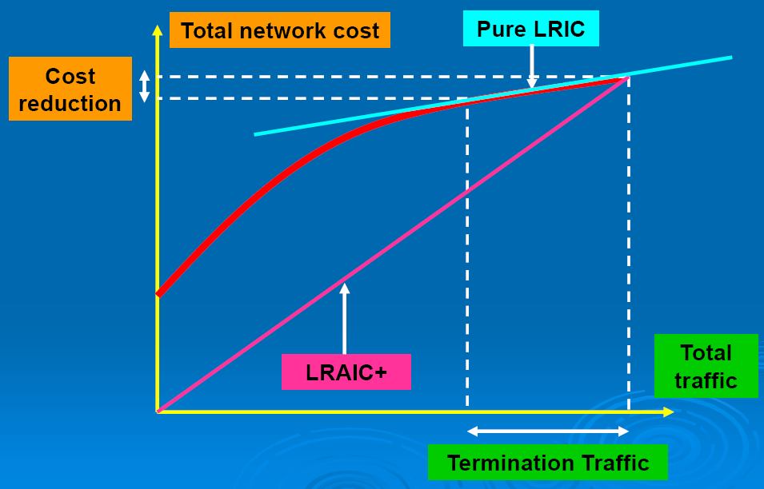
The difference between Pure LRIC and LRAIC+
Source: RTR by end of /2003
Source: BIPT

Slide 18
More costing definitions
Direct cost or directly attributable cost
  costs are incurred as a direct result of the provision of a particular service.
  can be fixed or variable.
Joint or shared cost (indirectly attributable cost)
  The cost of inputs that contribute to the production of two (or more) different increments.
  For example the costs of mobile towers contribute to 2G and 3G services (and maybe others)
  Costs can be allocated on the basis of identifiable cost drivers (e.g. tower space)
Common cost
  inputs necessary to produce several services, which cannot be directly assigned to specific services.

Slide 19
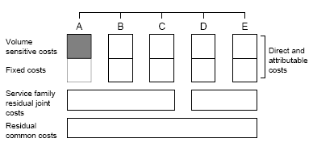
Cost categories for Pure LRIC or Marginal Costs
Marginal costs (MC)
Volume sensitive costs
Directly
attributable
costs
Fixed costs
Joint costs
Common costs
Source: RTR
In Pure LRIC the increment is a full service (e.g. terminating calls), whereas in Marginal Costs it is the smallest possible unit (e.g. a single call)

Slide 20
Cost categories for Incremental Costs
Incremental cost
Volume sensitive costs
Directly
attributable
costs
Fixed costs
Joint costs
Common costs
Source: RTR

Slide 21
Cost categories for Stand Alone Costs
Stand alone costs (SAC)
Volume sensitive costs
Direct and
attributable
costs
Fixed costs
Joint costs
Common costs
Source: RTR

Slide 22
Cost categories for Fully Allocated Costs
Fully allocated cost (FDC or FAC) of service A
Volume sensitive costs
Direct and
attributable
costs
Fixed costs
Joint costs
Common costs
Source: RTR

Slide 23
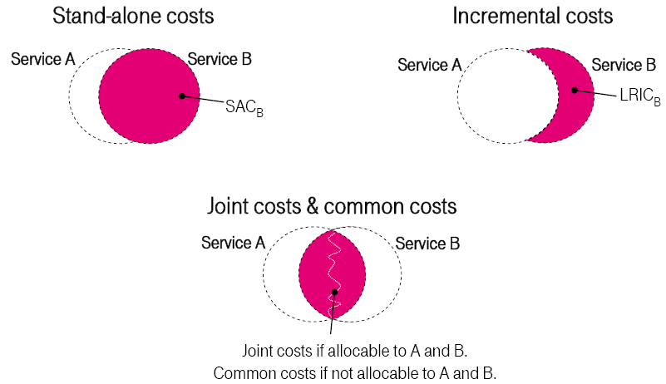
Another view of cost accounting concepts
Cost accounting concepts
Source: DTAG

Slide 24
With LRIC the definition of the increment matters (1)
Possible increments in a mobile network
service traffic
voice traffic |  |  |  | low bandwidth data traffic |  | high bandwidth data traffic
call termination | call origination | check voicemail | leave voicemail | SMS origination | SMS termination | send GPRS/UMTS/HSDPA data | receive GPRS/UMTS/HSDPA data
Source: Europe Economics

Slide 25

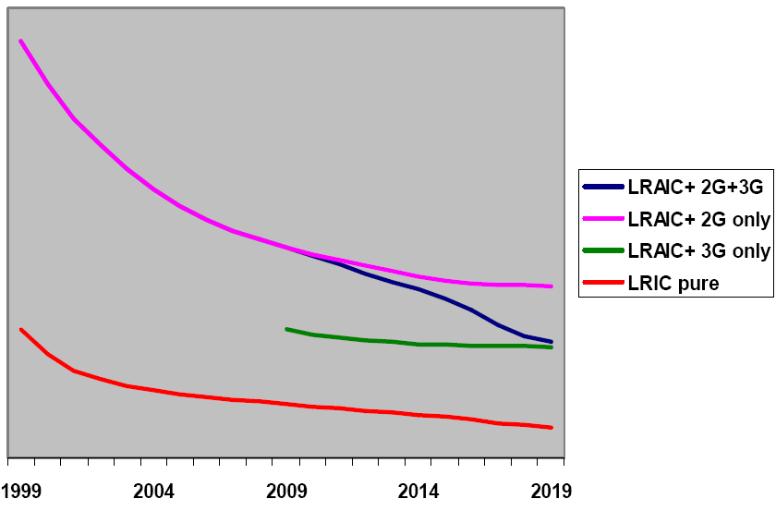
With LRIC the definition of the increment matters (2)
Difference between LRAIC+ and pure LRIC in Belgium
Source: RTR by end of /2003
Source: BIPT
The larger the increment the higher the LRIC

Slide 26


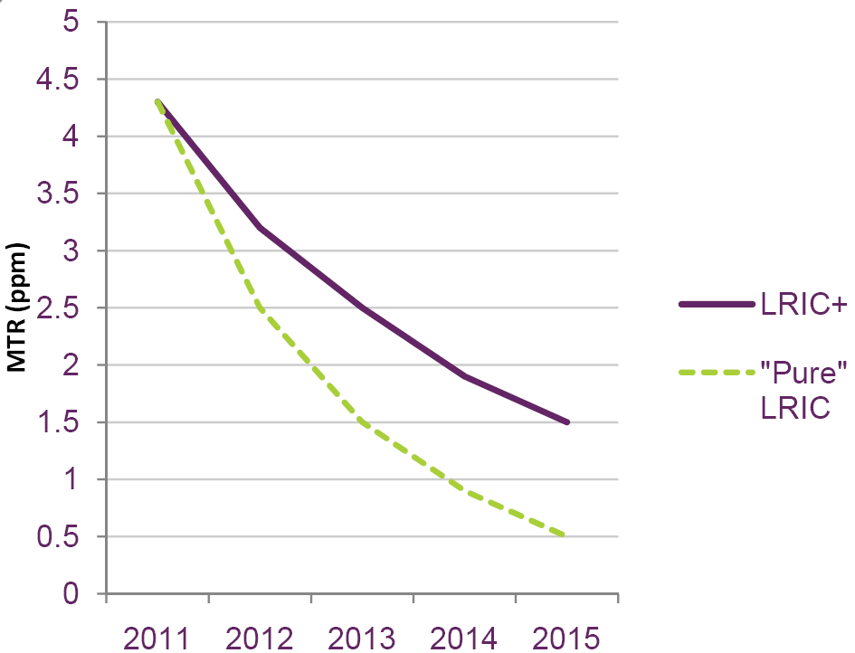
With LRIC the definition of the increment matters (3)
Analysys Mobile Model UK – LRIC+ vs. Pure LRIC
Source: RTR by end of /2003
Source: OFCOM

Slide 27
Applying the different cost standards to regulation

Slide 28
The questions regulators face

Slide 29
Emerging best practice
Constant mark-up
  same percentage to all services
Efficient Component Pricing Rule (ECPR)
  based on opportunity cost - considers retail prices
  only works well if retail prices already competitively priced
Ramsey Pricing
  sets mark-ups inversely proportional to the price elasticity of demand
  theoretically works well, but very difficult to implement
Floors and Ceilings
  allows the operator flexibility of assigning mark-ups within limits (generally defined as between MC and SAC)

Slide 30
The aim of cost based regulation
Aim is to encourage economically efficient investment to promote the long term interests of end users
Balance between:
  efficient use of existing infrastructure
  investment in new infrastructure by incumbents and new entrants
Regulation of interconnect services is required where there is potential market failure
Without infrastructure based competition - ongoing regulation will be necessary

Slide 31
LRIC balances competing interests
LRIC is an economic cost concept designed to:
  Encourage use of existing facilities where desirable
  Encourage investment in new facilities where justified
Neutral
benefits
Increasing desire
for entrants
to build rather than buy
Interconnect
tariff
Decreasing desire for
incumbent to sell
LRIC

Slide 32
Deviating either side of LRIC has its dangers

Slide 33
Emerging best practice
FAC (or benchmarks) until LRIC models in place
TSLRIC+ or LRAIC+ (for all services initially)
Pure LRIC (for call termination only)

