Slide 1
EXPERT LEVEL TRAINING ON TELECOM NETWORK COST MODELLING FOR THE HIPSSA REGIONS
Arusha
15-19 July, 2013
Christopher Kemei, ITU Expert

Slide 2
Session 3 – Overview of regulatory accounting and cost modelling in Sub-Sahara Africa

Slide 3
Agenda
Aims and objectives of this session
Legal and regulatory framework for tariff regulation
Cost accounting and regulatory auditing
Costing tools and cost modelling development

Slide 4
Aims and objectives

Slide 5
ITU-EC joint project for “Harmonisation of ICT Policies in Sub-Sahara Africa” (HIPSSA) has initiated a work on regulatory accounting and cost modelling so as to develop and promote home-grown harmonized policies and regulatory guidelines as well as build human capacity in the field of cost orientation implementation trough the use of appropriate tools.
The present session is aimed at providing stakeholders with key indicators of what is done and/or foreseen at the whole region level so as to favour a coherent approach on methodologies all across the region.
Relevant information, obtained through questionnaires, refers to:
Adopted price control strategies, their implementation, the difficulties encountered and the foreseen evolutions
Implemented procedures regarding cost accounting obligations and associated regulatory auditing processes
Costing tool(s) implemented and methodology used to implement the chosen costing tool(s)

Slide 6
The present document is based on stakeholders’ feedback to the HIPSSA G5(s) project as detailed below.
NRAs’ feedback to the ITU/HIPSSA G5 questionnaire as of February 28th, 2012 and reported by the regional experts inside their respective regional assessment reports. 34 countries addressed ITU/HIPSSA G5 questionnaire, as presented in the table below:
Sub-Region | Countries having addressed ITU/HIPSSA G5 questionnaire | No.
Central Africa | Burundi, Cameroon, Central African Republic, Chad, Congo (Republic of The), Equatorial Guinea, Gabon, Sao Tome and Principe | 8
East Africa | Ethiopia, Kenya, Madagascar, Rwanda, Seychelles, Tanzania, Uganda | 7
Southern Africa | Botswana, Malawi, Lesotho, Mozambique, South Africa (Republic), Swaziland, Zambia, Zimbabwe | 8
West Africa | Benin, Burkina Faso, Cape Verde, Gambia, Ghana, Guinea Bissau, Ivory Coast, Niger, Nigeria, Senegal, Togo | 11
In addition, regional experts for East Africa and Southern Africa completed the survey by their own researches for the following countries: Lesotho, Mauritius, Namibia and South Africa.

Slide 7
GSMA organization sent, by January 16th 2012, a contribution to ITU/HIPSSA G5 project reflecting its Members position arising from an ad hoc survey internally conducted. The operating groups having participated to the ITU GSMA internal survey were: Airtel, Etisalat Group (Atlantique Telecom), MTN, Orange, Vodacom and Vodafone. GSMA contribution covered the following 22 countries:
Sub-Region | Scope of countries covered by GSMA contribution | No.
Central Africa | Central African Republic, Chad, Congo (Republic of the), Democratic Republic of Congo, Gabon | 5
East Africa | Kenya, Madagascar, Seychelles, Tanzania, Uganda | 5
Southern Africa | Lesotho, Malawi, Mozambique, Republic of South Africa, Zambia | 5
West Africa | Benin, Burkina Faso, Ghana, Ivory Coast, Niger, Nigeria, Togo | 7

Slide 8
Legal and regulatory framework for tariff regulation

Slide 9
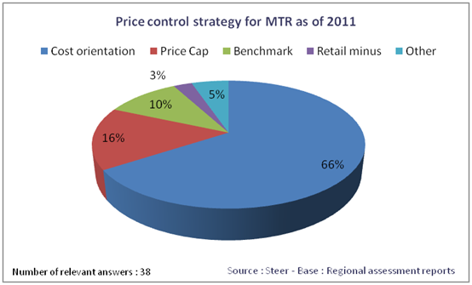
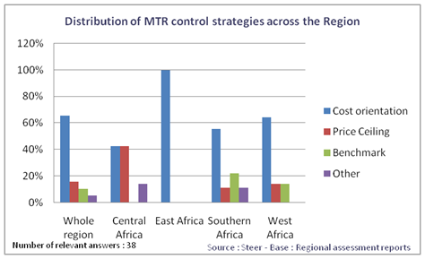
Price control strategy for MTR
Cost orientation adoption across all region.
In the EU12, years after the liberalization, cost orientation was implemented in 65% of the countries
Cost orientation approach varies across the Sub-Regions, ranging from 43% of respondents from Central Africa to 100% in East Africa.

Slide 10
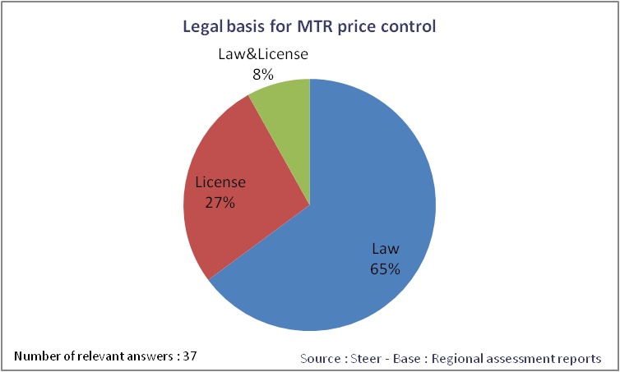
Legal basis for MTR price control
The main legal basis is the law and, to a lesser extent, license terms or both
In Senegal, Rwanda*, Niger*, South Africa, Nigeria, Guinea Bissau and Cape Verde, the legal framework states that price control is applicable to operators deemed to have SMP.
In terms of regulatory strategic goals, the main concerns expressed by the NRAs are customer interest, especially in terms of price reduction, investments attractions as well as effective and fair competition promotion.
* Source – Worldbank Africa’s ICT Infrastructure - Building on the Mobile Revolution- 2011

Slide 11
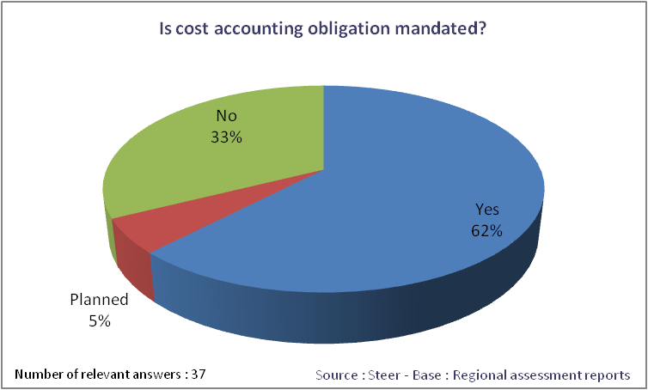
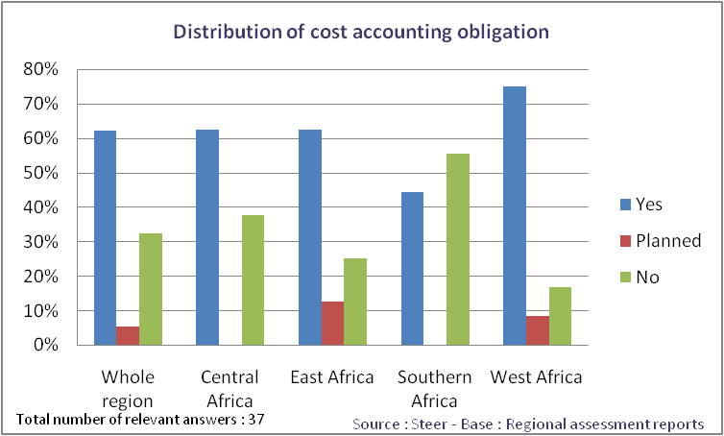
Is cost accounting mandated?
Cost accounting obligations are provisioned or planned to be for most of the frameworks in place in the region.
The prevailing legal basis to impose cost accounting obligation to MNOs is the law and, to a lesser extent operators licenses.
Cost accounting obligation is most provisioned in West Africa representing 77% of the countries having addressed the issue.
Southern Africa has the lowest rate. The main reasons for which cost accounting was not mandated, as underlined by NRAs in Southern Africa, are the lack of legal basis as well as the lack of resources and skills.

Slide 12
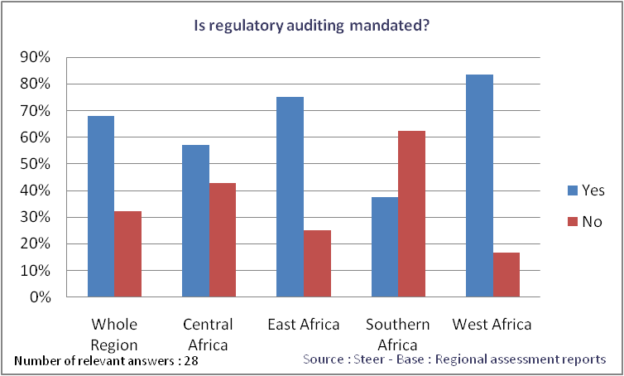
Is regulatory auditing mandated?
Regulatory auditing, is provisioned in the majority of the respondents representing 68% of the responses.
Southern Africa has the lowest rate in parallel (below 40%)with the cost accounting situation presented before and for the same set of reasons

Slide 13
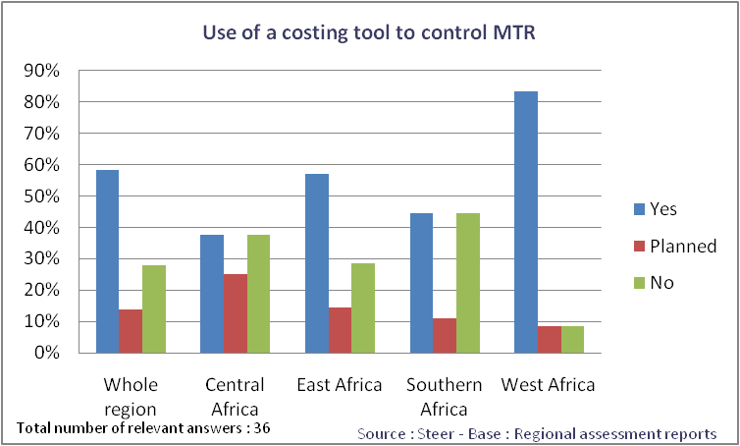
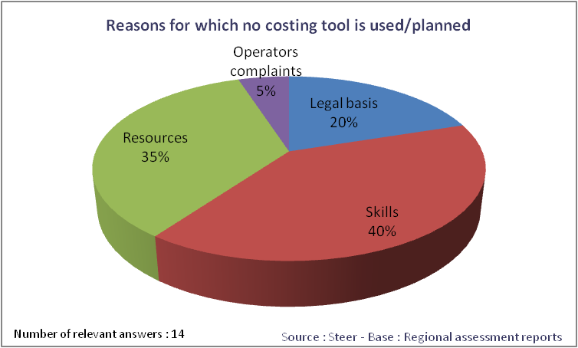
Use of costing tools
Costing tools to regulate MTR are used or planned to be used in 72% of the surveyed countries.
Central Africa has the lowest proportion of costing tool use and West Africa has the highest rate.
The lack of resources or skills represents 75% of all reasons for which a costing tool is not used or planned to be used by the respondents.

Slide 14
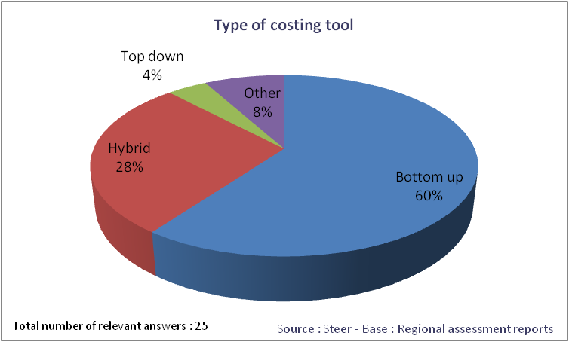
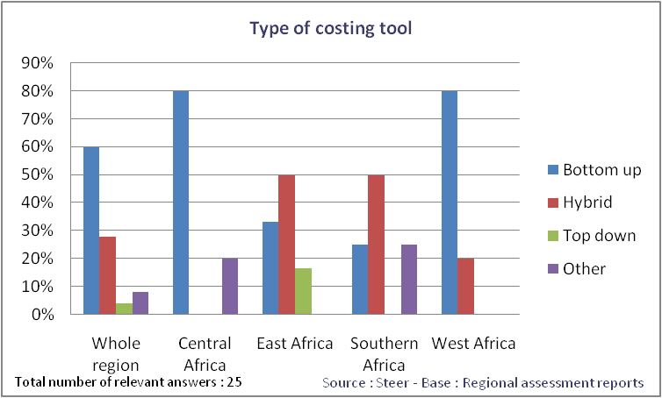
Type of costing tools
Bottom up or hybrid models prevail in the region representing 88% of the respondents.
The significant use of bottom up approach is attributable to the difficulties to collect data from the operators
Bottom up/Hybrid models are used by 100% of the respondents in West Africa Sub-Region

Slide 15
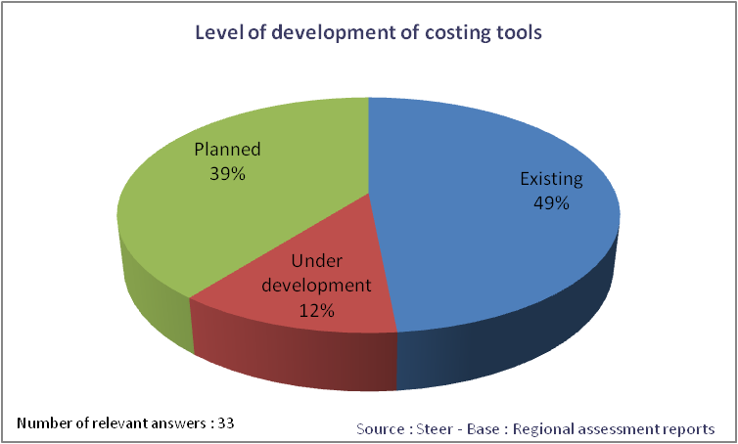
Level of development of costing tools
Costing tools are deemed to exist in half of the countries surveyed
But in 39% of them is only at the “plan” level
This result shows the urgent need for capacity building in the Region regarding regulatory accounting and cost modelling.

Slide 16
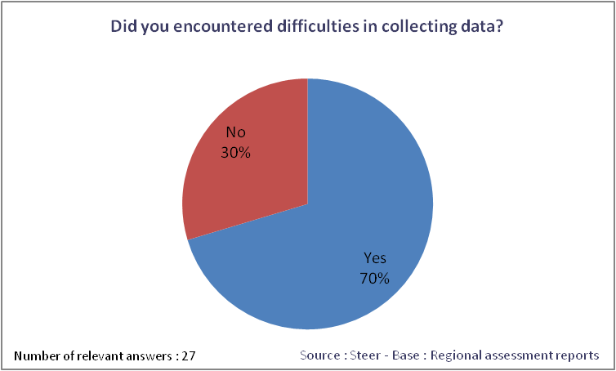
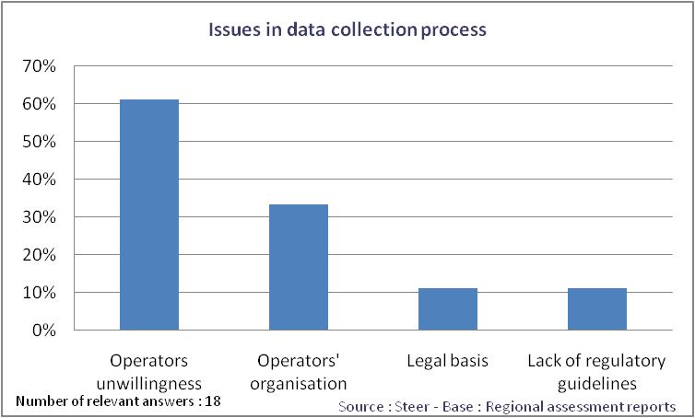
Difficulties regarding data collection
70% of the respondents reported that they encountered difficulties in collecting data due to the lack of will from operators and, to a lesser extent, the difficulties for operators to provide relevant data.
In addition, several operators inside GSMA* underlined the lack of regulatory guidelines regarding cost accounting systems. Such an issue may explain, at least partially, operators’ unwillingness and internal difficulties to retrieve the relevant data.
* Source : GSMA report on regulatory auditing and cost modelling in Sub-Sahara Africa prepared for the ITU – January 2012

Slide 17
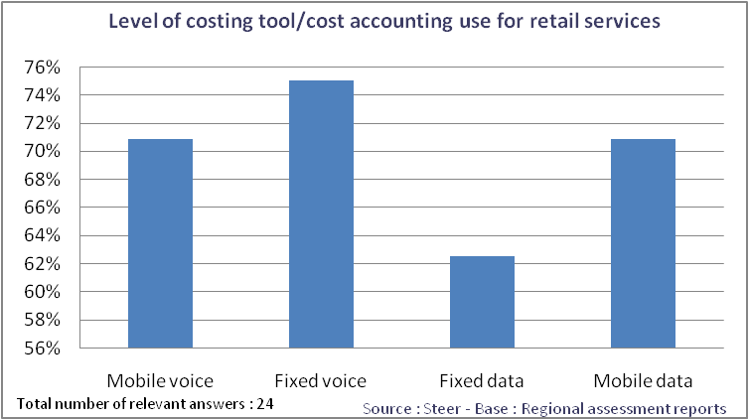
Price control of retail services
71% of the respondents reported they use costing tools/cost accounting model to control mobile voice.
Most of NRAs use costing tools to control the prices probably whatever the level of competition that prevail in the market.

Slide 18
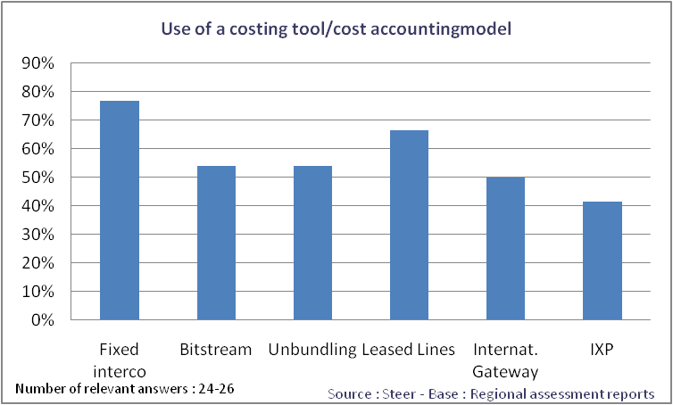
Price control of wholesale services
54% of the respondents reported they use costing tools/cost accounting model to control bitstream or unbundling prices.
Regarding access to the international gateway, 50% of the respondents use such tools.
The use of costing tools/cost accounting systems to control wholesale rates is relatively low for services where the incumbent has a quasi-monopolistic situation namely unbundling and bitstream.

Slide 19
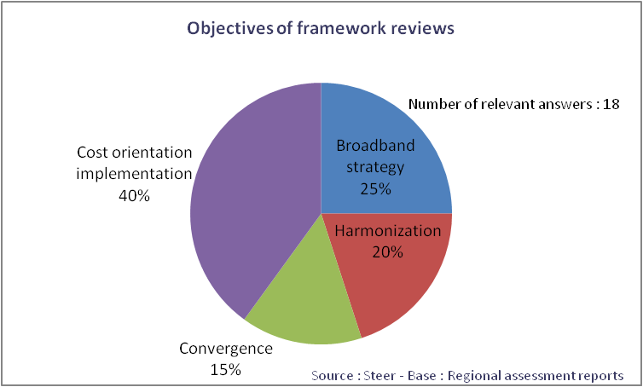
Objectives of framework reviews
66,6% of the respondents (out of 21 relevant responses) indicated that a regulatory review is planned or underway
The first motivation for the review of the frameworks in the region is cost orientation implementation.
For several countries the objectives of the planned/under way framework review concern new challenges brought about by broadband, submarine cables deployments, ICT convergence and NGN developments.

Slide 20
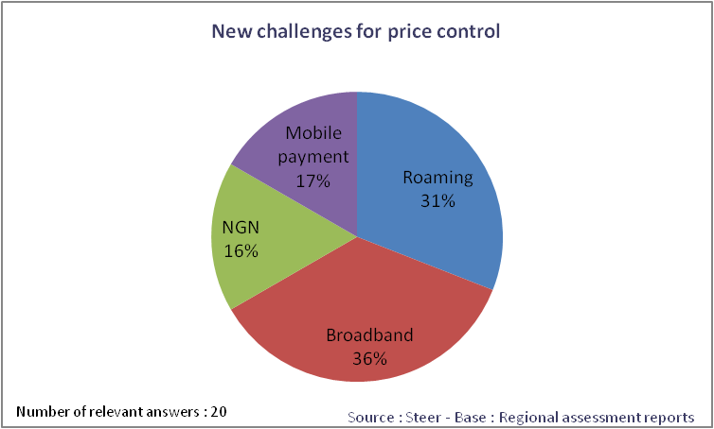
New challenges for price control
NGN and broadband infrastructures represent more than 50% of the new challenges considered by the NRAs.
With the roll out of submarine cable networks and government policies towards broadband growth, NGN are emerging. Gambia, for instance, reported that almost all the operators are deploying NGN networks.
The development of cost models is perceived as a key regulatory strategy to address these new challenges.

Slide 21
Cost accounting and regulatory auditing

Slide 22
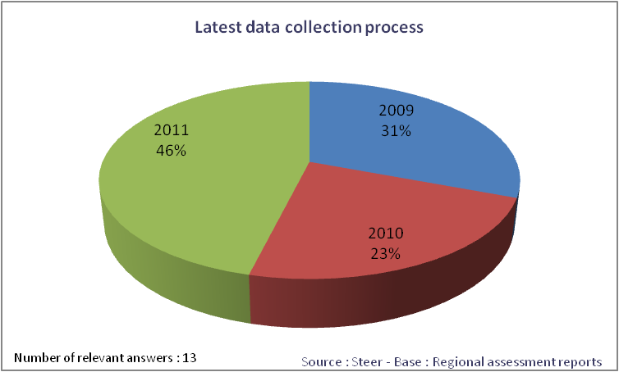
Data collection process
The best practice consisting in collecting data on an annual basis is implemented in more than half of the countries having addressed this issue (out of 15 countries).
25% of the respondents mentioned to do so when price changes occur.
When cost accounting is mandated the latest data collection process took place in 2011 for almost half of NRAs

Slide 23
Scope of costs and cost preparation
The degree of regulatory prescription regarding the scope of cost and cost preparation need to be detailed enough to provide clear guidance for operators and ensure that cost accounting data are prepared in consistency with price regulation strategic goals (cost orientation, non discrimination, …).
The best practice consisting in:
Establishing beforehand a cost and revenues nomenclature
Imposing a set of specifications on cost preparation methodology
Such a practice is in place, among the countries having addressed the questionnaire, in:
Botswana, Mozambique, South Africa, Zimbabwe, Kenya, Uganda, Benin, Cape Verde, Ghana and Ivory Coast.

Slide 24
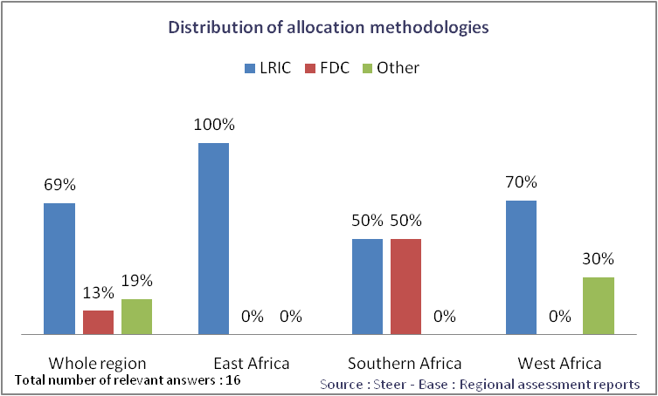
Cost allocation methodologies
LRIC allocation methodology prevails in the region (no data were available for Central Africa).
East Africa knows the highest rate of use for LRIC.
The relatively high use of FDC in Southern Africa, compared with the other Sub-Regions, may attributable to the historical use of top-down models initially based on FDC methodology.

Slide 25
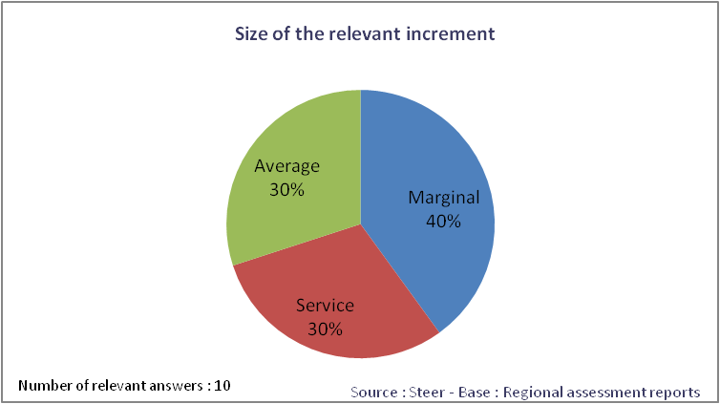
Size of the relevant increment
The use of LRIC accounting methodology implies the definition of the relevant increment. NRAs should opt to, among others, the following approaches:
Marginal corresponding to an increase in costs following the introduction of a small unit of the service;
Service increment corresponding to an increase in total costs following the introduction of the service;
Average increment corresponding to an increase in costs following the introduction of a group of services.
Out of the 3 NRAs opting for a service increment, one of them opted to a pure LRIC approach.
The EC recommends a pure LRIC approach (this approach is implemented in Kenya)

Slide 26
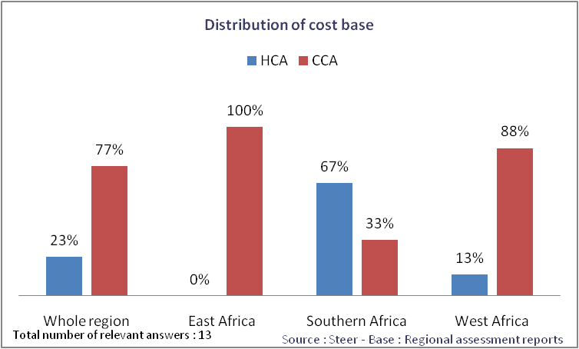
Cost base
What arises from this survey is that the best practice consisting in using CCA as a cost base standard is used by the majority of the NRAs having addressed the issue.
Best practice cost base – Current Cost Accounting
As stated by the EC in its recommendation* on CCA: “In a competitive environment, operators would compete on the basis of current costs and would not be compensated for costs which have been incurred through inefficiencies. Historic cost figures therefore need to be adjusted into current cost figures to reflect the costs of an efficient operator employing modern technology.”
* Commission recommendation of 7.5.2009 on the Regulatory Treatment of Fixed and Mobile Termination Rates in the EU

Slide 27
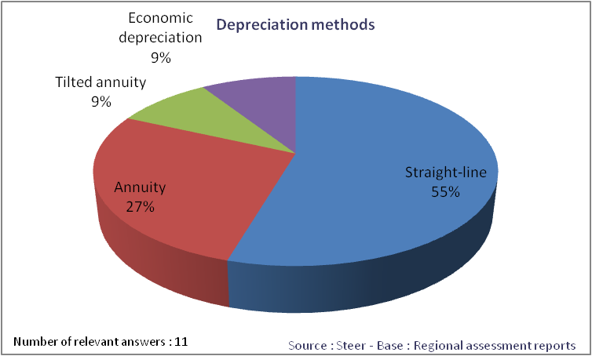
Depreciation methods
Straight line method is used by over half of the NRAs
In principle, economic depreciation is the most appropriate depreciation method as it incorporates an appropriate allowance for the cost of capital.
Best practice – depreciation method – Tilted annuity
Tilted annuity depreciation tilts the annuity depreciation calculation charge by adding a factor to take into account the average annual change of assets price.
This method is implemented in, among others, Nigeria, France, Italy and Romania.

Slide 28
Allowed rate of return
The Weighted Average Cost of Capital (WACC) methodology is a widely accepted method for calculating the allowed rate of return. WACC is calculated by applying cost of debt and cost of equity respectively on the proportion of debt and equity in the capital employed.
All NRAs having addressed the allowed rate of return issue use WACC methodology.
When using WACC, the cost of equity, which is affected by risk, need to be estimated as, contrary to cost of debt, it is not known or easily derived. To this end Capital Asset Pricing Model (CAPM) is usually used.
All NRAs except one use CAPM.
Some operators expressed concerned on the appropriate value retained by the NRA’s.

Slide 29
Scope and issues of regulatory auditing
The scope of regulatory audit as indicated by almost all the respondents concerned by regulatory auditing is:
Reconciliation with statutory accounts
Scope of costs and costs allocated,
Cost valuation and allocation
Cost capitalization, assets valuation and amortization
Transfer charges
The international best practice consists in conducting a regulatory audit regarding at least, the whole items as indicated above. 3 NRAs out of the 9 having addressed this issue reported that regulatory auditing in place in their respective countries (Mozambique, Uganda and Cape Verde) covers all these items.

Slide 30
Operators obligations
When regulatory auditing is implemented, in most cases, operators have to respond in a predefined timeframe and give access to all internal supporting data
For all 12 countries where regulatory auditing is in place
The obligation for operators to respond in a predefined timeframe to any question is implemented in 8 countries
The obligation for operators to give access to all internal supporting data is implemented in 10 countries

Slide 31
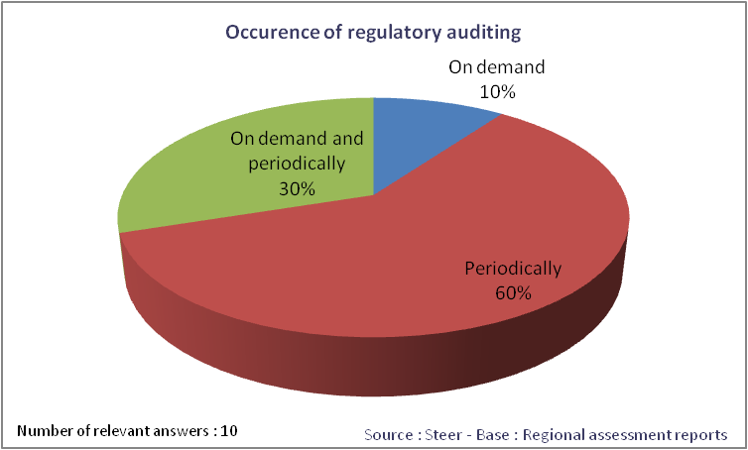
Regulatory auditing process
90% of the respondents do regulatory auditing on a regular basis.
In 10% of the cases, regulatory auditing is exclusively done on demand either during tariff approval process or cost modelling exercises.
In most cases, regulatory auditing is conducted by an independent auditor commissioned by the NRA.

Slide 32
Costing tools

Slide 33
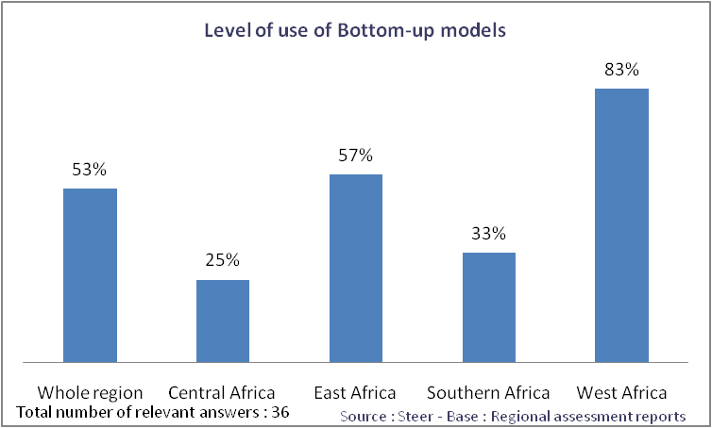
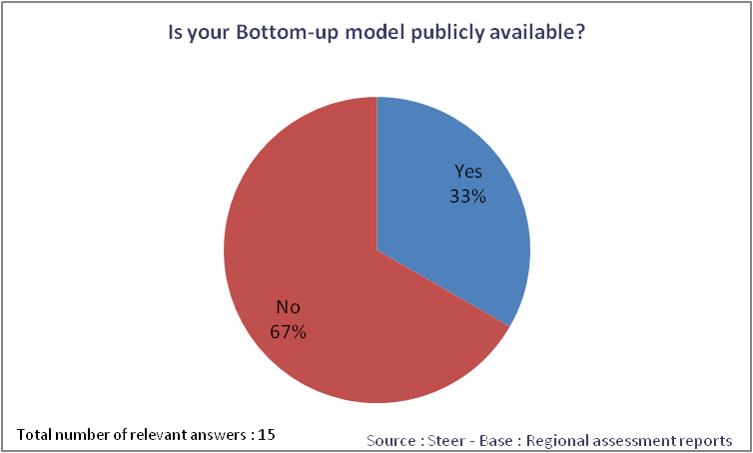
Bottom up models
53% use a bottom up model, either as the only costing tool or in conjunction with a Top-Down model.
West Africa, with 83% of the countries using bottom up, has the highest level of use.
In most cases, the cost model built by the NRA is not publicly available

Slide 34
Data collection strategy
The model development relies essentially on operators’ data following a specific request or a consultation procedure. This means that the implementation of a cost model requires a significant workload for data collection both from operators’ side and NRAs’ side.
For all 16 countries where responses where obtained
14 countries use a specific request
The best practice consisting in using regulatory cost accounting data, as a reference of costs to calibrate the model is in use in Uganda.

Slide 35
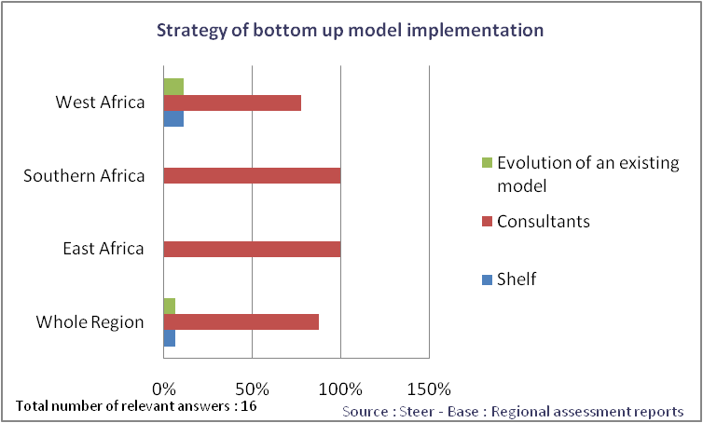
Strategy for Bottom up models implementation
Almost all respondents commissioned consultants to develop a bespoke model. In West Africa, some NRAs opted to the evolution of an existing model or using a model off the shelf (WBG)
Regarding the burden associated with cost model implementation, consultant fees, based on a sample of 6 countries, ranged from around 100k USD up to 1mil USD, corresponding to an average of 500k USD.

Slide 36
Modelled operator and time horizon
The definition of the efficient operator and time horizon to be considered in the model are key steps when building up a Bottom-up model.
For all 15 countries where responses where obtained
More than half of NRAs having addressed this issue model a hypothetical operator either alone or in combination with an existing operator.
6 countries use an existing operator.
Regarding the time horizon a minimum of 5 years is commonly used by the NRAs. The most common is 10 years.
When using LRIC allocation methodology, as this is the case for almost all NRAs having addressed this issue, the methodology entails that the time horizon has to be sufficiently long for fixed cost to become variable.

Slide 37
Level of demand and market share
The level of demand the modelled operators shall satisfy and its market share are sensitive assumptions for the model.
For all 15 countries where responses where obtained
6 countries use current level of demand.
4 countries use both current and expected demand.
In the context of Sub-Sahara African countries, which are mainly still in a growing phase, it is more appropriate to estimate the future level of demand.
Regarding market share, the best practice, recommended by the European Commission, is to set a market share for the modelled operator of at least 20% which is considered at the minimum efficient scale. This is the case for all NRAs having provided the value of the retained market share. Benin, Ghana, Kenya, Uganda, Botswana.

Slide 38
Key cost drivers
Key cost drivers to consider when building the model are another key step in a bottom-up approach. A cost driver can be defined as "the factor or event that causes a cost to be incurred".
For all 14 countries where responses where obtained
The majority of countries uses coverage as a key cost driver, alone or in combination with other factors.
It is most appropriate not to consider coverage as a key cost driver. Indeed, coverage can be described as an ‘access’ type service whereby mobile subscribers purchase the ability to access the operator’s network at any point of the operator’s coverage.
Such an approach is also recommended by the European Commission and should be used as a best practice.

Slide 39
Network configuration
When adopting a bottom up approach based on efficiency considerations, assumptions regarding optimal network configuration are structuring.
For all 12 countries where responses where obtained
The majority of NRAs having adopted a bottom up approach model coverage on the basis of existing mobile networks configuration either by using the average of existing networks or the current coverage of largest network.
Derived from efficiency consideration, the coverage to be modelled shall be the minimal one to address the demand as done by one NRA among the NRAs having addressed this issue. With the use of existing network coverage, inefficient costs are likely to be taken into account.
Regarding topology, all NRAs having adopted a FL-LRIC, except one, use the topology of the existing MNOs (i.e. scorched node methodology).

Slide 40
Operating expenses modelling
OPEX modelling is another sensitive item when adopting a FL-LRIC based bottom up approach.
NRAs in the region (all 15 NRAs having addressed this issue) and beyond usually model OPEX as a mark up on network assets. The mark-up depends on assets type for the majority of the NRAs having addressed this question ,
The majority of NRAs adopting a FL-LRIC based bottom up approach use MNOs data to derive OPEX (9 out of 14 NRAs).
The remainder 5, three use benchmark data and two of them a combination of benchmark and operator’s data

Slide 41
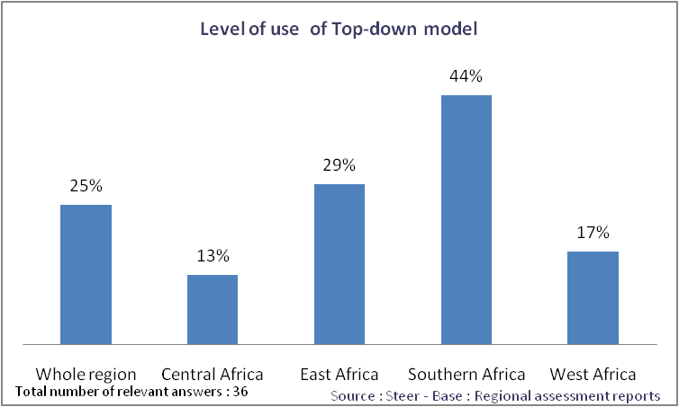
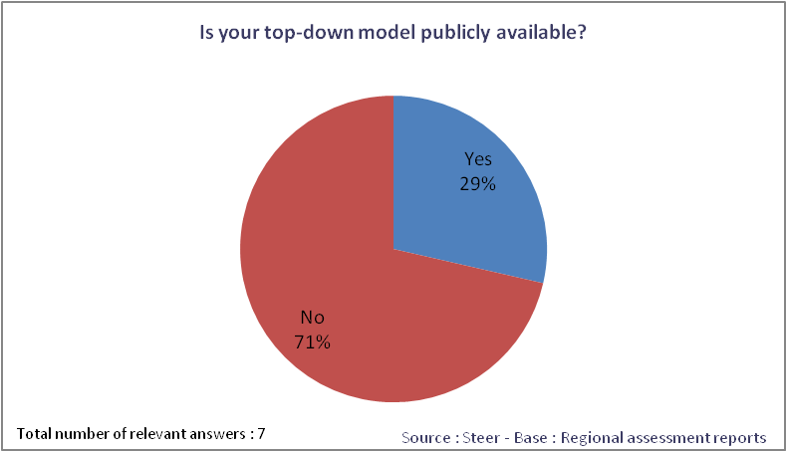
Top down models implementation
The level of use of a Top-Down approach is of 25% for the whole region
At the Sub-Region level, Southern Africa knows the highest level of use and Central Africa has the lowest
For a large proportion of countries that addressed the issue of model transparency, the top-down model is not publicly available
In consistency with international best practices, cost models, associated assumptions and their underlying rationale as well as the methodology used to build up the model should be publicly available.

Slide 42
Data collection strategy
Based on NRAs feedback on the data collection strategy for top down models one conclusion is that cost accounting routines in the region are not enough implemented to represent a cost reference for building up a top-down model.
For all 9 countries where responses where obtained
4 NRAs make use of a specific request to obtain data.
3 NRAs use cost accounting data alone or in combination with a specific request.
The best practice consisting in basing top-down model on cost accounting data is in place in 3 countries, namely South Africa, Zimbabwe and Benin.

Slide 43
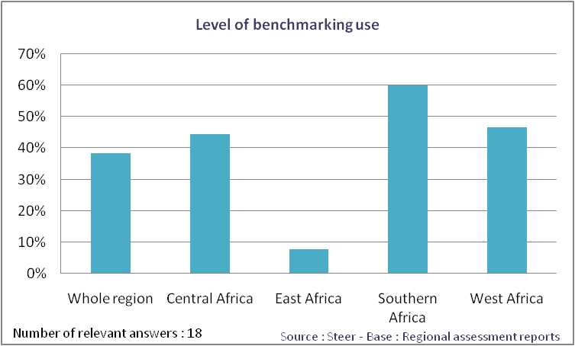
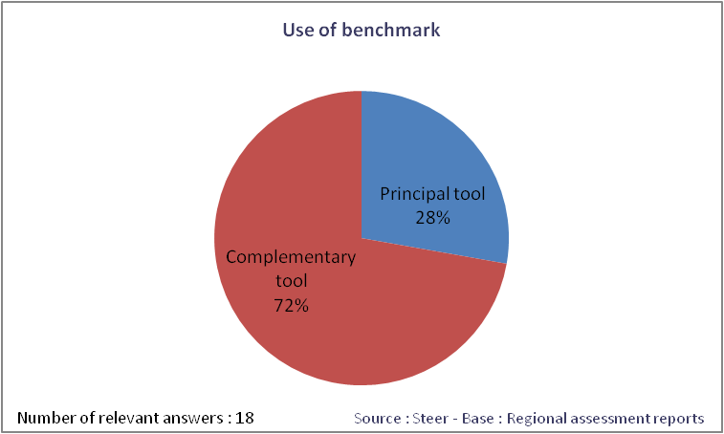
Benchmark
The level of benchmarking tool implementation is of 38% for the whole region.
Southern Africa knows the highest level of implementation with 60% of them using benchmark as a tool for MTR regulation. The level of implementation is the lowest in East Africa.
72% of the NRAs having addressed the issue of benchmark implementation use benchmark as a complementary tool to another costing tool.

Slide 44
Benchmark rules
When using benchmark the main implementation rules are the following:
The choice of the set of countries/MNOs used in the benchmark;
The corrections made for country or MNO differences;
The rules used to set the final price.
Regarding the set of countries, the scope of countries considered varies across the region from 1 country to 38 countries, but slightly less than half of the NRAs (6 out of 13) uses 15 or more countries in the benchmark exercise
Three respondents retained their respective regional economical organisation, namely SADC and ECOWAS/UEAMO as a starting point for the benchmark.

